Slide 1
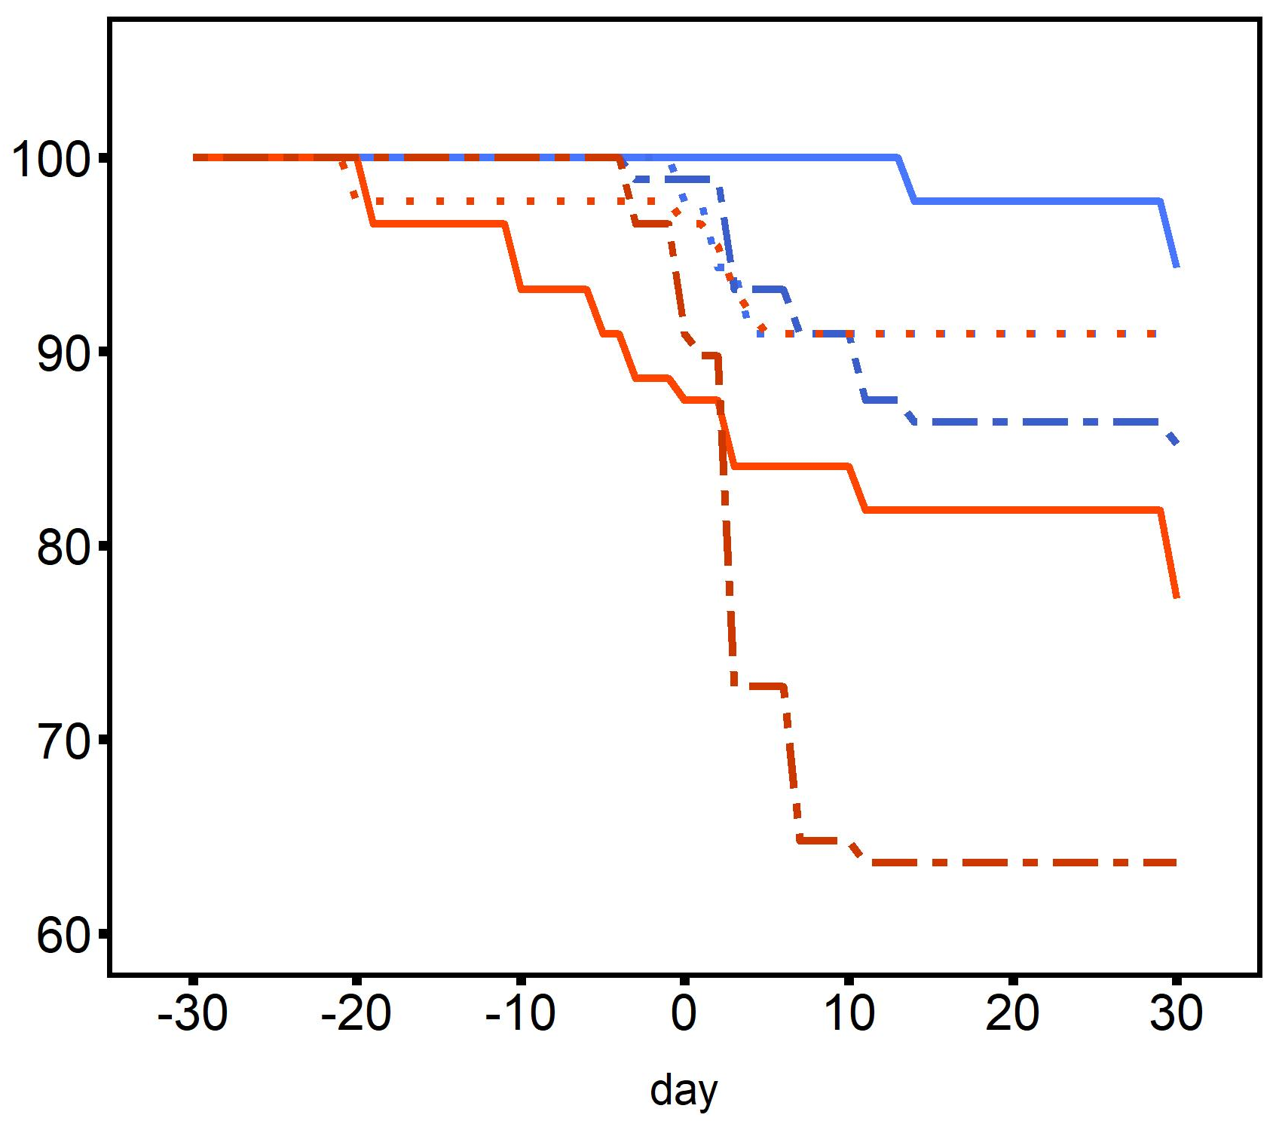
Desiccation @ 44°C for 4 h
2°C d⁻¹ ramp
20°C
30°C
Treatment
2n control
2n heated
2n heated +
desiccation
Survival (%)
3n control
3n heated
3n heated +
desiccation
Day

