Slide 1
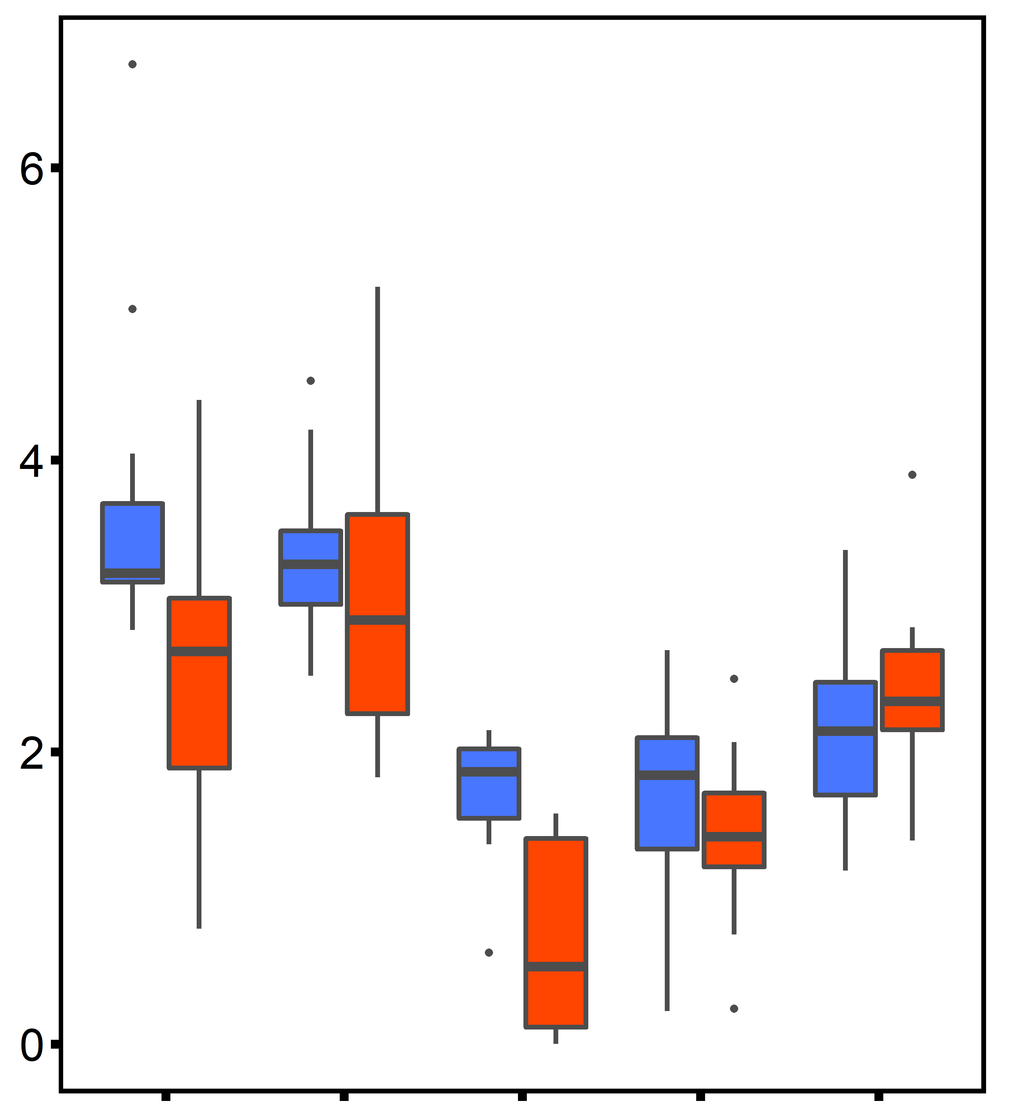
2°C d⁻¹ ramp
Desiccation @ 45°C for 4 h
20°C
30°C
30°C
ploidy: p<0.001
time: p<0.001
ploidy×time: p<0.001
abc
Ploidy
bcd
ab
Diploid (2n)
a
Na⁺/K⁺ ATPase Activity
(µmol ADP mg protein⁻¹ h⁻¹ )
Triploid (3n)
cde
def
bcde
ef
def
f
Control (pre-stress)
Heated
2d
10d
Heated
+ Desiccation
5d after stress
10d after stress

Slide 2
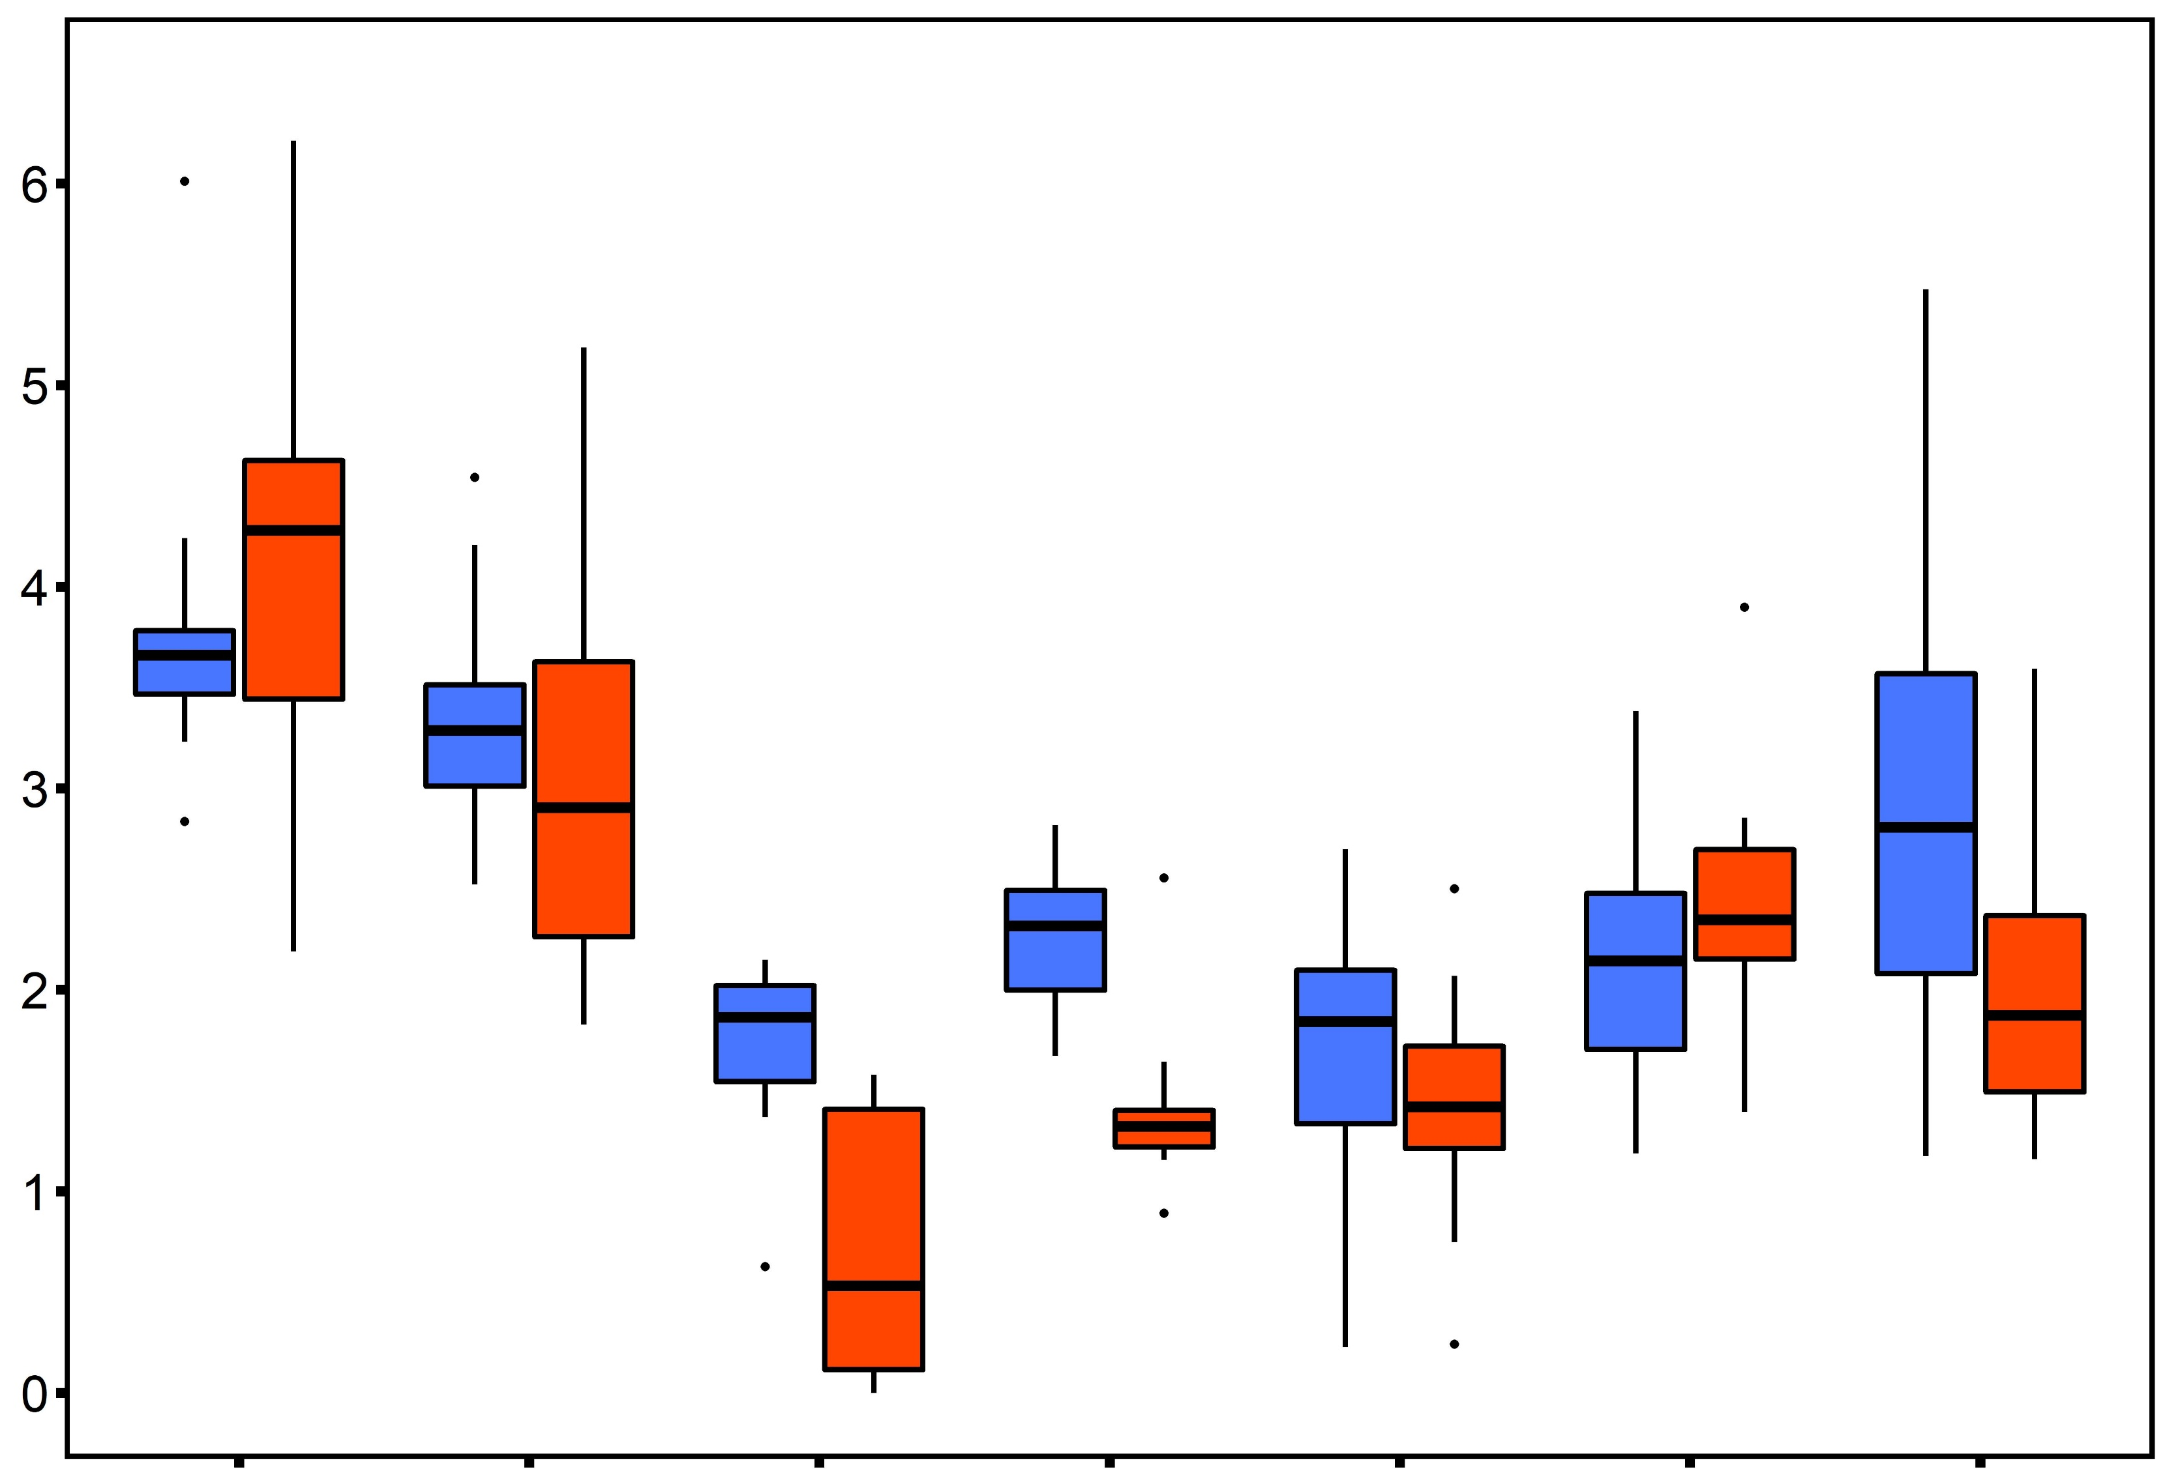
a
ploidy: p<0.001
time: p<0.001
ploidy×time: p=0.001
bcd
Ploidy
bcd
abc
Diploid (2n)
ab
cde
def
Triploid (3n)
def
Na⁺/K⁺ ATPase Activity
(µmol ADP mg protein⁻¹ h⁻¹ )
cdef
ef
cde
fg
ef
g
Control (pre-stress)
Heated
Heated
+ Desiccation
Heated
Heated
+ Desiccation
Heated
Heated
+ Desiccation
1d after stress
5d after stress
10d after stress

