Slide 1

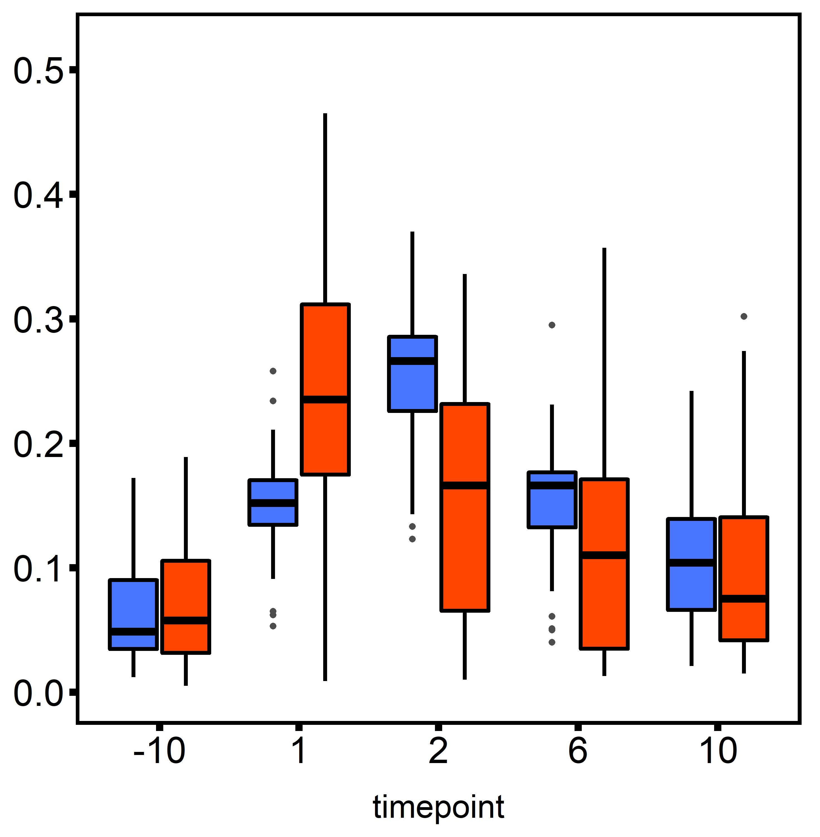
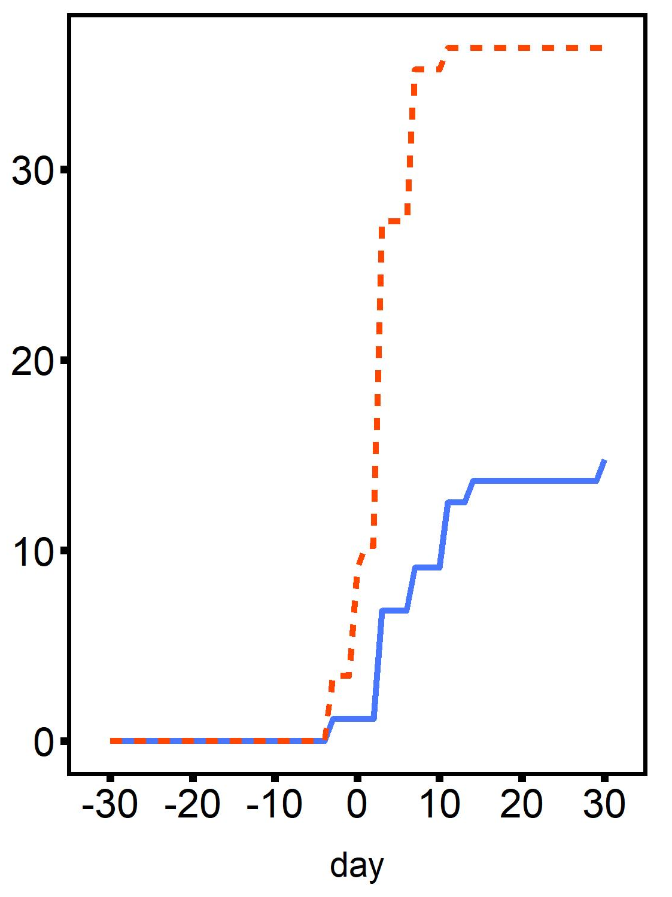
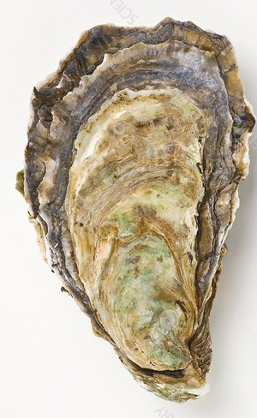
Secondary Stressor
Diploid
A
B
ploidy: p=0.003
time: p<0.001
ploidy×time: p=0.03
C
Triploid
Primary Stressor
Metabolic Rate (mg O₂ h⁻¹ cm⁻³)
Mortality (%)
Pacific oyster
Time after stress exposure (days)
Time after stress exposure (days)

