Slide 1
Sentiment Analysis on Social Data using Clustering
Daniel Levy
Luan Nguyen

Slide 2
Goals and Objectives
Give a simple and useful measure of users’ sentiment on a topic (e.g. case study: Snowden)
Using database of all posts, comments, and likes from NYT facebook page in 2013.
Gain experience engineering a business-oriented Python utility.

Slide 3
Program Flow
Community
Detection / Graph Clustering
1
NetworkX
c_id c_ranking
2
Weighted stm_score from each community
Fb_id c_id
Sentiment Analysis
3
Business Logic
NLTK VADER
Fb_id stm_score

Slide 4
Software Architecture
Domain Layer
Data Access Layer
Control Layer
Application Entry Point
Separation of concerns between. input, output, and processing.

Slide 5
Clustering
To filter out:
Spam
Jokes
Unproductive comments
“Electoral College”
Smoothing out noise.
Allow fair & equal representation from communities of similarity.

Slide 6
Building Communities: “Likes Graphs”
Likes graph of comments within a single post
Clusters of people who agree with each others
Directed
Unweighted
Likes graphs of shared mutual news interests
Less concrete: If they all like reading the same posts, they probably think alike.
Undirected
weighted

Slide 7
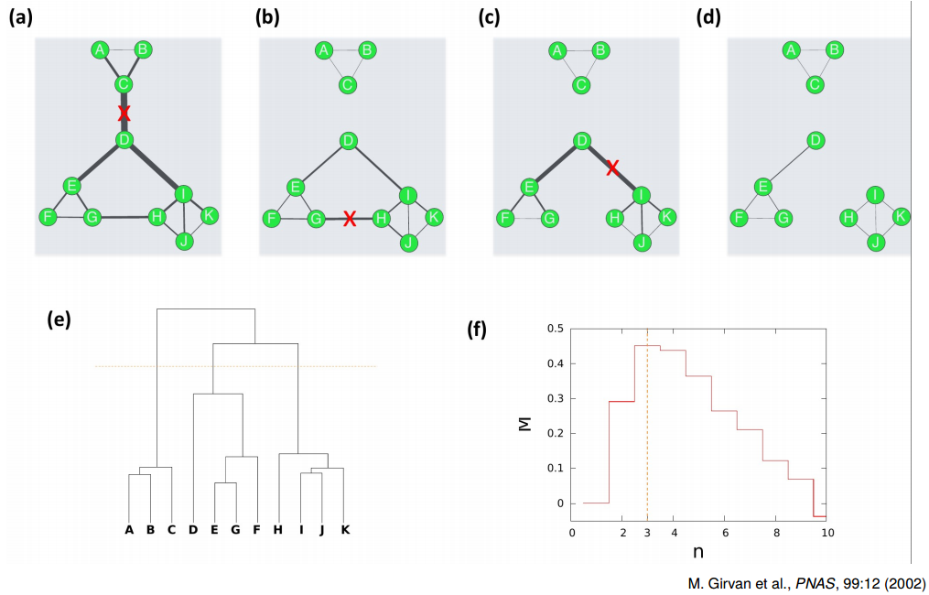
Clustering: Louvainn Method
How many communities to divide into? Chosen by highest modularity.
Which of the three graphs give good modularity?

Slide 8
Likes graph of comments within a single post
Post 10150319556949999 (July 12, 2013)
Modularity: 0.588
Modularity with resolution: 0.588
Number of Communities: 14

Slide 9
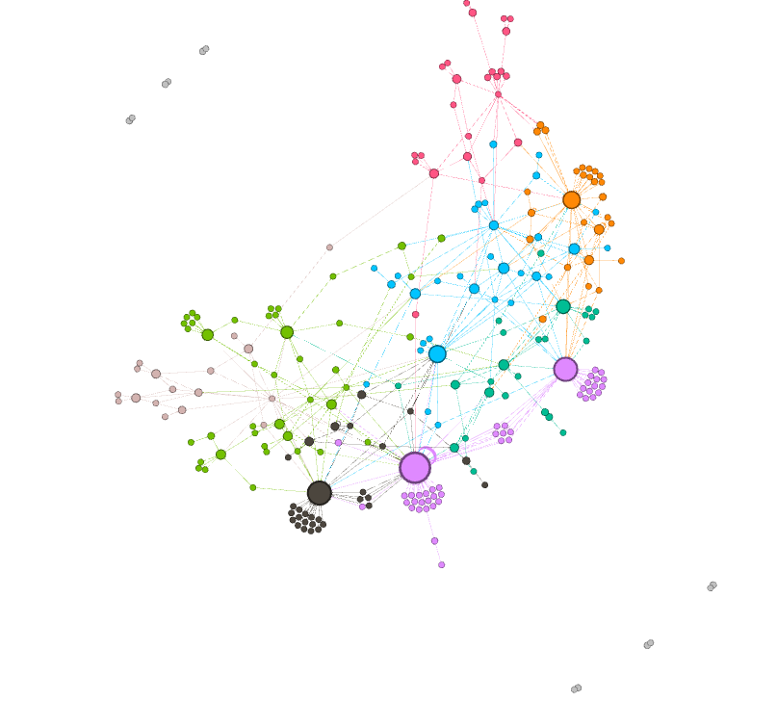
709430356 He, at the end of the day is a traitor. He purposely sought out dirt for his 15 minutes of fame. He's just another publicity seeker. A pissant for sure.
100004045586201 What he did was wrong, and that includes "stealing" government property. He has no respect for the laws of the United States or for that matter his own committments.
1009602763 He's a traitor, not a refugee. He chose to violate the principles of his contractor position, then ran off cuz he couldn't face the consequences. He got what he deserves.
1810244250 If he is a "hero" why is he running. Stand and fight. Modern day espionage.
723420428 What the govt is doing is against the law. Snowden is a brave man.
1454689065 Regardless of what he was trying to achieve, his plan was certainly not the most brilliant. Snowden cheapens the meaning of asylum for those that actually need it--not because someone chickened out of becoming a martyr.
1144961186The guy is brave and I for one stand by what he's done..
100000784142119 Traitor, call him for what he is.
697370596 He must feel so safe and free in Russia, not like in police-state USA with its Big Brother gov't, human rights travesties and eroding civil liberties....
100003207145901 I wonder how many Americans feel ashamed to have US passports because of the illegal things being done in their names!
1040338519 Russia has human rights workers ???? Must have shipped then in. :/
100000566817703 A great man !
162139207302061 I wonder what he knows about Russia?
100003782750166 Ironic how people are simultaneously outraged that the government is collecting vast amounts of information on its own citizens without cause and at the person who told you about how far-reaching it was.
1360591769 Go live your live freely snowden. w so many idiotic right-wing mongers in this cuntry i doubt it will be worse elsewhere.
1447524719 Thank God, a new picture of him

Slide 10
Community structure
Orange is very strongly opposed
Pink to a less degree.
Blue is slightly opposed
Green is strongly for Snowden
We don’t simply want posts with the most likes!
How can we filter out the noise?

Slide 11
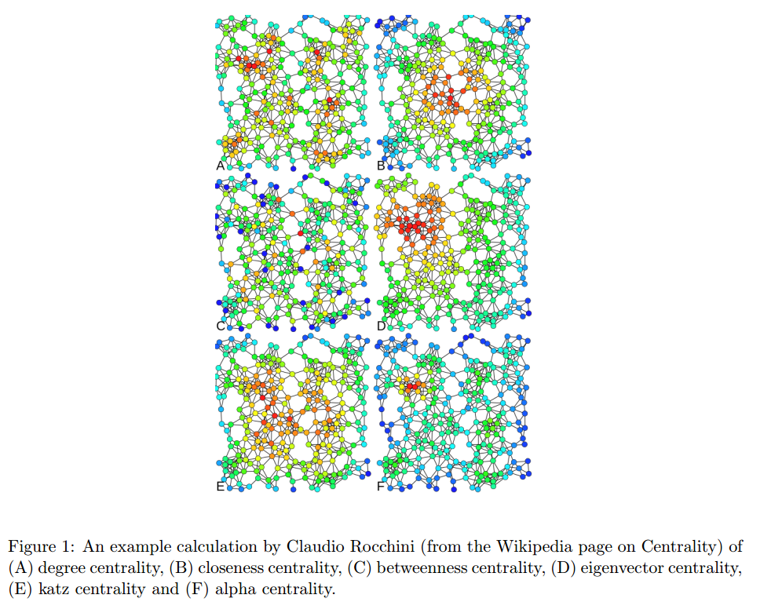
Inbetweenness Centrality:

Slide 12
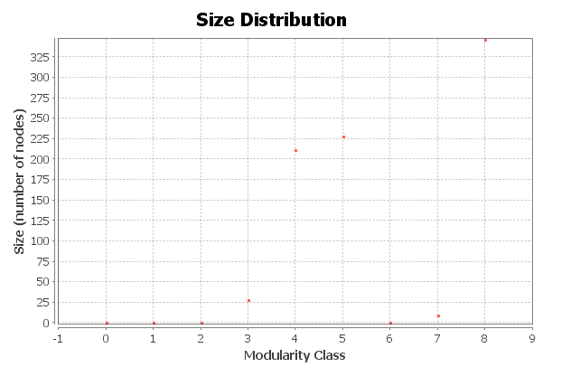
3. Likes graphs of shared mutual interests
Modularity: 0.153
Modularity with resolution: 0.153
Number of Communities: 9
Low modularity number!

Slide 13
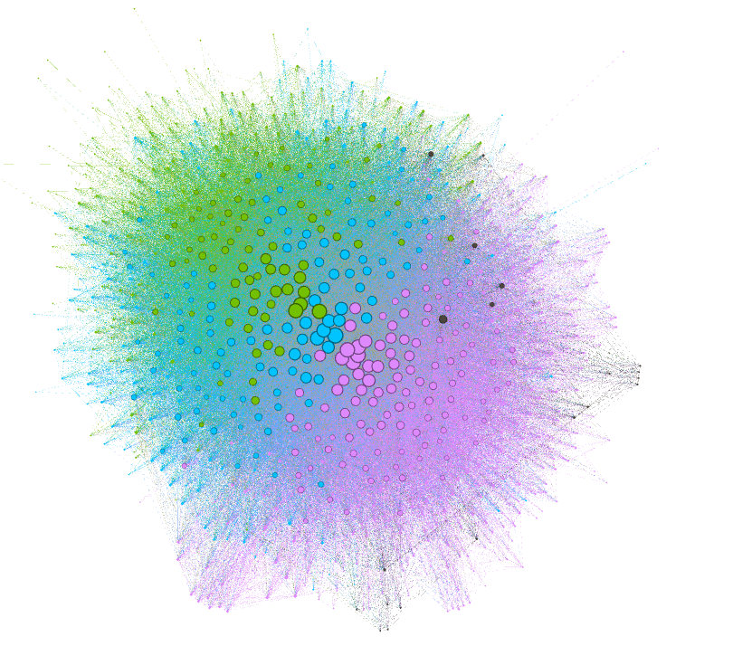

Slide 14
Sentiment Analysis
User Sentiment Score
Comments weighted by post message sentiment.
Community Sentiment Score
Average across users (constituents).
Aggregate Sentiment Score
Average of weighted community scores.
“Impact Score”

Slide 15
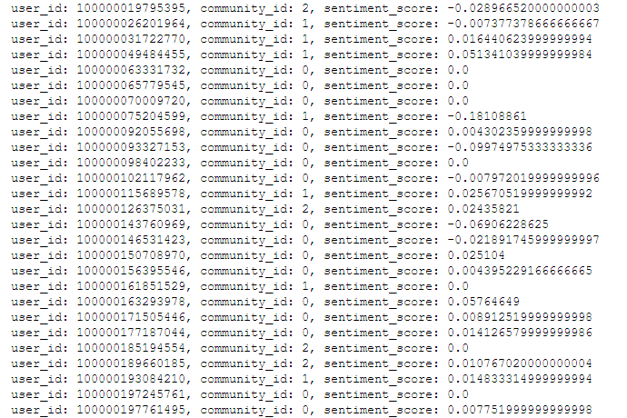
Sentiment Analysis

Slide 16
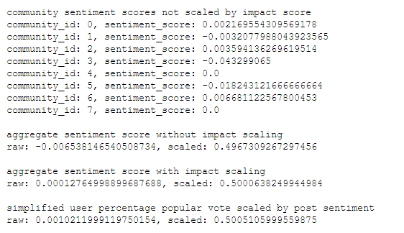
Final Results on Snowden

Slide 17
Verifications
We based the results on FB users.
Public opinion polling re: Snowden.
https://en.wikipedia.org/wiki/Edward_Snowden#Public_opinion_polls
Avg. 49 approve to 51 disapprove

Slide 18
Clustering Issues
People don’t go back to old comments and ‘like’ everything they agree with.
Time dependent
Multiple fb_id for the same person
Additional filtering?

Slide 19
Sentiment Analysis Issues
Context “is key”:
Sentiment Analysis doesn’t know the context.
Who is the negativity/positivity directed against?
Large number of neutral/informational comments
Skews sentiment?

Slide 20
Future Opportunities
PCA
Using supplemental user data.
Directly associating users with topics instead of shared communities.

