Slide 1
Real Estate Analysis Project
Atul Bachhav, David Little, Elliott Sancrant

Slide 2
Overview
Goal: Use post-pandemic MLS real estate sales data to illustrate market trends.
Examine housing market trends for list and sale prices, days on market, and volume of homes listed. as functions of seasonality and mortgage rates.
Analysis focuses on the Triangle real estate market in general, as well as the individual cities of Raleigh and Fayetteville.

Slide 3
Data Collection & Engineering
As one of our members is a licensed real estate agent, we were able to access all Triangle MLS data.
Data on over 150,000 residential home sales were exported from the Triangle MLS in CSV format.
Data fields included the following:
MLS#, Class, Property Type, Address, City, Zip Code, Neighborhood, Subdivision, Bedrooms, Baths, Square Footage, Acreage, Year Built, List Date, Closing Date, Days on Market, List Price, and Sold Price

Slide 4
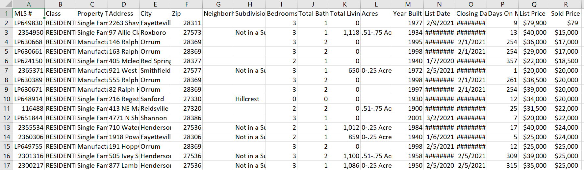
Data Collection & Engineering (cont’d)
Example CSV

Slide 5
Data Collection & Engineering (cont’d)
Columns with majority NaN or null occurrences were dropped, such as "Neighborhood" and "Subdivision".
Acreage was listed as a given range if the property's actual acreage fell within that range, and this was split into two separate columns "Acres min" and "Acres max" which utilize the min and max values of the given range.
Aggregate market data was examined alongside the individual cities of Raleigh and Fayetteville in order to compare trends.
For specific cities, data was refined to only include single family homes with 3 bedrooms and 2 bathrooms.

Slide 6
Approach/Division of Labor
David Little, being a licensed agent, was assigned to procure the data, choose questions, write the “readme” and present findings.
Elliott Sancrant was responsible for the majority of data engineering, as well as seasonality analysis and visualizations.
Atul Bachhav was responsible for engineering mortgage rate data, and completing mortgage rate analysis and visualizations.

Slide 7
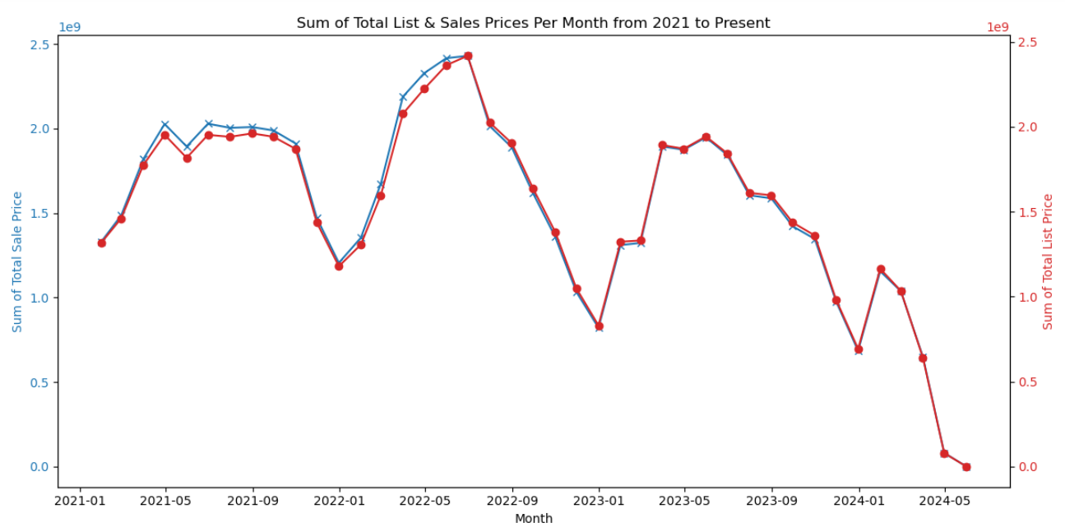
Results

Slide 8
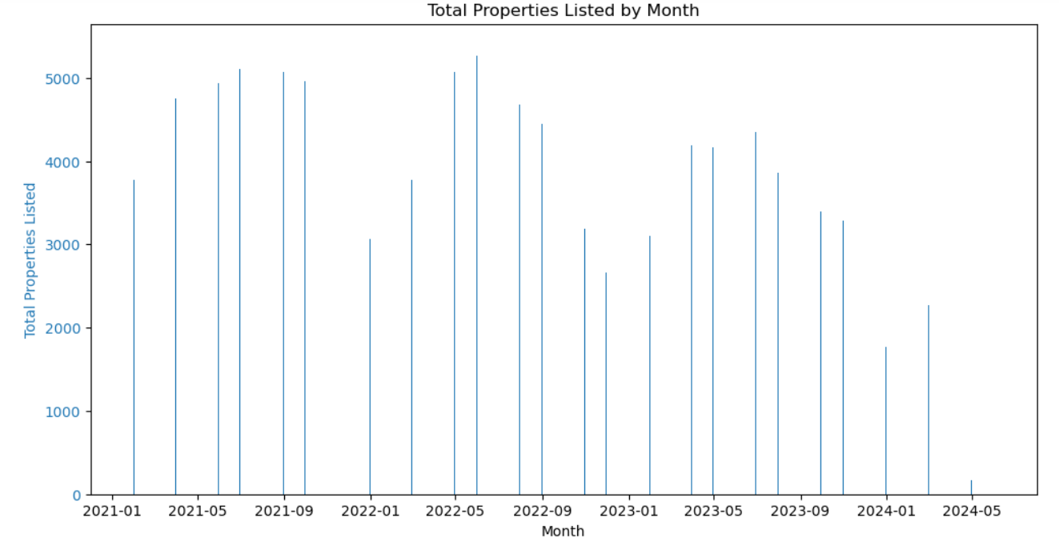
Results

Slide 9
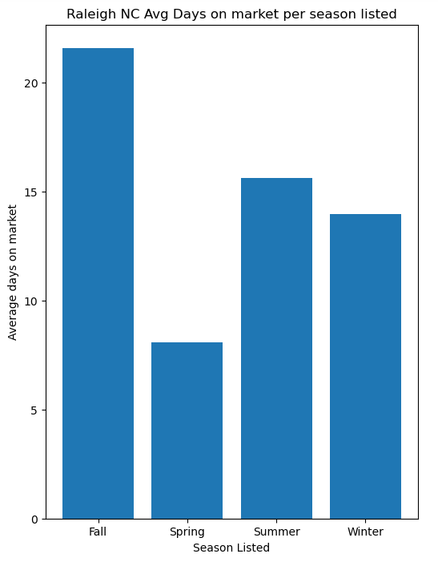
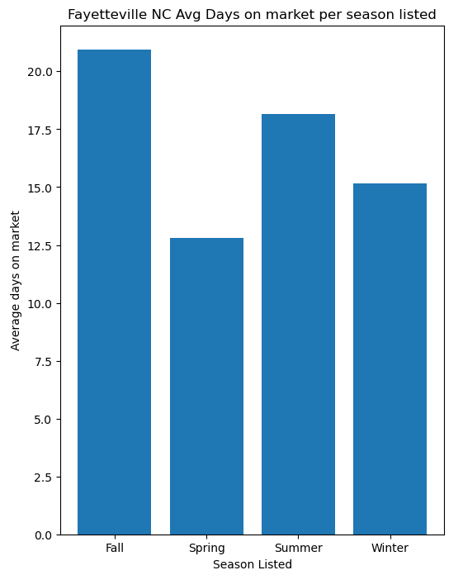
Results

Slide 10
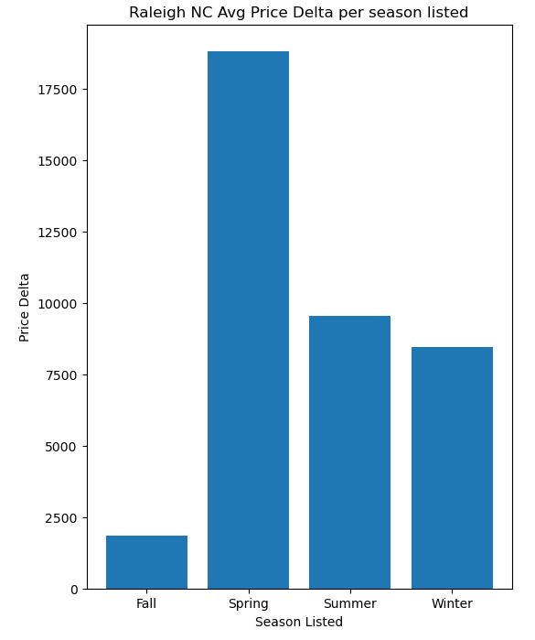
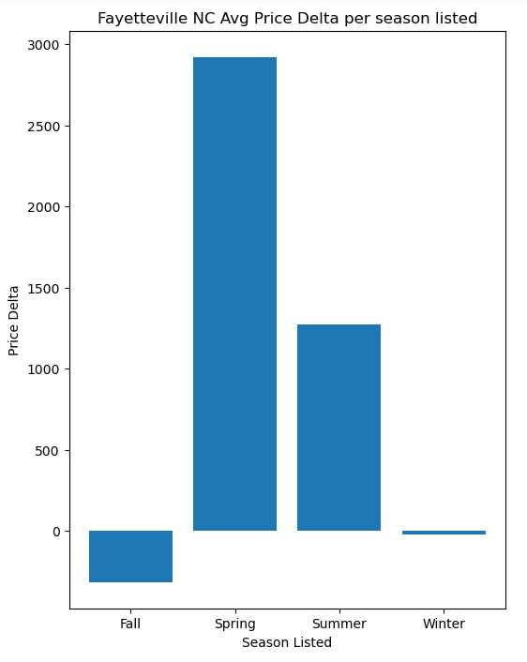
Results

Slide 11
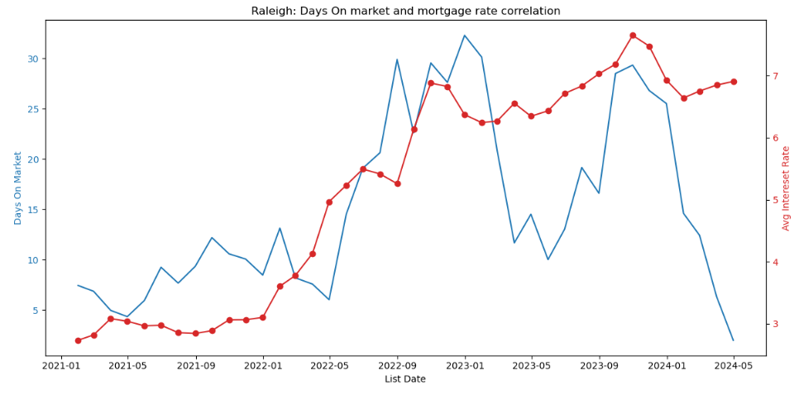
Results

Slide 12
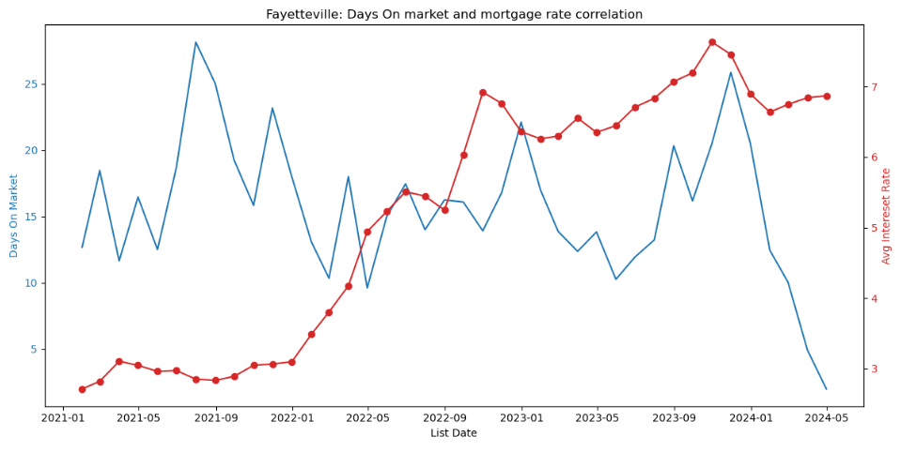
Results

Slide 13
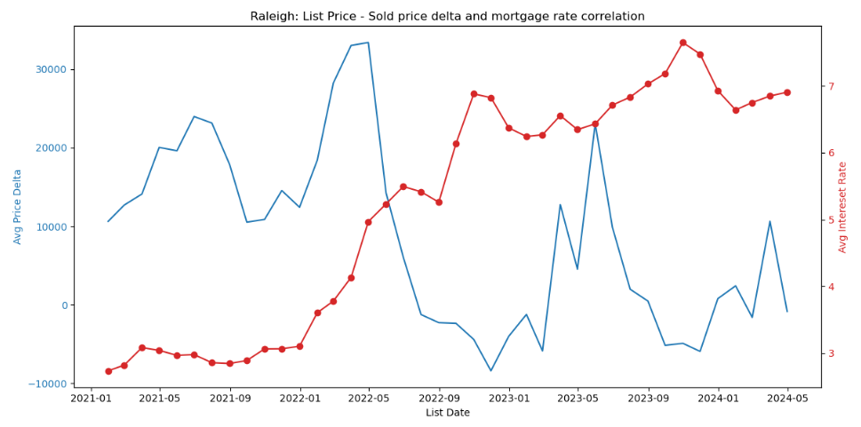
Results

Slide 14
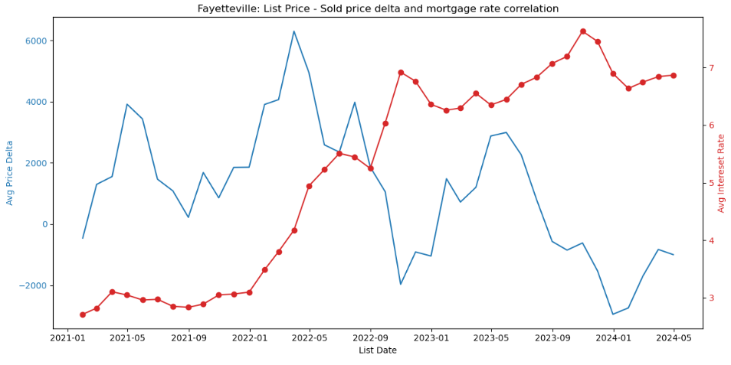
Results

Slide 15
Conclusions
It’s clear that seasonality has a notable effect on total home listings, DOM, and list-sale price delta, with the hottest period being the spring into the summer.
Effects of seasonality are more pronounced in Raleigh data than in Fayetteville (likely due to overall lower incomes and home values).
Mortgage rates have also affected the price delta, with both Raleigh and Fayetteville showing an inverse correlation after the 2022 rate hike.
While rates had a clear correlation with DOM for the Raleigh market, the effect was not clearly noted in the Fayetteville data (possibly due to lower home values resulting in smaller monthly payments, as well as section 8 housing)

Slide 16
Questions & Future Work
Remove cities with less than 10 data points
Determine if it’s possible to find routinely updated data for individuals moving into a city or job creation. These would serve as good data fields.
It may be worthwhile to include area median income as a field for each city as well.
Data should be further refined for future analyses. Take the mean of square footage and include only homes within 10% of that mean. Take the mean of the acreage as well.
Going forward, we would initially like to develop ML models to make predictions of what would be competitive home offers in the Triangle.
Ideally, we can expand this to predict the ideal Triangle market list prices, trends, etc., which may be useful for agents.

