Slide 1


P R E S E N T E D B Y
Your Name Here
D E V E L O P E D B Y
David Freeman Linda Kirby Nancy Barger

Slide 2
About the MBTI® Instrument
An indicator—not a test
Looks only at normal behavior
Forced-choice questions
No right or wrong answers—no better or worse types.
All types have potential strengths and possible pitfalls or blind spots
Your results are confidential
2

Slide 3

Where the MBTI® Tool Is Used
USA
Canada
Mexico
South America
UK
Europe
Australia
New Zealand
China
India
Japan
Korea
Malaysia
Singapore
Middle East
Dubai
South Africa
Kenya
And more!
3

Slide 4
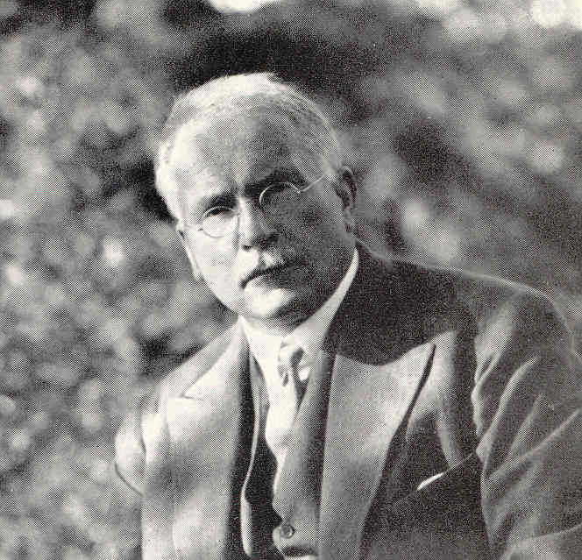
Carl G. Jung
Carl Gustav Jung (1875–1961), a Swiss psychiatrist, developed a theory of personality: Differences between people are not random. Instead they form patterns—types.
Psychological Types (published 1921, translated into English 1923)
4

Slide 5
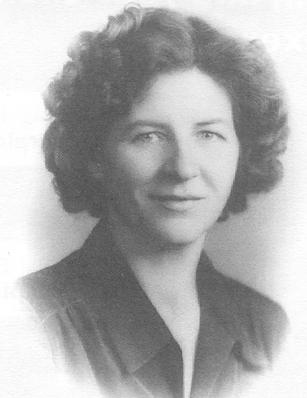
Isabel Briggs Myers
Isabel Briggs Myers (1897–1980) developed Jung’s theory in partnership with Briggs.
Beginning in 1943, she developed questions that became the Myers-Briggs Type Indicator® instrument.
5

Slide 6
Jung’s Personality Theory
Every person carries out two kinds of mental processes:
We take in information
Then we make decisions about the information
Everyone has preferred ways of using these mental processes
6

Slide 7
Jung’s Personality Theory (cont.)
Jung believed that preferences are innate—“inborn predispositions”
He also recognized that they are shaped by environmental influences, such as family, culture, and education
Nature
MBTI® instrument
Nurture
Environment
vs.
7

Slide 8
The MBTI® Dichotomies
The MBTI® instrument indicates preferences on four pairs of opposites, called dichotomies:
Extraversion E or I Introversion
Sensing S or N Intuition
Thinking T or F Feeling
Judging J or P Perceiving
8

Slide 9
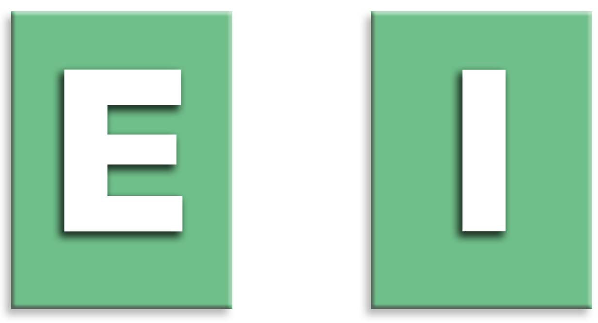
Extraversion (E) or Introversion (I)
Where we focus our attention and get energy
Source: Introduction to Type® (6th ed.), I. B. Myers, p. 9.
9

Slide 10
E–I Differences
People who prefer Extraversion:
Direct their energy and attention outward
Focus on the outer world of people and activity
People who prefer Introversion:
Direct their energy and attention inward
Focus on their inner world of ideas and experiences
We all use both preferences, but usually
not with equal comfort.
Source: Introduction to Type® (6th ed.), I. B. Myers, p. 9.
10

Slide 11
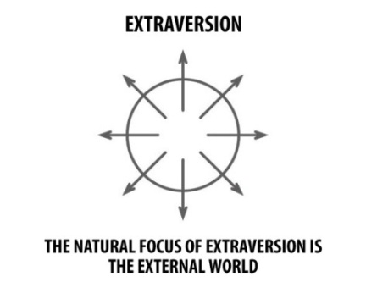
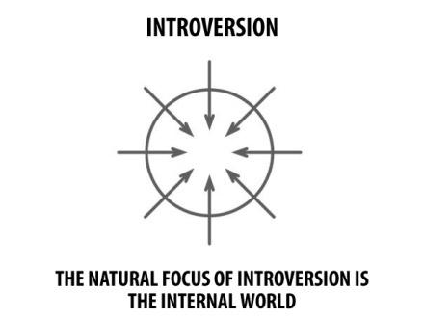
E–I Illustration
Source: Introduction to Type® and Change, N. J. Barger & L. K. Kirby, p. 4.
11

Slide 12
Where People Focus Their Attention
People who prefer Extraversion (E)
Are energized by interacting with others
Are sociable and expressive
Prefer to communicate face-to-face
Work out ideas by talking them through
People who prefer Introversion (I)
Are energized by opportunity to reflect
Are private and contained
Prefer to communicate by writing
Work out ideas by thinking them through
Source: Introduction to Type® (6th ed.), I. B. Myers, p. 9.
12

Slide 13
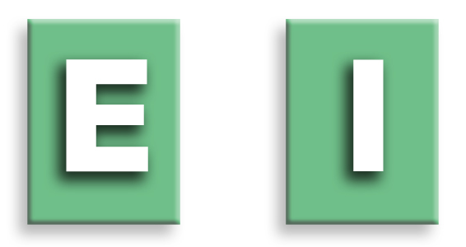
Key Words Associated with E–I
Extraversion
Action
Outward
People
Interaction
Many
Expressive
Do-Think-Do
Introversion
Reflection
Inward
Privacy
Concentration
Few
Quiet
Think-Do-Think
13

Slide 14
E–I Self-Assessment
Given the choice, which do you prefer: Extraversion or Introversion?
☑ your self-assessment
14

Slide 15
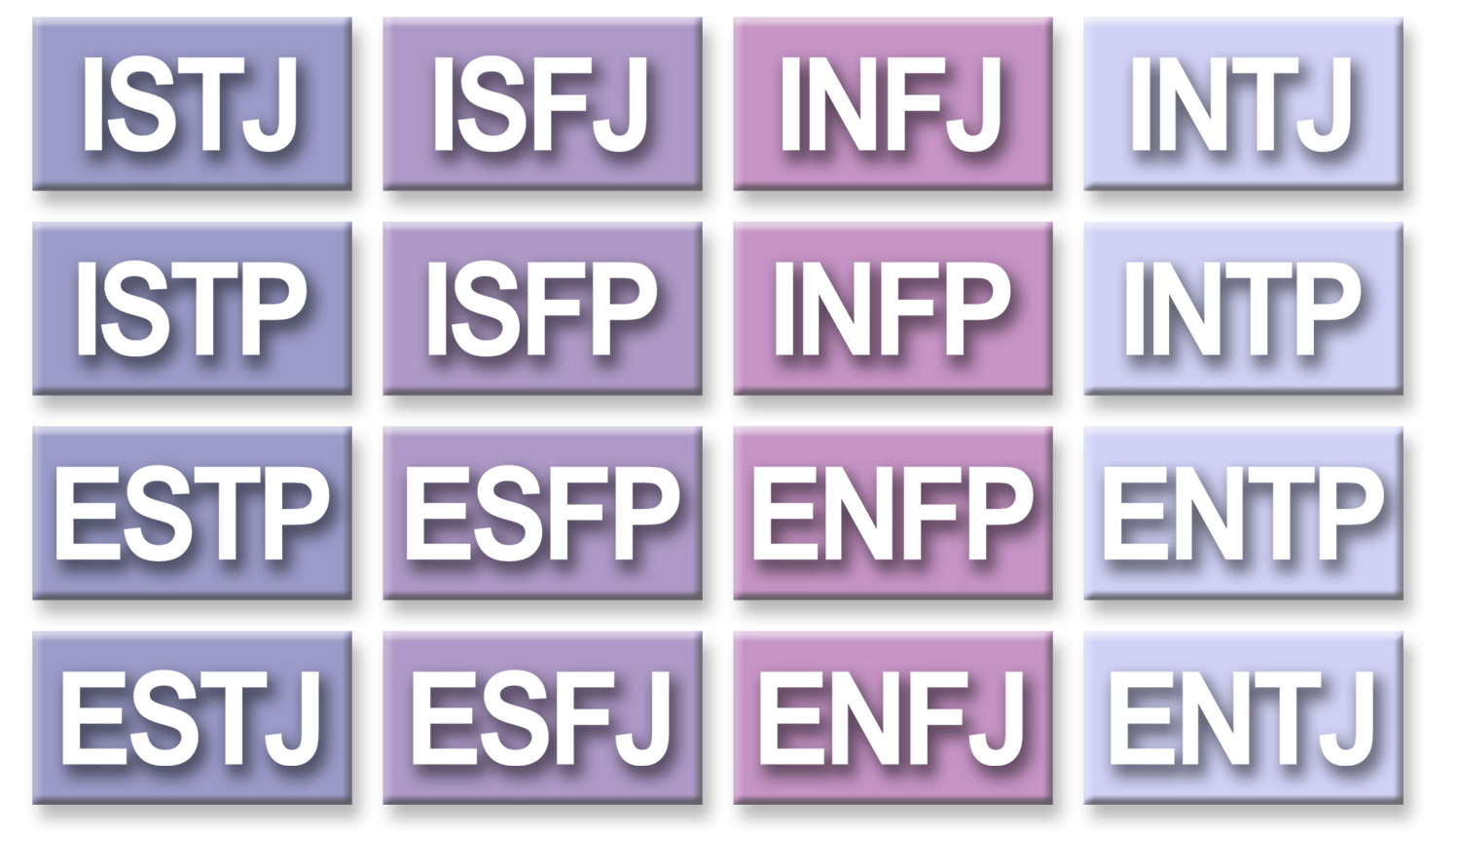
16 Personality Types
15

Slide 16
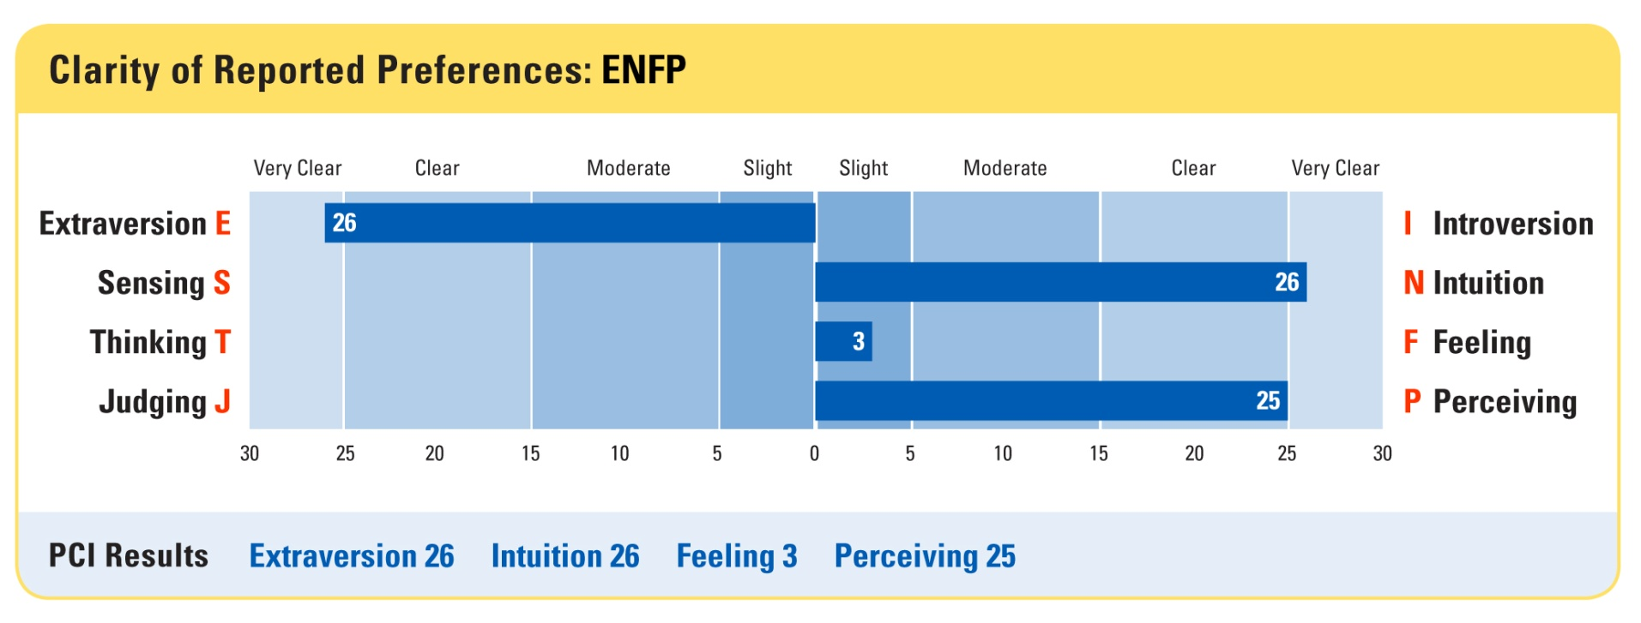
MBTI® Step I™ Profile Report (cont.)
Page 2:
PCC
PCI
16

Slide 17
Type Results
pci = preference clarity index
a number ranging from 1 to 30, assigned by computer scoring, that indicates how consistently you chose one side of a dichotomy
pcc = preference clarity category
a label describing how consistently you chose one side of a dichotomy— slight, moderate, clear, or very clear
17

Slide 18
Levels of Confidence
“Best-fit” type
Reported type
Self-estimated type
True type—innate predispositions
18

Slide 19
Slide One
Bullet list item 1 Slide 1
Bullet list item 2 Slide 1
Nested bullet list item 1 Slide 1
Nested bullet list item 2 Slide 1

Slide 20
Slide Two
Bullet list item 1 Slide 2
Bullet list item 2 Slide 2
Nested numbered list item 1 Slide 2
Nested numbered list item 2 Slide 2

Slide 21
Inline Tests
Bold: bold
Italic: italic
Underline: underline
codeph: code phrase
Small caps: small caps
Bold Small caps: bold small caps

Slide 22
Block Tests
Test of paragraphs with child lists and other blocks
Para with just a list child, no text:
List item 1
List item 2
Para with text before the list child
This is a list:
List item 1
List item 2

Slide 23

Image Test
Bullet list item 1 Slide 2
Bullet list item 2 Slide 2

