Slide 1
Azure AZ900 in Arabic for Beginners
Java Object Oriented Programming in Arabic for Beginners
Introduction to AI
SQL DB using MySQL
Advanced OOP with Java in Arabic
Neural Network in Java
No-SQL DB with Mongo
Intro to Web Programing in Arabic
NLP using Java
DB on Azure
TensorFlow
Spring Boot and WebFlux
Deep Neural Networks
Deploying Spring Boot on Azure
FrontEnd Programming with React
Building an end-to-end application on Azure
Using Kafka with Spring Boot

Slide 2
Introduction to Artificial Intelligence
Dr. Magdi AMER

Slide 3
Why AI
Question: Is a word processor an AI application?
  Answer: it depends
When to use AI?
  Search space is too big
  Problem too complex to solve using equations
  There are so many constrains that
    finding a solution is difficult
    finding the optimal solution is practically impossible
Dr. Magdi Amer

Slide 4
Classical AI
(Expert System)

Slide 5
First Order Logic
- All men are mortal.
- Socrates is a man.
Conclusion: Socrates is mortal.
- For all X; if X is a bird → X has feathers
- Brady is a bird
Conclusion: Brady has feathers
What if Brady is a penguin?
Dr. Magdi Amer

Slide 6
Expert Systems
Set of facts
Set of rules used to produce new facts
2 modes:
  Forward chaining
    Produce all possible facts
  Backward chaining
    From the result, apply reverse rules till all pre-condition are true
Dr. Magdi Amer

Slide 7
Expert System Drawbacks
Major drawback:
    If the information is not there, (for example search if John is a Student), then we cannot deduce that the opposite is true (John is not a Student is unknown).
    It is hard to represent exceptions
    It is not possible to represent different opinions
    It cannot deal with inconsistency
Dr. Magdi Amer

Slide 8
Reactive Architecture

Slide 9
Introduction to Reactive Architecture
In mid 80s, to control a robot using classic AI:
  All info from sensors written as facts
  Use rules
    to deduce the current state
    to choose best action.
In 1986, Rodney Brooks, a PhD student at MIT , built the first reactive architecture
  divided the control of the robot into layers
  each layer limited to a few sensors
  each layer is responsible for an action (preventing collision, movement, …).
  An upper layer decision overwrites a lower layer.
Dr. Magdi Amer

Slide 10
Introduction to Reactive Architecture
With this simple system, Brooks was capable of realizing advanced functions that classical AI systems could not achieve.
This was the first proof that alternative architectures can perform intelligent behavior better than classical AI.
Dr. Magdi Amer

Slide 11
1) Heuristics

Slide 12
Heuristics
Code rules that comes from:
  Knowledge of the Domain
  Model of the entities of the domain knowledge, believes and motivations.
Dr. Magdi Amer

Slide 13
Heuristics:
Using knowledge from the domain
Solve the problem
  SEND + MORE = MONEY
  Where each letter represents a digit, and no repetition is allowed.
If this problem is solved traditionally, a program will implement all the possible combinations and test each combination.
Using some knowledge from the mathematical domain, the complexity of the problem can be significantly reduced.
Dr. Magdi Amer

Slide 14
Heuristics:
Using knowledge from the domain
Take the most significant digits:
  S+M+(1) = 10*M + O ➔ +(1): in case of a carry on
  M must be 1 ➔ S is either 9 or 8, O is 0 or 1
  But O cannot be 1 (no repetition)➔ O = 0
S E N D ➔ 8 or 9 E N D
M O R E 1 0 R E
M O N E Y 1 0 N E Y
Dr. Magdi Amer

Slide 15
Heuristics:
Using knowledge from the domain
E + 0 +(1) = N ➔ no repetition ➔ E+1 = N
And E cannot be 9 (N bigger single digit)
  E+ 0 cannot generate a carry on
  S must be equal to 9
S E N D ➔ 9 E E+1 D
M O R E 1 0 R E
M O N E Y 1 0 (E+1) E Y
Dr. Magdi Amer

Slide 16
Heuristics:
Using knowledge from the domain
E + 1 + R + (1) = E + 10➔ R = 9 - (1)
  But R cannot be 9 ➔ R = 8
D + E = Y + 10
  D + E > 10 ➔ 9, 8 taken, N = E +1
    E max value = 6
    If E = 6, D = 5 ➔ Y = 1 but 1 is taken
    Let E = 5 ➔ N = 6 and D = 7 ➔ Y =2
9567+1085 = 10652
Dr. Magdi Amer

Slide 17
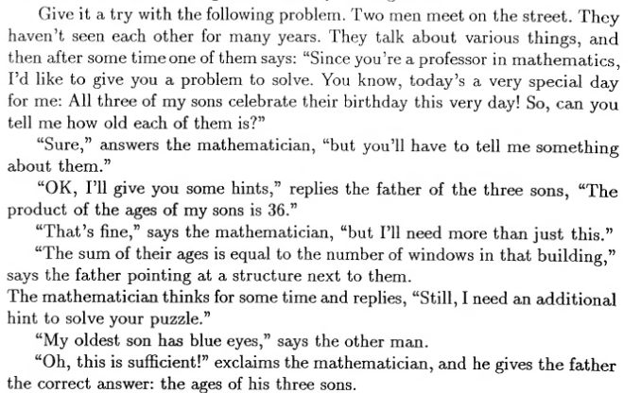
Heuristic:
Using the model of the entities
Dr. Magdi Amer

Slide 18
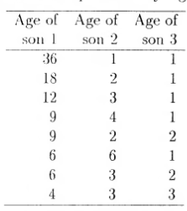
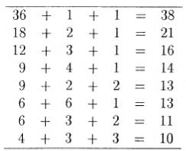
Heuristic:
Using the model of the entities
If the number of windows was 38, 21, 16, 14, 11 or 10, the mathematician would have answered immediately.
The fact that he needed another info, means that there are more than one solution. ➔ the number of windows is 13
In the third info, the man has an Oldest son ➔ the ages are: 9, 2, 2
Dr. Magdi Amer

Slide 19
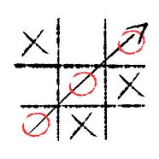
Heuristic in practice: Chess
tic-tac-toe (X O)
  Get tree of all possible actions
  Cannot be defeated
Chess
  Tree is too large
  Get sub-tree of all possible actions for X turns
  Use heuristic to evaluate the positions
  Choose the action whose worst-case scenario is best for you.
Dr. Magdi Amer

Slide 20
2) Fuzzy Logic

Slide 21
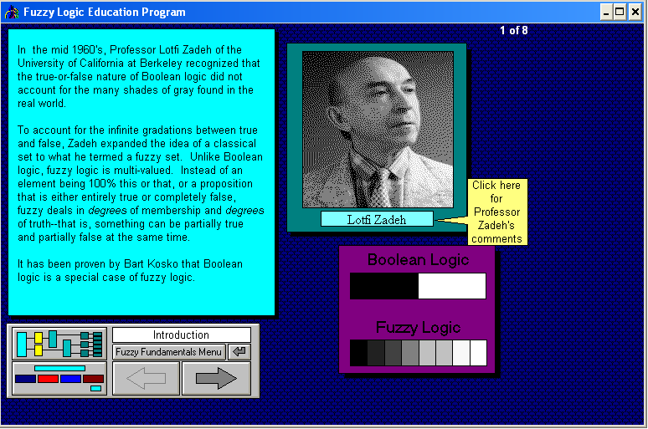
Dr. Magdi Amer

Slide 22
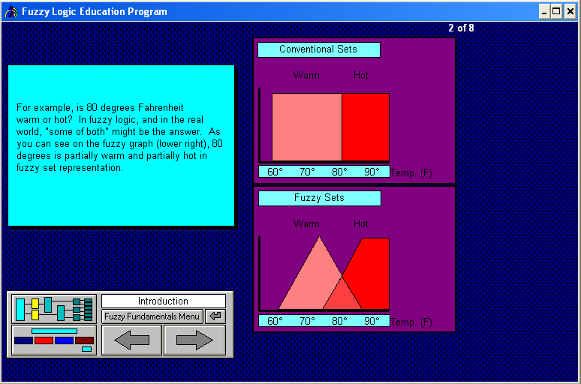
Dr. Magdi Amer

Slide 23
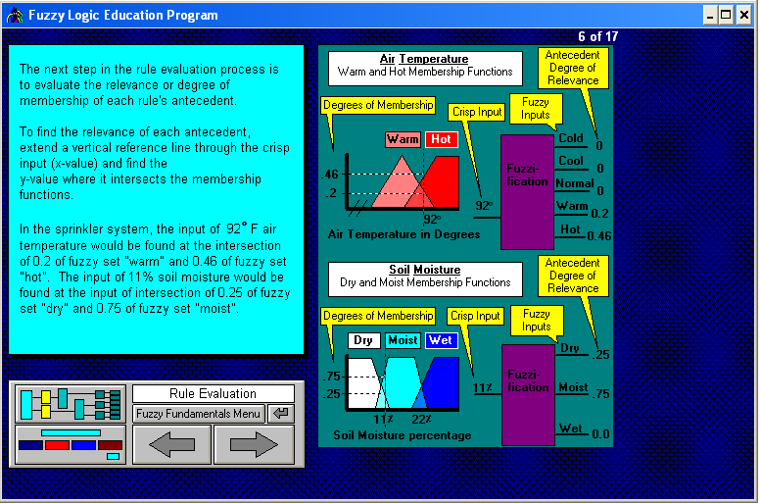
Dr. Magdi Amer

Slide 24
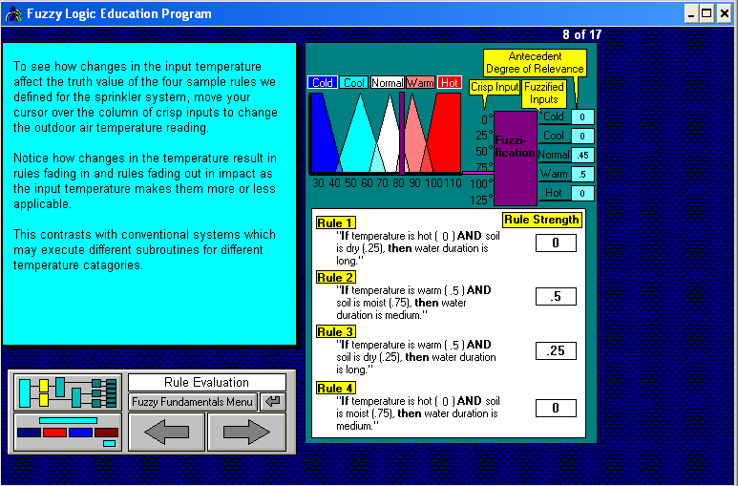
Dr. Magdi Amer

Slide 25
3) Game Theory

Slide 26
Game Theory
Let’s play a game. You have 100$ and a button.
When you click the button, every other player loses 2$.
If one or more players push the button and you have pushed your button, you lose 1$ instead of 2$.
This game is:
  Interactive (actions of one player affect the others).
  Symmetric (same rule apply to you apply to others).
  Common knowledge (all the players know all the rules and know that others know all the rules).
Are you going to push the button, or not?
You must have a strategy to decide what actions are more appropriate with your goals.
Between 30% to 70% choose to push the button.
Will you decision be different if you were playing for 1 million or manipulating nuclear missiles?

Slide 27
What is Game Theory
Game theory == Strategic Interactive Decision Making
Game theory can be applied to board games and card games, but its main goal is to provide a person with a better strategy when facing a conflict in business or life.
Game theory handles simple problem, but it help develop intuition on how to solve more complex, real-life problems.
Game theory applications in economics led to a series of Nobel price winners

Slide 28
Strategic Game Example
Example of a simultaneous game: Airbus competing in medium airplanes market with Boeing.
  Start up cost: 1 Billion
  Europe and USA are two separate market, any monopoly in either of these market generates 900M from each market.
  A competition reduces the profit to 300M for each company, but makes the country gain 700M (lower cost, better quality).
  A country can generate a Protective Legislation that does not allow manufactures from another region to enter its market.
  A country gains the profit of its local airplane manufacture and the market gain, if any.

Slide 29
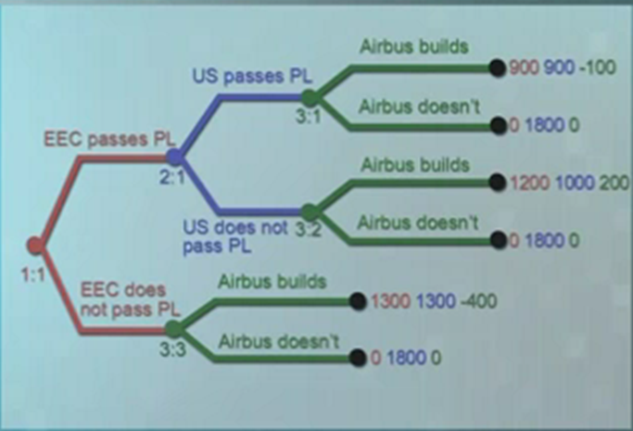
Game Theory – Decision Trees

Slide 30
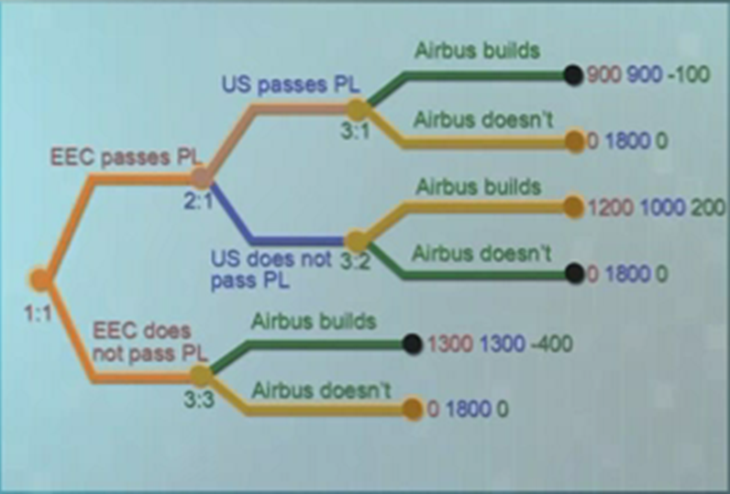
Game Theory – Decision Trees

Slide 31
4) Genetic Algorithm

Slide 32
Genetic Algorithm
All living organisms consist of cells. In each cell there is the same set of chromosomes.
During reproduction, first occurs recombination (or crossover). Genes from parents form in some way the whole new chromosome.
The new created offspring can then be mutated. Mutation means, that the elements of DNA are a bit changed. This changes are mainly caused by errors in copying genes from parents.
The fitness of an organism is measured by success of the organism in its life.
Genetic algorithms uses this model to find sub-optimal solutions.

Slide 33
Genetic Algorithm
[Start] Generate random population of n chromosomes (suitable solutions for the problem)
[Fitness] Evaluate the fitness f(x) of each chromosome x in the population
[New population] Create a new population by repeating following steps until the new population is complete
  [Selection] Select parent chromosomes from a population according to their fitness (the better fitness, the bigger chance to be selected)
  [Crossover] With a crossover probability cross over the parents to form a new offspring (children).
  [Mutation] With a mutation probability mutate new offspring at each locus (position in chromosome).
  [Accepting] Place new offspring in a new population
[Replace] Use new generated population for a further run of algorithm
[Test] If the end condition is satisfied, stop, and return the best solution in current population
[Loop] Go to step 2
Notes:
Mutation is done to prevent falling all solutions of the population into a local optimum of solved problem. Mutation changes randomly the new offspring.
Selection is not restricted to optimal fitness to prevent falling into local optimum. Instead, chromosomes are classified depending on their fitness. Members of chromosome groups with better fitness are more likely to be chosen than those from groups with lower fitness.

Slide 34
5) Neural Networks

Slide 35
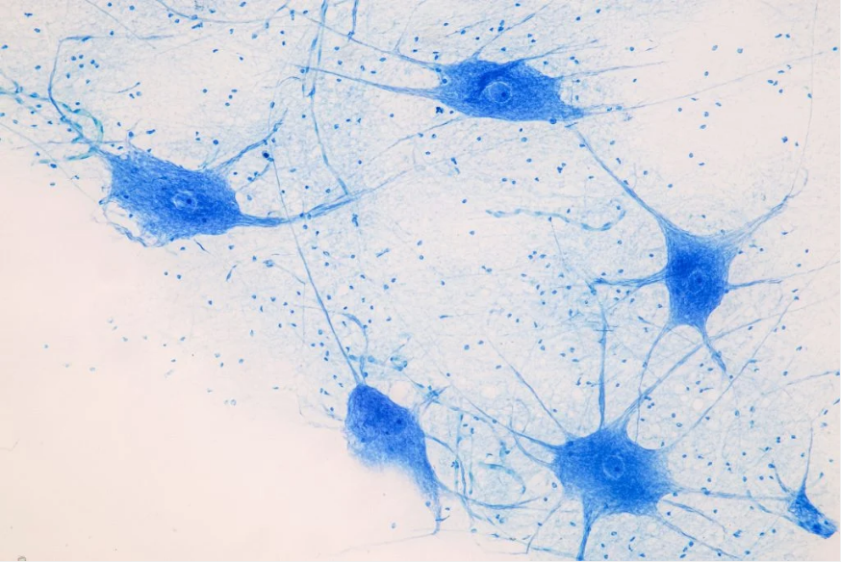
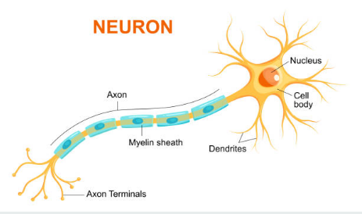
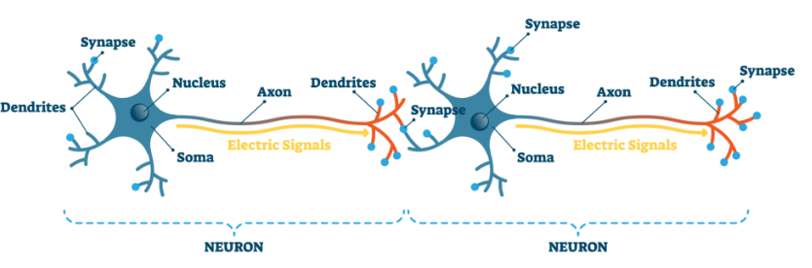
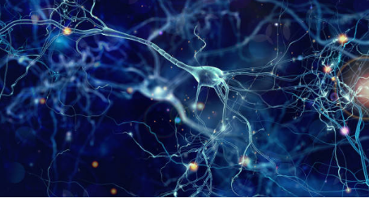
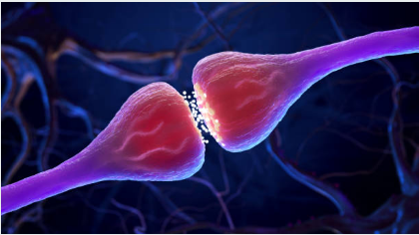
Neural Networks
How does the brain work
How does the brain learn

Slide 36
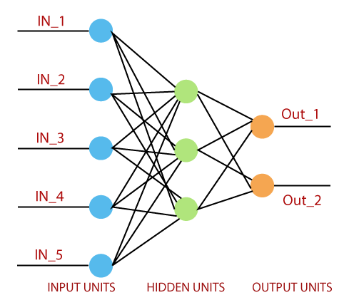
Neural Networks
Frank Rosenblatt proposed in 1958 the use of single layer neural network (Perceptron) as a linear classifier.

