Slide 1

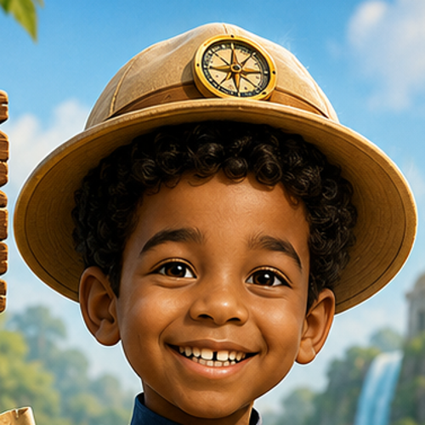

Letter Sounds Adventure
مغامرة أصوات الحروف
“Welcome, Explorer! I found a map to the Treasure of Sounds!”
▶ START ADVENTURE

Slide 2


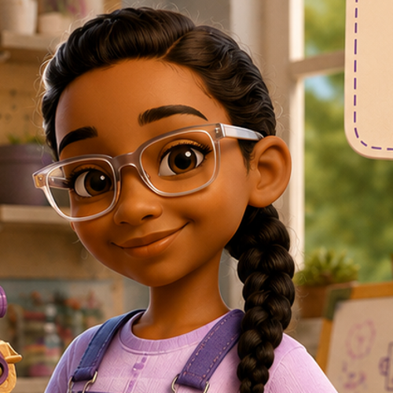
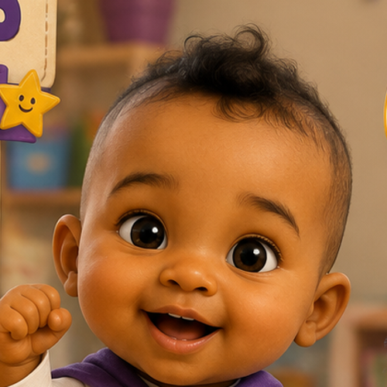
Meet the Team
استكشف. فكر. اصنع. واصل. — Explore. Think. Create. Keep Going.
Mahir
Maya
Marya
Malik
Explore
Think
Create
Keep Going
“I love to explore!”
“I love to think!”
“I love to create!”
“I help you keep going!”
CONTINUE ▶

Slide 3
Mission Briefing
Mahir:
“Today we discover the secret sounds of letters! Five sound-gates stand between us and the treasure.”
Maya:
“Let's listen carefully — every sound is a clue!”
LET'S GO! ▶

Slide 4
Adventure Map
Choose a sound-gate to explore!
S
A
T
P
M
Gate 1 — Snake
Gate 2 — Apple
Gate 3 — Tiger
Gate 4 — Pig
Gate 5 — Moon
Mahir: “Choose a gate to explore! Each one hides a secret sound.”
★ OPEN THE TREASURE CHEST
(unlocks after all 5 gates — free to preview now)

Slide 5

Sound Gate: S
Map
Discover the sound with Mahir
S
Mahir: “This sound is /s/! Like… Snake!”
Tap the gold speaker icons to hear it again and again.
/s/
🐍
☀️
🧦
Snake
Sun
Sock
NEXT: CHALLENGE ▶

Slide 6
Which letter makes this sound?
Map
Maya: “Listen carefully… which letter makes the sound /s/?”
tap to hear /s/
S
T
M

Slide 7

Sound Gate: S /s/
Map
Malik the Motivator
“Not yet — listen again! You're getting closer. Mistakes help us learn.”
TRY AGAIN ▶

Slide 8
Sound Gate: A
Map
Discover the sound with Marya
A
Marya: “This sound is /a/! Like… Apple!”
Tap the gold speaker icons to hear it again and again.
/a/
🍎
🐜
🐊
Apple
Ant
Alligator
NEXT: CHALLENGE ▶

Slide 9
Which letter makes this sound?
Map
Maya: “Listen carefully… which letter makes the sound /a/?”
tap to hear /a/
A
M
T

Slide 10
Sound Gate: A /a/
Map
Malik the Motivator
“Not yet — listen again! You're getting closer. Mistakes help us learn.”
TRY AGAIN ▶

Slide 11
Sound Gate: T
Map
Discover the sound with Mahir
T
Mahir: “This sound is /t/! Like… Tiger!”
Tap the gold speaker icons to hear it again and again.
/t/
🐯
🐢
🚰
Tiger
Turtle
Tap
NEXT: CHALLENGE ▶

Slide 12
Which letter makes this sound?
Map
Maya: “Listen carefully… which letter makes the sound /t/?”
tap to hear /t/
T
P
A

Slide 13
Sound Gate: T /t/
Map
Malik the Motivator
“Not yet — listen again! You're getting closer. Mistakes help us learn.”
TRY AGAIN ▶

Slide 14
Sound Gate: P
Map
Discover the sound with Marya
P
Marya: “This sound is /p/! Like… Pig!”
Tap the gold speaker icons to hear it again and again.
/p/
🐷
🐼
🍍
Pig
Panda
Pineapple
NEXT: CHALLENGE ▶

Slide 15
Which letter makes this sound?
Map
Maya: “Listen carefully… which letter makes the sound /p/?”
tap to hear /p/
P
S
M

Slide 16
Sound Gate: P /p/
Map
Malik the Motivator
“Not yet — listen again! You're getting closer. Mistakes help us learn.”
TRY AGAIN ▶

Slide 17
Sound Gate: M
Map
Discover the sound with Mahir
M
Mahir: “This sound is /m/! Like… Moon!”
Tap the gold speaker icons to hear it again and again.
/m/
🌙
🗺️
🐒
Moon
Map
Monkey
NEXT: CHALLENGE ▶

Slide 18
Which letter makes this sound?
Map
Maya: “Listen carefully… which letter makes the sound /m/?”
tap to hear /m/
M
S
T

Slide 19
Sound Gate: M /m/
Map
Malik the Motivator
“Not yet — listen again! You're getting closer. Mistakes help us learn.”
TRY AGAIN ▶

Slide 20
Marya's Word Workshop
Map
Let's build a word!
Marya: “Listen: /s/ … /a/ … /t/ — which order builds the word correctly?”
S
A
T
tap tiles above, or here to hear each sound
S – A – T
A – S – T
SAT
AST

Slide 21
Marya's Word Workshop
Map
Malik the Motivator
“Not yet — listen again! You're getting closer. Mistakes help us learn.”
TRY AGAIN ▶

Slide 22
Mahir's Treasure Gate
Map
Final Challenge — prove you know your sounds!
Mahir: “One last challenge, Explorer! Are these two sounds the same, or different?”
/s/
/m/
SAME
DIFFERENT

Slide 23
Mahir's Treasure Gate
Map
Malik the Motivator
“Not yet — listen again! You're getting closer. Mistakes help us learn.”
TRY AGAIN ▶

Slide 24

We Found the Treasure!
Mahir: “We did it, Explorer! Look what we found!”
★
★
★
Sound Explorer
Word Builder
Treasure Hunter
Total Stars Earned:
★
★
★
CONTINUE ▶

Slide 25
Malik: “You kept going, and you did it! I'm SO proud of you! Every try made you stronger.”
أنا فخور بك جداً!
CONTINUE ▶

Slide 26
Great Adventure, Explorer!
“Ready to play again, or explore something new?”
PLAY AGAIN ▶
HOME

