Slide 1
ROTABLATION-ASSISTED
LEFT MAIN PCI
A single centre experience
Dr. Mohd Maqbool Sohil, MD, DM, FSCAI
Interventional Cardiologist
Sohil MMª, Masood I^{b}, Goyal D^{b}, Rashid Hª
ª Paras Hospital Srinagar, J&K ^{b} Max Hospital Bathinda, Punjab, India
Am Heart J Plus: Cardiol Res Pract 2026;61:100678 | doi:10.1016/j.ahjo.2025.100678
Notes:
Single centre experience of rotablation-assisted left main percutaneous coronary intervention.
Authors: Mohd Maqbool Sohil (a), Ishtiyaq Masood (b, corresponding author), Dixit Goyal (b), Haider Rashid (a).
(a) Paras Hospital Srinagar, Jammu and Kashmir, India; (b) Max Hospital Bathinda, Punjab, India.
American Heart Journal Plus: Cardiology Research and Practice 61 (2026) 100678. https://doi.org/10.1016/j.ahjo.2025.100678
Received 20 August 2025; revised 12 November 2025; accepted 13 November 2025; available online 20 November 2025. Open access (CC BY-NC-ND 4.0).
Presenter: Dr. Mohd Maqbool Sohil, MD, DM, FSCAI, Interventional Cardiologist.
Objective (abstract): to assess in-hospital and two-year clinical outcomes of patients undergoing rotablation-assisted left main PCI at our centre.

Slide 2
01
BACKGROUND
Calcified left main disease makes PCI hard, yet for some patients PCI is the only option.
Sohil MM et al. | Am Heart J Plus 2026;61:100678
2
Notes:
Background (abstract and Introduction).
CABG is a class I indication in suitable surgical candidates with significant left main stenosis and anatomically complex CAD, and has shown superior long-term outcomes versus PCI, especially in diabetes mellitus [refs 1-4 in the article].
CABG has limitations in patients with left main disease and a high SYNTAX score; some patients are unsuitable for surgery owing to high surgical risk, and limited centres offer CABG, particularly in our part of the world.
PCI has emerged as a viable alternative for patients unsuitable for surgery [5]. In some regions, cultural or religious beliefs and unavailability of cardiac surgery leave PCI as the only option, as medical management alone is associated with high mortality.
Significant coronary calcification, particularly in the LMCA, makes PCI challenging: calcified plaques often resist balloon dilatation and deployed stents may remain underexpanded, leading to short- and long-term adverse outcomes [6-8].
Rotablation facilitates lesion debulking, enhances device deliverability and improves stent expansion [9,10]. Unprotected LM PCI remains technically challenging because of the large myocardial territory at risk, bifurcation involvement with an important side branch, and the need for haemodynamic support with LV dysfunction.

Slide 3
Why Indian data matter
Extensive, multivessel, heavily calcified CAD
CAD a decade earlier than in the West
High burden of diabetes and dyslipidemia
DAPT compliance hit by cost and awareness
Little rotablation LM-PCI evidence from India
Sohil MM et al. | Am Heart J Plus 2026;61:100678
3
Notes:
Why region-specific data are needed (Introduction).
Several international studies and registries have examined rotablation-assisted PCI in LMCA lesions, but there is much less evidence from the Indian subcontinent.
In India, patients often present with left main disease associated with extensive, multivessel and heavily calcified CAD, probably because of delayed diagnosis, inadequate access to primary preventive care, and a high burden of metabolic conditions, including diabetes mellitus and dyslipidemia.
CAD manifests a decade earlier than in the Western population [14].
Compliance with dual antiplatelet therapy (DAPT) may be challenging in the developing world because of financial constraints and lack of awareness.
These distinct demographic and clinical characteristics underscore the need for region-specific data, as outcomes observed in Western populations may not be directly applicable to the Indian context.
Hence the study aim: evaluate clinical features, angiographic and procedural characteristics, and in-hospital and two-year outcomes of rotablation-assisted PCI of severely calcified LMCA lesions at a tertiary care centre in India.

Slide 4
Prospective study design
45
2020–23
2 years
consecutive patients,
rota LM-PCI
enrolled Jan 2020 – Jan 2023
follow-up, 100% complete
Sohil MM et al. | Am Heart J Plus 2026;61:100678
4
Notes:
Aim (Introduction): to evaluate the clinical features, angiographic and procedural characteristics, and in-hospital and two-year outcomes of rotablation-assisted PCI of severely calcified LMCA lesions at a tertiary care centre in India.
Design (Methods 2.1): prospective observational study of 45 consecutive patients who underwent rotablation-assisted PCI for severely calcified left main coronary artery lesions from January 1, 2020, to January 1, 2023. Approved by the Institutional Ethics Committee.
Follow-up (2.6): clinical follow-up at predetermined times up to two years post-procedure via structured telephone interviews with patients or family members; 100% completion of follow-up interviews.
Results 3.4.2: two-year follow-up accomplished in all patients (100%) for an average of 24.3 ± 2.1 months.
Medication protocol: DAPT with aspirin 75 mg daily plus clopidogrel 75 mg daily, ticagrelor 90 mg twice daily, or prasugrel 10 mg daily for one year, then indefinite aspirin 75 mg daily.
Statistics (2.7): mean ± SD (median/IQR if non-normal; Shapiro-Wilk), Pearson / Spearman correlation, Fisher's exact test, Kaplan-Meier for overall survival; p < 0.05 significant; SPSS version 25.0; 95% CIs for correlation coefficients.

Slide 5
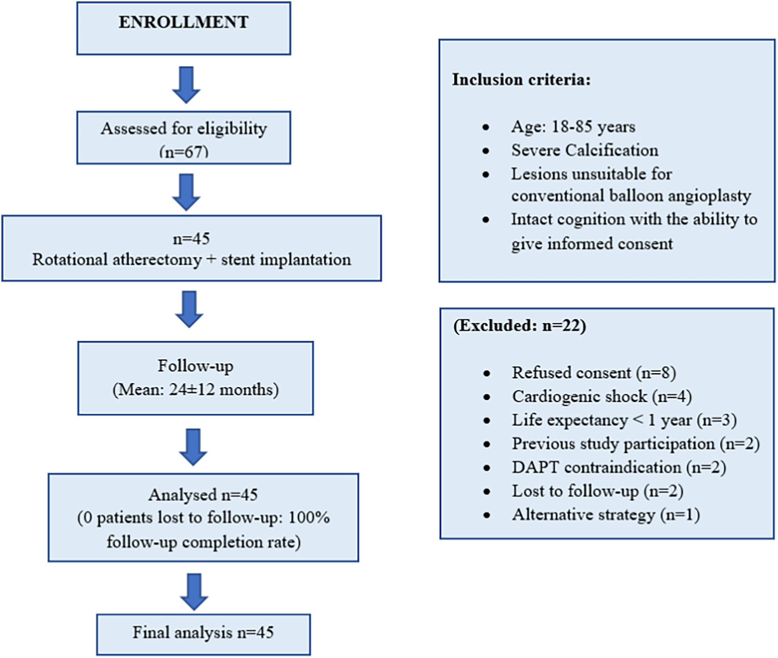
Patient selection (Fig. 1)
Heart team: SYNTAX >32 advised CABG
PCI by patient choice after counselling
LMCA ≥50% + severe Ca or IVUS Ca score ≥2
Sohil MM et al. | Am Heart J Plus 2026;61:100678
5
Notes:
Fig. 1 (article): flow diagram showing methodology for patient selection. Assessed for eligibility n = 67; excluded n = 22 (refused consent 8, cardiogenic shock 4, life expectancy < 1 year 3, previous study participation 2, DAPT contraindication 2, lost to follow-up 2, alternative strategy 1); n = 45 rotational atherectomy + stent implantation; analysed n = 45 (0 patients lost to follow-up, 100% follow-up completion); final analysis n = 45.
Figure inclusion criteria: age 18-85 years; severe calcification; lesions unsuitable for conventional balloon angioplasty; intact cognition with ability to give informed consent.
Methods 2.2: all patients underwent coronary angiography and SYNTAX score calculation and were discussed in the heart team, which decided the optimal revascularization strategy. Patients with high SYNTAX scores (>32) were advised to undergo CABG. Patients who chose PCI after appropriate discussion of risks and benefits across the entire risk spectrum were considered for PCI.
Inclusion criteria (text): LMCA diameter stenosis ≥50% with severe angiographic calcification or IVUS calcium score ≥2, and volition for rotablation-assisted PCI.
IVUS calcium score (range 1-4): 1 point each for calcium >270° in ≥5 mm, 360° calcium, calcified nodule, and vessel diameter < 3.5 mm.
Note for presenter: the figure box states follow-up "Mean: 24±12 months", whereas the Results text states 24.3 ± 2.1 months; the figure is reproduced exactly as published.

Slide 6
Rotablator RA technique
0.7
1.25–2.0
140–180k
target burr : artery ratio
mm burrs; multiple if needed
rpm; burr runs <30 s
Sohil MM et al. | Am Heart J Plus 2026;61:100678
6
Notes:
PCI protocol and rotablation technique (Methods 2.4).
Loading doses of aspirin 300 mg and clopidogrel 600 mg before the procedure.
Rotablation was performed when the operator judged angiographic calcification severe, often confirmed with IVUS; decision at operator discretion.
Rotablator RA system (Boston Scientific, Marlborough, MA, USA). Burrs 1.25 mm to 2.0 mm, operated at 140,000 to 180,000 rpm. Multiple burrs used when clinically necessary. Target burr-artery ratio 0.7.
Burr advancement periods kept < 30 s to decrease thermal injury. Continuous infusion of normal saline, heparin and nitroglycerin during atherectomy to reduce heat generation and coronary spasm.
After rotablation, balloon pre-dilatation as necessary (semicompliant or noncompliant balloons; no specialized balloons or intravascular lithotripsy), followed by drug-eluting stent deployment. Predilatation was done in all patients after rotablation except one with acute coronary syndrome and a balloon-undilatable lesion.
Stenting strategy at operator discretion: single-stent or two-stent (DK CRUSH or TAP). IVUS used when considered necessary; IABP according to haemodynamics and operator judgement.

Slide 7
Outcome definitions
In-hospital
Two-year
Angiographic: <20% residual, TIMI 3
Procedural: no major complication, death, MI or emergency revasc.
MACE: cardiac death, nonfatal MI, TLR
Stent thrombosis (ARC), stroke, bleeding (BARC)
Sohil MM et al. | Am Heart J Plus 2026;61:100678
7
Notes:
Outcome definitions (Methods 2.5).
Angiographic success: <20% residual stenosis with TIMI grade 3 flow [18].
Procedural success: angiographic success without any major complications, in-hospital mortality, myocardial infarction, or emergency revascularization.
MACE: cardiac death, nonfatal myocardial infarction, and target lesion revascularization (TLR).
Cardiac death: death due to a cardiac cause. TLR: ischaemia-driven repeat revascularization of the target lesion with ≥50% angiographic diameter stenosis by QCA or positive fractional flow reserve.
Stent thrombosis: Academic Research Consortium definitions — definite (angiographic or pathological confirmation), probable (unexplained death within 30 days, or MI in the target-vessel territory without angiographic confirmation), possible (unexplained death after 30 days) [19].
Stroke: sudden-onset focal neurological deficit persisting >24 h attributable to a cerebrovascular lesion. Bleeding: Bleeding Academic Research Consortium criteria [20].
In-hospital outcomes are reported in Table 4; two-year outcomes and MACE in Table 5.

Slide 8
Elderly, high-risk cohort
Clinical profile | Value | Risk / history | n (%)
Age (years) | 75.2 ± 5.9 | Hypertension | 38 (84.4%)
Male | 31 (68.9%) | Diabetes | 25 (55.6%)
LVEF (%) | 43.3 ± 8.1 | Previous PCI | 15 (33.3%)
SYNTAX score | 40.1 ± 8.2 | Previous CABG | 11 (24.4%)
EuroSCORE II | 5.4 ± 1.9 | NSTEMI | 24 (53.3%)
Sohil MM et al. | Am Heart J Plus 2026;61:100678
8
Notes:
Table 1. Baseline clinical and demographic characteristics (n = 45). Full table:
Demographics: age 75.2 ± 5.9 years; gender male/female 31/14 (68.9%/31.1%).
Risk factors: hypertension 38 (84.4%); diabetes mellitus 25 (55.6%); dyslipidemia 16 (35.6%); current smoker 4 (8.9%).
Medical history: previous MI 12 (26.7%); previous PCI 15 (33.3%); previous CABG 11 (24.4%); previous stroke 1 (2.2%); peripheral arterial disease 8 (17.8%); CKD 2 (4.4%); COPD 3 (6.7%).
Clinical presentation: unstable angina 13 (28.9%); chronic stable angina 6 (13.3%); STEMI 2 (4.4%); NSTEMI 24 (53.3%).
LVEF 43.3 ± 8.1%; SYNTAX score 40.1 ± 8.2; EuroSCORE II 5.4 ± 1.9.
Text (Results 3.1): an elderly population in the intermediate- to high-risk surgical group; acute coronary syndromes were the predominant presentation, NSTEMI most frequent (53.3%), followed by unstable angina (28.9%).
Slide shows a selection of rows; "Diabetes" = diabetes mellitus; "NSTEMI" = clinical presentation.

Slide 9
Mostly LM + 3-vessel CAD
86.7%
severe LMCA calcification
62.2%
distal LMCA lesion
Sohil MM et al. | Am Heart J Plus 2026;61:100678
9
Notes:
Table 2. Angiographic characteristics (n = 45). Chart shows the CAD profile (% of 45 patients): isolated LMCA 2 (4.4%); LMCA + SVD 6 (13.3%); LMCA + DVD 9 (20.0%); LMCA + TVD 28 (62.2%).
LMCA stenosis location: ostium 3 (6.7%); mid 14 (31.1%); distal 28 (62.2%).
LMCA diameter stenosis: mean 69.8 ± 12.5%; median 75%; range printed in Table 2 as "8–85" % (reproduced as printed; not shown on the slide).
LMCA calcification: mild 0 (0%); moderate 6 (13.3%); severe 39 (86.7%).
Medina classification: 1,0,0 2 (4.4%); 0,1,0 2 (4.4%); 1,1,0 5 (11.1%); 0,1,1 15 (33.3%); 1,0,1 4 (8.9%); 1,1,1 17 (37.8%).
True bifurcation lesion (abstract): 71.1% (n = 32).
SVD/DVD/TVD: single-, double-, triple-vessel disease.

Slide 10
Procedural details
Technique | n (%) | Parameter | Value
Femoral access | 38 (84.4%) | Max burr, mm | 1.50 ± 0.13
7F guide | 45 (100%) | Burrs/patient | 1.11 ± 0.31
Two-stent | 34 (75.6%) | Stent len., mm | 22.98 ± 6.54
DK crush | 32 (71.1%) | Stent dia., mm | 3.49 ± 0.40
IVUS | 34 (75.6%) | IABP, n (%) | 7 (15.6%)
Sohil MM et al. | Am Heart J Plus 2026;61:100678
10
Notes:
Table 3. Procedural characteristics (n = 45). Full table:
Access: radial 7 (15.6%); femoral 38 (84.4%); 6F 0 (0%); 7F 45 (100%).
PCI technique: provisional 11 (24.4%); two-stent 34 (75.6%). Two-stent technique: DK CRUSH 32 (71.1%); TAP 2 (4.4%).
Procedural parameters: IVUS 34 (75.6%); maximum rota burr size 1.50 ± 0.13 mm; rota burrs per patient 1.11 ± 0.31; stent length 22.98 ± 6.54 mm; stent diameter 3.49 ± 0.40 mm; final kissing balloon inflation 34 (75.6%); contrast volume 115.78 ± 17.45 ml; fluoroscopy time 22.56 ± 5.69 min; IABP 7 (15.6%); GP IIb/IIIa inhibitor 31 (68.9%).
Results 3.3: all procedures used 7F guide catheters. No serious procedural complications such as coronary perforation, acute vessel closure, or no-reflow. Minor complications: transient bradycardia requiring temporary pacing in 2 patients (4.4%) and access-site haematoma in 1 patient (2.2%).
Abbreviations: DK CRUSH, double-kissing crush; TAP, T and small protrusion; IABP, intra-aortic balloon pump; GP, glycoprotein.

Slide 11
In-hospital outcomes
100%
97.8%
2.2%
angiographic success (45/45)
procedural success (44/45)
in-hospital death (1/45)
Sohil MM et al. | Am Heart J Plus 2026;61:100678
11
Notes:
Table 4. In-hospital clinical and procedural outcomes: angiographic success 45 (100.0%); procedural success 44 (97.8%); emergent CABG 0 (0%); in-hospital death 1 (2.2%).
Results 3.4.1: all patients achieved <20% residual stenosis with TIMI 3 flow. Procedural success 97.8% (44/45) without any emergency CABG. In-hospital mortality 2.2% (1/45): one cardiac death during the index hospitalization.
That patient presented with new-onset LBBB and severe LV dysfunction (LVEF 25%), treated as a STEMI equivalent; balloon-undilatable distal left main and ostioproximal LAD lesion treated with rotational atherectomy with IABP support. Angiographic success was achieved, but he developed refractory cardiogenic shock and hospital-acquired pneumonia with MODS.
Table 7 (IVUS subgroup): procedural success 12/13 (92.3%) without IVUS vs 32/32 (100%) with IVUS, p = 0.289 (Fisher's exact); in-hospital death 1 (7.69%) vs 0, p = 0.289.

Slide 12
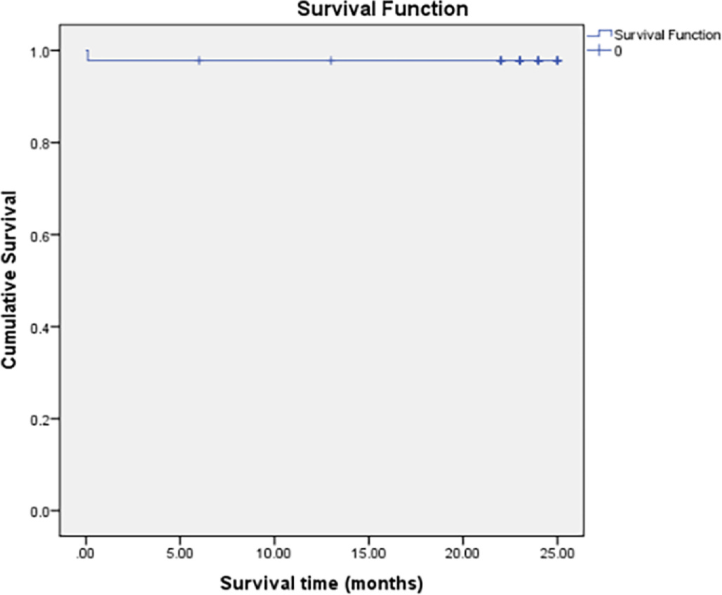
Two-year outcomes
Overall survival 97.78%
(Fig. 2, Kaplan-Meier)
MACE-free 93.3%
1 death, 1 TLR, 1 TVMI
No bleeding or stroke
Sohil MM et al. | Am Heart J Plus 2026;61:100678
12
Notes:
Fig. 2 (article): Kaplan-Meier survival analysis curve to assess OVERALL survival; Results: overall survival of 97.78% at two-year follow-up; the single event was the in-hospital death.
Table 5. Two-year clinical outcomes and MACE: all-cause death 1 (2.2%); cardiac death 1 (2.2%); TLR 1 (2.2%); target vessel MI 1 (2.2%); stent thrombosis 1 (2.2%); bleeding 0 (0%); stroke 0 (0%).
Two-year follow-up achieved in all patients (100%), mean 24.3 ± 2.1 months. The only death was the cardiac death during the index hospitalization.
Target vessel MI: angiography confirmed stent thrombosis at the LCX ostium; this patient had a two-stent (TAP) procedure and had stopped antiplatelets before a planned cataract surgery.
MACE-free survival at two years: 93.3% (abstract; Results: "over 93.3% of patients remaining free of major adverse events").
Note on a discrepancy in the article: the Discussion text states "the MACE-free survival rate was 97.8%". The slide uses 93.3% (abstract and Results); 97.78% is the Kaplan-Meier overall survival.
DAPT adherence: 42 of 44 discharged patients followed the one-year protocol; one stopped clopidogrel at 8 months for mild gum bleeding, one stopped antiplatelets at 7 months for planned cataract surgery; all were still taking aspirin at two years.
Table 8 (IVUS subgroup): no significant differences (all-cause death, cardiac death, stent thrombosis, TVMI each p = 0.289; TLR p = 1).

Slide 13
Correlation analysis
Variable pair | Pearson r | 95% CI | p
Age vs SYNTAX score | 0.23 | 0.02–0.42 | 0.028
EuroSCORE II vs age | 0.52 | 0.34–0.67 | <0.001
LMCA stenosis vs fluoro | 0.31 | 0.11–0.49 | 0.003
Contrast vs fluoro time | 0.38 | 0.19–0.55 | 0.001
Burr size vs stent diam. | 0.45 | 0.26–0.61 | <0.001
SYNTAX vs stent length | 0.28 | 0.08–0.46 | 0.006
Sohil MM et al. | Am Heart J Plus 2026;61:100678
13
Notes:
Table 6. Correlation analysis between clinical, angiographic and procedural variables (Pearson r, 95% CI, p; all p values marked significant in the article):
Age vs SYNTAX score r = 0.23 (0.02–0.42), p = 0.028; EuroSCORE II vs age r = 0.52 (0.34–0.67), p < 0.001; LMCA stenosis % vs fluoroscopy time r = 0.31 (0.11–0.49), p = 0.003; contrast volume vs fluoroscopy time r = 0.38 (0.19–0.55), p = 0.001; burr size vs stent diameter r = 0.45 (0.26–0.61), p < 0.001; SYNTAX score vs stent length r = 0.28 (0.08–0.46), p = 0.006.
Interpretation (Results 3.5): age relates to complex CAD; age is a component of EuroSCORE II; tighter calcified LMCA lesions needed longer burr times and more balloon predilatations; the strongest correlation, burr size vs stent diameter, means larger burrs were used for larger stents; higher SYNTAX scores received longer stents because of concomitant LAD and/or LCX involvement.
Subgroup analysis (3.6): SYNTAX ≤32 (n = 15): procedural success 100%, no adverse events at two years. SYNTAX >32 (n = 30): procedural success 96.7%, two-year MACE 6.7% vs 0%, p = 0.28. Single-stent (n = 11) vs two-stent (n = 34): two-year TLR 0% vs 2.9%, p = 0.65. ACS (n = 39) vs stable (n = 6): no differences (p > 0.05). No significant difference by IVUS use (Tables 7 and 8).
Fluoroscopy time trend: 25.1 ± 6.2 in 2020 vs 20.8 ± 4.9 in 2022, p = 0.08 (the article prints the unit as "s" here, while Table 3 reports fluoroscopy time in minutes).

Slide 14
Endpoints differ by study
Not like-for-like
Garcia-Lara 2-yr cardiac-mortality-free survival
71 ± 7%
Sohil MM et al. | Am Heart J Plus 2026;61:100678
14
Notes:
Discussion comparisons (article Section 4 and Fig. 4). The values are different endpoints at different time points, so the bars are not like-for-like.
ROTATE registry (rotational atherectomy followed by stenting): in-hospital MACE 8.3%; two-year MACE 24.9%, driven by target vessel revascularization; dialysis was an independent predictor of in-hospital and two-year MACE [21].
Garcia-Lara (rotational atherectomy for severely calcified unprotected left main): two-year cardiac-mortality-free survival 71 ± 7%; two-year target vessel revascularization 19.3 ± 7% [24,25]. The survival figure is shown in the side panel, not as a bar, because it is a survival rate, not an event rate.
Bouisset et al.: MACE 13.2% at 1 year.
This study: 100% angiographic success, 2.2% in-hospital mortality, and 2.2% TLR at two years, described as favourable compared with contemporary series in this very high-risk population.
The article's Fig. 4 is a horizontal bar graph of all-cause mortality, TLR and overall survival versus the three studies; its caption cites "excellent two-year survival (97.8%)". This slide redraws only the rates stated in the Discussion text.
Discussion also notes: in-hospital mortality 2.2% similar to published studies [21,22]; no major procedural complications such as perforation or no-reflow; IVUS 75.6% and DK CRUSH in 71.1% of two-stent cases likely contributed to outcomes [26,27].

Slide 15
Limitations
Design
Scope
Single centre, small sample (n = 45)
No control group (non-rota PCI or CABG)
No systematic angiographic follow-up
Rotablator RA only: not orbital or IVL
Sohil MM et al. | Am Heart J Plus 2026;61:100678
15
Notes:
Limitations (Section 4.1, as stated in the article):
Single-centre study with a small sample size (n = 45), which limits the generalizability of the results and the strength of the conclusions.
No control group, such as patients with non-rotablation PCI or CABG, making outcome comparisons difficult.
No systematic angiographic follow-up; clinical or telephonic follow-up could have resulted in under-reporting of asymptomatic restenosis.
The study focused on the Rotablator RA system, so the results are not translatable to other atherectomy approaches such as orbital atherectomy and intravascular lithotripsy (IVL).
The Conclusion adds that multicentre prospective studies are needed to confirm these findings and develop standardized protocols for calcified left main lesions.

Slide 16
Take-home messages
Rota-assisted LM-PCI is feasible, safe and effective in severely calcified lesions
Procedural success 97.8%, with a low rate of periprocedural complications
Durable two-year outcomes: MACE-free survival 93.3%
Sohil MM et al. | Am Heart J Plus 2026;61:100678
16
Notes:
Take-home messages, from the article's Conclusion (Section 5) and abstract only:
Rotablation-assisted PCI is a technically feasible and clinically effective revascularization strategy in selected high-risk patients with severely calcified left main lesions; the abstract concludes it is safe and effective.
It showed good procedural success (97.8%; angiographic success 100%), a low rate of periprocedural complications, and durable clinical outcomes over two years of follow-up (in-hospital mortality 2.2%; two-year MACE-free survival 93.3%).
The results support the evolving role of complex PCI techniques, including plaque modification and intravascular imaging, in heavily calcified LMCA disease, particularly for patients who are not surgical candidates.
This was a small, single-centre study; multicentre prospective studies are needed to confirm the findings and develop standardized protocols for calcified left main lesions in various healthcare settings.

Slide 17
THANK YOU
Questions and discussion
Dr. Mohd Maqbool Sohil, MD, DM, FSCAI
Interventional Cardiologist | drmaqboolsohil.deed.page
Sohil MM, Masood I, Goyal D, Rashid H. Single centre experience of rotablation-assisted left main percutaneous coronary intervention. Am Heart J Plus: Cardiol Res Pract 2026;61:100678.
doi:10.1016/j.ahjo.2025.100678 | Open access, CC BY-NC-ND 4.0
Sohil MM et al. | Am Heart J Plus 2026;61:100678
17
Notes:
Thank you. Questions and discussion.
Presenter: Dr. Mohd Maqbool Sohil, MD, DM, FSCAI, Interventional Cardiologist. Website: drmaqboolsohil.deed.page
Citation: Sohil MM, Masood I, Goyal D, Rashid H. Single centre experience of rotablation-assisted left main percutaneous coronary intervention. American Heart Journal Plus: Cardiology Research and Practice 2026;61:100678. https://doi.org/10.1016/j.ahjo.2025.100678
Open access article under the CC BY-NC-ND 4.0 licence (http://creativecommons.org/licenses/by-nc-nd/4.0/). Published by Elsevier Inc.
Affiliations: Paras Hospital Srinagar, Jammu and Kashmir, India; Max Hospital Bathinda, Punjab, India.

