Slide 1

Introduction to Python
Mark Slater

Slide 2
Useful Links
Main python documentation:
https://docs.python.org/2/
Good place to ask questions:
http://stackoverflow.com/
Google is very good as well!
My contact details:
Mark Slater <mslater(AT)cern.ch>, Physics West 317

Slide 3
Course Info and Aims
The aim of this part of the course is to give some basic experience with Python so you can start writing scripts to help with various types of analysis
It will cover Python programming from the very basics to using functions, file I/O and external modules
It will demonstrate these techniques using the example of a cipher program
At the end there will also be an additional, more advanced exercise about plotting and fitting if we have time!

Slide 4
Preliminary Setup
There is a skeleton structure for the course on github here:
https://github.com/drmarkwslater/CCBPythonCourseSep2017
With your newly acquired git skills, can you:
  Fork this repo on github
  'git clone' your copy of the repo to your VM (or wherever you're working)
  'cd' into the 'intro' folder and you're ready to go!

Slide 5

Overview
Writing and Running Python Code
Types, Objects, Values and Variables
Operators
Program Flow
Conditionals
Loops
Lists, Dictionaries and Tuples
Command Line Arguments
Functions
File Operations
The Caesar Cipher
Basic Data Analysis (Optional!)

Slide 6
What is Python?
Python is a general purpose, extensible object oriented programming language widely used across in the software industry and beyond
It is not compiled to machine code (like C/C++) allowing it to be a highly dynamic language at runtime and therefore providing you with a lot of control over how code is executed
This does mean there is a loss in performance but it is unlikely you will hit these issues in your work

Slide 7
Why Python?
Though comprised of fairly basic syntax and conventions, it is very powerful. However, it is also easy to learn and produce results with quickly
The main benefits of Python are readability and ease of use combined with a very large (and growing) set of external modules that will cover a lot of what you need to do (e.g. plotting, statistical analysis, etc.)
As of writing, it's one of the most used (and fastest growing) languages:

Slide 8
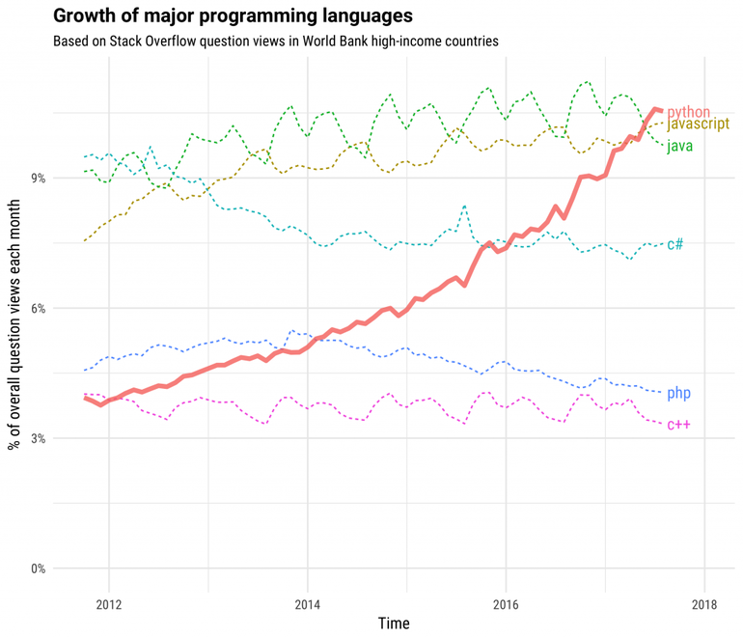
Why Python?

Slide 9
1. Writing and Running Python Code

Slide 10

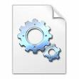
Writing and Running Code
There are two ways to run python code: Through the interpreter or as a script
slatermw$ python
>>> f = open('my_data.vcf')
>>> for ln in f.readlines():
... if ln.find('0/1') > -1:
... print 'Found 0/1'
>>> f.close()
.py File
slatermw$ python my_script.py
f = open('my_data.vcf')
for ln in f.readlines():
if ln.find('TAG') > -1:
print 'Found TAG'
f.close()

Slide 11
The Hello World Program (Ex. 1)
To make a start with python, we will create the ubiquitous 'Hello World' program:
  After cd'ing to the 'intro' dir...
  Run the command 'python'
  Type in the code to the right (note the spaces/tabs!)
  Use 'Ctrl+D' to exit
  Edit the file 'hello.py' – I would suggest using 'gedit'!
  Type the code again in to the file
  Back in your terminal, type 'python hello.py'
  NOTE: You have to be careful about the indentation – either 'Tab' or 3-4 spaces. Be consistent as well!
def myprint( ):
# Function to print hello
print 'Hello World'
myprint()

Slide 12
Basic Syntax of a Python Program
Before we start looking in more detail at Python coding, we will just cover the basic syntax of the program you've just written
A new 'block' of code is usually denoted by a colon (':'). These can be after function definitions, conditionals or loops
A function definition - see later
def myprint( ):
# Function to print hello
print 'Hello World'
myprint()
It is good practise to add comments to your code – these are ignored by the interpreter but help you explain what you're trying to do, both to other people and yourself a few months on!
Indentations indicate 'blocks' of code – in this case, the body of a function. Python is very strict on the indentation and you MUST be consistent!

Slide 13
2. Types, Objects, Values and Variables

Slide 14
What are Types, Objects, Values and Variables?
Python (and many other languages) have a defined way of holding and organising data within a computer's memory
The appropriate terms are:
    Types – How to interpret data in a memory location ('object') and what operations can be performed by it
    Object – Defined area of memory that holds the data ('values') associated with a type
    Value – Actual data/bits in memory interpreted by the 'type'
    Variable – A flag or name of an area of memory ('object')
These may seem a bit abstract but it is important to know the difference as we progress to avoid confusion later!

Slide 15

What are Types, Objects, Values and Variables?
In terms of a laptop:
    Type – Laptop
    Object – The actual physical laptop
    Value – The bits and pieces that make up the laptop ('MacBook')
    Variable – MARK'S Laptop
a = 5
b = 76.2
c = 'Hello'
a
b
c
43
76.2
Hello
The given code initialises 3 variables – an int, float and string
The variable names are labels that are attached to the objects in memory. The values are the contents of the memory and the type is how python interprets the memory

Slide 16
Basic Types and Initialising Variables
We will start by introducing the basic types that are available in Python and showing how to create them
The built-in basic types are (excluding Lists and Dictionaries – see later!):
    A boolean – bool (True/False)
    Integer number – int (1, 2, 3, etc.)
    Floating point number – float/double (1.2, 5.7, etc)
    String – an array or list of characters ('hello', 'world', etc.)
To declare a variable (a named object of this type), all you need to do is provide a variable name and initialise it to whatever starting value you want:
This will create an object of the requested type (i.e. assign the appropriate memory) and initialise it with the value
It also assigns this object with the given variable name so you can refer to it later
a = 5
b = 76.2
c = 'Hello'

Slide 17
Getting Experience with Variables (Ex. 2)
Now either edit the code in your 'Hello World' script or directly use the python interpreter to do the following:
    Create, modify (e.g. add 1 to it) and output an integer variable
    Create a decimal ('float') variable and output this
    Create a string variable and print it
Note that you can use the same variable name for each of the above variables but it's good practise not to reuse variable names for different objects in the same area of code
As you've probably guessed, to output things to the screen, use the 'print' statement:
print 'Hello World'

Slide 18
3. Operators

Slide 19
Operators (1)
Through the introduction to variable creation, you have also now met the idea of operators
Operators are symbols that perform a specific operation on one or more objects. A subset of these are the arithmetic operations you're familiar with:
    Multiplication: a * b
    Addition: a + b
    Subtraction: a - b
    Division: a / b
For example, 'a + b' is the addition operator being applied to the objects 'a' and 'b'
Also note that operators in Python are nothing 'special' – they are essentially shorthand calling other bits of code

Slide 20
Operators (2)
As well as these arithmetic operators, there are several more language specific ones:
    Assignment: a = b
    Addition/Subtraction and assignment: a += b, a -= b
    Exponent: a ** b ( e.g. 10**3 = 1000 )
    Modulus: % (e.g. 9 % 4 = 1)
    Floor Division: a // b (e.g. 9 // 4 = 2)
    Subscript/Array: []
What each operator does is entirely a property of the type(s) they are operating on though generally it is obvious what effect they will have
Note that as in Maths, operators have precedence and you should use brackets appropriately!

Slide 21
Single Character Access
As another example of simple operator use, we will look at the 'string' type
As mentioned, this type can be considered an array or list of characters (chars) and so to access a single character from that array, you use the '[]' operator
# Assign a variable for the string
a = 'Hello World'
# Print the whole string
print a
# output 'o'
print a[4]
The array operator references the zero-indexed list of letters in string and returns the appropriate element

Slide 22
Getting Experience with Variables (Ex. 3)
Again, either edit the code in your 'Hello World' script or directly use the python interpreter to do the following:
    Create float and integer variables
    Output the product of these
    See what happens when you divide a float and an int and then two ints
    Create a string variable
    Output various letters from your string variable

Slide 23
4. Program Flow

Slide 24
Program Flow
It would be difficult to do much with a language if a program was just executed from top to bottom and you couldn't control what parts of the code were executed
There are a number of ways provided to gain this control over the program:
    Conditionals
    Loops
    Functions
We'll go over each one in turn and give you a chance to use them as we start to develop the cipher code

Slide 25
Program Flow – Scope and Indentation
Before we go into the main ways of controlling program flow, it's important to understand the idea of scope. This refers to 'blocks of code' that, in Python, are indicated by levels of indentation
Generally, all program flow statements are terminated by a colon and followed by a code block that is indented relative to where it is defined
This indentation can be tabs or a certain number of spaces (3-4 usually) but it MUST be consistent!
An error you may see quite often is an 'Indentation Error' – this is when Python encountered more/less indentation without an appropriate Program Flow Control statement

Slide 26
Program Flow – Scope and Indentation
def my_func():
# Start of a function is indented
# from where it was declared
a = 10
for i in range(0, a):
# loop needs to be indented
print i
print 'all done!'
# 'Global' namespace - no indentation!
my_func()
All Program Flow statements (a function in this case) requires the associated code to be indented from where it is declared
As the 'for' loop is already indented in the function, it's associated code must be indented a second time
If code is in the 'global' namespace, it doesn't have any indentation

Slide 27
5. Conditionals

Slide 28
Program Flow - Conditionals
Conditionals allows different code blocks to be executed based on the outcome of a simple test. It uses a number of additional operators, including:
    Comparison: ==
    Greater/Less than: > / <
    Greater/Less than or equal to: >= / <=
    Not equal to: !=
    'not' to negate a boolean value
    'in' to test if an object is present in a list/string – see later!
Examples of this are shown on the next slide, but the main points are:
    The 'if', 'elif' and 'else' keywords are used
    The conditions must evaluate to True or False
    The code must be indented

Slide 29
Program Flow - Conditionals
a = 1
b = 2
mybool = True
if a == b:
# a equals b so do this
print 'a equals b'
elif mybool:
# This code will actually run as mybool is True
# equivalent to 'if mybool == True'
print 'mybool was True'
elif not mybool:
# 'not' negates a boolean
# i.e. this will be called if mybool is False
print 'mybool was False'
else:
# if none of these apply, do this
print 'none of the conditions were met'

Slide 30
6. Loops

Slide 31
Program Flow – Loops
Loops are very useful for re-using code – a very important practise in all code development, not just Python. Loops allow you to repeat a block of code a set number of times, over a list of objects or until a condition is met
The first type of loop we will look at is the 'while' loop. This will continue to run iterations of the loop code until the given condition evaluates to False
Some useful points to note are:
    Like conditionals, the code to be executed must be indented
    You must declare any loop variables before the 'while' statement
    The evaluation of the condition is done at the beginning of each loop
    The loop will continue until the condition is False, so be careful of infinite loops!
    Use 'break' to get out of the loop and 'continue' to skip the iteration
i = 1
while i < 5:
print i
i += 1

Slide 32
Aside: Calling Functions
Though we will be covering these in more detail later, I will briefly go over calling functions as these will be needed for the next exercise
When you call a function, you are sending the program off to run another section of code before returning back to you either having done something to object(s) or returned some information
Functions can either be called with the object as an argument or ON the object itself with the '.' operator:
# Create a string
mystr = 'hello world'
# change this to lower case
mystr = mystr.lower()
# Find out how many letters
print len(mystr)
# find the first instance of a letter
pos = mystr.find('l')
# split the string according to white space
tokens = mystr.split()

Slide 33
Transliterate User Input (Ex 4)
We have now covered enough material to start writing our Caesar Cipher program
As the Caesar cipher is a classical cipher, we have to impose the following restrictions:
    Letters must be only one case (we have chosen upper-case)
    Numbers must be changed to words
    Any other non-alphanumeric characters need to be removed
The next exercise is to take some input from the user, change it based on the above restrictions and then print it out

Slide 34
Transliterate User Input (Ex 4)
To help you with writing the transliteration code, we’ll break it down into steps and you should tackle each one in turn – the file to use is in the 'caesar_cipher' directory
Check each individual step is working and outputting what you expect before moving on to the next
Use the following code to loop over user input
# Take each letter from user input and in each case:
# - Convert to upper case
# - Change numbers to words
# - Ignore any other (non-alpha) characters
# - In each case, add result to a string variable
# print out the new string
in_string = raw_input('Input: ')
while i < len(in_string):
# use in_string[i] to access each element
i = i + 1
Use a set of if..elif..else blocks for now
Use Google to find functions that check if a char is alphabetic and shift it to uppercase

Slide 35
7. Lists, Dictionaries, Tuples

Slide 36
Collections
For the next part of the cipher code we will need to start using arrays or collections of objects
There are additional basic types in Python designed to deal with these collections (or objects that 'contain' a set of other objects). There are many provided but we'll focus on the most frequently used:
    List – a simple list of objects
    Dictionary – an associative list of objects (e.g. 1 → 'ONE')
    Tuple – An immutable (cannot be changed) list
The most useful of these are the first two – I include the tuple as you may come across things that look like lists but are created using parentheses ('()') instead of square brackets ('[]') – these are tuples!

Slide 37
Lists
A list can hold any array of types and can be altered by adding, removing or modifying elements
A string is very similar to a list and can be manipulated in a very similar way
You've already met how to access single elements in a string using square brackets '[]' and the same works for a list
You can also access a subset of elements in a list (or string) using the 'slicing' method
This is where you specify a range within the brackets using a colon ':' rather than a single number, e.g. mylist[3:7] will return a list containing elements 3, 4, 5 and 6
If you miss out the first or last index, it will return all the elements from the start or to the end of the list respectively
You can also specify elements from the end of a list using a negative index, e.g. mylist[-1] returns the last element in the list

Slide 38
Lists
# Create a list of strings
mylist = ['Hello', 'World', 'and', 'everyone', 'in', 'it']
# Take a few slices - Note: zero indexed!
a = mylist[3]
b = mylist[0:2]
c = mylist[-1]
# this will give: everyone ['Hello', 'World'] it
print a, b, c
# Can add lists (and strings) together
d = b + mylist
# How many elements are in the list?
print len(mylist), len(d)
# Add and remove some elements
mylist.append('!')
print mylist
mylist.remove('World')
del mylist[2]
print mylist
Create a list of objects using square brackets and a comma separated list
Also use the square brackets to access elements of the list
You can use the 'append' and 'remove' methods to change the contents of the list. There are many other methods to manipulate a list – here's a good start: https://docs.python.org/2/tutorial/datastructures.html

Slide 39
Dictionaries
A dictionary is similar to a list but instead of storing objects in order, it associates them with a 'key' which can be referenced to access the object
As with lists, anything can be stored as value or key
# Create a dictionary
# (and that's TOTALLY my age :)
dict = { 'First Name' : 'Mark', 'Surname': 'Slater', 'Age': 25 }
# access some elements
print dict['First Name']
print dict['Age']
# Extend/Delete elements
dict['School'] = 'EPS'
del dict['Age']
# Some useful functions
print dict.keys()
print dict.values()
Create a dictionary using curly brackets, key, value pairs separated by a colon and elements separated by a comma
Use square brackets and a key value to access a value
Add Key/Value pairs to a dictionary by just specifying the new key. Use 'del' to delete a pair.
You can access a list of the keys and values using these functions. More useful functions can be found here: https://docs.python.org/2/tutorial/datastructures.html

Slide 40
Revisiting Program Flow – The 'for' Loop
Now we've got to grips with collections (lists and dictionaries primarily), we can now introduce the other major type of loop you'll use – the 'for' loop.
As with the 'while' loop, this loops over a code block but in this case it perform the iteration for each object in the given list, assigning each element to a given variable
Some useful points to note are:
    A cycle of the loop will happen with the given variable set to each object in the list
    You can use 'break' to terminate a loop and 'continue' to skip to the next iteration
    The loop variables are just like normal variables and can be accessed both in the loop and after it
    The 'range' function can be useful as this creates a list of numbers from the first value to the last minus one
for i in [1, 2, 3, 4]:
print i
for i in range(1, 5):
print i

Slide 41
Improving the Transliterate Code (Ex 5)
Now you know about lists and dictionaries, you can make the following improvements to your cipher code
  Instead of looping with a 'while' loop and a counter, change it to a 'for' loop going over each element in the string
  Instead of using lots of if..elif...else statements to convert numbers to words, set a dictionary to map from one to the other, i.e. mydict['1'] = 'ONE' then just check if the char is in the dictionary keys

Slide 42
8. Command Line Arguments

Slide 43
Command Line Arguments
After you've got your code working as you want it, it would be rather annoying if you had to keep editing the file just to change one or two settings
This is where command line arguments can be very useful as you can provide additional information to your script that it can then act on, e.g. which file to load, how to interpret a file, etc.
To gain access to the command line arguments supplied to your program, you will need to access the external 'sys' module
Note that I'll be just showing a very basic method of handling command line arguments. For a much more powerful method, see:
https://docs.python.org/2.7/library/argparse.html

Slide 44
Aside: Using External Code
As we've mentioned before, reusing code is a very good idea as less code generally means fewer bugs!
A key part of this, as well as meaning you don't have to write code for everything yourself is using external modules that provide code and data you can use
You can ask Python to load these modules using the 'import' statement, after which you can access the functions and data provided by the module
# import the 'os' module
import os
# Access things from the module using the '.' operator
print os.environ
print os.uname()

Slide 45
Command Line Arguments
sys.argv is a list containing all the supplied command line options
# Get access to the sys module
import sys
# print out the command line arguments
for arg in sys.argv:
print 'Argument: ' + arg
# Look for '--help'
if arg == '--help':
print 'Help requested!'
Import the sys module into your program
Loop over the command line arguments and print them out. If –help is found, print something
EPSC02PN49MFVH8:~ slatermw$ python cmdline.py test1 --help test2
Argument: cmdline.py
Argument: test1
Argument: --help
Help requested!
Argument: test2
EPSC02PN49MFVH8:~ slatermw$

Slide 46
Adding Command Line Options (Ex 6)
To allow our cipher program to read input from a given file and output to a different file, we'll now add command line argument handling
You need to make your program accept 3 options:
    --help: Give some info about the program and how to use it
    -i <file>: Specify an input file to pull the text from - store in a variable
    -o <file>: Specify an output file to save the text to - store in a variable
Note: To do the input and output files, in addition to checking for the flag, you need to save the following arguments into variables:
# print out the command line arguments (first is script name!)
i = 1
while i < len(sys.argv):
print 'Argument: ' + sys.argv[i]
# Look for '-i' and store following argument
if sys.argv[i] == '-i':
# sys.argv[i+1] is the next arg
# don't forget to skip it with i += 1!
pass
i += 1

Slide 47
9. Functions

Slide 48
Functions (1)
As mentioned several times now, its good coding practise to reuse as much code as possible. The main way of doing this in Python is through the use of functions that can then be called in other code blocks. Just like a variable, a function must be declared before it can be used:
def <function_name> ( <arguments> ):
After declaration, the function is called by just giving the function name and the required arguments in brackets (as we've already seen).
At this point, the program flow jumps to this function until it hits a 'return' statement or the end of it's scope (i.e. the end of the indented code block)
Some points to note:
    Variables declared in a function aren't visible outside of the function
    You can specify default values for arguments in a function
    When calling a function, you can specify arguments by name
    Unless they are immutable types (Numbers, bools, strings) the object itself is passed to function (see next slide)

Slide 49
Program Flow – Functions (2)
Define a function that prints a list and changes the input arguments
def print_list( inlist, line_msg = '' ):
"print the values in a list"
for val in inlist:
print line_msg + ": " + val
inlist.append('All done')
line_msg = 'All done'
return 'Returning...'
# Call the function a couple of times
print_list( ['hello', 'world'], 'MSG1' )
mylist = ['test1', 'test2', 'test3']
my_msg = 'MSG2'
out = print_list( line_msg = my_msg, inlist = mylist)
# This will show the addition to the list but
# the message won't be changed
print mylist, my_msg
# We also have the output from the function stored
print out
# This would cause an error
#print val
Note that, the list will be changed but the string will not!
We can use the output from a function as given by the 'return' statement that it exited with
'val' was declared in the function and so is not available outside

Slide 50
Start Using Functions (Ex. 7)
Now you have learnt what functions are and why they are used, we can now start using them in your cipher code
For the next exercise, move your transliteration code within the loop into a function called 'transformChar' that takes a string and returns a string after applying the transliteration:
Don't forget to put the function above your main code so it is defined before being referenced
You will also need to alter the loop in your main code appropriately to call this
def transformChar( in_char ):
'Take the input char, apply transliteration and return'

Slide 51
Returning More Than One Value
Returning one value from a function is useful for a single answer, but quite often you will need to return several values
In python, you can return multiple values with the return statement and 'unpack' them automatically from the calling code:
However, this can quickly become a problem if the number of values returned changes or you forget which order they come in
A better method is to return a dictionary:
def myfunc():
return 1, 'hello'
var1, var2 = myfunc()
def myfunc():
return {'var1':1, 'var2':'hello' }
var_dict = myfunc()

Slide 52
Continue Using Functions (Ex. 8)
To continue 'cleaning up' your main code, you should now move the code for dealing with the command line arguments to a function called 'parseCommandLine'
This should take no arguments but return a dictionary with the following key:value pairs:
    help_req: boolean, True if –help was found
    in_file: String, Input file if specified
    out_file: String, Output file if specified
This should leave you with the main (global namespace) code looking something like this:
# <transformChar function>
# <parseCommandLine function>
# ----------------------------------
cmd_args = parseCommandLine()
if cmd_args['help_req']:
# print help and quit
sys.exit(0)
in_string = raw_input('Input: ')
out_string = ''
for in_char in in_string:
out_string += transformChar( in_char )

Slide 53
10. File Operations

Slide 54
File Operations
One of the main things you will want to do is load files and process their contents as well as write out some processed data
I will just be dealing with text files in this course as they will be the most useful to you, however extending to any binary data is fairly easy
The main way to access files is with the 'open' function
This returns what's called a 'file object' – basically a reference to the open file which has a number of useful functions to interact with it
There are many options for dealing with files, see the following link for more info:
https://docs.python.org/2/tutorial/inputoutput.html

Slide 55
File Operations
Open a file called 'hello.py' for reading (the default)
# Open a file for reading
myfile = open('hello.py')
# print the contents
out_str = ''
for ln in myfile.readlines():
print ln
out_str += ln.split()[0]
# close this file
myfile.close()
# Open another for writing
myfile2 = open('myout.txt', 'w')
myfile2.write(out_str)
myfile2.close()
Close the file – this will happen automatically when the variable goes out of scope
The 'readlines' function returns a list of all the lines (including a new line '\n' character). This makes it easy to loop over each line in turn
After opening another file for writing, tell python to just write the contents of the string to the file

Slide 56
Start using Input/output Files (Ex. 9)
Now we have the knowledge necessary to implement reading the input for the cipher from a file rather than the keyboard as well as writing the output to a file as well
You already have the command line options that provide you with the input and output files (if they were provided) so now you should do the following:
  If an input file is given, load the string to be processed from that instead of asking for input (use the 'read' function rather than 'readlines')
  If an output file is given, write the output to that instead of the screen

Slide 57
11. Caesar Cipher

Slide 58
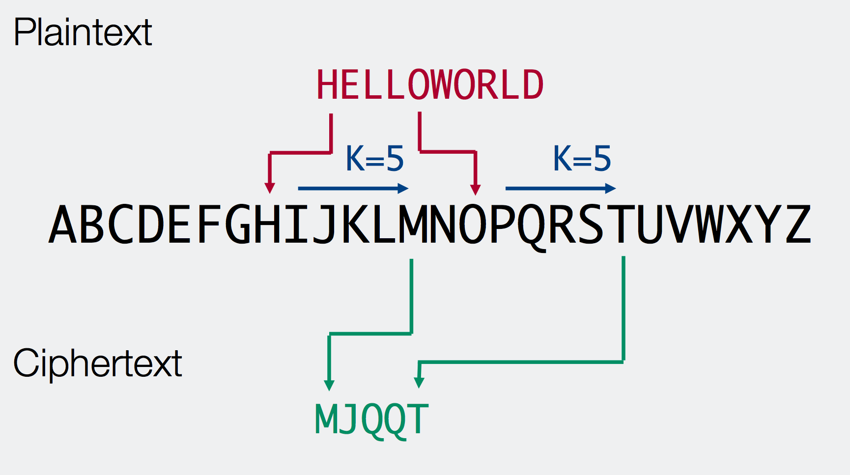
Caesar Cipher
We can now finish off the last part of our program – the actual Cipher code!
This is a basic substitution cipher that swaps an input letter with one given by a key:

Slide 59
Caesar Cipher (Ex 10)
Our code already 'sanitises' the input text so at this point we only need to worry about applying the actual cipher
Before this however, you should extend the parseCommandLine function to allow the user to provide a key – use 'int()' to convert from a string to an integer
As with the transliterate code, we'll tackle the caesar ciper by breaking up the problem into sections and doing each one in turn
You should create a new function (as given in the next slide) that takes an input string and key and returns the cipher text
Then, write code that does what each comment asks for
Make sure each bit of code does what is required by checking the variables before and after the additional code
When you're happy, move on to the next bit – you should only need ~1-2 lines of code per comment
Run your code over 'dickens.txt' with a key of 5 and compare your output to the 'dickens_cipher.txt' file using the 'diff' shell command as a check!

Slide 60
Caesar Cipher (Ex 10)
def runCaesarCipher( plain_text, key ):
'Apply the caesar cipher method on the given text'
# Create the alphabet container and output string
# Loop over the input text
# For each character find the corresponding position in the alphabet
# (use find or index depending on how you set up the alphabet)
# Apply the shift to the position, handling correctly potential wrap-around
# Determine the new character and add it to the output string
# Finally (after the loop), return the output string

Slide 61
12. Basic Data Analysis

Slide 62
Performing a Basic Data Analysis
Now we have covered the basics of Python, we'll now use that to cover a more practical example that will be more relevant to your research
The next few slides will take you through extracting data from a text file, plotting the results and then fitting a curve to the data
It will use a number of external modules: matplotlib, numpy and scipy
This is a fairly advanced example so do please ask for help if you need it!

Slide 63
Extracting Data from a Text File
The first step of this data analysis is to retrieve the appropriate data from a text file
I have already pre-generated some data that you can find in the 'data_analysis' folder in the git repo – datasets.txt
If you look at the file, you'll see 4 columns:
  The 'time' (x value) of the data point
  Value of an exponential (e^x) function
  Value of a 4th order polynomial
  Value of a gaussian/normal distribution
Note that the time values are not regular and there is some noise applied to each of the curves
Also, comments are denoted by a '#' at the start of the line

Slide 64
Extracting Data from a Textfile (Ex. 11)
You should create a new program file for this section
Then, code each of the following steps so you open the file and retrieve the data:
  Initialise 4 lists to take the 't' values and each of the 3 datasets
  Open the file and loop over each line (use 'readlines' here!)
  Ignore any line starting with '#' - don't forget how to access single characters!
  Split the line up into it's tokens
  Add each to the appropriate lists given it's position (use the 'float' function to convert the string to a number)
As before, you only need a few lines of code for each stage and you should test after each point to make sure it's working
You may find the following useful:
# Set up a string of words with white space
mystr = ' my test string'
# Remove whitespace/newlines from front and back
print mystr.strip()
# split up string into a list of the tokens
toks = mystr.split():

Slide 65
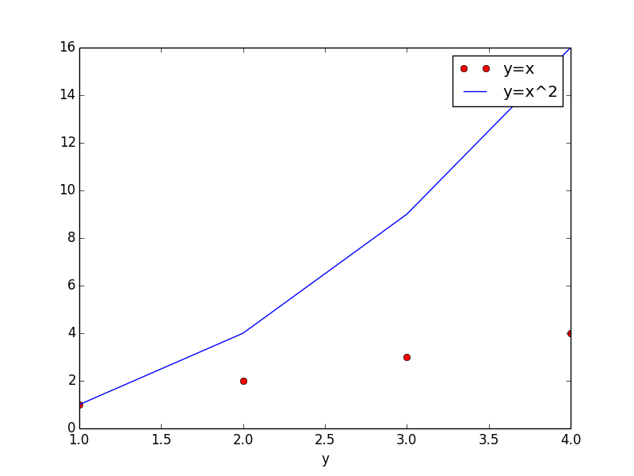
Plotting in Python
Now we have the data in lists we want to plot it
This is actually made quite easy thanks to the 'matplotlib' library
It has many ways of plotting data including contour plots, histograms, error bars, etc.
A typical example is:
I would highly recommend having a look at the documentation:
https://matplotlib.org/contents.html
# import the matplotlib library
import matplotlib.pyplot as plt
# plot an y=x curve with red circles
plt.plot([1,2,3,4], [1,2,3,4], 'ro', label='y=x')
# Add a y=x^2 curve as a blue line
plt.plot([1,2,3,4], [1,4,9,16], 'b-', label='y=x^2')
plt.xlabel('x')
plt.xlabel('y')
Plt.legend()
plt.show()

Slide 66
Plotting data from a file (Ex 12)
Using the code on the previous slide, you should now be able to extend your data analysis code to do the following:
  Import matplotlib
  Plot each of the three curves on the same axes
  They should be plotted with different coloured points
  Label the axes and provide a legend

Slide 67
Fitting in Python
All that's left to do in this basic data analysis is to fit the data to a given a model(s) to see what parameters are best
Again, this is made fairly simple for us by the external 'scipy' and 'numpy' modules that provide simple functions to do this
To use this function, you need to provide a model for the data and the data itself, and scipy will return the best fit parameters
You can then use these parameters to plot the resulting fit
See the next slide for an example of how to do it!
As with matplotlib, do go through the documentation to see what else is there:
https://www.scipy.org/docs.html

Slide 68
Fitting in Python
Note that we need to use the 'numpy' version of the exponential function to avoid problems when running the fit
import matplotlib.pyplot as plt
from scipy.optimize import curve_fit
import numpy as np
# assume we have a decaying exponential
def model(x, a, b, c):
return a * np.exp(-b * x) + c
# assume xdata and ydata are lists of the data and then do the fit
popt, pcov = curve_fit(model, xdata, ydata, bounds=([0, 0, 0], [3., 2., 1.])
# popt is now an array of the optimal values
# can just pass this to the model using the '*' operator to unpack
ydata_fit = []
for x in xdata:
ydata_fit.append( model(x, *popt) )
# can now plot the fitted data
plt.plot(xdata, ydata_fit, 'r-', label='fit')
Can specify bounds for the fit if you're having trouble getting it to converge

Slide 69
Fitting Models to the Data (Ex 13)
Again, as you already have the data in lists, you can apply the code in the previous slide to do a best fit for the 3 models:
  Set up 3 functions as the models for each dataset
    n0 * exp( lambda * x )
    a + x*b + x*x*c + x*x*x*d + x*x*x*x+e
    n0 * exp( -1 * (x – mu) * (x – mu) / (2 * sd * sd )
  Perform a fit on each to obtain the best parameters
  Plot these as (labelled) curves to your final plot
  Print out the best fit parameters for the 3 models
Note that you may need to specify bounds for the exponential fit to get a decent convergence!

Slide 70
Solutions and Links again!
To get the 'solutions' for the exercises, have a look at:
https://github.com/drmarkwslater/CCBPythonCourseSep2017Solutions
Main python documentation:
https://docs.python.org/2/
Good place to ask questions:
http://stackoverflow.com/
Google is very good as well!
My contact details:
Mark Slater <mslater(AT)cern.ch>, Physics West 317

