Slide 3
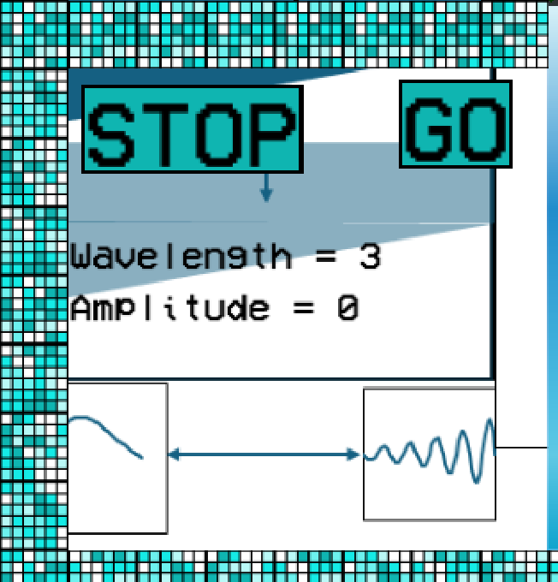

Slide 9
WAVEMAKERS

Slide 10
WAVEMAKERS

Slide 11


Slide 12


Slide 22
Pool noodle

Slide 24
Floaties

