Slide 1
Component Based Software Engineering - CBSE
Komponentinis programų sistemų projektavimas
sarunas@ieee.org

Slide 2
Why – Pick Two

Slide 3
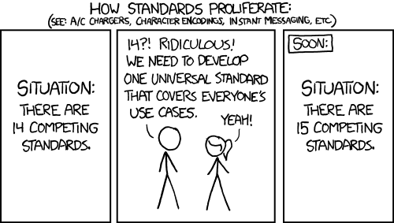
Not Invented Here

Slide 4
Software Development Trends
Chaotic software development is ending.
Developers do not want to do same things over again.
Software has to be created as quick as possible (time to market).
Object Oriented Design/ Programming is the most common one for now.
Software complexity stays the same due to increased requirements from users
Notes:
Necessity is the mother of invention definition

Slide 5
Couse work, Final grade
Project:
Design component or component-based system.
Document component: API, examples, license, user guide,
Implementation,
Usage examples
Final grade - 70%
Final presentation at the end of the semester
Project report
Monthly progress reports – verbal.
Exam/Test
Final grade - 30%

Slide 6
Course Projects
Types
Topics
Components
Systems from components.
UI widgets.
Game components.
…
CBL - New ways of modern energy consumer engagement

Slide 7
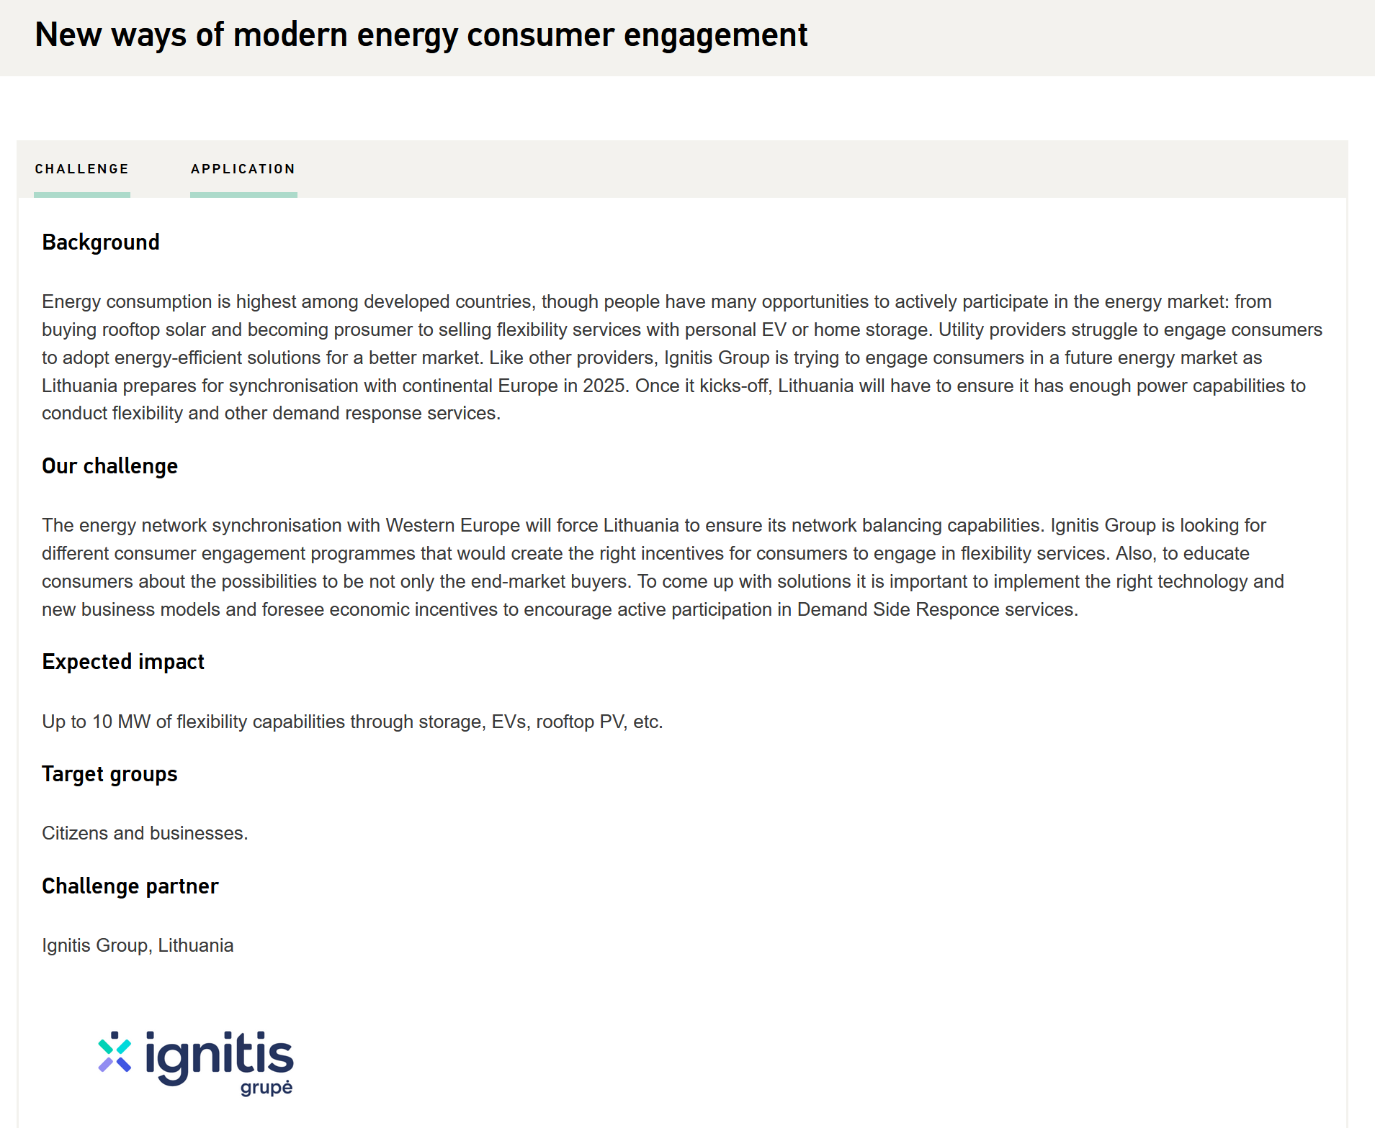
CBL - New ways of modern energy consumer engagement

Slide 8
Lecture Topics
Software development trends
CBSE Advantages and Disadvantages
Component markets
Definition of component
Component systems and technologies
Requirements for Component Systems

Slide 9
Software Development Trends
Chaotic software development is ending.
Developers do not want to do same things over again.
Software has to be created as quickly as possible (time to market).
Object Oriented Design/ Programming is the most common one, for now.
Software complexity stays at the same level due to increased requirements from users
Notes:
Necessity is the mother of invention definition

Slide 10
CBSE Process - Iterative

Slide 11
CBSE Advantages and Disadvantages
Advantages
Disadvantages
Software Development:
Reduced costs
Shorter time to market
Increased software reliability
Better maintenance
Improved quality
Due to components usage:
Lost flexibility – constrained business processes.
Lost uniqueness.

Slide 12
Components Search
Components search based on System Requirements.
Search in components stores.
Component's candidates are filtered by refining system requirements – functional and non functional.
Selected components rarely satisfy all requirements, therefore:
Requirements are refined
Architecture is reworked
New components are developed
Components are extended

Slide 13
Components Markets
The critical mass of buyers is necessary for components to appear.
No components – no buyers.
Components pushes out traditional software developers:
Components are updated, refined more rapidly.
Components are cheaper that specialized software solutions.
Not to lose market – software solutions have to be converted to components.

Slide 14
Definition of Component
Component :
Is an independent unit of deployment,
Is a composition unit from third parties,
Its internal state can not be observed externally.
Component scope varies:
From minimal functionality
To heavy weight subsystems.

Slide 15
Definition of Component - Alternative
Software component is:
a unit of composition,
has an interface and a contract,
has defined component’s dependencies.

Slide 16
Definition of object
Objects:
Have unique id,
Have state that can be observable from outside,
Encapsulates state and behaviour.
Component ban be exposed through objects.
Constructor defines initial object state.

Slide 17
Component and Object
Components can be build using objects.
Components are built with OOP classes, however:
That is not required,
Can be created using procedural, functional approaches.
Components can have a fixed set of objects that:
Define initial component state.
Contain components resources.

Slide 18
Examples of Components
GUI Library, ex.: CocoaTouch
public class Box { public int getSize(); };
Charting component – MonarchCharts
SQL Server
WebLogic application server
IIS Web server

Slide 19
Components System
Assembled from components.
Components can be:
Third party,
In-house.
Components are connected using a glue (programming, scripting language).

Slide 20
Requirements to Components System
Components
Glue
Components Platform
Licensing tools
Messages Service
Transactions Support
Components Interface Definition Language
Multithreading Support
Events Support

Slide 21
Component Technologies
.NET (-assembly)
JavaBeans (.jar)
EJB
CORBA
VBX, OLE, COM, ActiveX, COM+

Slide 22
Summary
Components are composition units having defined interfaces and dependencies.
Software component can be independently deployed and used together with other components.
Software development consists of:
Architecture definition,
Components selection,
Architecture refining.
Components need component platforms to function.

Slide 23
References
Colin Atkinson, Christian Bunse, Hans-Gerhard Gross, Christian Peper. Component-Based Software Development for Embedded Systems: An Overview of Current Research Trends, Springer, ISBN 978-3540306443, 2005, 353p.
Ivica Crnkovic, Magnus Larsson, Building Reliable Component-Based Software Systems, 2002, 452p.
Clemens Szyperski. Component Software: Beyond Object-Oriented Programming. Addison-Wesley Professional, 2002, ISBN 978-0201178883, 411p.

Slide 24




Komponentinis programų sistemų projektavimas
Projektas „Aukštojo mokslo I ir II pakopų informatikos ir informatikos inžinerijos krypčių studijų programų atnaujinimas bei naujų sukūrimas ir įgyvendinimas (AMIPA)“, projekto kodas VP1–2.2–ŠMM–09–V–01–003, finansuojamas iš Europos socialinio fondo ir Lietuvos valstybės biudžeto lėšų.

