Slide 1
Component System Architecture
Components Platforms

Slide 2
Topics
Licenses Service
Messages Service
Transactions
Interfaces
Threading
Persistence
Events Service

Slide 3
Components Frameworks
Technical Frameworks
Industrial Frameworks
Application Frameworks

Slide 4
Middle-ware
Components can not be used stand-alone.
Components must be composed by combining them into a system.
Middle-ware allows to combine components together.
Middle-ware coordinates components interactions by providing:
transactions,
persistence,
threading,
events,
messages.

Slide 5
Concept of a Component System

Slide 6
Component Platform
Coordinates components interaction
Let’s assume a problem related to COM+ and .NET technologies usage:
How to call object’s method
That is implemented in a Visual Basic (not .NET) language,
That is not thread-safe,
from a C++ component
And display C++ component’s user interface in a browser’s window?
Possible solution: use COM platform that:
ensures thread-safe calls,
Wraps calls between C++ and VB components,
Allows to use JavaScript for results presentation with-in a HTML DOM model.

Slide 7
Component Model
Component must satisfy several conditions.
Has to implement specific interface:
Ex: IUnknown (COM/ActiveX),
Ex: Extends Object, RemoteObject.
Should be provided in binary form:
.dll (COM, .NET),
.jar (Java, EJB, JavaBean).
Provide its interface in common format:
Meta-data (.NET),
IDL (Corba, COM).

Slide 8
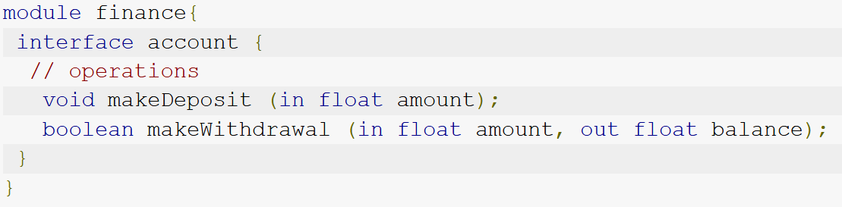
Interface
For components interaction, it is necessary:
To have an interface aggreged between components
It must be implemented
Additional interfaces that are required by components platform must be implemented.

Slide 9
COM Interfaces Example
Notes:
Cia galima prie sitos visa paskaita sneketi ☺
Kodel COM seniena, Java, .NET paslepia visos komponentines platformos vidurius nuo developerio, (it just works, developeris net nezino kodel ir kaip)

Slide 10
Licenses Server
Developers would like to:
Limit component’s usage based on sold licenses count.
Provide trail versions of components.
Licenses Server
Additional component in a component platform.
Handles components lifecycle.
Performs licenses, certificates, serial numbers management.

Slide 11
Messages
How does developer can make a call to a component that resides
In a remote server,
In a same process,
In a separate process.
new PhysicEngine().RunSimulation();
Same code in all cases. How?
All is done by middle-ware.

Slide 12
Message

Slide 13
Message (same process)
Component’s binary code is loaded into the same process and a call is made as a regular code call (same memory address space):
.dll,
.jar,
Staticly linked library.

Slide 14
Message (inter-process)
Definitions:
server – process that hosts component.
client – process that uses component.
Component platform intercepts calls and:
Generates proxy object for a client.
Generates stub component for a server.
Proxy component is transparently called by a client.
Stub component makes a call to an actual component.
Component platform:
Accepts messages from cient components and routes messages to server components,
Translates message formats from one type to other (ex. converts pointers, data types).

Slide 15
Messages (remote)
Same as inter-process messages:
Messages are serialized to network format,
Transferred over network,
De-serialized to a binary format that is suitable for a server component.
Examples: XML, RESET Services
Messages are serialized as XML (SOAP format) or JSON;
Data is transferred over HTTP;
Server deserializes message to a binary format;
De-serialized data is passed to server component.

Slide 16
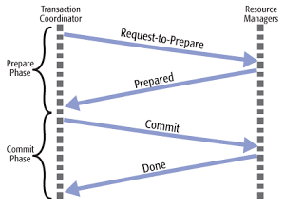
Transactions
Assume two components that work with separata databases.
Systems uses both components.
System performs action that calls both components.
System’s action must be atomic – components must update both database or neither of them.
Problem – components have no relegation between them
Component platform can make this action atomic.
Both components must implement additional component platform specific interface.
Ex: „two phase commit“ protocol.

Slide 17
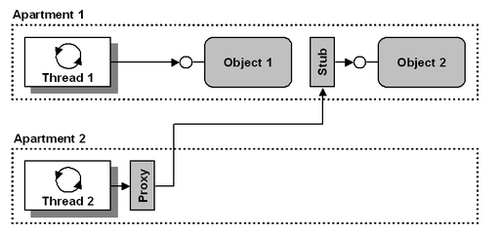
Threading
Assuming server component is not thread-safe.
How can developer ensure that clients would not crash, break server component?
Component platform inserts stub and proxy objects that
Are used even inside-process situation,
If it is necessary, they serialize method calls.

Slide 18
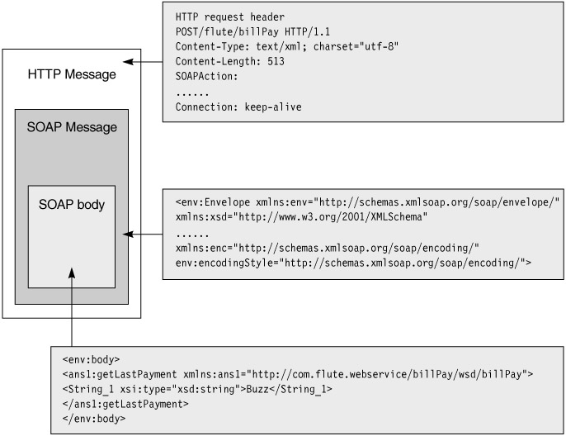
Persistence
A.K.A. serialization, de-serialization
How can object state be passed to remote object?
Component platform can serialize object to disk or memory based on certain rules and can transport over network.
Ex, object can be serialized as
XML, passed as a document to a
XML web service.
EX. REST call with JSON data.

Slide 19
Events
Components can get
messages when something
happens on a remote component.
Event interface is defined.
Clients implement the interface.
Clients pass interface references to a server. (registration for events).
Server calls all registered interfaces then event happens.
Remote component?
Registration and calls are handled by component platform (stub, proxy again),
Additional constrains are added for clients and servers (ex.: additional interfaces are required).

Slide 20
Summary
Components can not be used without components platform.
Components must play by platform’s rules.
Platform provides handy services:
licensing,
transactions,
threads,
events,
messages,
persistence.
Components define interfaces and are used through them.

Slide 21
References
Colin Atkinson, Christian Bunse, Hans-Gerhard Gross, Christian Peper. Component-Based Software Development for Embedded Systems: An Overview of Current Research Trends, Springer, ISBN 978-3540306443, 2005, 353p.
Ivica Crnkovic, Magnus Larsson, Building Reliable Component-Based Software Systems, 2002, 452p.
Clemens Szyperski. Component Software: Beyond Object-Oriented Programming. Addison-Wesley Professional, 2002, ISBN 978-0201178883, 411p.

Slide 22
Komponentų sistemos architektūra
Komponentinė platforma
Projektas „Aukštojo mokslo I ir II pakopų informatikos ir informatikos inžinerijos krypčių studijų programų atnaujinimas bei naujų sukūrimas ir įgyvendinimas (AMIPA)“, projekto kodas VP1–2.2–ŠMM–09–V–01–003, finansuojamas iš Europos socialinio fondo ir Lietuvos valstybės biudžeto lėšų.

