Slide 1
Components Design

Slide 2
Topics
Component Contract (specification and its purpose)
Interface Design
Events design
Problems
Multithreading

Slide 3
Component Design
Component must play by Component Platform rules (ex:, implement IUnknown interface).
Component is for third parties use. Some aspects must by accounted for:
Stable and elegant interface,
Version control,
Documentation,
Defect free component's behaver in various deployment environments.
Correct implementation of components functionality.

Slide 4
Component’s Contract (specification and importance)
Contract:
Defines interface;
Can implement multiple interfaces;
Defines interfaces that are required from other components.
Full contract in some cases can not be fully defined by interface
(IDL, C++, or Java), part of it is defined in documentation:
Usage scenarios
constraints

Slide 5
Defining Interface

Slide 6
IDL Interface
module AudioEngine
{
interface ITrack
{
oneway void play();
oneway void stop();
};
interface ISound
{
oneway void play();
oneway void stop();
oneway void setPosition(float x, float y, float z);
};
interface IAudio
{
ISound createSound(string fileName);
ITrack createTrack(string fileName);
};
};

Slide 7
Generating Component
Component’s stub can be generated from its IDL specification.
Reverse approach:
Implement component;
Mark interfaces that are component’s public interface;
Component Platform hides private interfaces.
Users get only public/marked interfaces.

Slide 8
Component Permissions
Component is a black box for a user.
How to be sure that it does only what is defined in a contract?
Does it contain some malicious code?
Component’s trust:
Developer’s reputation;
Source code availability;
Reviews;
Component platform sandbox:
Component declares required permissions;
Application declares available permissions;
Component platform ensures that all actions are performed according granted permissions.

Slide 9
Component Permissions
File System Access.
Isolated Storage Access.
Network Access.
User Data Access.
Registry Access.
Active Directory Access.
...
No permissions
Refuse to load component,
Show error message.

Slide 10
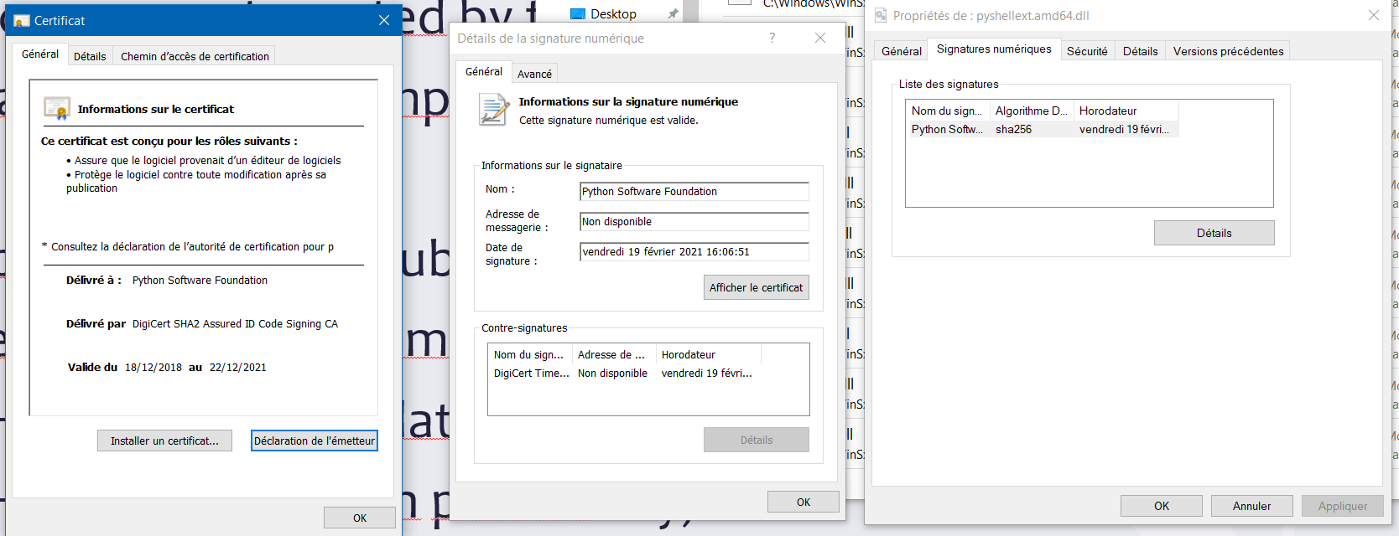
Certificates
Component is obtained from market. Questions:
Is component created by the specified developer?
Was component tampered?
Cryptography, hash, public private keys:
Developer signs component with a private key:
Hash code is calculated of component’s bytes;
Hash is signed with private key;
Signature and developer certificate is added to the component.
User can verify component by developer's public key

Slide 11
Designing Interface
Component’s features are accessed through interfaces.
Can be object oriented (not supported by every platform).
Developer must adhere to platform’s constraints.
Ex:, IDispatch interface must be implemented if component should be accessible from JavaScript or VBSript (COM).
Design patterns can be of use when designing and implementing a component:
factory,
adapter,
MVC,
proxy.
…

Slide 12
Events Interface
How can component notify other components about completion of some tasks?
Component platform defines additional interfaces for events implementations.

Slide 13
Implementing Events
There could be more than one event subscriber.
While raising event, It is not recommended to:
Change components state (sender),
Call components methods (subscriber).
Component should pass all relevant data with an event.
Component should not change its state.

Slide 14
Fragile Class Problem
Component provides a class that is used by many clients.
That class is modified:
All clients are broken;
All classes that expend this class are broken.
Solutions:
Deny inheritance,
Do not modify class,
Use only unchanged interfaces,
Use correct component versions.

Slide 15
Interface Stability
We have component version 1.0
Version 2.0 is released
It has many fixes and improvements.
Clients' expectations:
Replace component (ex:. overwrite component file);
All work as before (no recompile);
Old bugs vanished;
New features can be used.

Slide 16
Interface Stability (what really happens)
After update, everything is broken:
Some classes are deleted;
Some methods require additional parameters;
Some methods works in a different way than before.
Common situation for free components:
Rapid evolution brakes backword compatibility.

Slide 17
Interface Stability
How can wildly used interface be removed?
How can wildly used interface be changed?
Versioning Strategy:
Components have versions.
Each modification gets new version.
Clients are bound to specific version.
Side by side deployment.
Deny interface change.
Interface deprecation strategy.

Slide 18
Interface Change Strategy
Legacy interfaces must be marked as deprecated, not recommended for use
Interfaces must still be supported and maintained.
Implement compatibility layer – move deprecated interfaces there.
Remove deprecated interfaces.
Allow customers to obtain older component versions.

Slide 19
Multithreading
Component can be signed for single-threaded environment.
Can this component be used in multi-threaded environment?
Component Platform solves the problem:
Component declares suitable threading model;
Client declares available threading model;
Component Platform inserts synchronization code, if necessary.
(.NET, COM – Apartment models)

Slide 20
Summary
Components must be designed according Component Platform rules.
Stable interface is important.
Interface change must be planned.

Slide 21
References
Colin Atkinson, Christian Bunse, Hans-Gerhard Gross, Christian Peper. Component-Based Software Development for Embedded Systems: An Overview of Current Research Trends, Springer, ISBN 978-3540306443, 2005, 353p.
Ivica Crnkovic, Magnus Larsson, Building Reliable Component-Based Software Systems, 2002, 452p.
Clemens Szyperski. Component Software: Beyond Object-Oriented Programming. Addison-Wesley Professional, 2002, ISBN 978-0201178883, 411p.
Erich Gamma, Richard Helm, Ralph Johnson, John Vlissides. Design Patterns: Elements of Reusable Object-Oriented Software. Addison Wesley. 1994. ISBN-13: 978-0201633610. 416p.s

Slide 22




Komponentų kūrimas
Projektas „Aukštojo mokslo I ir II pakopų informatikos ir informatikos inžinerijos krypčių studijų programų atnaujinimas bei naujų sukūrimas ir įgyvendinimas (AMIPA)“, projekto kodas VP1–2.2–ŠMM–09–V–01–003, finansuojamas iš Europos socialinio fondo ir Lietuvos valstybės biudžeto lėšų.

