Slide 1
Creating Components
Design Patterns

Slide 2
Topics
Design Patterns:
Abstract Factory
Proxy
Adapter
Model View Controller

Slide 3
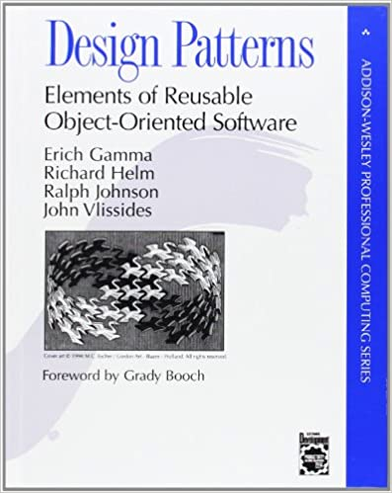
Design Patterns
Solutions for most common architecture problems.
Reuse of component architecture instead of a component itself.

Slide 4
Proxy
Goal – provide a surrogate component, that could limit, control, restrict access to real component.

Slide 5
Proxy - Members
Proxy - maintains a reference that lets the proxy access the real subject.
Proxy may refer to a Subject if the RealSubject and Subject interfaces are the same.
provides an interface identical to Subject's so that a proxy can by substituted for the real subject.
controls access to the real subject and may be responsible for creating and deleting it.
Subject - defines the common interface for RealSubject and Proxy so that a Proxy can be used anywhere a RealSubject is expected.
RealSubject - defines the real object that the proxy represents.

Slide 6
Proxy – Result
remote proxies are responsible for encoding a request and its arguments and for sending the encoded request to the real subject in a different address space.
virtual proxies may cache additional information about the real subject so that they can postpone accessing it.
protection proxies check that the caller has the access permissions required to perform a request.

Slide 7
Proxy - Example

Slide 8
Adapter
Goal – convert component interface to the expected interface.
Adapter pattern allows to integrate incompatible components together.

Slide 9
Adapter - Structure
Can be implemented by
inheritance,
aggregation.

Slide 10
Adapter - Members
Target
defines the domain-specific interface that Client uses.
Client
collaborates with objects conforming to the Target interface.
Adaptee
defines an existing interface that needs adapting.
Adapter
adapts the interface of Adaptee to the Target interface.

Slide 11
Adapter - Results
A class adapter
adapts Adaptee to Target by committing to a concrete Adapter class. As a consequence, a class adapter won't work when we want to adapt a class and all its subclasses.
lets Adapter override some of Adaptee's behavior, since Adapter is a subclass of Adaptee.
introduces only one object, and no additional pointer indirection is needed to get to the adaptee.
An object adapter
lets a single Adapter work with many Adaptees—that is, the Adaptee itself and all of its subclasses (if any). The Adapter can also add functionality to all Adaptees at once.
makes it harder to override Adaptee behavior. It will require subclassing Adaptee and making Adapter refer to the subclass rather than the Adaptee itself.

Slide 12
Adapter - Example

Slide 13
Adapter - Example

Slide 14
Abstract Factory
Goal – provide interfaces that allow creating a family of related objects with our revealing their actual implementation classes.

Slide 15
Abstract Factory - Members
AbstractFactory
declares an interface for operations that create abstract product objects.
ConcreteFactory
implements the operations to create concrete product objects.
AbstractProduct
declares an interface for a type of product object.
ConcreteProduct
defines a product object to be created by the corresponding concrete factory.
implements the AbstractProduct interface.
Client
uses only interfaces declared by AbstractFactory and AbstractProduct classes.

Slide 16
Abstract Factory - Results
Isolates concrete classes.
Makes exchanging product families easy.
Promotes consistency among products.
Supporting new kinds of products is difficult.

Slide 17
Abstract Factory – Example

Slide 18
Abstract Factory - Example

Slide 19
Abstract Factory - Example
Loader can be changed with a single line of code.

Slide 20
Model View Controller
Goal – separate data, its presentation, and control from each other.

Slide 21
MVC - Observation
Objects are separated in a way that changes on data can invoke views updates, however data objects do not have any knowledge of view objects.
View is separated from data.
Observer design pattern

Slide 22
MVC - Model
A set of objects can behave as a single one.
Composite design
pattern

Slide 23
MVC - Control
Controller and view interaction can be implemented as Strategy Design patterns
Strategy encapsulates data/model manipulation algorithm.
Data manipulation algorithm can be changed on the fly.

Slide 24
Summary
Useful design patterns for components creation and usage: proxy, adapter, abstract factory, MVC.
MVC separates data, view, and controlling components from each other.
Proxy impersonates the actual component. Can be used for restricting or allowing remote access to component.
Adapter allows to integrate components having incompatible interfaces.

Slide 25
References
Erich Gamma, Richard Helm, Ralph Johnson, John Vlissides. Design Patterns: Elements of Reusable Object-Oriented Software. Addison Wesley. 1994. ISBN-13: 978-0201633610. 416p.s

Slide 26




Komponentų kūrimas
Projektavimo pavyzdžiai
Projektas „Aukštojo mokslo I ir II pakopų informatikos ir informatikos inžinerijos krypčių studijų programų atnaujinimas bei naujų sukūrimas ir įgyvendinimas (AMIPA)“, projekto kodas VP1–2.2–ŠMM–09–V–01–003, finansuojamas iš Europos socialinio fondo ir Lietuvos valstybės biudžeto lėšų.

