Slide 1
.NET Framework

Slide 2
Topics
Virtual Machine
Assemblies
COM+
Transactions
Threads
Events
Exceptions
Platform Services
XML Web Services
Garbage Collector
Reflection
Interaction with other Component Platforms

Slide 3
Component Technologies
Microsoft .NET
Oracle Java
CORBA
COM/ActiveX

Slide 4
.NET Framework

Slide 5
.NET Framework
Component platform aspects:
Common type system,
Intermediate code,
Virtual machine,
Assemblies,
Reflection.

Slide 6
Framework Types
.NET Framework
.NET Client Profile
.NET Compact Framework
.NET Micro Framework
.NET Core – new cool stuff..
.NET Framework 7 – even newer …

Slide 7
Common Type System

Slide 8
Virtual Machine
Common types
Intermediate code
„Just in time“ compiling
Components can run on any platform, CPU architecture
Garbage Collector
Solves memory management problems.
C#, VB.NET, C++
Any* language can be used for components development.

Slide 9
Exceptions
Instead of result code checking (HREULT)
try
{
// many lines of code
}
catch (Exception ex)
{
// error handling code
}
Works between components, over network, etc..
Achieved using Remoting, XML web services.

Slide 10
Threading
Common interface for parallel programming in all languages.
All components use same API for parallel programming:
Threads,
Semaphores,
Locks.
Critical section using a lock Object
lock(objectA)
{
}

Slide 11
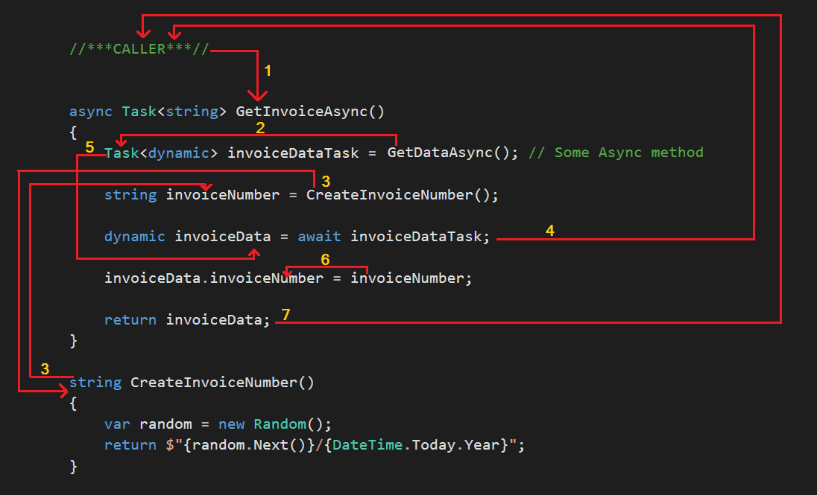
Threading Async – looks like serial code

Slide 12
Events
Standardized interface for events subscription, raising.
Some syntax sugar for call-back interface pattern.
delegate void ChangedEventHandler(object sender, EventArgs e);
public event ChangedEventHandler Changed;
object.Changed += new ChangedEventHandler(ListChanged);
object.Changed -= new ChangedEventHandler(ListChanged);
Changed(this, EventArgs.Empty);

Slide 13
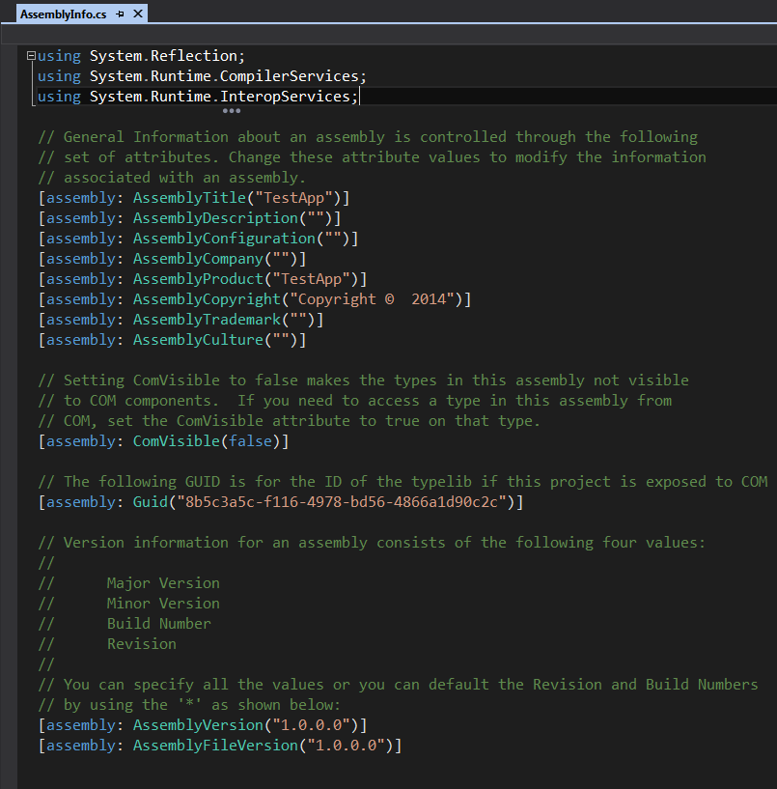
Assemblies
.NET components
.dll
.exe
Version management
Component declares its version number.
App declares linked version numbers.
Platform matched required components.
Digital signature

Slide 14
Remoting
class MyRemoteObject : MarshalByRefObject
[Serializable]

Slide 15
Remoting
Accessing component over the network
Proxy design pattern
Server:
ChannelServices.RegisterChannel (new TcpChannel(1500));
MyRemoteObject rb = new MyRemoteObject();
RemotingServices.Marshal (rb, "TestService");
Client:
MyRemoteObject rb = (MyRemoteObject) Activator.GetObject(typeof(MyRemoteObject), "tcp://host:1500/TestService");
rb.hello()
Fast, binary protocol.

Slide 16
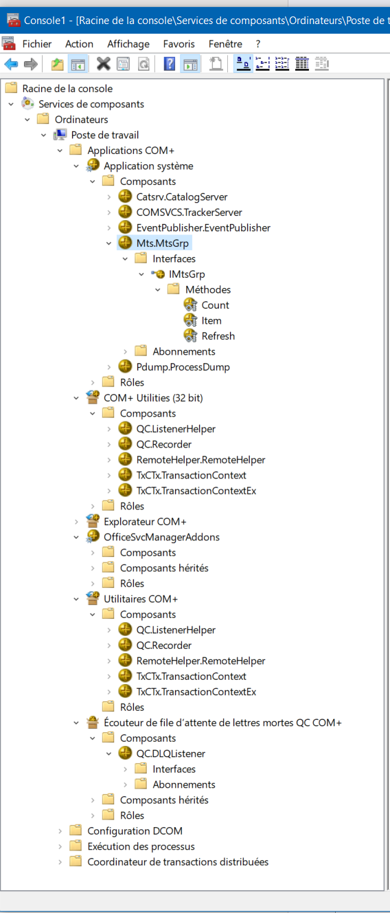
Enterprise Services
COM+
Transactions
MyClass : ServicedComponent;
[Transaction(TransactionOption.Required)]
[Synchronization(SynchronizationOption.Required)]
[JustInTimeActivation(true)]
public class Account : ServicedComponent { … }
Sufficient to apply attributes only

Slide 17
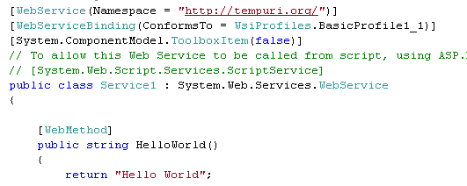
XML Web Services
Remote components.
Uses SOAP.
Regular class with a [WebMehod] attribute.
.NET uses IIS server.
REST Services are also available

Slide 18
Relation to other platforms
XML web services/ REST services
Standard based. (open standards).
Interoperability between Java, PHP, etc..
COM
[assembly: ComVisible(true)] - .NET component exposed to COM components.
COM components get .NET wrappers.
PInvoke
C functions can be accessed from .dll libraries.
Managed C++
Mix of native and managed c++ code.

Slide 19
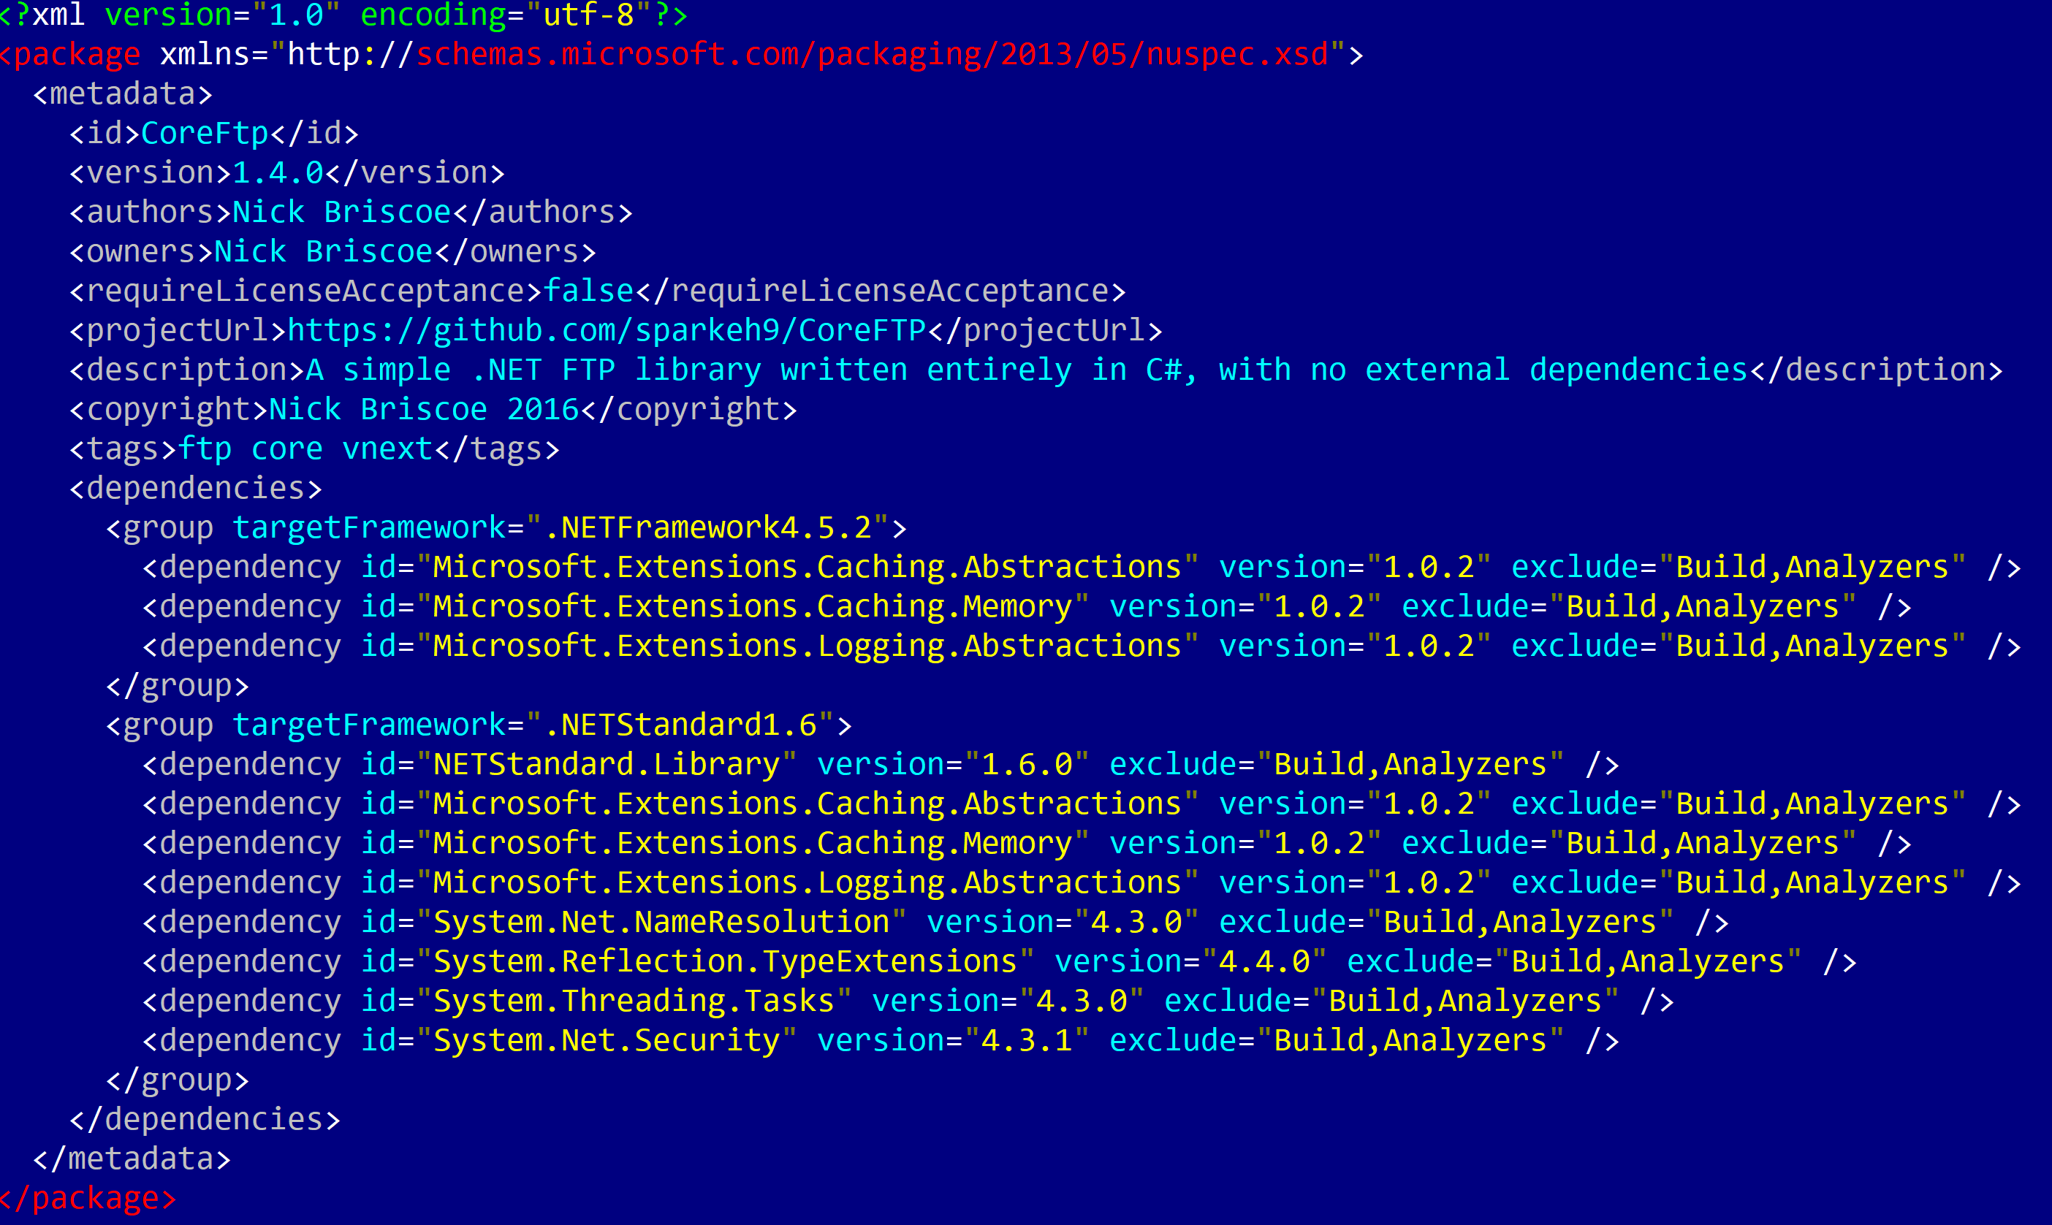
Package Manager
https://www.nuget.org/
Component packed in .npkg file (zip)
+ Component description
Actual component has more information in its meta-data.

Slide 20
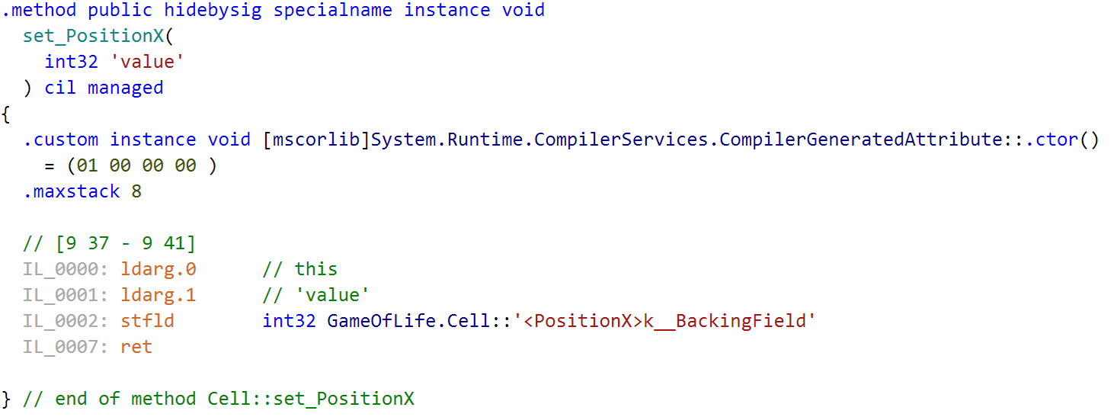
Summary
.NET is based on Virtual Machine and intermediate language code.
Provides components version management, digital signatures.
Interfaces are defined using common type system.
Provides standardized parallel programming api.
Interoperability with other platform can be achieved using web services, pinvoke.

Slide 21
References
Colin Atkinson, Christian Bunse, Hans-Gerhard Gross, Christian Peper. Component-Based Software Development for Embedded Systems: An Overview of Current Research Trends, Springer, ISBN 978-3540306443, 2005, 353p.
Ivica Crnkovic, Magnus Larsson, Building Reliable Component-Based Software Systems, 2002, 452p.
Clemens Szyperski. Component Software: Beyond Object-Oriented Programming. Addison-Wesley Professional, 2002, ISBN 978-0201178883, 411p.
Jeffrey Richter. Applied Microsoft .NET Framework Programming. Publisher: Microsoft Press. ISBN-13: 978-0735614222. 2002. 632p.

Slide 22




.NET Framework
Projektas „Aukštojo mokslo I ir II pakopų informatikos ir informatikos inžinerijos krypčių studijų programų atnaujinimas bei naujų sukūrimas ir įgyvendinimas (AMIPA)“, projekto kodas VP1–2.2–ŠMM–09–V–01–003, finansuojamas iš Europos socialinio fondo ir Lietuvos valstybės biudžeto lėšų.

