Slide 1
Components Quality

Slide 2
Topics
Testing Problems
Integrated Components Tests
Assertion Tests
Component Contract Test
Component Test Interface
Component System Testing

Slide 3
Testing Problems
Component works in unknown context.
Developers can only guess about component's usage.
Component is a black box.
Reduced testability and controllability.
Sufficient component testing:
How much testing is needed by user?
How much testing is needed by developer?

Slide 4
Integrated Components Tests
Tests are provided with a component.
Tests are provided by component developer.
Tests check if component is used correctly – validates user data.
Tests check if component calculates correct response.
Component checks if environment is satisfactory:
Are all dependencies met?
Are all platform services available?

Slide 5
Assertions and Testing
Assertions are not testing.
Assertions are using during development and integration.
Reassembles hardware self-check tests.
Assertions are added to component code and are validated on each use..

Slide 6
Assertion Types
Method: preconditions.
Method: postconditions.
Object: invariants.

Slide 7
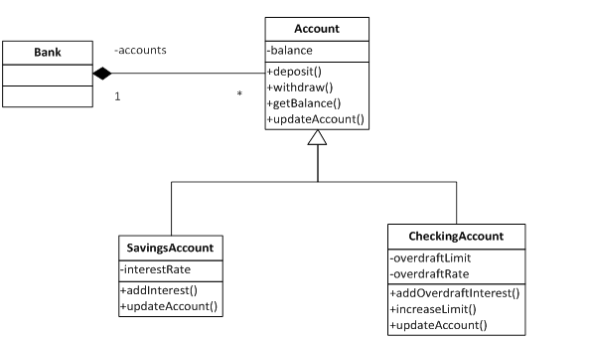
Bank Example

Slide 8
Assertions in Code

Slide 9
Component Usage
Integrated with other components.
Provides interfaces.
Requires interfaces.
Component does not know what components will be connected to it.

Slide 10
Component Contract
Server contract
Works as defined in component specification.
Client contract
Component works as it is expected from it in a component system.

Slide 11
Component Testing
Developer uses same testing methods (white, black box, ...).
Developer tests according component’s specification:
Imitates possible environments and tests in them.
Provides tests with a component.
Client tests if component works as expected.

Slide 12
Contract Test
Component expects:
Does environment provide expected services?
Does dependent components work as expected?
Component is provided with contract tests.
Component is integrated into client context.
Included component tests ate executed.
Tests check if environment matches expectations.

Slide 13
Component Tests Steps
Setting initial state.
Passing test date.
Using component services.
Checking component state.
Validating component response.

Slide 14
Candy Vending Machine

Slide 15
Candy Vending – CoinsCollector Interface

Slide 16
Coins Collector Tests
Start collection (need 2.5 Eur).
Insert 1 Eur coin.
Insert 2 Eur coin.
Stop collection.
Check collected amount.
Expects: 2.5 Eur.

Slide 17
Test Problem
Missing insertCoin method – internal state can not be observed or manipulated.
Solutions:
State is changed using existing component’s interface.
Component is provided with a testing interface.

Slide 18
Testing Interface Design
Special purpose-built testing interface:

Slide 19
Providing Testing Interfaces
All-in-One, convenient.
Two components:
Component
And Component with a contract testing.
After resting redundant components can be removed.

Slide 20
Integrated Contract Testing Model

Slide 21
Component System Testing
Components are tested in isolation.
Combine components – integration testing.
Combine more components – integration testing.
Full system test.

Slide 22
Summary
Developers test to component’s specification.
Users perform contract tests:
Checks if components works as expected.
Developer provides testing interface and tests.
No changes in full system testing.

Slide 23
References
Gross, H.-G., Component-Based Software Testing with UML. 2010, Berlin: Springer.
Beydeda, S. Self-testability in unit testing. 2005.
64. Canna, J. Testing, fun? Really?: Using unit and functional tests in the development process. 2001 2010-09-10]; Available from: http://www-128.ibm.com/developerworks/library/j-test.html.
Louridas, P., JUnit: unit testing and coding in tandem. Software, IEEE, 2005. 22(4): p. 12-15.
Binder, R.V., Testing Object-Oriented Systems: Models, Patterns, and Tools. 2003, Boston: Addison-Wesley Professional. 1248.

Slide 24




Komponentų kokybė
Projektas „Aukštojo mokslo I ir II pakopų informatikos ir informatikos inžinerijos krypčių studijų programų atnaujinimas bei naujų sukūrimas ir įgyvendinimas (AMIPA)“, projekto kodas VP1–2.2–ŠMM–09–V–01–003, finansuojamas iš Europos socialinio fondo ir Lietuvos valstybės biudžeto lėšų.

