Slide 1
ETL for Pros Getting Data into MongoDB

Slide 2
André Spiegel
Principal Consulting Engineer
MongoDB
@drmirror

Slide 3

Remember this?

Slide 4
Sound familiar?
At some point, most applications need to batch-load large amounts of data
billions of documents
huge initial load
daily updates

Slide 5
Sound familiar?
{
"_id" : "admin.mongo_dba",
"user" : "mongo_dba",
"db" : "admin",
"roles" : [
{ "role" : "root", "db" : "admin" },
{ "role" : "restore", "db" : "admin" }
]
}
Using MongoDB properly means complex documents
[
{ "$sort" : { "st": 1 } },
{
"$group" : { "_id" : "$st",
"start" : { "$first" : "$ts" },
"end" : { "$last" : "$ts" } }
}
]

Slide 6
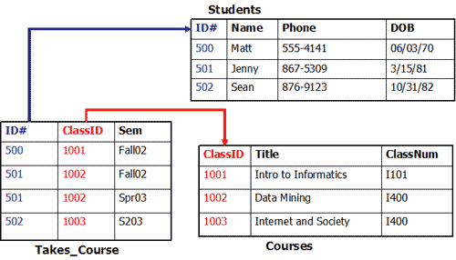
Sound familiar?
How do I create these documents from relational tables?

Slide 7

Sound familiar?
How do I do it fast?
Image: Julian Lim

Slide 8
I've done this for a few years
I've seen people do it
We all make the same mistakes
Let's understand them and come up with something better

Slide 9
Case Study

Slide 10
ORDERS
ID
FIRST_NAME
LAST_NAME
SHIPPING_ADDRESS
1
James
Bond
Nassau, Bahamas, US
2
Ernst
Blofeldt
Caracas, Venezuela
ITEMS
ID
ORDER_ID
QTY
DESCRIPTION
PRICE
1
1
1
Aston Martin
120,000
2
1
1
Dinner Jacket
4,000
3
1
3
Champagne Veuve-Cliquot
200
4
2
100
Cat Food
1
5
2
1
Launch Pad
1,000,000
TRACKING
ORDER_ID
TIMESTAMP
STATUS
1
1985-04-30 09:48:00
ORDERED
2
1985-04-23 01:30:22
ORDERED
2
1985-04-25 08:30:00
SHIPPED
2
1985-05-14 21:37:00
DELIVERED

Slide 11
ORDERS
ID
FIRST_NAME
LAST_NAME
SHIPPING_ADDRESS
1
James
Bond
Nassau, Bahamas, US
2
Ernst
Blofeldt
Caracas, Venezuela
ITEMS
ID
ORDER_ID
QTY
DESCRIPTION
PRICE
1
1
1
Aston Martin
120,000
2
1
1
Dinner Jacket
4,000
3
1
3
Champagne Veuve-Cliquot
200
4
2
100
Cat Food
1
5
2
1
Launch Pad
1,000,000
TRACKING
ORDER_ID
TIMESTAMP
STATUS
1
1985-04-30 09:48:00
ORDERED
2
1985-04-23 01:30:22
ORDERED
2
1985-04-25 08:30:00
SHIPPED
2
1985-05-14 21:37:00
DELIVERED

Slide 12
ORDERS
ID
FIRST_NAME
LAST_NAME
SHIPPING_ADDRESS
1
James
Bond
Nassau, Bahamas, US
2
Ernst
Blofeldt
Caracas, Venezuela
ITEMS
ID
ORDER_ID
QTY
DESCRIPTION
PRICE
1
1
1
Aston Martin
120,000
2
1
1
Dinner Jacket
4,000
3
1
3
Champagne Veuve-Cliquot
200
4
2
100
Cat Food
1
5
2
1
Launch Pad
1,000,000
TRACKING
ORDER_ID
TIMESTAMP
STATUS
1
1985-04-30 09:48:00
ORDERED
2
1985-04-23 01:30:22
ORDERED
2
1985-04-25 08:30:00
SHIPPED
2
1985-05-14 21:37:00
DELIVERED

Slide 13
{
"first_name" : "James",
"last_name" : "Bond",
"address" : "Nassau, Bahamas, US",
"items" : [
{ "qty": 1, "description" : "Aston Martin", "price" : 120000 },
{ "qty": 1, "description" : "Dinner Jacket", "price" : 4000 },
{ "qty": 3, "description" : "Champagne Veuve-Cliquot", "price": 200 }
],
"tracking" : [
{ "timestamp" : "1985-04-30 09:48:00", "status": "ORDERED" }
]
}

Slide 14
{
"first_name" : "James",
"last_name" : "Bond",
"address" : "Nassau, Bahamas, US",
"items" : [
{ "qty": 1, "description" : "Aston Martin", "price" : 120000 },
{ "qty": 1, "description" : "Dinner Jacket", "price" : 4000 },
{ "qty": 3, "description" : "Champagne Veuve-Cliquot", "price": 200 }
],
"tracking" : [
{ "timestamp" : "1985-04-30 09:48:00", "status": "ORDERED" }
]
}

Slide 15
{
"first_name" : "James",
"last_name" : "Bond",
"address" : "Nassau, Bahamas, US",
"items" : [
{ "qty": 1, "description" : "Aston Martin", "price" : 120000 },
{ "qty": 1, "description" : "Dinner Jacket", "price" : 4000 },
{ "qty": 3, "description" : "Champagne Veuve-Cliquot", "price": 200 }
],
"tracking" : [
{ "timestamp" : "1985-04-30 09:48:00", "status": "ORDERED" }
]
}

Slide 16
{
"first_name" : "James",
"last_name" : "Bond",
"address" : "Nassau, Bahamas, US",
"items" : [
{ "qty": 1, "description" : "Aston Martin", "price" : 120000 },
{ "qty": 1, "description" : "Dinner Jacket", "price" : 4000 },
{ "qty": 3, "description" : "Champagne Veuve-Cliquot", "price": 200 }
],
"tracking" : [
{ "timestamp" : "1985-04-30 09:48:00", "status": "ORDERED" }
]
}

Slide 17
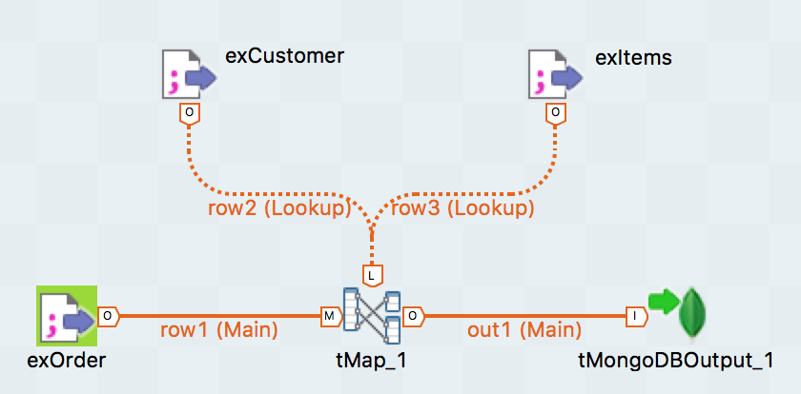
How do I get from relational to JSON?
ETL Tools: Talend, Pentaho, Informatica, ...
Gretchen's Question: How do you handle arrays?

Slide 18
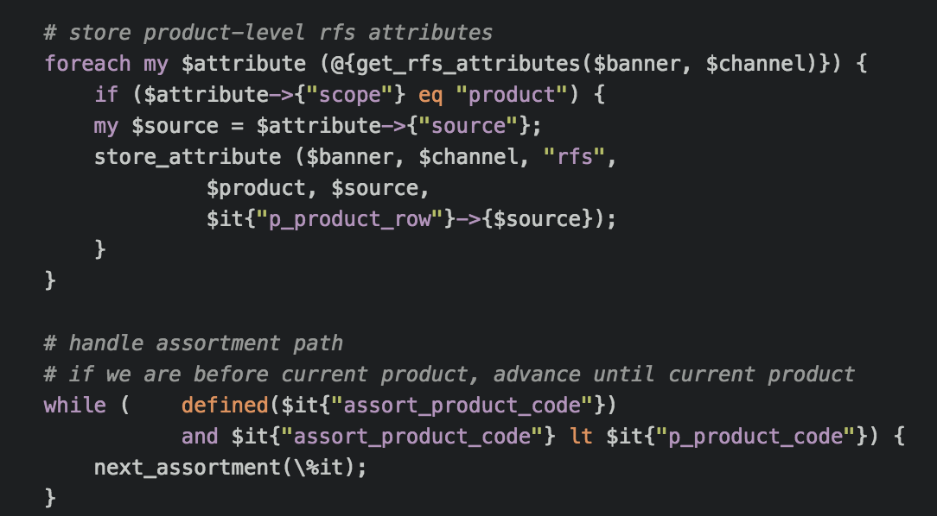
How do I get from relational to JSON?
WYOC (Write Your Own Code)
More challenging, but you've got ultimate control

Slide 19
Orders of Magnitude
Any operation in the CPU is on the order of nanoseconds: 0.000 000 001s
typically tens of nanoseconds per high-level operation
Any roundtrip to the database is on the order of milliseconds: 0.001s
typically just under 1 millisecond at the minimum
mostly due to network protocol stack latency
faster networks don't help
in-memory storage does not help

Slide 20
A Gallery Of Mistakes

Slide 21
ORDERS
ID
FIRST_NAME
LAST_NAME
SHIPPING_ADDRESS
1
James
Bond
Nassau, Bahamas, US
2
Ernst
Blofeldt
Caracas, Venezuela
ITEMS
ID
ORDER_ID
QTY
DESCRIPTION
PRICE
1
1
1
Aston Martin
120,000
2
1
1
Dinner Jacket
4,000
3
1
3
Champagne Veuve-Cliquot
200
4
2
100
Cat Food
1
5
2
1
Launch Pad
1,000,000
TRACKING
ORDER_ID
TIMESTAMP
STATUS
1
1985-04-30 09:48:00
ORDERED
2
1985-04-23 01:30:22
ORDERED
2
1985-04-25 08:30:00
SHIPPED
2
1985-05-14 21:37:00
DELIVERED

Slide 22
Mistake #1 – Nested queries
for x in SELECT * FROM ORDERS
doc = { "first_name" : x.first_name, "last_name" : x.last_name,
"address" : x.address,
"items" : [], "tracking" : [] }
for y in SELECT * FROM ITEMS WHERE ORDER_ID = x.order_id
doc.items.push (y)
for z in SELECT * FROM TRACKING WHERE ORDER_ID = x.order_id
doc.tracking.push (y)
mongodb.insert (doc)

Slide 23
Mistake #1 – Nested queries
for x in SELECT * FROM ORDERS
doc = { "first_name" : x.first_name, "last_name" : x.last_name,
"address" : x.address,
"items" : [], "tracking" : [] }
for y in SELECT * FROM ITEMS WHERE ORDER_ID = x.order_id
doc.items.push (y)
for z in SELECT * FROM TRACKING WHERE ORDER_ID = x.order_id
doc.tracking.push (y)
mongodb.insert (doc)

Slide 24
Mistake #1 – Nested queries
for x in SELECT * FROM ORDERS
doc = { "first_name" : x.first_name, "last_name" : x.last_name,
"address" : x.address,
"items" : [], "tracking" : [] }
for y in SELECT * FROM ITEMS WHERE ORDER_ID = x.order_id
doc.items.push (y)
for z in SELECT * FROM TRACKING WHERE ORDER_ID = x.order_id
doc.tracking.push (y)
mongodb.insert (doc)

Slide 25
Mistake #1 – Nested queries
for x in SELECT * FROM ORDERS
doc = { "first_name" : x.first_name, "last_name" : x.last_name,
"address" : x.address,
"items" : [], "tracking" : [] }
for y in SELECT * FROM ITEMS WHERE ORDER_ID = x.order_id
doc.items.push (y)
for z in SELECT * FROM TRACKING WHERE ORDER_ID = x.order_id
doc.tracking.push (y)
mongodb.insert (doc)

Slide 26
Mistake #1 – Nested queries
for x in SELECT * FROM ORDERS
doc = { "first_name" : x.first_name, "last_name" : x.last_name,
"address" : x.address,
"items" : [], "tracking" : [] }
for y in SELECT * FROM ITEMS WHERE ORDER_ID = x.order_id
doc.items.push (y)
for z in SELECT * FROM TRACKING WHERE ORDER_ID = x.order_id
doc.tracking.push (y)
mongodb.insert (doc)

Slide 27
Mistake #1 – Nested queries
for x in SELECT * FROM ORDERS
doc = { "first_name" : x.first_name, "last_name" : x.last_name,
"address" : x.address,
"items" : [], "tracking" : [] }
for y in SELECT * FROM ITEMS WHERE ORDER_ID = x.order_id
doc.items.push (y)
for z in SELECT * FROM TRACKING WHERE ORDER_ID = x.order_id
doc.tracking.push (y)
mongodb.insert (doc)

Slide 28
Mistake #1 – Nested queries
for x in SELECT * FROM ORDERS
doc = { "first_name" : x.first_name, "last_name" : x.last_name,
"address" : x.address,
"items" : [], "tracking" : [] }
for y in SELECT * FROM ITEMS WHERE ORDER_ID = x.order_id
doc.items.push (y)
for z in SELECT * FROM TRACKING WHERE ORDER_ID = x.order_id
doc.tracking.push (y)
mongodb.insert (doc)

Slide 29
Results
1 million orders
10 million line items
3 million tracking states
MySQL (local) to MongoDB (local)
Python

Slide 30
Fan-In and Fan-out
ETL Job
1/n + 2
1
Number of Database Operations per MongoDB Document

Slide 31
Mistake #2 – Build documents in DB
for x in SELECT * FROM ORDERS
doc = { "first_name" : x.first_name, "last_name" : x.last_name,
"address" : x.address,
"items" : [], "tracking" : [] }
mongodb.insert (doc)
for y in SELECT * FROM ITEMS
mongodb.update ({"_id" : y.order_id},
{"$push" : {"items" : y}})
for z in SELECT * FROM TRACKING
mongodb.update ({"_id" : z.order_id},
{"$push" : {"tracking" : z}})

Slide 32
Mistake #2 – Build documents in DB
for x in SELECT * FROM ORDERS
doc = { "first_name" : x.first_name, "last_name" : x.last_name,
"address" : x.address,
"items" : [], "tracking" : [] }
mongodb.insert (doc)
for y in SELECT * FROM ITEMS
mongodb.update ({"_id" : y.order_id},
{"$push" : {"items" : y}})
for z in SELECT * FROM TRACKING
mongodb.update ({"_id" : z.order_id},
{"$push" : {"tracking" : z}})

Slide 33
Mistake #2 – Build documents in DB
for x in SELECT * FROM ORDERS
doc = { "first_name" : x.first_name, "last_name" : x.last_name,
"address" : x.address,
"items" : [], "tracking" : [] }
mongodb.insert (doc)
for y in SELECT * FROM ITEMS
mongodb.update ({"_id" : y.order_id},
{"$push" : {"items" : y}})
for z in SELECT * FROM TRACKING
mongodb.update ({"_id" : z.order_id},
{"$push" : {"tracking" : z}})

Slide 34
Mistake #2 – Build documents in DB
for x in SELECT * FROM ORDERS
doc = { "first_name" : x.first_name, "last_name" : x.last_name,
"address" : x.address,
"items" : [], "tracking" : [] }
mongodb.insert (doc)
for y in SELECT * FROM ITEMS
mongodb.update ({"_id" : y.order_id},
{"$push" : {"items" : y}})
for z in SELECT * FROM TRACKING
mongodb.update ({"_id" : z.order_id},
{"$push" : {"tracking" : z}})

Slide 35
Mistake #2 – Build documents in DB
for x in SELECT * FROM ORDERS
doc = { "first_name" : x.first_name, "last_name" : x.last_name,
"address" : x.address,
"items" : [], "tracking" : [] }
mongodb.insert (doc)
for y in SELECT * FROM ITEMS
mongodb.update ({"_id" : y.order_id},
{"$push" : {"items" : y}})
for z in SELECT * FROM TRACKING
mongodb.update ({"_id" : z.order_id},
{"$push" : {"tracking" : z}})

Slide 36
Mistake #2 – Build documents in DB
for x in SELECT * FROM ORDERS
doc = { "first_name" : x.first_name, "last_name" : x.last_name,
"address" : x.address,
"items" : [], "tracking" : [] }
mongodb.insert (doc)
for y in SELECT * FROM ITEMS
mongodb.update ({"_id" : y.order_id},
{"$push" : {"items" : y}})
for z in SELECT * FROM TRACKING
mongodb.update ({"_id" : z.order_id},
{"$push" : {"tracking" : z}})

Slide 37
Mistake #2 – Build documents in DB
for x in SELECT * FROM ORDERS
doc = { "first_name" : x.first_name, "last_name" : x.last_name,
"address" : x.address,
"items" : [], "tracking" : [] }
mongodb.insert (doc)
for y in SELECT * FROM ITEMS
mongodb.update ({"_id" : y.order_id},
{"$push" : {"items" : y}})
for z in SELECT * FROM TRACKING
mongodb.update ({"_id" : z.order_id},
{"$push" : {"tracking" : z}})

Slide 38
Fan-In and Fan-out
ETL Job
3/n
1 + p + q
Number of Database Operations per MongoDB Document

Slide 39
Results

Slide 40
Mistake #3 – Load it all into memory
db_items = SELECT * FROM ITEMS
db_tracking = SELECT * FROM TRACKING
for x in SELECT * FROM ORDERS
doc = { "first_name" : x.first_name, "last_name" : x.last_name,
"address" : x.address,
"items" : [], "tracking" : [] }
doc.items.pushAll (db_items.getAll(x.order_id))
doc.tracking.pushAll (db_tracking.getAll(x.order_id))
mongodb.insert (doc)

Slide 41
Mistake #3 – Load it all into memory
db_items = SELECT * FROM ITEMS
db_tracking = SELECT * FROM TRACKING
for x in SELECT * FROM ORDERS
doc = { "first_name" : x.first_name, "last_name" : x.last_name,
"address" : x.address,
"items" : [], "tracking" : [] }
doc.items.pushAll (db_items.getAll(x.order_id))
doc.tracking.pushAll (db_tracking.getAll(x.order_id))
mongodb.insert (doc)

Slide 42
Mistake #3 – Load it all into memory
db_items = SELECT * FROM ITEMS
db_tracking = SELECT * FROM TRACKING
for x in SELECT * FROM ORDERS
doc = { "first_name" : x.first_name, "last_name" : x.last_name,
"address" : x.address,
"items" : [], "tracking" : [] }
doc.items.pushAll (db_items.getAll(x.order_id))
doc.tracking.pushAll (db_tracking.getAll(x.order_id))
mongodb.insert (doc)

Slide 43
Mistake #3 – Load it all into memory
db_items = SELECT * FROM ITEMS
db_tracking = SELECT * FROM TRACKING
for x in SELECT * FROM ORDERS
doc = { "first_name" : x.first_name, "last_name" : x.last_name,
"address" : x.address,
"items" : [], "tracking" : [] }
doc.items.pushAll (db_items.getAll(x.order_id))
doc.tracking.pushAll (db_tracking.getAll(x.order_id))
mongodb.insert (doc)

Slide 44
Mistake #3 – Load it all into memory
db_items = SELECT * FROM ITEMS
db_tracking = SELECT * FROM TRACKING
for x in SELECT * FROM ORDERS
doc = { "first_name" : x.first_name, "last_name" : x.last_name,
"address" : x.address,
"items" : [], "tracking" : [] }
doc.items.pushAll (db_items.getAll(x.order_id))
doc.tracking.pushAll (db_tracking.getAll(x.order_id))
mongodb.insert (doc)

Slide 45
Mistake #3 – Load it all into memory
db_items = SELECT * FROM ITEMS
db_tracking = SELECT * FROM TRACKING
for x in SELECT * FROM ORDERS
doc = { "first_name" : x.first_name, "last_name" : x.last_name,
"address" : x.address,
"items" : [], "tracking" : [] }
doc.items.pushAll (db_items.getAll(x.order_id))
doc.tracking.pushAll (db_tracking.getAll(x.order_id))
mongodb.insert (doc)

Slide 46
Fan-In and Fan-out
ETL Job
3/n
1
Number of Database Operations per MongoDB Document

Slide 47
Results

Slide 48
Getting it right: Co-Iteration

Slide 49
ORDERS
ID
FIRST_NAME
LAST_NAME
SHIPPING_ADDRESS
1
James
Bond
Nassau, Bahamas, US
2
Ernst
Blofeldt
Caracas, Venezuela
ITEMS
ID
ORDER_ID
QTY
DESCRIPTION
PRICE
1
1
1
Aston Martin
120,000
2
1
1
Dinner Jacket
4,000
3
1
3
Champagne Veuve-Cliquot
200
4
2
100
Cat Food
1
5
2
1
Launch Pad
1,000,000
TRACKING
ORDER_ID
TIMESTAMP
STATUS
1
1985-04-30 09:48:00
ORDERED
2
1985-04-23 01:30:22
ORDERED
2
1985-04-25 08:30:00
SHIPPED
2
1985-05-14 21:37:00
DELIVERED

Slide 50
ORDERS
ID
FIRST_NAME
LAST_NAME
SHIPPING_ADDRESS
1
James
Bond
Nassau, Bahamas, US
2
Ernst
Blofeldt
Caracas, Venezuela
ITEMS
ID
ORDER_ID
QTY
DESCRIPTION
PRICE
1
1
1
Aston Martin
120,000
2
1
1
Dinner Jacket
4,000
3
1
3
Champagne Veuve-Cliquot
200
4
2
100
Cat Food
1
5
2
1
Launch Pad
1,000,000
TRACKING
ORDER_ID
TIMESTAMP
STATUS
1
1985-04-30 09:48:00
ORDERED
2
1985-04-23 01:30:22
ORDERED
2
1985-04-25 08:30:00
SHIPPED
2
1985-05-14 21:37:00
DELIVERED

Slide 51
ORDERS
ID
FIRST_NAME
LAST_NAME
SHIPPING_ADDRESS
1
James
Bond
Nassau, Bahamas, US
2
Ernst
Blofeldt
Caracas, Venezuela
{
"first_name" : "James",
"last_name" : "Bond",
"address" : "Nassau, Bahamas, US"
}
ITEMS
ID
ORDER_ID
QTY
DESCRIPTION
PRICE
1
1
1
Aston Martin
120,000
2
1
1
Dinner Jacket
4,000
3
1
3
Champagne Veuve-Cliquot
200
4
2
100
Cat Food
1
5
2
1
Launch Pad
1,000,000
TRACKING
ORDER_ID
TIMESTAMP
STATUS
1
1985-04-30 09:48:00
ORDERED
2
1985-04-23 01:30:22
ORDERED
2
1985-04-25 08:30:00
SHIPPED
2
1985-05-14 21:37:00
DELIVERED

Slide 52
ORDERS
ID
FIRST_NAME
LAST_NAME
SHIPPING_ADDRESS
1
James
Bond
Nassau, Bahamas, US
2
Ernst
Blofeldt
Caracas, Venezuela
{
"first_name" : "James",
"last_name" : "Bond",
"address" : "Nassau, Bahamas, US",
"items" : [
{ ..., "description" : "Aston Martin", ... }
]
}
ITEMS
ID
ORDER_ID
QTY
DESCRIPTION
PRICE
1
1
1
Aston Martin
120,000
2
1
1
Dinner Jacket
4,000
3
1
3
Champagne Veuve-Cliquot
200
4
2
100
Cat Food
1
5
2
1
Launch Pad
1,000,000
TRACKING
ORDER_ID
TIMESTAMP
STATUS
1
1985-04-30 09:48:00
ORDERED
2
1985-04-23 01:30:22
ORDERED
2
1985-04-25 08:30:00
SHIPPED
2
1985-05-14 21:37:00
DELIVERED

Slide 53
ORDERS
ID
FIRST_NAME
LAST_NAME
SHIPPING_ADDRESS
1
James
Bond
Nassau, Bahamas, US
2
Ernst
Blofeldt
Caracas, Venezuela
{
"first_name" : "James",
"last_name" : "Bond",
"address" : "Nassau, Bahamas, US",
"items" : [
{ ..., "description" : "Aston Martin", ... },
{ ..., "description" : "Dinner Jacket", ... }
]
}
ITEMS
ID
ORDER_ID
QTY
DESCRIPTION
PRICE
1
1
1
Aston Martin
120,000
2
1
1
Dinner Jacket
4,000
3
1
3
Champagne Veuve-Cliquot
200
4
2
100
Cat Food
1
5
2
1
Launch Pad
1,000,000
TRACKING
ORDER_ID
TIMESTAMP
STATUS
1
1985-04-30 09:48:00
ORDERED
2
1985-04-23 01:30:22
ORDERED
2
1985-04-25 08:30:00
SHIPPED
2
1985-05-14 21:37:00
DELIVERED

Slide 54
ORDERS
ID
FIRST_NAME
LAST_NAME
SHIPPING_ADDRESS
1
James
Bond
Nassau, Bahamas, US
2
Ernst
Blofeldt
Caracas, Venezuela
{
"first_name" : "James",
"last_name" : "Bond",
"address" : "Nassau, Bahamas, US",
"items" : [
{ ..., "description" : "Aston Martin", ... },
{ ..., "description" : "Dinner Jacket", ... },
{ ..., "description" : "Champagne...", ... }
]
}
ITEMS
ID
ORDER_ID
QTY
DESCRIPTION
PRICE
1
1
1
Aston Martin
120,000
2
1
1
Dinner Jacket
4,000
3
1
3
Champagne Veuve-Cliquot
200
4
2
100
Cat Food
1
5
2
1
Launch Pad
1,000,000
TRACKING
ORDER_ID
TIMESTAMP
STATUS
1
1985-04-30 09:48:00
ORDERED
2
1985-04-23 01:30:22
ORDERED
2
1985-04-25 08:30:00
SHIPPED
2
1985-05-14 21:37:00
DELIVERED

Slide 55
ORDERS
ID
FIRST_NAME
LAST_NAME
SHIPPING_ADDRESS
1
James
Bond
Nassau, Bahamas, US
2
Ernst
Blofeldt
Caracas, Venezuela
{
"first_name" : "James",
"last_name" : "Bond",
"address" : "Nassau, Bahamas, US",
"items" : [
{ ..., "description" : "Aston Martin", ... },
{ ..., "description" : "Dinner Jacket", ... },
{ ..., "description" : "Champagne...", ... }
]
}
ITEMS
ID
ORDER_ID
QTY
DESCRIPTION
PRICE
1
1
1
Aston Martin
120,000
2
1
1
Dinner Jacket
4,000
3
1
3
Champagne Veuve-Cliquot
200
4
2
100
Cat Food
1
5
2
1
Launch Pad
1,000,000
TRACKING
ORDER_ID
TIMESTAMP
STATUS
1
1985-04-30 09:48:00
ORDERED
2
1985-04-23 01:30:22
ORDERED
2
1985-04-25 08:30:00
SHIPPED
2
1985-05-14 21:37:00
DELIVERED

Slide 56
ORDERS
ID
FIRST_NAME
LAST_NAME
SHIPPING_ADDRESS
1
James
Bond
Nassau, Bahamas, US
2
Ernst
Blofeldt
Caracas, Venezuela
{
"first_name" : "James",
"last_name" : "Bond",
"address" : "Nassau, Bahamas, US",
"items" : [
{ ..., "description" : "Aston Martin", ... },
{ ..., "description" : "Dinner Jacket", ... },
{ ..., "description" : "Champagne...", ... }
],
"tracking" : [
{ ... "1985-04-30 09:48:00", ... "ORDERED" }
]
}
ITEMS
ID
ORDER_ID
QTY
DESCRIPTION
PRICE
1
1
1
Aston Martin
120,000
2
1
1
Dinner Jacket
4,000
3
1
3
Champagne Veuve-Cliquot
200
4
2
100
Cat Food
1
5
2
1
Launch Pad
1,000,000
TRACKING
ORDER_ID
TIMESTAMP
STATUS
1
1985-04-30 09:48:00
ORDERED
2
1985-04-23 01:30:22
ORDERED
2
1985-04-25 08:30:00
SHIPPED
2
1985-05-14 21:37:00
DELIVERED

Slide 57
ORDERS
ID
FIRST_NAME
LAST_NAME
SHIPPING_ADDRESS
1
James
Bond
Nassau, Bahamas, US
2
Ernst
Blofeldt
Caracas, Venezuela
{
"first_name" : "James",
"last_name" : "Bond",
"address" : "Nassau, Bahamas, US",
"items" : [
{ ..., "description" : "Aston Martin", ... },
{ ..., "description" : "Dinner Jacket", ... },
{ ..., "description" : "Champagne...", ... }
],
"tracking" : [
{ ... "1985-04-30 09:48:00", ... "ORDERED" }
]
}
ITEMS
ID
ORDER_ID
QTY
DESCRIPTION
PRICE
1
1
1
Aston Martin
120,000
2
1
1
Dinner Jacket
4,000
3
1
3
Champagne Veuve-Cliquot
200
4
2
100
Cat Food
1
5
2
1
Launch Pad
1,000,000
TRACKING
ORDER_ID
TIMESTAMP
STATUS
1
1985-04-30 09:48:00
ORDERED
2
1985-04-23 01:30:22
ORDERED
2
1985-04-25 08:30:00
SHIPPED
2
1985-05-14 21:37:00
DELIVERED

Slide 58
ORDERS
ID
FIRST_NAME
LAST_NAME
SHIPPING_ADDRESS
1
James
Bond
Nassau, Bahamas, US
2
Ernst
Blofeldt
Caracas, Venezuela
ITEMS
ID
ORDER_ID
QTY
DESCRIPTION
PRICE
1
1
1
Aston Martin
120,000
2
1
1
Dinner Jacket
4,000
3
1
3
Champagne Veuve-Cliquot
200
4
2
100
Cat Food
1
5
2
1
Launch Pad
1,000,000
TRACKING
ORDER_ID
TIMESTAMP
STATUS
1
1985-04-30 09:48:00
ORDERED
2
1985-04-23 01:30:22
ORDERED
2
1985-04-25 08:30:00
SHIPPED
2
1985-05-14 21:37:00
DELIVERED

Slide 59
ORDERS
ID
FIRST_NAME
LAST_NAME
SHIPPING_ADDRESS
1
James
Bond
Nassau, Bahamas, US
2
Ernst
Blofeldt
Caracas, Venezuela
ITEMS
ID
ORDER_ID
QTY
DESCRIPTION
PRICE
1
1
1
Aston Martin
120,000
2
1
1
Dinner Jacket
4,000
3
1
3
Champagne Veuve-Cliquot
200
4
2
100
Cat Food
1
5
2
1
Launch Pad
1,000,000
TRACKING
ORDER_ID
TIMESTAMP
STATUS
1
1985-04-30 09:48:00
ORDERED
2
1985-04-23 01:30:22
ORDERED
2
1985-04-25 08:30:00
SHIPPED
2
1985-05-14 21:37:00
DELIVERED

Slide 60
ORDERS
ID
FIRST_NAME
LAST_NAME
SHIPPING_ADDRESS
1
James
Bond
Nassau, Bahamas, US
2
Ernst
Blofeldt
Caracas, Venezuela
{
"first_name" : "Ernst",
"last_name" : "Blofeldt",
"address" : "Caracas, Venezuela"
}
ITEMS
ID
ORDER_ID
QTY
DESCRIPTION
PRICE
1
1
1
Aston Martin
120,000
2
1
1
Dinner Jacket
4,000
3
1
3
Champagne Veuve-Cliquot
200
4
2
100
Cat Food
1
5
2
1
Launch Pad
1,000,000
TRACKING
ORDER_ID
TIMESTAMP
STATUS
1
1985-04-30 09:48:00
ORDERED
2
1985-04-23 01:30:22
ORDERED
2
1985-04-25 08:30:00
SHIPPED
2
1985-05-14 21:37:00
DELIVERED

Slide 61
ORDERS
ID
FIRST_NAME
LAST_NAME
SHIPPING_ADDRESS
1
James
Bond
Nassau, Bahamas, US
2
Ernst
Blofeldt
Caracas, Venezuela
{
"first_name" : "Ernst",
"last_name" : "Blofeldt",
"address" : "Caracas, Venezuela",
"items" : [
{ ..., "description" : "Cat Food", ... }
]
}
ITEMS
ID
ORDER_ID
QTY
DESCRIPTION
PRICE
1
1
1
Aston Martin
120,000
2
1
1
Dinner Jacket
4,000
3
1
3
Champagne Veuve-Cliquot
200
4
2
100
Cat Food
1
5
2
1
Launch Pad
1,000,000
TRACKING
ORDER_ID
TIMESTAMP
STATUS
1
1985-04-30 09:48:00
ORDERED
2
1985-04-23 01:30:22
ORDERED
2
1985-04-25 08:30:00
SHIPPED
2
1985-05-14 21:37:00
DELIVERED

Slide 62
ORDERS
ID
FIRST_NAME
LAST_NAME
SHIPPING_ADDRESS
1
James
Bond
Nassau, Bahamas, US
2
Ernst
Blofeldt
Caracas, Venezuela
{
"first_name" : "Ernst",
"last_name" : "Blofeldt",
"address" : "Caracas, Venezuela",
"items" : [
{ ..., "description" : "Cat Food", ... },
{ ..., "description" : "Launch Pad", ... }
]
}
ITEMS
ID
ORDER_ID
QTY
DESCRIPTION
PRICE
1
1
1
Aston Martin
120,000
2
1
1
Dinner Jacket
4,000
3
1
3
Champagne Veuve-Cliquot
200
4
2
100
Cat Food
1
5
2
1
Launch Pad
1,000,000
TRACKING
ORDER_ID
TIMESTAMP
STATUS
1
1985-04-30 09:48:00
ORDERED
2
1985-04-23 01:30:22
ORDERED
2
1985-04-25 08:30:00
SHIPPED
2
1985-05-14 21:37:00
DELIVERED

Slide 63
ORDERS
ID
FIRST_NAME
LAST_NAME
SHIPPING_ADDRESS
1
James
Bond
Nassau, Bahamas, US
2
Ernst
Blofeldt
Caracas, Venezuela
{
"first_name" : "Ernst",
"last_name" : "Blofeldt",
"address" : "Caracas, Venezuela",
"items" : [
{ ..., "description" : "Cat Food", ... },
{ ..., "description" : "Launch Pad", ... }
]
}
ITEMS
ID
ORDER_ID
QTY
DESCRIPTION
PRICE
1
1
1
Aston Martin
120,000
2
1
1
Dinner Jacket
4,000
3
1
3
Champagne Veuve-Cliquot
200
4
2
100
Cat Food
1
5
2
1
Launch Pad
1,000,000
TRACKING
ORDER_ID
TIMESTAMP
STATUS
1
1985-04-30 09:48:00
ORDERED
2
1985-04-23 01:30:22
ORDERED
2
1985-04-25 08:30:00
SHIPPED
2
1985-05-14 21:37:00
DELIVERED

Slide 64
ORDERS
ID
FIRST_NAME
LAST_NAME
SHIPPING_ADDRESS
1
James
Bond
Nassau, Bahamas, US
2
Ernst
Blofeldt
Caracas, Venezuela
{
"first_name" : "Ernst",
"last_name" : "Blofeldt",
"address" : "Caracas, Venezuela",
"items" : [
{ ..., "description" : "Cat Food", ... },
{ ..., "description" : "Launch Pad", ... }
],
"tracking" : [
{ ... "1985-04-23 01:30:22", ... "ORDERED" }
]
}
ITEMS
ID
ORDER_ID
QTY
DESCRIPTION
PRICE
1
1
1
Aston Martin
120,000
2
1
1
Dinner Jacket
4,000
3
1
3
Champagne Veuve-Cliquot
200
4
2
100
Cat Food
1
5
2
1
Launch Pad
1,000,000
TRACKING
ORDER_ID
TIMESTAMP
STATUS
1
1985-04-30 09:48:00
ORDERED
2
1985-04-23 01:30:22
ORDERED
2
1985-04-25 08:30:00
SHIPPED
2
1985-05-14 21:37:00
DELIVERED

Slide 65
ORDERS
ID
FIRST_NAME
LAST_NAME
SHIPPING_ADDRESS
1
James
Bond
Nassau, Bahamas, US
2
Ernst
Blofeldt
Caracas, Venezuela
{
"first_name" : "Ernst",
"last_name" : "Blofeldt",
"address" : "Caracas, Venezuela",
"items" : [
{ ..., "description" : "Cat Food", ... },
{ ..., "description" : "Launch Pad", ... }
],
"tracking" : [
{ ... "1985-04-23 01:30:22", ... "ORDERED" },
{ ... "1985-04-25 08:30:00", ... "SHIPPED" }
]
}
ITEMS
ID
ORDER_ID
QTY
DESCRIPTION
PRICE
1
1
1
Aston Martin
120,000
2
1
1
Dinner Jacket
4,000
3
1
3
Champagne Veuve-Cliquot
200
4
2
100
Cat Food
1
5
2
1
Launch Pad
1,000,000
TRACKING
ORDER_ID
TIMESTAMP
STATUS
1
1985-04-30 09:48:00
ORDERED
2
1985-04-23 01:30:22
ORDERED
2
1985-04-25 08:30:00
SHIPPED
2
1985-05-14 21:37:00
DELIVERED

Slide 66
ORDERS
ID
FIRST_NAME
LAST_NAME
SHIPPING_ADDRESS
1
James
Bond
Nassau, Bahamas, US
2
Ernst
Blofeldt
Caracas, Venezuela
{
"first_name" : "Ernst",
"last_name" : "Blofeldt",
"address" : "Caracas, Venezuela",
"items" : [
{ ..., "description" : "Cat Food", ... },
{ ..., "description" : "Launch Pad", ... }
],
"tracking" : [
{ ... "1985-04-23 01:30:22", ... "ORDERED" },
{ ... "1985-04-25 08:30:00", ... "SHIPPED" },
{ ... "1985-05-14 21:37:00", .. "DELIVERED" }
]
}
ITEMS
ID
ORDER_ID
QTY
DESCRIPTION
PRICE
1
1
1
Aston Martin
120,000
2
1
1
Dinner Jacket
4,000
3
1
3
Champagne Veuve-Cliquot
200
4
2
100
Cat Food
1
5
2
1
Launch Pad
1,000,000
TRACKING
ORDER_ID
TIMESTAMP
STATUS
1
1985-04-30 09:48:00
ORDERED
2
1985-04-23 01:30:22
ORDERED
2
1985-04-25 08:30:00
SHIPPED
2
1985-05-14 21:37:00
DELIVERED

Slide 67
ORDERS
ID
FIRST_NAME
LAST_NAME
SHIPPING_ADDRESS
1
James
Bond
Nassau, Bahamas, US
2
Ernst
Blofeldt
Caracas, Venezuela
{
"first_name" : "Ernst",
"last_name" : "Blofeldt",
"address" : "Caracas, Venezuela",
"items" : [
{ ..., "description" : "Cat Food", ... },
{ ..., "description" : "Launch Pad", ... }
],
"tracking" : [
{ ... "1985-04-23 01:30:22", ... "ORDERED" },
{ ... "1985-04-25 08:30:00", ... "SHIPPED" },
{ ... "1985-05-14 21:37:00", .. "DELIVERED" }
]
}
ITEMS
ID
ORDER_ID
QTY
DESCRIPTION
PRICE
1
1
1
Aston Martin
120,000
2
1
1
Dinner Jacket
4,000
3
1
3
Champagne Veuve-Cliquot
200
4
2
100
Cat Food
1
5
2
1
Launch Pad
1,000,000
TRACKING
ORDER_ID
TIMESTAMP
STATUS
1
1985-04-30 09:48:00
ORDERED
2
1985-04-23 01:30:22
ORDERED
2
1985-04-25 08:30:00
SHIPPED
2
1985-05-14 21:37:00
DELIVERED

Slide 68
ORDERS
ID
FIRST_NAME
LAST_NAME
SHIPPING_ADDRESS
1
James
Bond
Nassau, Bahamas, US
2
Ernst
Blofeldt
Caracas, Venezuela
ITEMS
ID
ORDER_ID
QTY
DESCRIPTION
PRICE
1
1
1
Aston Martin
120,000
Done!
2
1
1
Dinner Jacket
4,000
3
1
3
Champagne Veuve-Cliquot
200
4
2
100
Cat Food
1
5
2
1
Launch Pad
1,000,000
TRACKING
ORDER_ID
TIMESTAMP
STATUS
1
1985-04-30 09:48:00
ORDERED
2
1985-04-23 01:30:22
ORDERED
2
1985-04-25 08:30:00
SHIPPED
2
1985-05-14 21:37:00
DELIVERED

Slide 69
Results

Slide 70
Fan-In and Fan-Out
ETL Job
3/n
1
Number of Database Operations per MongoDB Document

Slide 71
Did you just explain to me what a JOIN is?
Yes. Although not as straightforward as you might think.
NAME | ITEM | TRACKING
James Bond | Aston Martin | ORDERED
James Bond | Aston Martin | SHIPPED
James Bond | Dinner Jacket | ORDERED
James Bond | Dinner Jacket | SHIPPED
James Bond | Champagne | ORDERED
James Bond | Champagne | SHIPPED
No. Co-Iteration works from multiple data sources.

Slide 72
Oh, and one more thing…

Slide 73
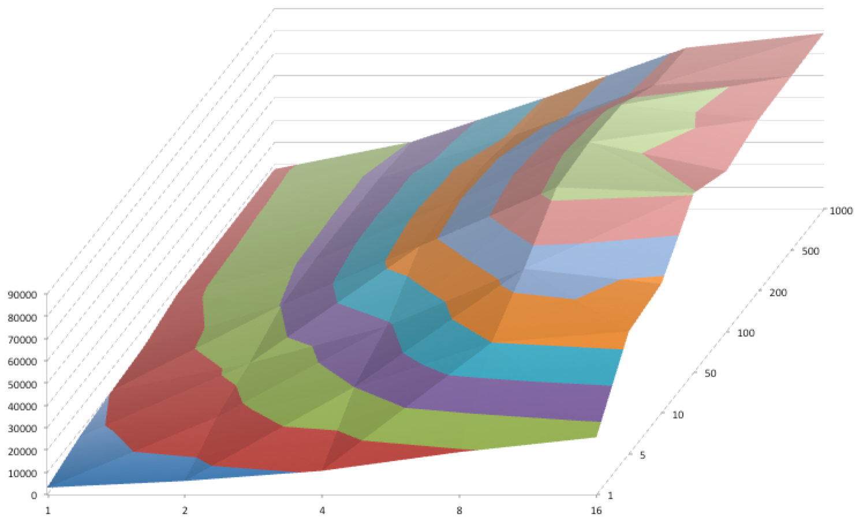
Threading and Batching
batch size
through put
threads

Slide 74
Fan-In and Fan-out
ETL Job
3/n
1/1000
Number of Database Operations per MongoDB Document

Slide 75
Results

Slide 76
Summary
Common Mistakes to Watch Out For
Nested Queries
Building Documents in the Database
Loading Everything into Memory
The Co-Iteration Pattern
Open All Tables at Once
Perform a Single Pass over Them
Build Documents as You Go Along
Don't Forget Batching and Threading

Slide 77
Thank you. github.com/drmirror/etlpro

