Slide 1


Citrix Access Gateway under the hood
Michael Rüefli
Senior Consultant
MCSE, CCEA , CCIA, VCP

Slide 2
About me
I live and work in Switzerland
As a senior consultant for INSERTO AG, a swiss systems integrator, I’m designing and integrating all kind of virtualization infrastructures. With more than 13 years experience I’m focused on:
OS platform integration (Windows, Linux)
Active Directory design and troubleshooting
Citrix App delivery products
Microsoft Exchange
Microsoft SQL Server
All kind of virtualization (VMware, Citrix, Microsoft)
ITIL process engineering and implementation
powershell, vb and perl scripting
.NET custom system software development
Notes:
Here’s a short bio of me, I’m focussed on virtualization technologies and application delivery since 13 years now

Slide 3
Agenda
What Citrix Access Gateway does, and what it does not
Why not to use CSG?
AG vs. AGEE (which version fits your needs?)
Component deployment variants
One-arm vs. Two-arm deployments
What happens when you start published apps / desktops via AG
AGEE Architecture
AGEE tipps and tricks (lessons learned)
Troubleshooting AGEE
What about Cloud Gateway and Cloud Bridge?
Licensing
O&A
Notes:
Let’s have a look at this session’s agenda:
It does not go very deeply into all the technical details on how to configure AG/AGEE, but the presentation contains a slide with a bunch of useful links where to find this stuff
I’ll focus on basic design considerations and good to knows..

Slide 4
Citrix Access Gateway… what it can do for you
SSL/TLS broker for cloud applications / desktops (same as the old school CSG)
Fully qualified SSL-VPN solution with comfortable «always on» feature for any tcp/udp application
Endpoint Analysis (check client health before giving access)
Fine grained access policies based on access method, location and endpoint type (AGEE)
Notes:
On one hand the AG was designed as a single point of access for any applications. A lot of customers use it as an ICA proxy only. But there are a lot of additional functionalities. You might want to use it as a fully qualified SSL VPN solution and you’ll be very ok with the AG. If you want the ultimate experience implement the AGEE version, we’ll see why within the next slides.

Slide 5
Why not to use CSG
Or why AG(EE) is the better choice….
CSG development retained
Certificate chaining
URL rewriting (single access URL for any device)
Security (authentication, OS)
Reliability / performance
Advanced access policies
Endpoint Analysis (check client health before giving access)
Notes:
So why not use CSG if you only want to broke ICA connections?
CSG has become very oldschool and hasn’t been enhanced the last few years. It does simple reverse proxying and the user is always forced to authenticate on the Web Interace Level. It lacks in terms of high availability and does not provide access policies and client endpoint checks.

Slide 6
AG vs. AGEE
CAG STD
Physical or virtual appliance
Good for ICA Proxying simple ssl-vpn
Basic EPA policies
CAG STD with AAC
Physical or virtual appliance
Additional Windows Server with SQL database for advanced access policies and EPA
CAG Enterprise
Physical or virtual appliance, based on Netscaler / Netscaler VPX
Includes all AAC functionalities
Supports Smart Card based authentication
Single point of management for multiple CAGs
No UI customization
Basic UI customization
Enhanced UI customization
Netscaler functions available
Notes:
While the AG STD edition might fit your needs for just broking XenApp / XenDesktop connections we noticed that the development power from citrix side is 100% focussed on the enterprise version, mostly because it runs on the netscaler platform. The STD Edition can be enhanced using the AAC Option, which requires a Windows Server and a SQL database to use access policies and EpA functionalities. The enterprise version does include all of those features in a single box which can be easily made high available.

Slide 7
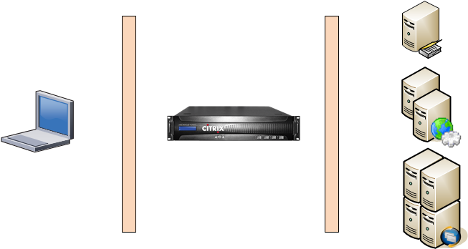


Deployment Model 1a
AG in DMZ, WI in trusted network, Auth on AG, SSON with WI
Notes:
This is the most common deployment model where AG is placed in the DMZ. Authentication takes place on AG, WI does a SSON with AG, so the user is not forced to authenticate twice.

Slide 8
Deployment Model 1b
AG in DMZ, WI in trusted network, Auth on AG/WI
Notes:
The difference with this model ist the authentication. WI is not configured to do SSON with AG, the user has to authenticate twice. You might want to use this model if user names should be different on AG and WI (if using dedicated accounts for RSA SecurID for example)

Slide 9
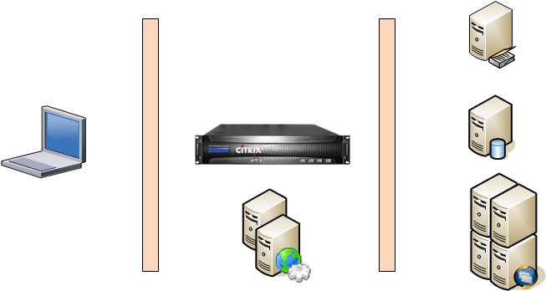
Deployment Model 2a
AG in DMZ, WI in DMZ, Auth on AG or WI, AAC Server in trusted net

Slide 10
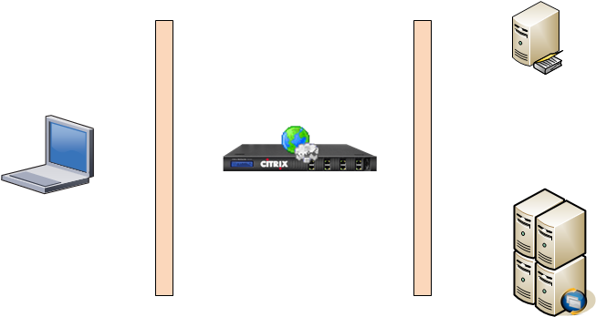
Deployment Model 2b
AGEE in DMZ, WI on AGEE, Auth on AGEE

Slide 11
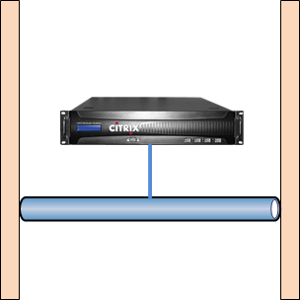
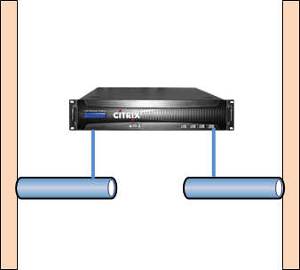
One-arm vs. Two-arm deployments
DMZ
DMZ
NSIP
SNIP
VIPs
VIPs
NSIP
SNIP
Both variants supported, choose based on customer environment
2-arm deployments require static routes for target hosts in trusted network

Slide 12
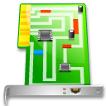
NSIP,SNIP,MIP,VIP, whaaat? ;-?
VIP
Netscaler (AGEE)
SNIP / MIP
NSIP
Type | Means | Usage
NSIP | Netscaler IP | Mgmt, Auth, STA traffic
SNIP | Subnet IP | Outbound connections to internal services in different subnets
MIP | Mapped IP | Outbound connections to internal services on same subnet
VIP(s) | Virtual IP | Inbound connections from clients to portals

Slide 13
ICA Proxy or/and full SSL VPN?
Use ICA Proxy session policies / basic portals when…
Citrix apps and desktops are the only applications to be delivered over Access Gateway
Use full VPN session policies / smart access portals when…
You want to deliver custom tcp/udp applications to remote endpoints
You want to authenticate to backend applications using Smart Card certificates
→ Requires Access Gateway Plugin

Slide 14
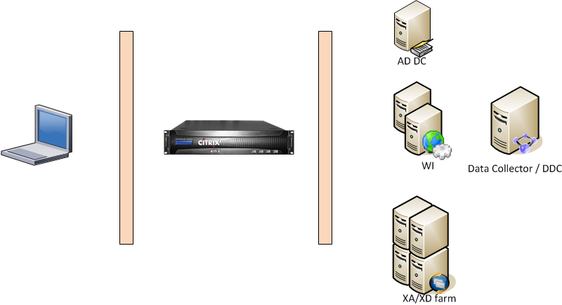
What is happening under the hood..
Access AG URL https://ag.corp.com
AG authenticates the user against LDAP / RADIUS / Smart Card Certificate
AG acts as reverse proxy and transmits credentials and session policy information to Web Interface
Web Interface queries XML service to gather applications to display for that user
User starts published app / desktop
Web Interface requests ticket of STA (XML service)
STA encrypts the IP address from the target host and sends it to the Web Interface
Web Interface send ICA file to the browser
User clicks on icon, Receiver is invoked by FTA. Receiver contacts AG and tries to establish a TLS session
AG requests ticket confirmation via STA
AG decrypts the original IP address of target host
If ticket can be verified, AG establishes the ICA/CGP session to the XenApp / XenDesktop host
….when you start Citrix apps/desktops
ldap
http/xml
https
SSL/TLS
ICA/CGP

Slide 15
AGEE Architecture
EPA expression filters
Policy expression filters
Session Policy
AGEE Virtual Server
Session Profile
Pre-Auth Policy
Bookmarks
Intranet Apps
Authentication Policy
Authentication Profile
Authentication Server

Slide 16
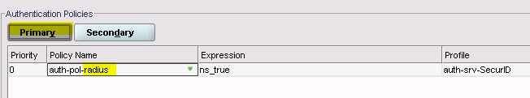
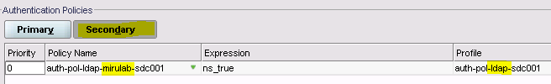

AGEE tipps and tricks (1)
User EPA on preauth-policies
Use virtual srv for inbound DNS if DNS servers are not reachable by ICMP
Use token authentication always as the first authentication method to protect AD accounts from DOS attacks
If using different usernames for RADIUS and LDAP check also the credential index on session profiles

Slide 17
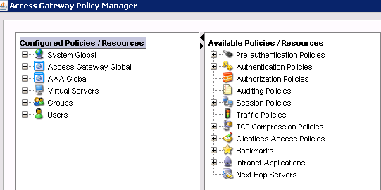
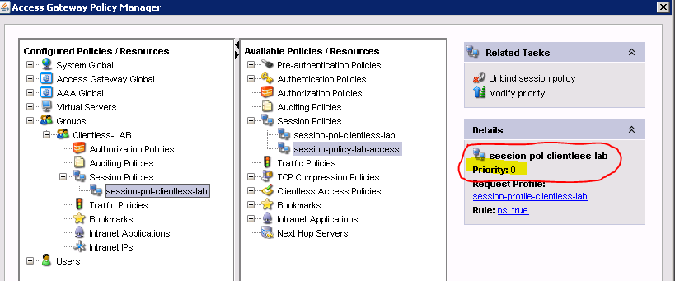
AGEE tipps and tricks (2)
Session policy appliance order
Global
Virtual server
Group
User
http://support.citrix.com/article/CTX117236
Session policy priorities can override default order

Slide 18
Troubleshooting AGEE (1)
Troubleshooting AGEE authentication Open SSH Session, Enter «console» cat /tmp/aaad.debug
Troubleshooting SSL Error 4, Connection Error 1030
→Mostly an issue with STA or Certificate (chain)
If XML port shared with IIS ensure anonymous access is enabled on /scripts/ctxsta.dll
Check STA config on WI to match AGEE
Chain (link) intermediate and root certificates on AGEE SSL configuration
Enable STA Logging http://support.citrix.com/article/CTX101997

Slide 19
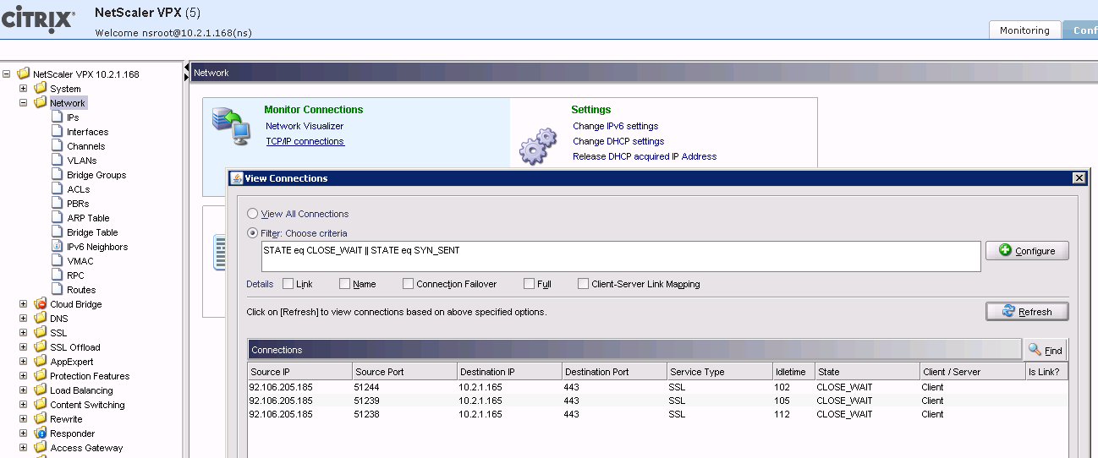
Troubleshooting AGEE (2)
Troubleshooting SSLVPN client side http://support.citrix.com/article/CTX117373
Troubleshooting connections

Slide 20
AGEE useful web resources
Customizing AGEE 9.x
http://support.citrix.com/product/ag/eev9.0/topic/customize/?sortBy=CREATIONDATE
Applying the Symphony theme to AGEE
http://blogs.citrix.com/2011/04/11/symphony-theme-for-citrix-netscaler-access-gateway-enterprise/
How to create endpoint scans
http://support.citrix.com/product/ag/eev9.2/topic/endpointscn/
How to Configure Citrix Access Gateway Enterprise Edition for Use with Citrix Receiver for Mobile Devices
http://support.citrix.com/article/CTX124937
AGEE Smart Card SSON Passthru http://support.citrix.com/article/CTX128418
http://support.citrix.com/article/CTX117489

Slide 21
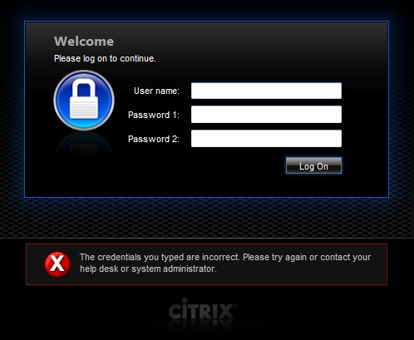
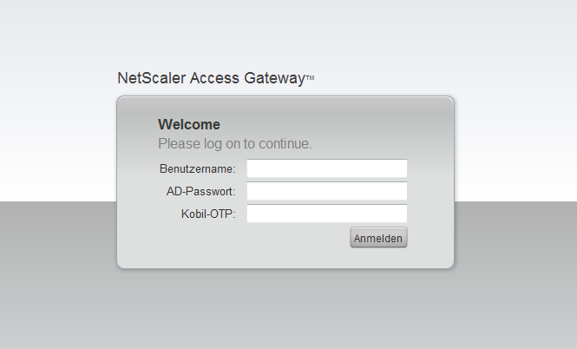
AGEE customizations

Slide 22
Licensing CAG/AGEE
CAG STD
Platform License
CAG STD with AAC
Platform License
AG Enterprise
Netscaler platform license (STD/ADV/ENT with either 10Mbps/200Mbps/1Gbps
Unlimited ICA broker sessions
Universal Access License (CCU) for SSL-VPN (100$ / CCU)
Universal Access License for Smart Access Portals (100$ / CCU)
Windows Server with SQL database
Universal Access License for full VPN sessions (100$ / CCU)
Unlimited ICA broker sessions

Slide 23
All about the «cloud» products…
in one sentence…
Cloud Gateway Express (free) Single point of access for private Citrix cloud, “replaces” WI
Cloud Gateway Enterprise App Controller appliance for a central point of SSON access to private and SaaS apps, integrates with the Express version
Cloud Bridge Feature of Netscaler to create an Ipsec tunnel between two or more clouds

Slide 24

michael@miru.ch
michael.rueefli@inserto.ch
@drmiru
www.miru.ch

