Slide 1

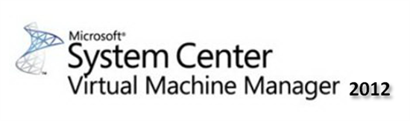
SCVMM - Mania
A Powerful Management Framework for your Private Cloud(s)
© 2013 Thomas Maurer (MVP), Michael Rüefli

Slide 2

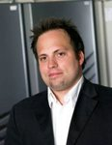
Who's talking to you
Thomas Maurer
MVP, MCSE Private Cloud, MCSE Server Infrastructure
Cloud Architect
Iitnetx gmbh, Switzerland www.thomasmaurer.ch
@ThomasMaurer
Michael Rüefli
MCSE Private Cloud, CCIA, VCP Senior Consultant / Virtualization Architect
INSERTO AG, Switzerland
www.miru.ch
@drmiru

Slide 3
Agenda
Why SCVMM?
Architecture
High Availability
Advantages of Software defined Networks
Baremetal Deployment
Working with VM and Service Templates
Appcontroller / Hybrid Clouds
About AD and Firewall Integration
Manage 3rd Party Hypervisors
Recap

Slide 4
why scvmm?
Central Cloud- and Datacenter Management
Software based Networks / Network Virtualization
Multi Tenancy
VM Templates
Service Templates
Restartable Tasks / Workflows
Role based Access / Self Service
Hyper-V Baremetal Deployment

Slide 5
Architecture | integration
Azure
App Controller
SCOM
SCSM
SCOR
Browser
Provider
Powershell
SCVMM 2012 SP1
WSUS
Console
Library
SQL DB
Agent
Powershell
WDS
Agent
Xen API
WinRM
Web API
ESX
SMI-S / WMI
XenServer
Hyper-V 2012
Hyper-V 2008 R2
vCenter
Storage
Agent
Agent

Slide 6
Supported Platforms
Gateways
Nappliance
IronNetworks
Hypervisors
Server 2008 R2
Server 2012
ESX 4.1 / 5.0 U1 / 5.1
XenServer 5.6 FP1 &SP2 / 6.02 / 6.1
Database
SQL 2008 R2 Sp1 / Sp2
SQL 2012 SP1
SCVMM 2012 SP1
Server 2012
Load Balancer
Citrix Netscaler 9.3.x
F5 Networks
Brocade ServerIron ADX

Slide 7
Single point of management
SCVMM
VDI
Self Service
Operation & Monitoring
VM Management
Fabric Management
Orchestration
General Considerations
Availability becomes more critical
Scalability can be challenging
Dependency on basic infrastrucure

Slide 8

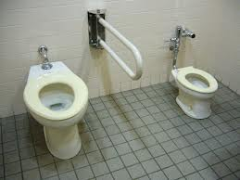
High availability options
Virtualize SCVMM and leverage Hyper-V Replica
Install an active-passive SCVMM Failover Cluster
User SQL Cluster or 2012 Always On Feature

Slide 9
Clustering | always on
Active / Passive on Application level
Active / Passive or Always On on DB Level
Requires SCVMM encryption keys stored in AD Container
Automatic Failover
Virtual or physical

Slide 10
Encapsulated | replicated
Virtual, Application and DB on single VM
VM replicated using Hyper-V Replica
Manual Failover

Slide 11
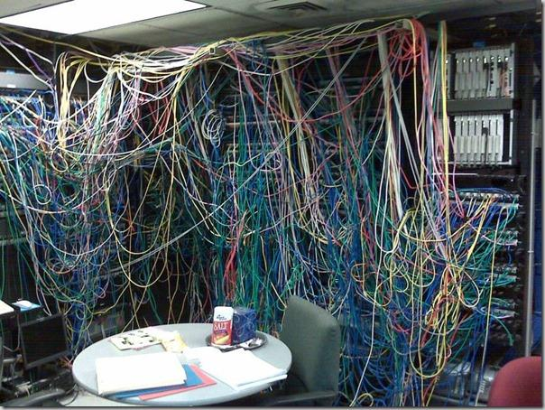
Software defined networks

Slide 12
SCMM 2012 Networking
Logical Networks
Physical Network Infrastructure
Network Sites
Network Sites / VLANs
IP Pools
IP Address Pools for deployment

Slide 13
Networking
Logical Networks
Physical Network Infrastructure / Sites / IP Pools
VM Networks
Virtual Networks for VMs
Port Profiles
New Features from Windows Server 2012 Hyper-V
Logical Switch
Logical Network Switch which combines all features
Notes:
Thomas

Slide 14
SCVMM 2012 Networking (Old Days…)
Virtual Machine
Virtual
Logical NW
Fabric
VLAN 25
Subnet 10.0.0.0/26
Physical Network
Notes:
Thomas

Slide 15
SCMM 2012 SP1 Networking
Virtual Machine
Virtual
VM Network
Logical NW
Fabric
Physical Network
Notes:
Thomas

Slide 16
SCVMM 2012 SP1 Networking
Virtual Machine
Virtual Machine
Virtual Machine
Virtual
VM Network
VM Network
VM Network
Logical NW
Fabric
Logical NW
Physical Network
Notes:
Thomas

Slide 17
SCVMM 2012 SP1 Networking
Virtual Machine
Virtual Machine
Software Defined Networking
Hyper-V Network Virtualization
Extensible Virtual Switch
Network Policy/Offloads
SR-IOV
DHCP Guard
IPSec Task Offload
Bandwidth Control
Trunk Mode
Virtual
VM Network
VM Network
Logical NW
Logical Switch
Fabric
Logical NW
Physical Network
Notes:
Thomas

Slide 18
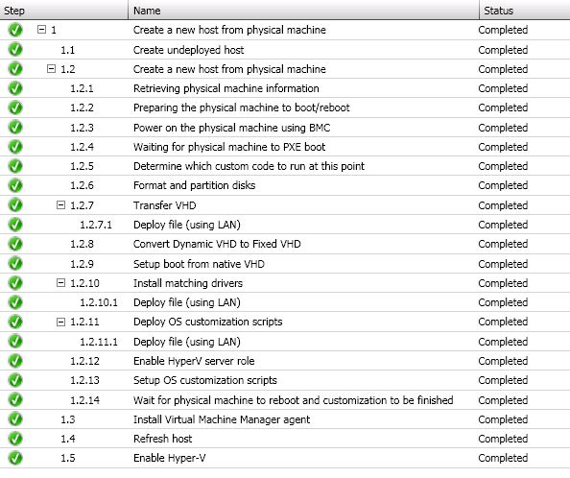
Automated Bare-Metal Hyper-V Deploy
Notes:
Thomas

Slide 19
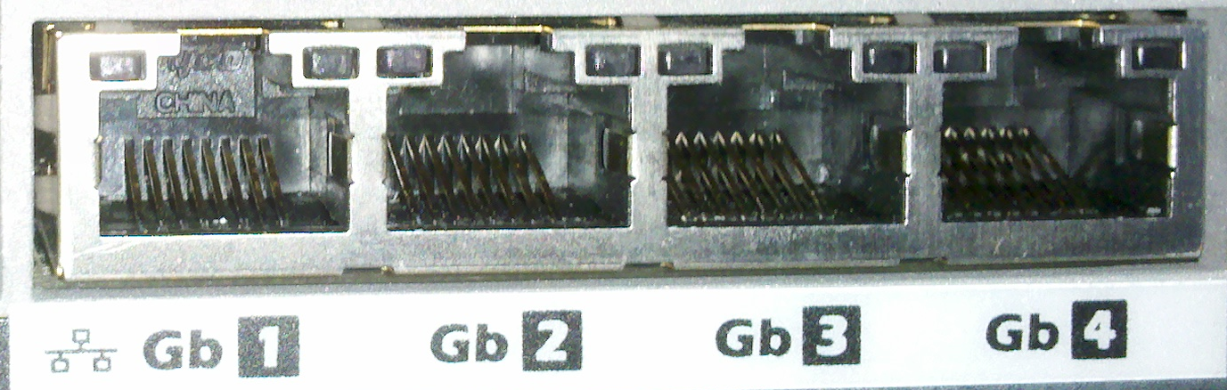
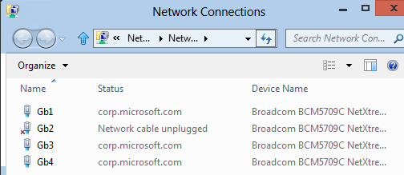
Enhanced Bare Metal Deployment
Deep Discovery
Deep Discovery when running WinPE
Use of Consistent Device Naming (CDN)
Logical Switch
Configure Logical switch (single management construct for multiple virtual switch instance)
Converged Fabric
Host Teaming and vNIC Configuration
Notes:
Thomas

Slide 20
Host Teaming and vNIC Configuration
Hyper-V Server
VM 2
VM 1
Live Migration
Cluster
Manage
Hyper-V Extensible Switch
1 GbE
1GbE / 10GbE
1 GbE
1 GbE
Network
Notes:
Thomas

Slide 21
Host Teaming and vNIC Configuration
Hyper-V Server
VM 2
VM 1
Live Migration
Cluster
Manage
Hyper-V Extensible Switch
Team
10GbE
10GbE
Network
Notes:
Thomas

Slide 22

NETWORKING| baremetal deploy

Slide 23
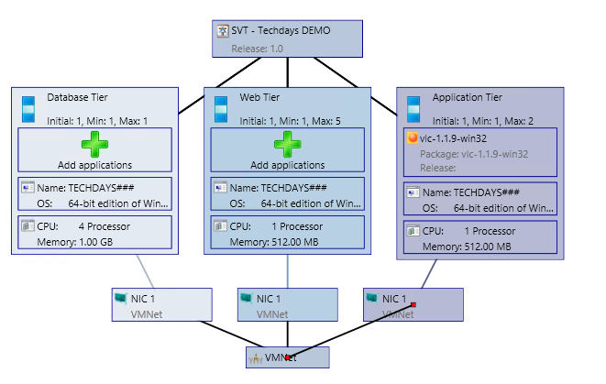
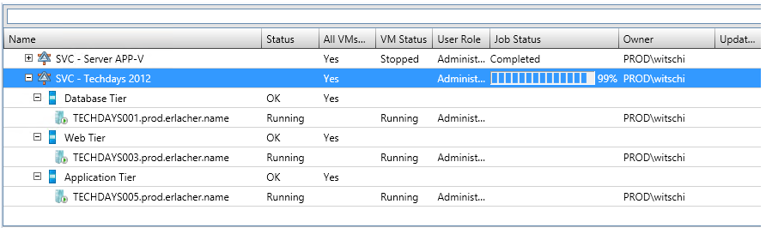
Services Overview
Notes:
Thomas

Slide 24
Services Overview
Why Services
Manage multi-tier applications across multiple servers as a single unit
Scale out based on demand
Composibility of OS and Applications, allows users to manage fewer OS images
Template
Specifies machine and connectivity requirements
Starting point for services
Deployed services are always linked to their templates
Enables servicing of the instances
Notes:
Thomas

Slide 25
Services Changes
Service Deployment
Support for Service deployment to untrusted domains and workgroups
Support for Service deployment to disconnected VMs
Linux Guest support
Supporting Linux Operating Systems
SQL Server 2012
Complete installation of prepared SQL 2012 instances
Notes:
Thomas

Slide 26
Microsoft Private Cloud Accelerator*
Service templates for Microsoft workloads
SCVMM explorer add-in to help discover service templates within VMM console
Service Templates
Windows Server 2012 / 2008 R2 SP1:
Domain Controller
DNS, DHCP
IIS
File Server
Notes:
Michel

Slide 27
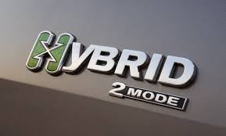
Hybrid cloud | app controller

Slide 28
Hybrid cloud | app controller

Slide 29
AD Integration | firewall
AD Boundaries
Hosts and Clusters in same Forest
Hosts and Clusters in trusted Forest
Hosts and Clusters in untrusted Forest
Firewall Boundaries
Single Hosts in Perimeter Neworks -> WinRM Port required
Adding host pushes agent via SMB!
VMM checks SMB shares periodically!

Slide 30
Managing Hyper-v
GUI Limitations -> Workarounds
Cluster Configuration -> Failover Cluster Mgmt Console
Hyper-V Replica -> Hyper-V Console
Import / Export VMs -> Hyper-V Console
VM HW mods while running -> None
As usual …. Powershell should be your best friend…

Slide 31
Managing VMware vsphere
Integrates native on vCenter Level for most operations
Multiple vCenter hosts / appliances can be connected
Uses VMware vSphere Web Services API
Requires RunAs Account with apropriate Permissions on vCenter
Two Host Support Modes (OK (limited) | OK)
NFS Storage cannot be managed

Slide 32
Managing VMware vsphere
Virtual Machines
VM Operations | OK (Limited) | OK
Power State (Start,Stop,Pause) | Yes | Yes
VM Mofifications | Yes | Yes
VMotion | Yes | Yes
Snapshot (New,Manage) | Yes | Yes
Clone (VC,Host) | Yes | Yes
Migrate (VC,to SCVMM library) | No | Yes
Convert (V2V) | No | Yes
Deploy VM from template | No | Yes

Slide 33
Managing VMware vsphere
Hosts / Clusters
Host Operations | OK (Limited) | OK
Restart | Yes | Yes
Register VM | Yes | Yes
Start / Stop Maintenance Mode | Yes | Yes

Slide 34
Managing Vmware ESX hosts

Slide 35
Managing CITRIX XENServer
Integrates with XenAPI
Requirements:
XenServer 6.x
RunAs Account with root permissions on host / pool
SCVMM Integration Suite Supplemental Pack http://go.microsoft.com/fwlink/?LinkID=213177
http://blog.itvce.com/?p=1746
NFS Storage cannot be managed

Slide 36
Managing citrix xenserver
Virtual Machines
VM Operations | OK
Power State (Start,Stop,Pause) | Yes
VM Modifications | Yes (Limited)
XenMotion | Yes (Limited)
Snapshot (New,Manage) | Yes
Clone (VC,Host) | Yes
Migrate (VC,to SCVMM library) | Yes
Convert (V2V) | No
Deploy VM from template | Yes

Slide 37
Managing citrix xenserver
Hosts / Clusters
Host Operations | OK
Restart | Yes
Dynamic Optimization | Yes
Power Optimization | Yes
Support for logical Networks | Yes
Start / Stop Maintenance Mode | Yes

Slide 38
Managing xenserver hosts

Slide 39
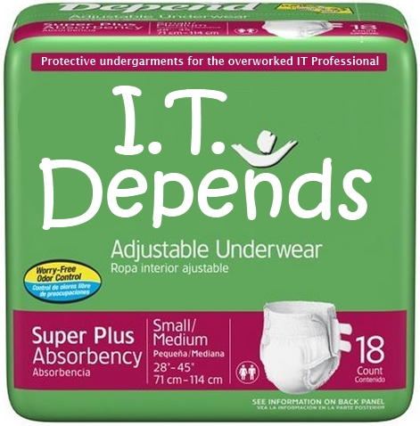
Real world experiences
Should or should I not use SCVMM for all my Hypervisors?
+++
Daily VM level operations
Self Service (App Controller)
VM and Service Deployment from templates
- - -
Host / Cluster Management
General Infrastructure Configurations

Slide 40
What about costs?
List Prices
3'607 $ for Datacenter Edition
1'323 $ for Standard Version (1 Host / 2 VMs)
→ http://bit.ly/10OSdTM

Slide 41

Recap
Complete Management Solution for a IAAS / Private Cloud
Integrates well with SysCtr 2012 products
Not everything can be done within the GUI
Runs best with Hyper-V 2012
OK for 3rd party VM operations
Limited for 3rd party Hypervisor management

Slide 42
If something goes wrong….
Enable Debug Logging in SCVMM http://bit.ly/176Zcyw
General Troubleshooting Guide http://bit.ly/13oTind

Slide 43
Other Resources
SCVMM Deployment & Sizing Guide http://bit.ly/MkSIij
SCVMM on TechNet http://bit.ly/hFrq4T
List o public KB articles for SCVMM 2012 SP1 http://bit.ly/WNEH0Z
Rollup 2 for System Center SP1 http://support.microsoft.com/kb/2802159

Slide 44

Thanks for your attention!
Thomas Maurer
@ThomasMaurer
www.thomasmaurer.ch
Michael Rüefli
@drmiru
www.miru.ch

