Slide 1




Empowering virtualization infrastructure management using Microsoft PowerShell
Michael Rüefli
Senior Consultant
MCSE, CCEA , CCIA, VCP 4

Slide 2
What INSERTO does…
Conception and design of mid to large IT infrastructures
Custom software development
RDS / Citrix access and delivery technologies
System center products
Directories, ID management
Mail and collaboration
Server- client & application virtualization
Workshops
Education

Slide 3
Agenda
Introduction / the shell in a nutshell
Managing Xenserver / vSphere environments
Managing XenApp Farms
Managing XenDesktop 5 environments
Managing Citrix Provisioning Services
How to keep maintaining a single golden image for a large VDI deployment
Introduction
Powershell Basics
Hypervisor Management
XenApp Management
XenDesktop Management
PVS Management

Slide 4
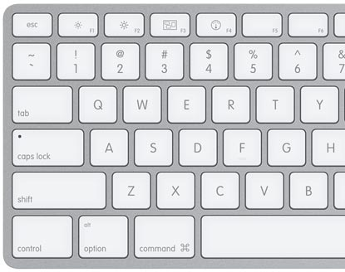



Are you compatible to CLIs ?
Introduction
Powershell Basics
Hypervisor Management
XenApp Management
XenDesktop Management
PVS Management

Slide 5
The Shell in a nutshell..
1st Impressions of new shell (Code: Monad in 2005) where not that bad, no interfaces to MS products
…..2010 / 2011 a lot of new products are primarily being managed using powershell modules and snapins as the GUI is built on top of PS CMDLET framework
Powershell (currently in v2.0) is a 100% .NET based scripting and development environment
Everything is an object (OOP)
Included by default in 2008 R2 / Win 7, installable on recent OS
Introduction
Powershell Basics
Hypervisor
Management
XenApp Management
XenDesktop Management
PVS Management

Slide 6
Powershell basics
cmdlet (little program containing functions and methods mostly written in c# / c)
SnapIn Microsoft .NET Framework assembly that contains Windows PowerShell cmdlets
Examples:
Plain cmdlet get-process | select-object name,id,VM | where { $_.VM –gt 100MB} | sort-object VM –descending | format-table –autosize .NET Assembly reference native integration Add-Type -AssemblyName System.Printing $server = new-object System.Printing.PrintServer
$queues = $Server.GetPrintQueues(@([System.Printing.EnumeratedPrintQueueTypes]::Shared))
Introduction
Powershell Basics
Hypervisor
Management
XenApp Management
XenDesktop Management
PVS Management

Slide 7
Management Framework
Orchestration & Automation
Citrix XenDesktop 4 SDK for PowerShell
GUI (AddOn)
Citrix XenServer SDK for PowerShell
Citrix XenApp 6 SDK for PowerShell
Citrix PVS SDK for Powershell
XenDesktop 5
Powershell Management Framework
Snap Ins & Modules
GUI (Mainly)
Microsoft Powershell
Core
Microsoft .NET Framework
Windows Operating System
Introduction
Powershell Basics
Hypervisor
Management
XenApp Management
XenDesktop Management
PVS Management

Slide 8
Powershell basics
Character | Description / usage
$ | Prefix of a variable
( ) | Marks the beginning / end of a condition
{ } | Surrounds a continous set of instructions
[ ] | Accesses a specific value within an array
" " | Surrounds a string and interprets variables.. While
' ' | .. does not interpret variables
% | Alias for "Foreach-Object"
? | Alias for "Where-Object"
| | (Pipe) Hands over a result of a command to the next one
$_ | Represents the current object within an array
-match -eq / -ne -contains -lt / -gt | Operators used in conditions
Example:
get-process | ? { $_.name –eq 'Powershell' –and $_.id –ne $pid} | kill
Introduction
Powershell Basics
Hypervisor
Management
XenApp Management
XenDesktop Management
PVS Management

Slide 9
Powershell basics
How do I know which CMDLETS are available after importing an SDK / SnapIn?
get-command –Module XenServer*
get-command –Module Citrix*
get-command –Module Vmware*
Show me only the set-* commands
get-command set-* –Module Citrix*
How do I know the required parameters for a CMDLET?
get-help get-XaServer
get-help get-XaServer -detailed
get-help get-XaServer -examples
Introduction
Powershell Basics
Hypervisor
Management
XenApp Management
XenDesktop Management
PVS Management

Slide 10
Powershell basics
How do I know wich properties / methods an object does have?
Get-Process | get-member
How can I create a custom object myself?
$e2e = New-Object -TypeName Object
$e2e | Add-Member -MemberType NoteProperty -Name Location -Value "Dublin"
$e2e | Add-Member -MemberType NoteProperty -Name Grandfathers -Value @("Sacha","Helmut","Simon")
Introduction
Powershell Basics
Hypervisor
Management
XenApp Management
XenDesktop Management
PVS Management

Slide 11
XenServer Management (1)
Install XenServer SDK: http://community.citrix.com/download/attachments/38633496/XenServerPSSnapIn-5.6.100-1.msi?version=1
Add Snapins: add-pssnapin XenServer*
For x64 Powershell Sessions, register it first C:\Windows\Microsoft.NET\Framework64\v2.0.50727\InstallUtil.exe "c:\Program Files (x86)\Citrix\XenServerPSSnapIn\XenServerPSSnapIn.dll"
Connect to XenServer Host Connect-XenServer -Url https://xens001
Introduction
Powershell Basics
Hypervisor
Management
XenApp Management
XenDesktop Management
PVS Management

Slide 12
XenServer Management (2)
Get Powered Off VMs (exclude all templates)
Get-XenServer:VM | ? {$_.power_state -eq "Halted" -and $_.is_a_template -ne $true} | ft
Move VM or set affinity
Get-XenServer:VM | ? {$_.name_label -ilike "VMLAB001"} | Set-XenServer:VM.Affinity -Affinity "XENS001"
Power on all halted VMs (exept templates)
Get-XenServer:VM | ? {$_.power_state -eq "Halted" -and $_.is_a_template -ne $true} | % {Invoke-XenServer:VM.Start -VM $_.name_label}
Power off all running VMs (exept templates and domain 0)
Get-XenServer:VM | ? {$_.power_state -eq "Running" -and $_.is_a_template -ne $true -a
nd $_.name_label -notmatch 'Control Domain'} | % {Invoke-XenServer:VM.HardShutdown -VM $_.name_label}
Introduction
Powershell Basics
Hypervisor
Management
XenApp Management
XenDesktop Management
PVS Management

Slide 13
VMware vSphere Management (1)
Install vSphere PowerCLI: http://www.vmware.com/support/developer/PowerCLI/index.html
Add Snapins: add-pssnapin Vmware*
Connect to vCenter connect-viserver –server "10.2.1.30"
Command Reference
http://www.vmware.com/support/developer/windowstoolkit/wintk40u1/html/index.html
Introduction
Powershell Basics
Hypervisor
Management
XenApp Management
XenDesktop Management
PVS Management

Slide 14
VMware vSphere Management (2)
Get All VM Snapshots with creation date > 5 days
$colsnapshots = Get-VM | Get-Snapshot | where {$_.Created -le ((get-date).addDays(-5))} | Select-Object Name,VM,Description,Created
Count the VMs per datastore, sort descending
Get-Datastore | Select Name, @{N="NumVM";E={@($_ | Get-VM).Count}},CapacityMB,FreeSpaceMB | Sort NumVM -Descending | ft –autosize
Disconnect all CDROM devices (preventing DRS)
get-vm | get-cddrive | Set-CDDrive -Connected $False -Confirm:$false
Introduction
Powershell Basics
Hypervisor
Management
XenApp Management
XenDesktop Management
PVS Management

Slide 15
XenApp Management (1)
MFCOM is no more with XA6 !
Install SDK: http://community.citrix.com/display/xa/XenApp+6+PowerShell+SDK
Add Snapins: add-pssnapin Citrix*
Export all applications to XML
Get-XAApplicationReport * | Export-Clixml c:\export.xml
Import all applications from XML
Import-Clixml C:\export.xml | New-XAApplication
Add a group/User to all applications
Get-XAApplicationReport * | Select-Object BrowserName,Accounts | % { $a = $_.Accounts ; Set-XAApplication -Browsername $_.BrowserName -Accounts ($a += "MIRULAB\hmuster")}
Introduction
Powershell Basics
Hypervisor
Management
XenApp Management
XenDesktop Management
PVS Management

Slide 16
XenApp Management (2)
Assign dummy load evaluator to all servers of a WG
Get-XAWorkerGroup WG_Desktop | % { $srvs = $_.ServerNames}; $srvs | % { Set-XAServerLoadEvaluator -LoadEvaluatorName "maintenance" -ServerName $_}
Add auto replicated print driver
Add-XAAutoReplicatedPrinterDriver -DriverName "HP LaserJet 4250 PCL6" -SourceServerName sxa6001 –Overwrite
Get all ICA sessions on all xenapp servers, exclude listeners
get-xaserver | get-xasession | ? { $_.Protocol -eq "ICA" -and $_.SessionId -ne 65536} | ft –autosize
Terminate all disconnected ICA sessions on all servers
get-xaserver | get-xasession | ? { $_.Protocol -eq "ICA" -and $_.State -eq "Disconnected" } | stop-xasession
Introduction
Powershell Basics
Hypervisor
Management
XenApp Management
XenDesktop Management
PVS Management

Slide 17
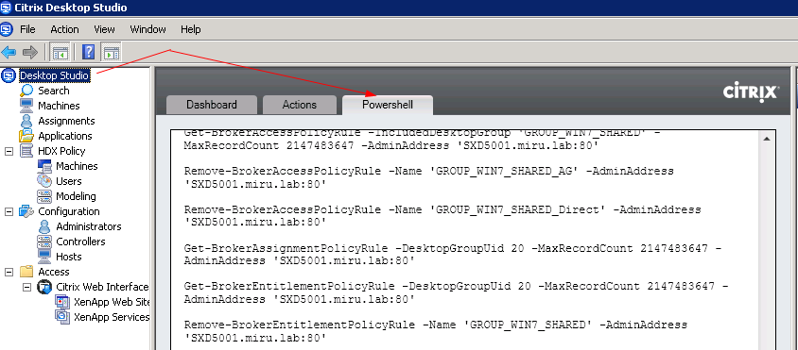
XenDesktop 5 Management (1)
Add Snapins: add-pssnapin Citrix*
Powershell TAB shows the executed PS CMDLETS on GUI transactions
Command Reference: http://support.citrix.com/static/kc/CTX127254/help/
PVS Management
Hypervisor
Management
PVS Management
Hypervisor
Management
XenApp Management
XenDesktop Management
Introduction
XenApp Management
Introduction
Powershell Basics
Powershell Basics
XenDesktop Management
17

Slide 18
XenDesktop 5 Management (2)
DEMO Script: XD5Prov.ps1
→ Get it from: http://www.miru.ch/wp-content/uploads/2011/05/XD5Prov.zip
Functions:
Creates a Catalog
Creates a Desktop Group
Creates computer Accounts in Active Directory
Assigns devices on hosting infrastructure (Xenserver / Vmware) to Catalog and Desktop Group
Assigns Users and BrokerAccessPolicy
DEMO
Introduction
Powershell Basics
Hypervisor
Management
XenApp Management
XenDesktop Management
PVS Management

Slide 19
PVS Management (1)
Install the PVS Management Console
Register the PVS SnapIn
For 32-bit %systemroot%\Microsoft.NET\Framework\v2.0.50727\installutil.exe "C:\Program Files (x86)\Citrix\Provisioning Services Console\McliPSSnapIn.dll"
For 64-bit %systemroot%\Microsoft.NET\Framework64\v2.0.50727\installutil.exe "C:\Program Files\Citrix\Provisioning Services Console\McliPSSnapIn.dll"
Add the PVS SnapIn Add-PSSnapin McliPSSnapIn
Connect to a remote PVS Soap Service mcli-run SetupConnection -p Server=10.2.1.169 (use IP Address here, using Hostname has a bug)
Programmers Guide: http://support.citrix.com/article/CTX124795
PVS Management
Hypervisor
Management
PVS Management
Hypervisor
Management
XenApp Management
XenDesktop Management
Introduction
XenApp Management
Introduction
Powershell Basics
Powershell Basics
XenDesktop Management
19

Slide 20
PVS Management (2)
Get Device Info
mcli-get DeviceInfo
Replace vDisk Assignment
mcli-run RemoveDiskLocator -p CollectionName='XenApp6' ,diskLocatorName='win7v10' ,siteName='Nollur' ,storeName='vDisk'
mcli-run AssignDiskLocator -p CollectionName='XenApp6' ,diskLocatorName='xa6v10' ,siteName='Nollur' ,storeName='vDisk'
Set Device Personalization Info
Mcli-SetList DevicePersonality -p devicename="WS7001" –r "Name=ENVIRONMENT,Value=LAB"
PVS Management
Hypervisor
Management
PVS Management
Hypervisor
Management
XenApp Management
XenDesktop Management
Introduction
XenApp Management
Introduction
Powershell Basics
Powershell Basics
XenDesktop Management
20

Slide 21
XenDesktop / PVS Use Case (1)
Requirement
Customer wants to use a single golden image for different deployment scenarios
Difficulties
Each deployment has some specific settings such as
AV Server
Appsense Management Server
App-V Management Server
XenApp Plugin Services Site
→ How to personalize this at boot time from vDisk?
PVS Management
Hypervisor
Management
PVS Management
Hypervisor
Management
XenApp Management
XenDesktop Management
Introduction
XenApp Management
Introduction
Powershell Basics
Powershell Basics
XenDesktop Management
21

Slide 22
XenDesktop / PVS Use Case (2)
The solution
Set device personality settings using a PS Script
Use a GPO to run a PS Script at system startup (check execution policy)
The script reads the %systemdrive%\personality.INI and executes agent and config personalization
Agents are started manually by the script after configuration has applied.
PVS Management
Hypervisor
Management
PVS Management
Hypervisor
Management
XenApp Management
XenDesktop Management
Introduction
XenApp Management
Introduction
Powershell Basics
Powershell Basics
XenDesktop Management
22

Slide 23

Help / Hints / Tools
Before you bang your head against the keyboard….
…It might be that somebody did already the work for you…
Ressources
http://community.citrix.com/p/cdn
http://poshcode.org/
http://www.miru.ch
Development Environment
http://www.powergui.org

Slide 24

Thanks for your patience…
Blog: www.miru.ch
Email: miru@inserto.ch
Twitter: @drmiru

