Slide 1
POWERSHELL
The Power of...
ITT Tech
September 17, 2009
David Mohundro
http://www.mohundro.com/blog/

Slide 2
Agenda
What is PowerShell?
Why should I care?
The Language
The Architecture
Customization
What can it do?

Slide 3

So… what is this PowerShell thing anyway?
“The original Power Shell is going to pump you up”

Slide 4
Windows PowerShell is a new command line shell and task-based scripting technology that provides information technology (IT) administrators comprehensive control and automation of system administration tasks, increasing administrator productivity. Windows PowerShell includes numerous system administration utilities, consistent syntax and naming conventions, and improved navigation of common management data such as the registry, certificate store, or Windows Management Instrumentation (WMI). Windows PowerShell also includes an intuitive scripting language specifically designed for IT administration.
via http://www.microsoft.com/windowsserver2008/en/us/powershell-faq.aspx
Windows PowerShell is Microsoft's task automation framework, consisting of a command-line shell and associated scripting language built on top of, and integrated with, the .NET Framework. PowerShell provides full access to COM and WMI, enabling administrators to perform administrative tasks on both local and remote Windows systems.
via http://en.wikipedia.org/wiki/Powershell

Slide 5
Less words, more content
PowerShell is Microsoft’s new object oriented command shell and scripting language that is based on .NET.
Interoperable with existing Windows scripting solutions.
It can be hosted by applications for scripting/automation purposes.
Original codename was Monad
Version 1 released for Windows XP on November 14, 2006.
Installed by default on Windows Server 2008 R2.
eWeek names it the number 7 best Microsoft Product!
PowerShell is 30% of value in Windows 7 according to NY Times

Slide 6
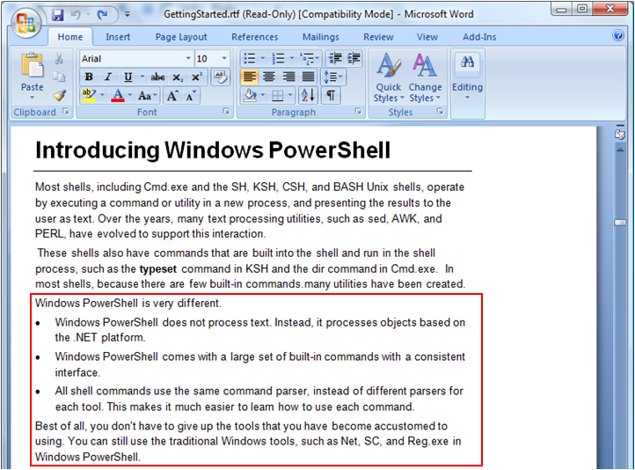
GettingStarted.rtf

Slide 7

Why Should I Care?
With <insert cool technology here>, who seriously cares about the command line?
Notes:
Obviously, I’m excited about PowerShell. But why should you be? There are lots of really cool things out there to learn like Silverlight, WPF, WCF, LINQ (including LINQ to SQL, LINQ to XML, LINQ to Objects), WF, dynamic languages like IronRuby and IronPython in the DLR, ASP.NET MVC… am I missing anything cool out there? I’m sure I am. I’ve purposely only included Microsoft technologies! There are tons more out there! Do you feel overwhelmed? You should!
So again, I ask the question, why should you care about PowerShell? Why should you care about scripting or the command line? Why should you, as a developer, care about a tool that is being marketed at least partially as an administration tool?
Any ideas?

Slide 8
Resurgence in the Command Line
Lifehacker Geek to Live Post entitled “The command line comeback”
Example of Search box (Google)
-inurl:(htm|html|php) intitle:"index of" +"last modified" +"parent directory" +description +size +(wma|mp3) "Nirvana“
Firefox
“Awesome Bar”
Ubiquity
“The Web Browser Address Bar is the New Command Line” – Jeff Atwood
Launchy, SlickRun, QuickSilver (OS X), Gnome Do (Linux), etc.
All the other keyboard/hotkey oriented applications
Notes:
LifeHacker has a great post on this entitled “The command line comeback.”
You can see examples of command line behavior all around us.

Slide 9
Top 6 Reasons you should learn a scripting language
It will let you automate repetitive tasks
They are simple to learn
Write it and run it
Most of them are free
Community and commercially supported
It will make you stronger
via http://www.pcdoctor-community.com/blog/posts/2007/07/27/Top-6-reasons-why-you-should-learn-a-scripting-language,-even-if-you-are-not-a-programmer/
Notes:
All of these reasons are from the referred link.
It will let you automate repetitive tasks. This is definitely the biggest selling point. As I said before, computers are supposed to do the tedious work for us and by using a scripting language we can easily give commands to our emotionless servants in a language they understand.
- How often do you do the same thing more than once?
- Why do you do it?
- Did you ever think about making it easier?
- Isn’t that our job as programmers?
They are simple to learn. If you are already a programmer, many scripting languages closely resemble the syntax of your favorite compiled language (small investment, big returns). If you are not a programmer, scripting languages are usually and very good introduction into the world of programming (medium investment, big returns).
- This is particularly true with PowerShell – it is based on .NET after all!
Write it and run it. Who doesn't like instant gratification? When you write a script you don't necessarily have to transform it into machine code to run it. No compile, no wait, just run, right away. This of course carries a small performance penalty, but if you are after ultimate performance by using a script, then you are probably looking in the wrong place.
- This is true for dynamic languages as well as scripting languages, but it is a fair point.
- The feedback loop is faster.
Most of them are free. Very inexpensive price of admission. No try before you buy, just use it and still have the peace of mind that it will always be yours.
- PowerShell is free after all.
Community and commercially supported. Some people are very passionate about their scripting language. If you have one close to you, he'll be more than happy to answer your questions. If you don't have one around, you can always find them at Internet forum flame wars defending their scripting language of choice. If you still can't find one, you can always find a company that will give you commercial support. Just make sure to read the manual before you even start looking.
- There is a huge community already built up around PowerShell and Microsoft is supporting it.
It will make you stronger. Having another weapon on your arsenal can only benefit you. Or at least give you bragging rights.
- Yeah, I like the imagery of “having another weapon” ☺
- It can’t hurt, can it? I don’t think so.

Slide 10
Is PowerShell useful to a developer and why?
Task automation
Quick access to the .NET framework.
Easy to build domain specific languages.
See psake by James Kovacs
It can provide a scripting language for your application.
PowerShell is part of the 2009 Common Engineering Criteria
Ease of creating a command-line interface
PowerShell provides a large part of the underlying plumbing needed for parsing arguments, and other basic tasks
It's just cool!
In about 250 lines (including comments), Rob Foust and Jeff Hicks wrote a network sniffer in PowerShell. Easier to use than WinDump for lightweight troubleshooting.
Community
see PowerShellCommunity.org.
Via http://stackoverflow.com/questions/8722/how-do-you-use-powershell#10137

Slide 11
Why I care about PowerShell
Efficiency
Automation
Prototyping
REPL (read-eval-print loop)
PowerShell fills a gap that (in my opinion) has been missing on Windows that *NIX developers have always had.
I use PowerShell for the same reason that I use Process Explorer instead of Task Manager.
“We are digging ourselves out of a 30 year hole.” – Jeffrey Snover’s Lang.Net PowerShell Talk
Notes:
These reasons are my own.
I am a huge fan of efficiency. I’m the guy who gets incredible annoyed when someone reaches for the mouse to copy and paste test (do an example to show them what you’re talking about). USE CTRL+C AND CTRL+V FOR CRYING OUT LOUD!
From the automation perspective, a few months back, I found myself repeating the same behavior multiple times to deploy an update to an application. The steps were basically to zip up a package and then copy them to the servers on the web farm. I wrote a script to do this for me and now it has been incorporated into our build script at work. This is the entire idea behind having a build script – you want to be able to have a build of your application in one step.
Because PowerShell is based on .NET, I can use it to quickly prototype or test behavior. We’ll see this in more detail later.
I also feel that Windows developers have largely been missing out on a lot of the benefits that *NIX developers have historically had. *NIX developers can instantly be productive at a baseline installation because their scripting and command line environment is so powerful! You can do a lot with the command line on Windows, but it doesn’t at all compare with bash. PowerShell helps to fix this problem.
The last line on this slide is a good summary for why I use PowerShell – “I use PowerShell for the same reason that I use Process Explorer instead of Task Manager.” PowerShell is a better tool for the job. I’m to the point now that I typically can get information far faster from PowerShell than I could have had I browsed to it via Windows Explorer.
“We are digging ourselves out of a 30 year hole.” – The context for that quote was regarding what is bad about PowerShell.

Slide 12
How to Get-Help and Get Started
The four most important commands
Get-Help
Get-Command
Get-Member
Get-PSDrive
Notes:
Okay, so hopefully, you’re at least interested in learning more about PowerShell… so let’s get started!

Slide 13
Get-Help DEMO
(With Get-Command, Get-Member and Get-PSDrive)
Notes:
> Get-Help
Notice all the different ways to get help as well as the topics.
Let’s follow their advice and look at get-command, about_object, and get-member.
> Get-Command
Notice the consistency? Everything is in the format of “Verb-Noun”
The language designers tried very hard to make the names of everything meaningful.
For example, Set-Location is the cmdlet to, surprisingly enough, set your location. It’s name describes exactly what it is.
The reason the command is Set-Location instead of Set-Directory is because Set-Location can do much more.
Let’s Get-Help on it. “That location could be a directory, a sub-directory, a registry location, or another location stack.” REGISTRY LOCATION?!?
> Set-Location hklm:
Nice!
This works because of a concept called PSDrives.
> Get-PSDrive
Notice the different providers, like FileSystem, Function, Variable, Registry, Environment, and Alias.
Yes, you can set the location to functions and variables, too.
Aliases also bring up an important point. Notice how all the commands seem extremely verbose?
I know what you’re thinking. “Set-Location?!? I’d much rather type cd instead!”
Let’s Set-Location to alias: and look in there.
> Set-Location alias:
> Get-ChildItem
Ah ha! We’ve got cd, ls, dir, cls, echo, cat, type, etc. Notice how these are all provided by default? They also created aliases that were common to *NIX systems as well.
You can be as verbose or as terse as you want. The verbosity is for consistency and readability, but aliases give you the power to type much less.
I think I’ll switch over to typing cd and ls from now on.
> cd function:
> dir
Here, we can see all of the functions currently loaded in PowerShell. We also get to see a few of the lies (conveniences) that are provided for us, like ‘c:’ or ‘a:’. We can see their definitions so we now know that typing ‘c:’ is actually running a function that calls ‘set-location c:’ for us.
> c:
Okay, what about Get-Member? Remember how I said that PowerShell was object oriented? An example will serve best here.
> Get-Member –InputObject 5 # System.Int32 – PoSH knows this is an integer! See how get-member provides the properties and methods? That is its purpose – basically an exploratory method.
The general usage for get-member (gm), though, is piping something to it. Like ‘5 | gm’ – I don’t have to specify the –InputObject parameter this way. Less typing is better. Let’s pipe something else to it.
> dir / | gm
The first time I ran this command is when it really clicked for what PowerShell provides and why it is different. Let me scroll through that again. FileInfo??? DirectoryInfo??? Can anyone tell me what is going on here? Dir (or Get-ChildItem) doesn’t spit out strings – it returns objects. The built-in commands here are doing this and PowerShell is displaying them as strings to us. This is a completely different way of thinking about the command line. We’ll talk about this more during the presentation.
The thing to remember with Get-Member is that it can tell you what you’re looking at and what it provides.

Slide 14
PowerShell Language Cheat Sheet!
How I learned to use other people’s content instead of my own!
Ben Pearce’s PowerShell Cheat Sheet

Slide 15
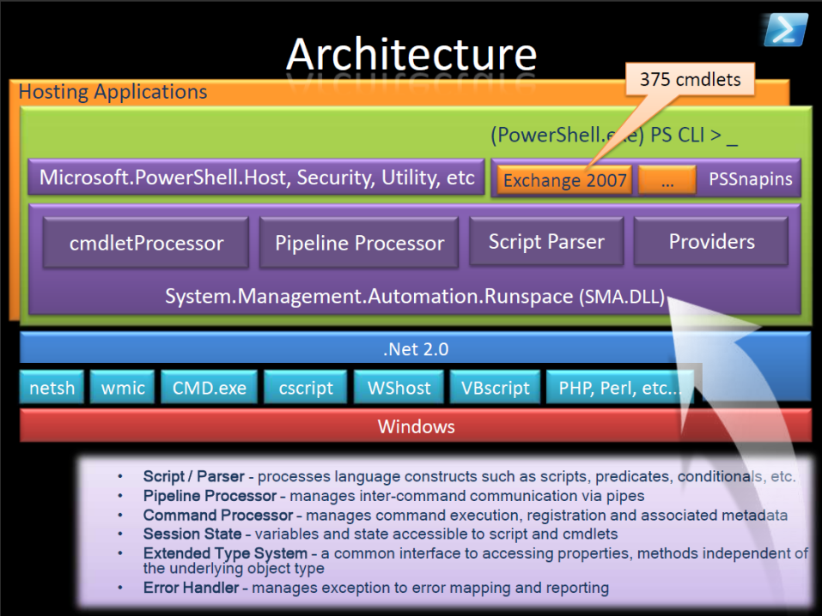
Notes:
From Chris Green’s Tech Ed 2007 presentation.
Big picture architecture.
Note where PowerShell lives compared to cmd.exe.
Note also Microsoft.PowerShell.Host.
PoSH is not standalone, but is hosted.
PoshConsole as an example
Open source WPF PoSH console… not much activity and still very buggy, but good proof of concept.
Out of the box, CMD.exe is the primary vehicle for hosting in version 1, but version 2 will have a graphical host that I hope to show you later
PoSH can also be hosted in your own applications if you so wish. Notice Exchange 2007? Both it, IIS7 and SQL Server 2008 extend and are extended by PoSH.
Contrast cmdlet idea between PoSH and CMD and *NIX.
CMD
Where does CD, DIR, etc live?
They’re actually implemented by CMD.
CMD can also run command line applications, but you have to know where they are or they must be in the %PATH%
*NIX
Where does LS, CD, GREP live?
They are separate executables.
Apps typically live in the %PATH% so the command line always has access to executables.
PoSH?
Cmdlets are loaded in the PowerShell host. Once in the host, you don’t have to know where they are, but you can add more commands to the host.
Sort of a blending of ideas.
Note the various parsers and providers.
With both CMD and *NIX shells, each application had to parse arguments.
PowerShell comes with parsers so the communication between applications is common.
What is this common communication mechanism?
Let’s look at the pipeline!

Slide 16
The Pipeline
“I want to write a console application that outputs the running processes…”
Console.WriteLine(…); // string!
How would another application parse this?
Regex
String parsing
“Prayer-based parsing”
What’s the solution?

Slide 17
Pipeline and Filters DEMO
Notes:
CMD.exe
pslist - Tool from Sysinternals that outputs processes.
tasklist – Tool to list processes
> pslist | findstr power
> tasklist /fi "imagename eq powershell.exe"
> pslist power | PipelineDemo\App\bin\Debug\PipelineDemo.App.exe cmdlinearg 1 2
You can pipe to findstr (find string), but most applications would have to provide this functionality every time to be used easily.
Look at how complicated tasklist is?
Notice how everything is a string… parsing this wouldn’t be fun. Or consistent.
Cygwin
ps - *NIX utility that outputs processes
> ps –W | grep power
> ps –W | PipeLineDemo\App\bin\Debug\PipelineDemo.App.exe
Once again, all strings.
We’ve already talked about PowerShell, so you know it returns objects. Let’s look at this some more.
PowerShell
get-process (alias is ps) - Cmdlet to return processes (like pslist and ps)
> ps
> ps power*
- The equivalent PowerShell command to the prior examples.
> ps power* | foreach { $_.gettype().fullname }
’$_’ is the variable indicating the OBJECT currently in the pipeline.
System.Diagnostics.Process! Not a string! You can ask about any property on it or call any method on it!
Get-Member is shorthand for this
Here, we’re also introducing the foreach cmdlet (Foreach-Object). It does what you would expect – performs some action on every object piped to it.
What do you think would happen if I typed ‘ps | foreach { $_.kill }’ ?
(nothing, because I didn’t specify the ()’s!)
If I add the ()’s, though… well, let’s not try that shall we?
> ps | where { -not $_.Responding }
One of my favorite commands – shows me all the apps that aren’t responding.
I usually use ‘ps someapp | select MainWindowTitle, Responding’ instead (though this requires me to run as an admin)
Shows the Select-Object cmdlet, too. You can specify properties on the object in the pipeline to be filtered out.
- So, let’s try piping Get-Process to our test application.
> ps power* | PipeLineDemo\App\bin\Debug\PipelineDemo.App.exe
Still a string? The reason involves the PoSH architecture. (switch to architecture slide)
See how the pipeline parser all lives in the hosted application? PoSH essentially uses a version of serialization to communicate between processes. If it sees that you’re passing/piping objects out to an external process, it treats it as console output and converts everything to a string representation.
To get into the object goodness, you can either write a PS1 script, a PS1 function, or a cmdlet if you need to use it from .NET.
We’ll cover a basic cmdlet later.
So, we’ve been spending a lot of time talking about PowerShell and how it passes objects around. I thought I’d share an interesting post from the PowerShell team regarding text output. The post mentions this command <get-command get-process -syntax> and how ugly the output is. One of the guys suggested cleaning up the output, but another person mentioned that would break any programs that depended on the text output. This is how the guy responded: “In PowerShell - TEXT OUTPUT IS NOT A CONTRACT.” [1]
[1] http://blogs.msdn.com/powershell/archive/2008/09/04/text-output-is-not-a-contract.aspx

Slide 18
Customization: “Make my prompt pretty”
CMD let you customize your prompt using cryptic environment variable settings
The default is $P$G
set prompt=$P$_$+$G
PowerShell has the prompt function.
Notes:
1 – Prompt reference from http://www.hanselman.com/blog/PromptsAlongWithPushDAndPopD.aspx
2 – More prompt reference from http://blogs.sqlservercentral.com/brian_kelley/archive/2008/02/20/changing-the-command-prompt.aspx
3 – Full prompt reference at http://technet.microsoft.com/en-us/library/cc772636.aspx
(ls function:pr*).definition # outputs the currently defined prompt function
How do we change it?
Let’s write a function!
function prompt { “PROMPT ME:” } # PROMPT ME:
function prompt { } # PS>
function prompt { ‘$ ‘ } # like *NIX
You can do whatever you want, including changing the color.
#show your first prompt function (maybe blog post?)
# close the session and pull it back up to show that your changes weren’t saved.

Slide 19
Saving my changes
PowerShell has the idea of a profile
Borrowed from *NIX (.bashrc, .bash_profile, etc.)
Modifications like new aliases, functions, etc. are only stored for the current session
Permanent changes go to the $profile
Default $profile location
[System.Environment]::GetFolderPath('MyDocuments') + ‘WindowsPowerShell\Microsoft.PowerShell_profile.ps1’
Notes:
$profile # writes out profile path
The default profile only loads for the default PoSH host. If you’re hosting PoSH in your own application, that profile won’t get loaded.
There are other profile file locations that will give you different behavior.

Slide 20
More customization: Formatting
[35] » ps power*
Handles NPM(K) PM(K) WS(K) VM(M) CPU(s) Id ProcessName
------- ------ ----- ----- ----- ------ -- -----------
829 50 36664 4668 311 31.95 488 POWERPNT
410 21 53408 38004 238 10.48 4684 powershell
How does PowerShell know how to format System.Diagnostics.Process?
%SystemRoot%\System32\WindowsPowerShell\v1.0\*.ps1xml
Notes:
I’ve run this command a few times during the presentation – the command once again is Get-Process power*, which will return all of the processes whose name starts with ‘power’. Regarding the formatting, what do you think is going on? Is the Get-Process command performing this formatting or is something else in control? Any ideas?
…
Note what happens when I just try to output an array of integers or strings. (5; ‘hello’; 1,2,3;) PowerShell just prints them out.
What about a StringBuilder? ($sb = new-object System.Text.StringBuilder; $sb) Now, we’re getting properties… what’s the difference?
…
Back to the Get-Process cmdlet and System.Diagnostics.Process. PowerShell is in control of the formatting, but it is entirely customizable. It uses formatting files with an extension of ps1xml… yes, they’re basically PowerShell plus XML. Don’t worry, it isn’t as bad as it sounds.
Let’s cd to $pshome. ($pshome is a variable that the host sets up for you that points to the install directory for PowerShell) (dir; dir *.ps1xml;) The first one we’re interested in is the DotNetTypes.format.ps1xml file. Let’s pull it up.
Things to note: Views. The file is a big group of ViewDefinitions… apparently by Type.
Let’s search on System.Diagnostics.Process. It has a sub-element of TableControl, which sounds promising. TableHeaders… and look, there are our properties! Handles, NPM(K), etc. You can see how they specify the width and text alignment. The next major sub-element is TableRowEntries, that actually specifies the definition for the various properties. For example, WS(K) (which is working set in kilobytes), is mapped to [int]($_.WS / 1024). Notice how it is using the $_ variable, which is the current object in the pipeline. The definitions can also be mapped to either properties or script blocks, so you can have a column be mapped to a function essentially.
This all sounds pretty neat, but I still have questions… like… where did the WS property come from? We can pull up Process in Reflector and we won’t find that type defined anywhere.
This is where the types.ps1xml file comes in. Let’s open it. The first item in there is System.Array. See how it has created an AliasProperty named Count that forwards to Length? You can think of this file as defining the equivalent of Extension Methods from .NET 3.5 in PowerShell. If we search on System.Diagnostics.Process, we’ll see a few other elements and finally the aliasing of WS to WorkingSet.
Any questions on this? Does this make sense?
1 – about_Formats – http://technet.microsoft.com/en-us/library/bb978746.aspx
2 – about_Types – http://technet.microsoft.com/en-us/library/bb978568.aspx
3 – “How does PowerShell formatting really work?” – http://blogs.msdn.com/powershell/archive/2006/06/21/more-how-does-powershell-formatting-really-work.aspx

Slide 21
Can I add my own formatting?
Yes, but…
Don’t change the system ps1xml files!
“The PS1XML files that are installed with Windows PowerShell are digitally signed to prevent tampering, because the formatting can include script blocks. Therefore, to add a property or method to a .NET type, create your own Types.Ps1XML files and then add them to your Windows PowerShell console.”
http://technet.microsoft.com/en-us/library/bb978568.aspx
Notes:
MyTypes.format.ps1xml
I’ve created my own MyTypes formatting ps1xml file. What I did to create it was I copied the existing DotNetTypes.format.ps1xml over and took out all but the type definitions that I cared about (i.e. I just let System.Diagnostics.Process in). Next, I added a property for MainWindowTitle, which I labeled “Window Title.”
(show changes)
To get PowerShell to see our customizations, we can call (Update-FormatData -PrependPath .\MyTypes.format.ps1xml). After doing this, when we run Get-Process, we now see the new column.
Make sense? If you wanted to customize types, you could create a copy of the types.ps1xml and then call Update-TypeData instead of Update-FormatData. Anyone know how you would ensure that PowerShell knows about these changes the next time you run? Yup, the profile.

Slide 22
External Customizations - PSCX
PowerShell Community Extensions
“PowerShell Community Extensions (PSCX) is aimed at providing a widely useful set of additional cmdlets, providers, aliases, filters, functions and scripts for Windows PowerShell that members of the community have expressed interest in.”
Adds useful functionality
Great tool for browsing the source and learning
Notes:
PowerShell Community Extensions are a community-driven, open source set of extensions to PowerShell. They’ve got new cmdlets, providers, aliases, filters, functions and more. When I set up PowerShell now, I usually install this first. PSCX comes with some a great default profile that is an excellent place to start your own as well as to get ideas and learn more. I also based my prompt off of theirs.
<pull up default profile : ep>
Just as an example, notice the TextEditorPreference variable – PSCX sets up a function Edit-File with an alias of e, so that you can type ‘e file’ and pull it up in your favorite text editor.
Just to show you how much they add, check this out:
<man about_pscx>

Slide 23
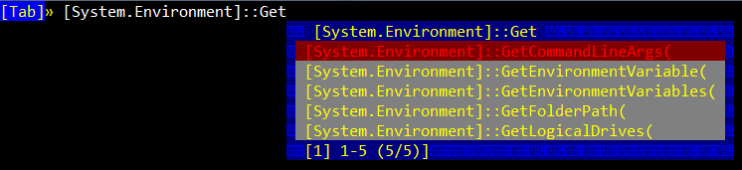
External Customizations – PowerTab
PowerTab TabExpansion
Did you know CMD has tab autocompletion?
PowerShell does, too… but it is customizable!
Don’t customize it yourself, though, just use /\/\o\/\/’s PowerTab!
Notes:
First off, did you know that the command prompt provides tab autocompletion?
<
cmd
cd \<TAB><TAB>
cd \prog*86*<TAB>
>
Pretty useful if you’re jumping around and, of course, PowerShell provides this, too… except that it is customizable!
<click>
PowerTab is… well… ridiculous. You can see the screenshot here – this is intellisense at the command line. We’re all Visual Studio developers right? We love our intellisense. Why not have it at the command prompt? PowerShell’s extensibility model for tab completion basically lets you create your own TabExpansion function to do whatever you want.
<gc function:TabExpansion # see the default TabExpansion>
Let’s see a demo of PowerTab actually being used.
<
[System.IO.<tab> # example in the screenshot
cd /<tab>
#etc
>

Slide 24
Integration with Microsoft Tools
Exchange 2007
Shipped with over 375 unique commands
SQL Server 2008
SQLPS
IIS7
IIS7 PowerShell Provider (Import-Module WebAdministration)
Windows Server 2008 R2
Installed by default!
Windows 7
Installed by default!
Common Engineering Criteria in 2009
Included in all server productions from 2009 forward
All future administration GUIs will be built on PowerShell (allows scripting anything)
And more!!!
“If you work with Microsoft Server products, you are going to be a PowerShell user.”
- Jeffrey Snover via http://blogs.msdn.com/powershell/archive/2008/08/30/powershell-vs-tsql-why-learn-powershell.aspx
Notes:
Exchange
See [1] for 375+ commands listed.
can’t really talk about this much because (1) I don’t have access to our Exchange server at work, (2) we’re running Exchange 2003, and (3) I’m too lazy to set up Exchange on my own just to see what the PowerShell integration looks like ☺
SQLPS
a minishell that gives you a complete pre-configured Powershell with all of SQL Server’s extensions preloaded. [2]
One guy says SQLPS is the best feature of 2008 for him! [3]
Biggest surprise for me? SQLPS is considered a replacement for SQLCMD!
<small demo – don’t forget to set the credentials up to kick off SQL Server!!!>
IIS7
Create Web-Sites, Web Applications, Virtual Directories and Application Pools
Change Simple Configuration Properties on Web-Sites, Application Pools, Web Applications and Virtual Directories
Add and Change Complex Configuration Settings
Query Run-time Data (Web-Site State, Application Pool State, Currently Executing Requests)
Execute Advanced Configuration Tasks, Scripting, Integration with other PowerShell Snap-Ins and features
Search and Discover Configuration Settings
(via [4])
Good overview at [5]
<example on Server 2K8 VM>
[1] http://www.exchangeninjas.com/pscmdlets
[2] http://blogs.msdn.com/mwories/archive/2008/06/14/SQL2008_5F00_Powershell.aspx
[3] http://blogs.msdn.com/ericnel/archive/2008/08/06/the-best-feature-in-sql-server-2008-sqlps-exe.aspx
[4] http://iis.net/downloads/default.aspx?tabid=34&g=6&i=1665
[5] http://blogs.iis.net/thomad/archive/2008/04/14/iis-7-0-powershell-provider-tech-preview-1.aspx

Slide 25
But… what else can it do?
IBM WebSphere MQ
PowerShell API to talk to WebSphere
VMware Infrastructure Toolkit
Manage VMware virtual machines
Intel vPro PowerShell Module
Power and CPU management
Web Farm Framework 2.0 for IIS7
Configure/Manage server farm

Slide 26
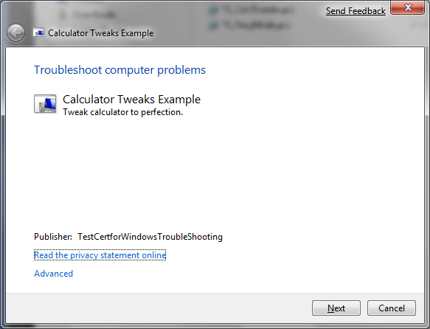
Troubleshooting Packs
New feature in Window
7 to automate trouble-
Shooting.
Via http://www.withinwindows.com/2009/01/12/
crash-course-on-authoring-windows-7-troubleshooting-packs/
Notes:
I can take no credit for the example – Rafael did all the work here.

Slide 27

Build scripts with PowerShell
properties {
$testMessage = 'Executed Test!'
$compileMessage = 'Executed Compile!'
$cleanMessage = 'Executed Clean!'
}
task default -depends Test
task Test -depends Compile, Clean {
Write-Host $testMessage
}
task Compile -depends Clean {
Write-Host $compileMessage
}
task Clean {
Write-Host $cleanMessage
}
From James Kovacs via http://code.google.com/p/psake/
Notes:
Heavily inspired by rake (ruby make) and bake (boo make).

Slide 28
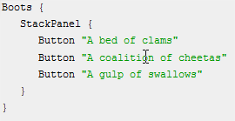
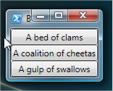
GUIs with PowerShell
PowerBoots from Joel Bennett
http://huddledmasses.org/powerboots-tutorial-walkthrough/
Notes:
See PowerBoots-Demo.ps1

Slide 29
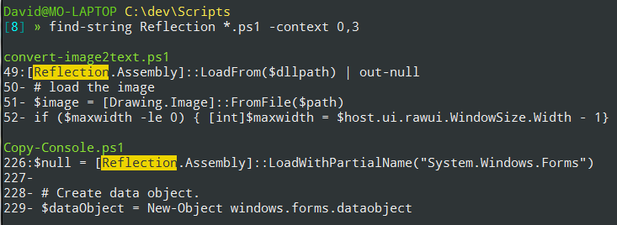
Find stuff quickly!
Find-String.ps1
Output based on ack
http://github.com/drmohundro/Find-String/

Slide 30
Even MORE Features
Remoting support (see remoting-demo.txt)
Job support (see job-demo.txt)
Graphical Console (ISE)
Transactions
Modules
Notes:
<demo from 2K8 VM>
PowerShell as a version 1 product has already become highly impressive. Historically, version 1 releases of Microsoft tools have been… well… iffy, maybe? But PowerShell is doing great and I think it will continue to improve.

Slide 31
Questions?
David Mohundro
http://www.mohundro.com/blog/
http://twitter.com/drmohundro

