Slide 1
Power, Energy and Delay
Static CMOS is an attractive design style because of its good noise margins, ideal voltage transfer characteristics, full logic swing, superior robustness (makes it easy to implement design automation) and its almost complete absence of power dissipation in steady state operation mode.
Power dissipation of CMOS circuits is dominated by the dynamic dissipation resulting from charging and discharging load capacitances.
Each time the output node capacitance C_{L} is charged from 0 to V_{DD} a certain energy is drawn from the power supply.
Part of this energy is dissipated in the pMOS device while the remainder is stored on the load capacitor.
When the output capacitance C_{L} is discharge the stored energy is dissipated in the nMOS device.
The energy taken from the supply during a low-to-high transition can be determined precisely.

Slide 2
Dynamic Power Consumption
Also the energy that get stored on the output capacitance can be determined
A simplified analysis is stated as follows:
  During the low-to-high transition C_{L} gets loaded with a charge C_{L}V_{DD}.
  If this charge requires energy from the supply, this energy equals C_{L}V_{DD}² = QV_{DD}.
  The energy stored on the capacitor equals C_{L}V_{DD}²/2, implying that only half the energy supplied by the power source is stored in C_{L}.
  The other half has been dissipated by the pMOS device.
  During the discharge phase charge is removed from the capacitor and its energy dissipated in the nMOS device.
Each switching cycle takes a fixed amount of energy (C_{L}V_{DD}²).
Power consumption is thus determined by taking into account how often the device is switched leading to P_{dynamic} = C_{L} V_{DD}²f

Slide 3
Dynamic Power Dissipation
With increasing complexity of digital ICs, it is anticipated that the power problem will get worse in future technologies.
To address these concerns low power design techniques must be employed:
  The power supply voltage has a quadratic relationship to the power, thus reducing V_{DD} is an attractive option (this approach will have a meaningful effect if the switching frequency is maintained or lowered as well).
  Reducing V_{DD} to 2V_{t} and below results in a large performance penalty.
  Another approach in lowering dynamic power is to reduce the load capacitance C_{L}. Recall that most of C_{L} results from the diffusion regions.
  We therefore must opt to increase transistor sizes when the output capacitance is dominated by the extrinsic capacitance.
  Device sizing combined with supply voltage reduction is a very effective approach in reducing the energy consumption of a logic network.

Slide 4
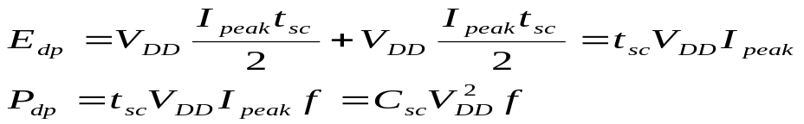
Dissipation Due to Direct-Path Currents
The finite slope of the input signals causes direct current path between V_{DD} and GND for a short duration while switching.
The nMOS and pMOS conduct simultaneously under these conditions.
If we assume symmetric switching the short current spikes can be approximated as having triangular shapes and the energy consumed per switching period can be determined as follows:
  t_{sc} represents the time both devices are conducting
  I_{peak} is determined by the saturation current of the devices. The peak current is also a strong function of the ratio between input and output slopes.
The impact of short circuit currents is reduced when the supply voltages are lowered.

Slide 5
Static Power dissipation
The steady state power dissipation of a circuit is defined by: P_{static} =I_{static}V_{DD}
I_{static} is the current that flows from V_{DD} to GND in the absence of switching activity. Ideally I_{static} is zore since nMOS and pMOS are never on at the same time in steady state operation.
Leakage current however flows through the reverse biased diode junctions of the transistors located between the source or drain and the substrate.
Sub-threshold currents are becoming an emerging source of leakage.
The closer the threshold voltage is to zero the larger the leakage current.
Will powering down portions of the system that are not active help reduce leakage currents?

Slide 6
Power-Delay-Product
In current technologies the capacitive dissipation is by far dominant.
The short circuit dissipation can be kept at a minimum by careful design.
Leakage has been ignorable, but this will change in nano-meter regime.
The power-delay-product (PDP) is a measure of energy and is defined by the product of the average power (P_{ave}) and the gate delay t_{p}.
Ignoring contributions from static and short circuit power and assuming maximum switching frequency, the expression for PDP is C_{L}V_{DD}²f_{max}t_{p} which is equivalent to C_{L}V_{DD}²/2.
This expresses the average energy consumed per switching event.
Power-delay product is a misleading metric, as it favors a processor/system that operates at lower frequency.
Energy-delay-product (EDP) is adequate, but energy delay² should be used instead.

Slide 7
Energy Delay Product
EDP=PDPxt_{p}=P_{ave}t_{p}²=(C_{L}V_{DD}²t_{p})/2
From the equation we can see that like power, EDP has a quadratic relationship to the power supply voltage.

