Slide 1
A Brief Look at Data Flow Diagrams
Devon Moulter

Slide 2
Introduction
Maps the flow of data for a process or system
Identifies input locations, output locations, storage points, and the routes between them
Great for mapping data flow software software
Not as applicable for interactive, real-time, or database-oriented systems

Slide 3
History
Popularized in the 1970s by Ed Yourdan’s and Larry Constantine’s Structured Design
Developed and popularized as part of a movement to improve design practices and remove more errors early in development
Yourdon and Constantine collaborated with Tom DeMarco, Chris Gane, and Trish Sarson in various combinations to further refine the symbols and concepts associated with data flow diagrams

Slide 4
Symbols in Data Flow Charts
Double Square
Arrow
Data Flow – shows the data’s contents, source, and destination
Data Source/Destination – external entity that sends or receives information
Rounded Rectangle
Open-Ended Rectangle
Process – changes input data to produce an output; sometimes merely sends data from a source to a destination
Data Store – a repository that holds data; data should be put through a process before being stored

Slide 5
General Rules
Data must go through a process before arriving at a destination or store, even if it means the process only retrieves and sends data
All processes must have an input and an output
When planning a DFD, first identify data sources and their sources/destinations
The initial flow chart should be simple; additional data flows, processes, and destinations/sources can be added later with refinement
Don’t get too specific with refinements; getting too detailed may lead to unnecessary complexities

Slide 6
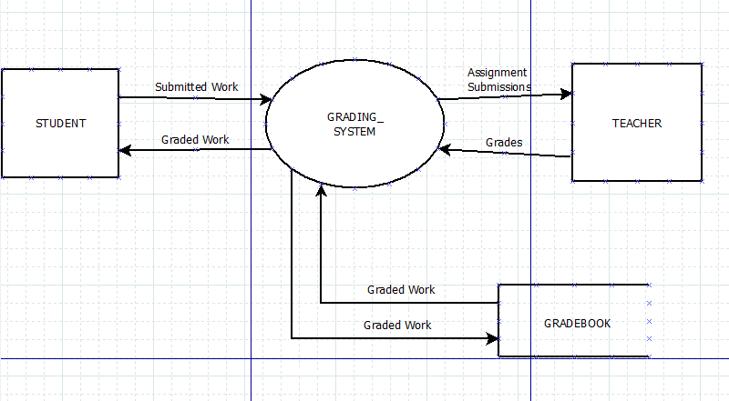
Initial DFD for Grade Processing System

Slide 7
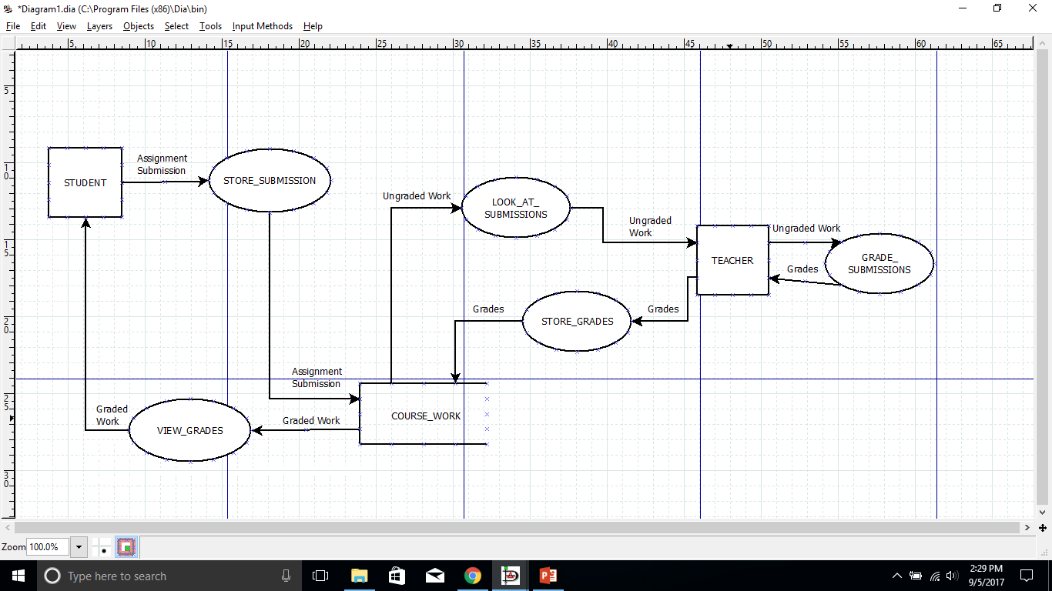
First Refinement

Slide 8
Sources
https://www.lucidchart.com/pages/data-flow-diagram from Lucid Software Inc.
Object-Oriented and Classical Software Engineering by Stephen R. Schach
Flow Charts based on examples found on creately.com

