Slide 1
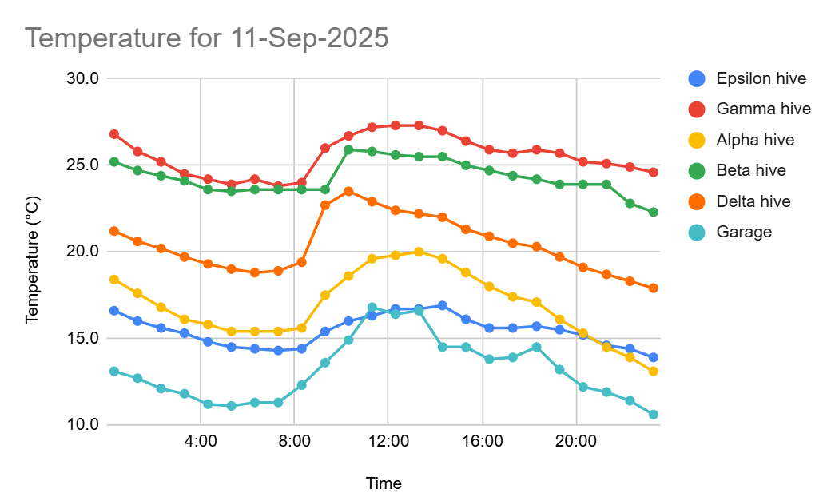
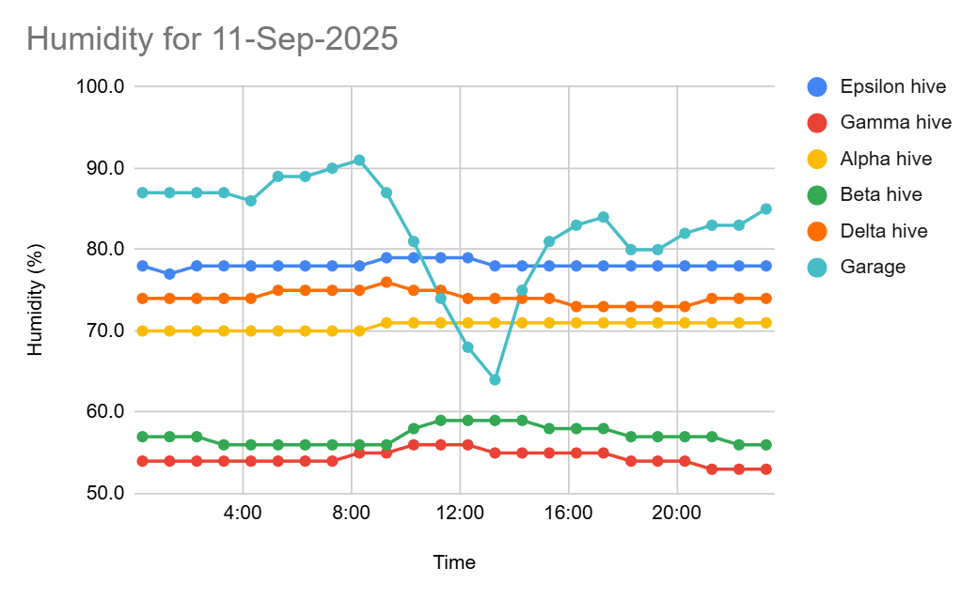

Slide 2
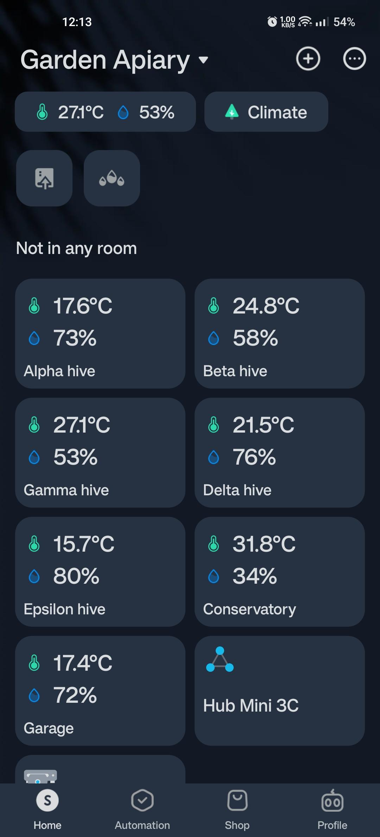

Slide 3
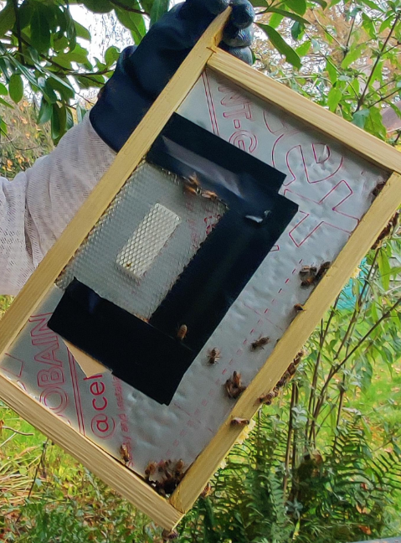

Slide 4
Can monitor many hives
Range ~50..100m
Sensor costs as low as ~£10/hive (Amazon)
Email reports and alerts (via Google sheets)
Minimal DIY skills required
Temperature and humidity

Slide 5
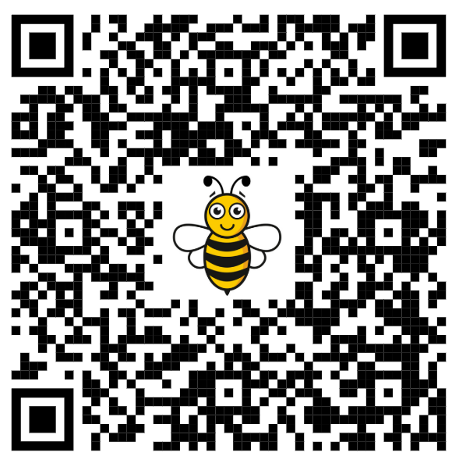
Learn more here
SCAN ME

