Slide 1
IBR Template Creation & Hybrid Network Architecture
Technical Deep-Dive: Grid-Mesh Pipeline, Results Walkthrough, FastAPI Dashboard
Supreeth Mysore | Lead GPU Architect
Hitachi Digital Services | Pratt & Whitney F135 Program
March 2026 | Sprint 3 Technical Review

Slide 2
OVERVIEW
2 / 30
Technical Agenda
Deep-dive into how the template is built and how every result traces back to it
1. Template Architecture: Grid + Mesh Hybrid
Why two data structures; how they complement each other
2. Voxel Grid: Discretizing 3D Space
The code that turns 55K raw points into 22K indexed cells
3. KD-Tree Mesh Network
Spatial queries at O(log n) — the backbone of every phase
4. Zone Template: 13-Zone Mapping
Percentage boundaries, multi-zone resolution, compliance logic
5. Results Trace: End-to-End Defect Walk
Following one defect through all 8 phases to its disposition
6. FastAPI Dashboard: Code Walkthrough
12 API endpoints, Plotly 3D rendering, live pipeline execution
THIS DECK
Goes deep into HOW the template is built, HOW results are computed, and HOW the dashboard works. Code snippets included.

Slide 3
01
Template Architecture
How we build the computational substrate for defect detection

Slide 4
ARCHITECTURE
4 / 30
Why Hybrid Grid + Mesh?
Two data structures, each optimized for different query patterns
Voxel Grid (Discretization)
KD-Tree Mesh (Spatial Queries)
O(1) lookup via floor(point / voxel_size) Uniform spatial partitioning 55K raw points → 22K unique cells at 0.5mm Used for: downsampling, zone lookup
O(log n) nearest-neighbor queries scipy.spatial.cKDTree (C-compiled) 22K queries in <1 second with workers=-1 Used for: deviation, outlier, adjacency
Grid alone cannot do nearest-neighbor queries on irregular geometry.
KD-tree alone cannot do O(1) cell-based zone lookup.
Together they cover every query pattern in the pipeline.
DESIGN RATIONALE
Grid gives speed for filtering. KD-tree gives precision for measurement. Neither alone is sufficient.

Slide 5
TEMPLATE
5 / 30
Template Creation: 5-Step Pipeline
From raw PLY to indexed, normal-enriched point cloud
1
2
3
4
5
PLY Load
Voxel Grid
Outlier Filter
Normals
Template
55K raw points
floor(pt/0.5mm) 22K cells
KD-tree k=20 μ+2.5σ threshold
PCA k=30 smallest eigvec
22,064 pts indexed+normals
The template IS the cleaned point cloud with normals.
Every downstream phase queries this structure via grid index or KD-tree.
KEY POINT
Template creation is deterministic. Same input always produces same template. No randomness, no ML, no tuning.

Slide 6
CODE
6 / 30
Voxel Downsampling: The Code
Three lines of NumPy that reduce 55K to 22K points
indices = np.floor(points / voxel_size).astype(np.int64)
_, unique_idx = np.unique(indices, axis=0, return_index=True)
downsampled = points[unique_idx]
Result: 55,000 → 22,545 points
Each voxel: 0.5mm³ cube
Points sharing the same cell collapse to one representative
Measurement requirement: ±0.001" = ±0.025mm
Voxel size: 0.5mm = 50x finer than requirement
Engineering margin built into the discretization step
PRECISION
0.5mm voxels give 50x finer resolution than our measurement requirement. That is deliberate engineering margin.

Slide 7
CODE
7 / 30
Statistical Outlier Removal
KD-tree k-NN distance filter removes scanner noise
tree = cKDTree(points)
dists, _ = tree.query(points, k=21) # self + 20 neighbors
mean_dists = np.mean(dists[:, 1:], axis=1)
threshold = global_mean + 2.5 * global_std
inliers = mean_dists < threshold
Result: 22,545 → 22,064 points
481 outliers removed (2.1%)
Each point's 20-nearest-neighbor mean distance
compared to the global population statistics.
Points with unusually high mean distance are isolated noise.
WHY THIS MATTERS
Scanner noise creates isolated points that would become phantom defects. This filter catches them before they corrupt analysis.

Slide 8
02
KD-Tree Mesh Network
The spatial data structure that powers every query in the pipeline

Slide 9
KD-TREE
9 / 30
What Is a KD-Tree?
Binary space partitioning for O(log n) spatial queries
Binary tree that alternates splitting on X, Y, Z axes.
Build complexity: O(n log n) — one-time cost
Query complexity: O(log n) — per point
Brute force on 22K points:
22,000 × 22,000 = 484,000,000 comparisons
KD-tree on 22K points:
22,000 × 15 levels ≈ 330,000 comparisons
Speedup: ~1,500x
Our implementation: scipy.spatial.cKDTree
C-compiled. Multi-threaded via workers=-1.
PERFORMANCE
Without KD-trees, Phase 3 takes 30 minutes. With them, 0.1 seconds. That is the difference between usable and unusable.

Slide 10
KD-TREE
10 / 30
KD-Tree Across the Pipeline
Used in 4 of 8 phases plus the defect library
Phase 1: Outlier Removal
Phase 2: ICP Registration
k-NN distance to detect isolated scanner noise points. k=20 neighbors, compare to global mean+2.5σ.
Nearest-neighbor correspondence matching. Iteratively finds closest CAD point for each scan point.
Phase 3: Deviation Analysis
Defect Library: Adjacency
Signed distance from every scan point to nearest CAD point. Vectorized batch query: 22K points in one call.
query_ball_point for radius-based neighbor search. Finds all defects within 5mm of each other.
BACKBONE
The KD-tree is the computational backbone. Remove it and Phase 3 alone exceeds our 90-second budget.

Slide 11
MATH
11 / 30
Signed Distance Computation
The core mathematical operation for defect detection
For each scan point pᵢ:
1. Find nearest CAD point cⱼ = KD-tree.query(pᵢ)
2. Get CAD surface normal nⱼ at cⱼ
3. signed_dist = (pᵢ − cⱼ) · nⱼ
Convention:
Negative = material removed (nick, gouge, crack)
Positive = material added (buildup, deposit)
Vectorized implementation:
tree = cKDTree(cad_pts)
_, indices = tree.query(scan_pts, k=1, workers=-1)
diff = scan_pts - cad_pts[indices]
signed = np.sum(diff * cad_normals[indices], axis=1)
VECTORIZED
No Python loops. 22,064 signed distances computed in one NumPy dot product operation.

Slide 12
RESULTS
12 / 30
Deviation Analysis Results
Output from our first pipeline run on synthetic IBR data
22,064
±0.14
800
4
Points analyzed
Deviation range (mm)
Below threshold (3.6%)
Defect clusters after DBSCAN
Mean deviation: -0.0008mm (near zero = good alignment)
Std deviation: 0.0132mm
Threshold: -0.010mm = 2x scanner precision floor
VALIDATION
3.6% candidate rate on synthetic data with 4 injected defects. Threshold performing as designed.

Slide 13
03
Zone Template System
Mapping every point on the blade to P&W's 13-zone classification

Slide 14
ZONES
14 / 30
Two-Layer Zone Boundary Design
Percentages for portability, millimeters for precision
Layer 1: Percentages (Stored)
Layer 2: Millimeters (Runtime)
A1: 0–3.83% of blade span A2: 3.83–62.88% of span A3: 62.88–99.77% of span Portable across all 9 F135 stages
resolve_zone(pct, measured_span_mm) Uses ACTUAL measured blade span from ICP Handles manufacturing variation Worn blade gets correct boundaries
Why measured span, not nominal?
ICP alignment gives actual as-manufactured geometry.
A blade worn 2mm at the tip has different effective span.
PORTABILITY
One config file works across all 9 F135 stages. Zero per-stage calibration needed.

Slide 15
LOGIC
15 / 30
Zone Classification Decision Tree
How each defect gets mapped to one or more P&W zones
if edge and nearest_edge == 'LE':
match A1/A2/A3 by span percentage
elif edge and nearest_edge == 'TE':
match B1/B2 by span percentage
else: # surface
default C1 (convex) or C2 (concave)
ALWAYS check tip zones regardless of classification:
tip_zones = match_tip_zones(height_pct)
# A defect at 95% span on LE gets both A3 AND E2
Multi-zone resolution:
most_restrictive = min(limits_list,
key=lambda l: (l.max_depth_in, l.max_length_in))
Confirmed by P&W: always most restrictive.
TIP ZONE CHECK
Tip zone check is independent of edge/surface. A defect near the tip always gets tightest applicable limits.

Slide 16
COMPLIANCE
16 / 30
Compliance Check: AND Logic, Three Tiers
Every condition must pass simultaneously
SERVICEABLE
BLEND
REPLACE
depth ≤ max_depth AND length ≤ max_length
depth ≤ 1.5× max_depth AND length ≤ 1.5× max_length
Exceeds blend limits Blade replacement required
Special modifiers:
Cracks: 0.5x normal limits (half tolerance)
FOD: 0.8x normal limits
Unknown zone: default to most restrictive
AND logic = a defect 0.001" over on length but
perfect on depth still gets flagged. No partial passes.
AEROSPACE SAFETY
No partial passes. Every dimension must be within limits simultaneously. This is non-negotiable.

Slide 17
04
Defect Library: Hybrid Storage
Grid + Metric dual-index for cross-dimensional analysis

Slide 18
LIBRARY
18 / 30
DefectLibrary Architecture
Four-dimensional query system with optimized indices
Primary store: dict[defect_id → defect_dict]
Secondary indices:
by_foil: foil_number → [defect_ids] (instant lookup)
by_zone: zone_id → [defect_ids] (instant lookup)
Spatial index:
cKDTree on defect centroids
Rebuilt lazily via _tree_dirty flag
4 Dimensions of Analysis:
D1: WHERE is the defect (Grid O(1) or Metric O(log n))
D2: WHICH zone (percentage-based lookup)
D3: CROSS-ZONE (aggregate via secondary index)
D4: CROSS-FOIL (RotorDefectAnalysis class)
QUERY OPTIMIZATION
Each dimension has its own optimized query path. D1-D3 run per-blade in parallel. D4 runs once after all blades finish.

Slide 19
CODE
19 / 30
Adjacency Detection: The Code
KD-tree radius query for cross-defect proximity analysis
def find_adjacent_defects(self, defect_id, threshold_mm=5.0):
center = self._centroids[defect_id]
indices = self._kdtree.query_ball_point(
center, r=threshold_mm)
return [defects[tree_ids[i]] for i in indices
if tree_ids[i] != defect_id]
Why adjacency matters:
Two small defects 3mm apart may each pass
individual zone limits, but together they create
a structural weakness that needs flagging.
query_ball_point: O(log n) radius search.
No brute-force distance matrix needed.
PROXIMITY
Cross-defect proximity is a safety-critical check. Two passing defects can together fail if they are close enough.

Slide 20
05
Results Walkthrough
Tracing defects through the full pipeline end to end

Slide 21
TRACE
21 / 30
Defect F001_D002: Full 8-Phase Trace
Following one defect from raw scan to REPLACE disposition
Phase 1: Part of 55,000 raw pts → survives voxel + outlier
Phase 2: Aligned with 0.016mm RMSE → correct position
Phase 3: 345 points have signed distance -0.048 to -0.122mm
All below -0.010mm threshold → flagged as candidates
Phase 5: DBSCAN groups 345 nearby pts into one cluster
eps=1.0mm, min_samples=3 → one contiguous defect
Phase 6: OBB measurement:
Length = 0.5960" | Width = 0.4683" | Depth = 0.0048"
Phase 7: Zones C1 + E2
C1 limit: depth≤0.010", length≤0.080"
Length 0.596" >> 0.080" → REPLACE
TRACEABILITY
Remove any single phase and this defect gets missed or gets wrong disposition. Every phase contributes.

Slide 22
RESULTS
22 / 30
All 4 Detected Defects
Complete results from the initial pipeline run
ID | Type | Zones | Depth (in) | Length (in) | Disposition
F001_D001 | Surface | C1, E2 | 0.0011 | 0.0757 | SERVICEABLE
F001_D002 | Surface | C1, E2 | 0.0048 | 0.5960 | REPLACE
F001_D003 | Surface | C1, E2 | 0.0056 | 0.6105 | REPLACE
F001_D004 | Surface | C1, E2 | 0.0006 | 0.0364 | SERVICEABLE
MATCH
D002/D003 exceeded C1 max_length 0.080" by 7x. System correctly identified them as REPLACE. Matches expected outcomes.

Slide 23
MEASUREMENT
23 / 30
PCA vs OBB: Why It Matters
Domain-validated measurement distinction from P&W
Edge Defects → PCA
Surface Defects → OBB
Within 0.080" of LE/TE Principal component aligns with edge tangent Measures LONGITUDINALLY along the curve Edge nicks elongate along the edge
Away from edges (>0.080") Oriented Bounding Box via convex hull Measures TRANSVERSELY across the surface Surface dents are more isotropic
Using the wrong method gives wrong measurements.
This distinction came from Bryan at P&W, not from the math.
DOMAIN KNOWLEDGE
PCA vs OBB is a domain decision you cannot derive from algorithms alone. Required direct input from P&W engineers.

Slide 24
06
FastAPI Dashboard
Live interactive web application code walkthrough

Slide 25
FASTAPI
25 / 30
FastAPI Architecture & Key Code
Async Python serving Plotly 3D visualizations over REST
Stack: FastAPI (async) → Jinja2 templates → Plotly.js (WebGL)
Key endpoint — deviation heatmap data:
@app.get('/api/pointcloud/deviations')
async def api_deviations():
scan_pcd = read_point_cloud(scan_path)
cad_pcd = read_point_cloud(cad_path)
tree = cKDTree(cad_pts)
_, idx = tree.query(scan_pts, k=1, workers=-1)
diff = scan_pts - cad_pts[idx]
signed = np.sum(diff * normals[idx], axis=1)
return {'points': pts.tolist(),
'deviations': signed.tolist()}
SAME MATH
Same KD-tree computation from Phase 3 exposed as a REST API. 30,000 signed distances computed per API call.

Slide 26
DASHBOARD
26 / 30
Dashboard: Visual Elements
Every chart reads from actual pipeline output — nothing mocked
Stats Row
3D Deviation Heatmap
5 cards: Part#, Defects, Serviceable, Blend, Replace
Plotly scatter3d, 30K points, blue→green→red colorscale
Disposition Donut
Zone Distribution
Pie chart: green/amber/red segments with counts
Bar chart showing defect count per P&W zone
Defect Table
Depth Comparison
All defects with measurements and color-coded badges
Bar chart: each defect depth vs zone limit threshold
REAL DATA
Re-run the pipeline, refresh the browser — dashboard updates instantly. No cache, no stale data.

Slide 27
3D VIEWER
27 / 30
3D Viewer: Plotly.js Rendering
Client-side WebGL handles 50K points smoothly in the browser
4 View Modes:
1. Deviation Heatmap — color by signed distance
2. Scan Point Cloud — raw scan in green
3. CAD Reference — blue reference model
4. Defect Clusters — colored by defect ID
Plotly.js rendering:
Plotly.newPlot('viewer', [{
x, y, z,
mode: 'markers', type: 'scatter3d',
marker: {
size: 2, color: deviations,
colorscale: [['#3b82f6'],['#22c55e'],['#ef4444']]
}
}]);
Controls: point size slider, max points, reset camera
BROWSER GPU
No server-side rendering. Plotly uses WebGL — the browser GPU does all the 3D work. Server only sends point data.

Slide 28
API
28 / 30
12 REST API Endpoints
Integration surface for Hitachi systems and external tools
Endpoint | Method | Description
/api/report/latest | GET | Latest inspection report JSON
/api/reports | GET | List all reports with metadata
/api/download/{file} | GET | Download JSON or Excel file
/api/pointcloud/scan | GET | Scan cloud (40K points)
/api/pointcloud/deviations | GET | Deviation-colored cloud
/api/config | GET | Pipeline YAML configuration
/api/rotor-configs | GET | F135 rotor definitions
/api/pipeline/run | POST | Trigger pipeline execution
/api/pipeline/status | GET | Pipeline run progress
INTEGRATION
Any system can POST to /api/pipeline/run and poll /api/pipeline/status. Ready for Hitachi system integration.

Slide 29
DISCUSSION
29 / 30
Discussion Questions for the Team
Technical decisions that need group input before Sprint 4
1. Voxel Resolution
Should we go finer than 0.5mm for production scanner data?
2. KD-tree vs R-tree
Would R-tree be better for zone boundary polygon queries?
3. LE/TE Curve Extraction
How do we extract edge curves from CAD mesh automatically?
4. Multi-Zone Handling
Defects spanning 3+ zones — flag for manual review?
5. Dashboard Integration
What other Hitachi systems need API access?
6. Real Scan Validation
When can we validate against actual P&W scanner output?
BLOCKERS
Items 3 and 6 are blocking. I need answers on LE/TE extraction and real scan data before Sprint 4 planning.

Slide 30
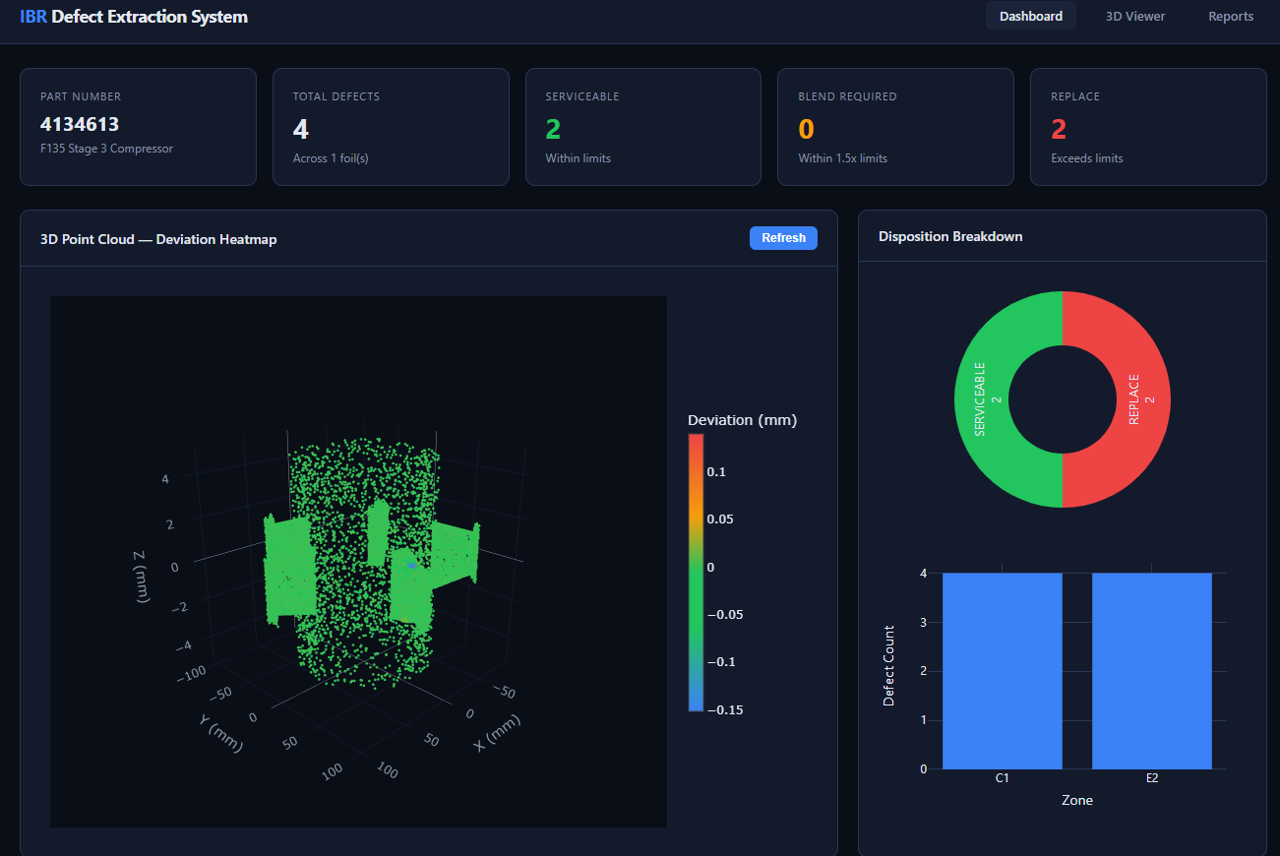

Slide 31
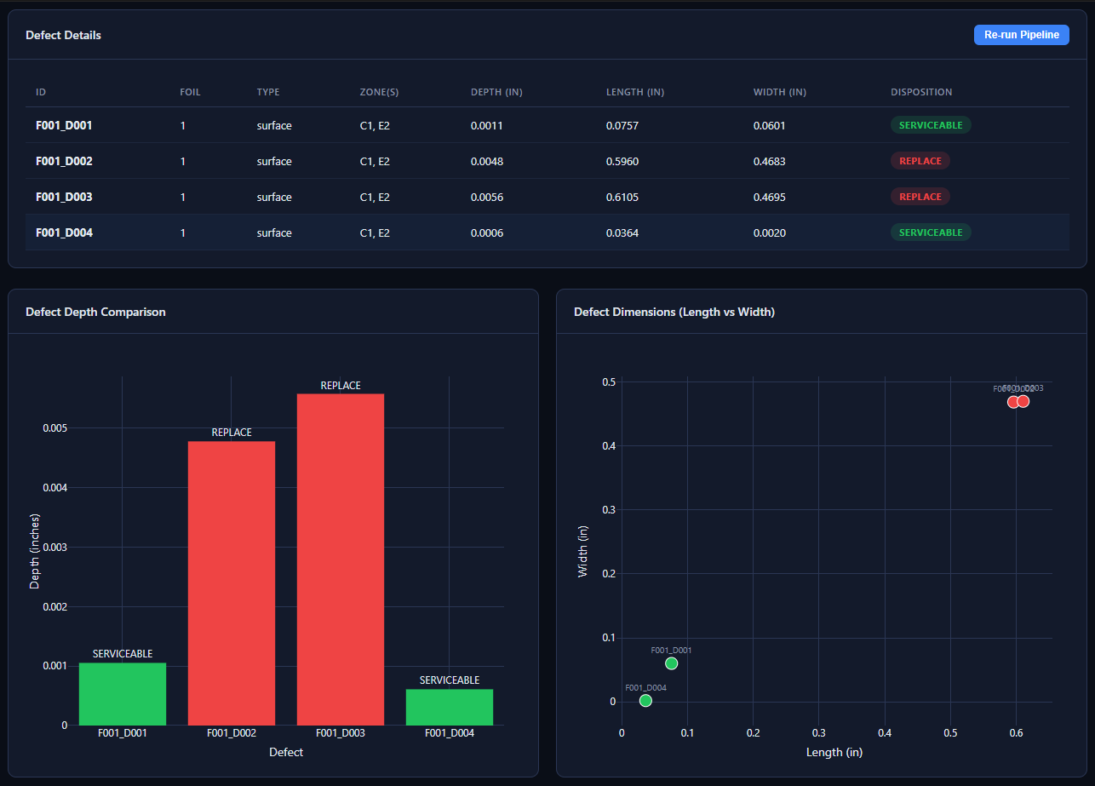

Slide 32
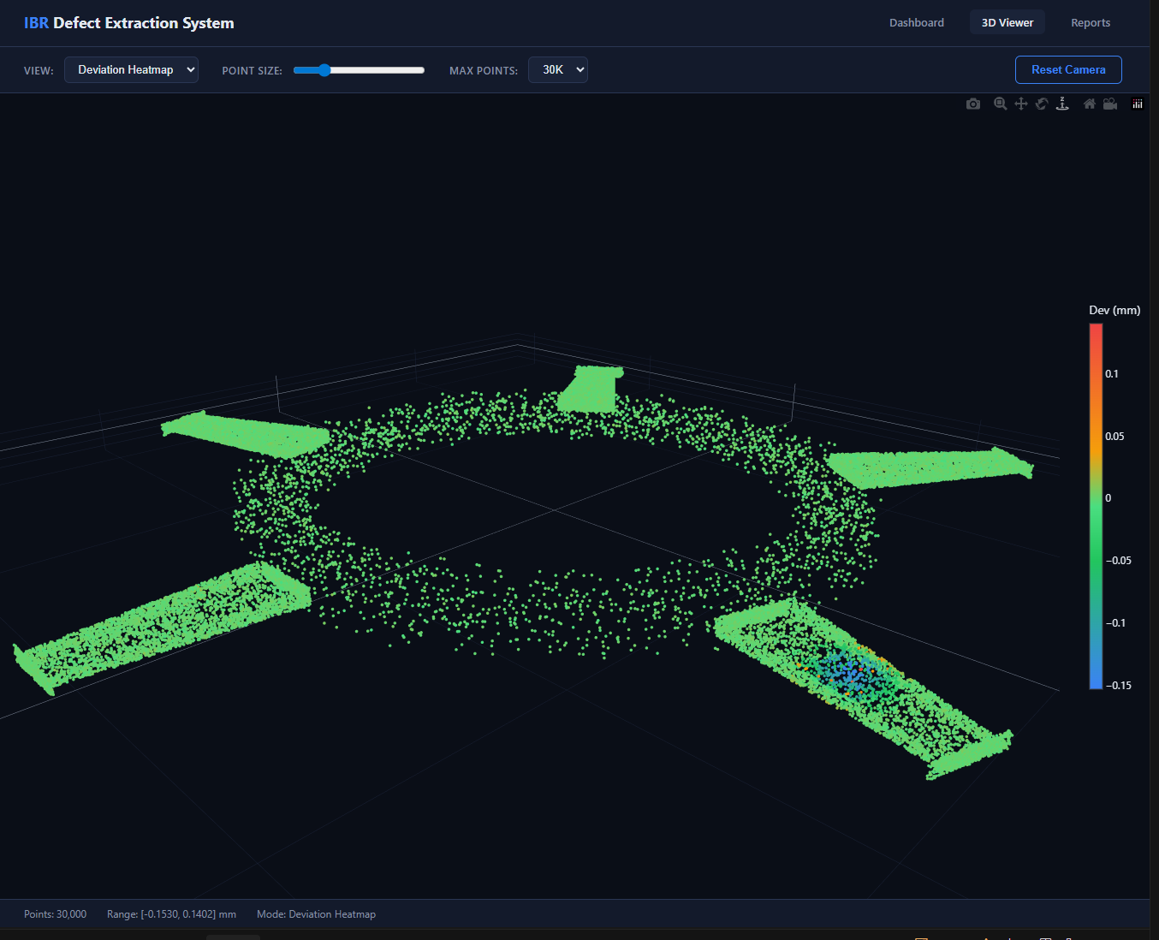

Slide 33
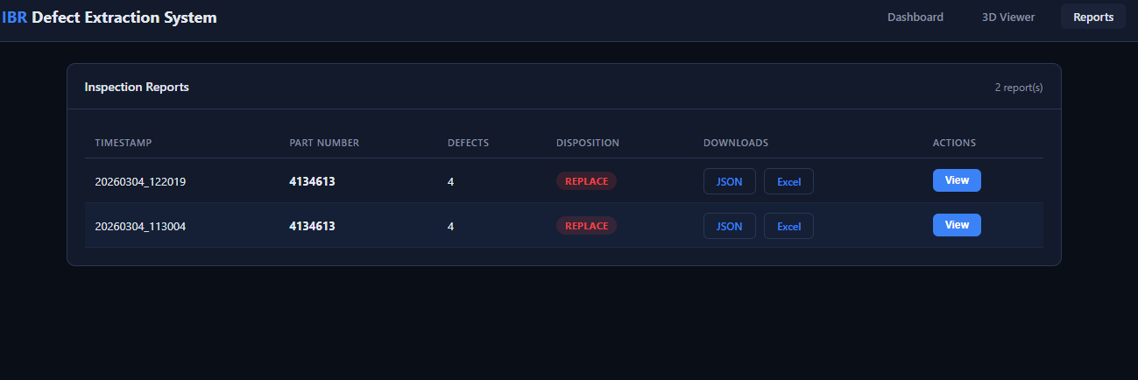

Slide 34
The Template Is Built. The Network Is Running.
Grid discretization + KD-tree mesh = hybrid precision at production speed
Supreeth Mysore | supreeth.mysore@hitachids.com
Hitachi Digital Services | P&W F135 Program
github.com/drmysore/open3d-ibr-defect-extraction

