Slide 1


Google Data Analytics
Project Presentation

Slide 2
Nike Vs. Adidas Financial Comparison
New South Wales

Slide 3
Scenario
The Nike sales manager from Australia finds from the TV news that Adidas’ turnover, sales volume, and profitability exceeded Nike’s significantly during the period 1/01/2016-01/01/2017, and especially for the women products, in New South Wales.
As the manager is concerned about the possible biases stemming from the news, he wants to test the current hypotheses, so he asks a data analyst to find out the truth.

Slide 4
Data Analysis Steps
Ask
Prepare
Process
Analyse
Share
Act

Slide 5

Main Analysed Facts
Total number of sales and profit by brand for all product categories (NSW, 01/01/2016 – 01/01/2017)
Total number of sales and profit by brand for women category (NSW, 01/01/2016 – 01/01/2017)

Slide 6
Sales and Profit Comparison

Slide 7
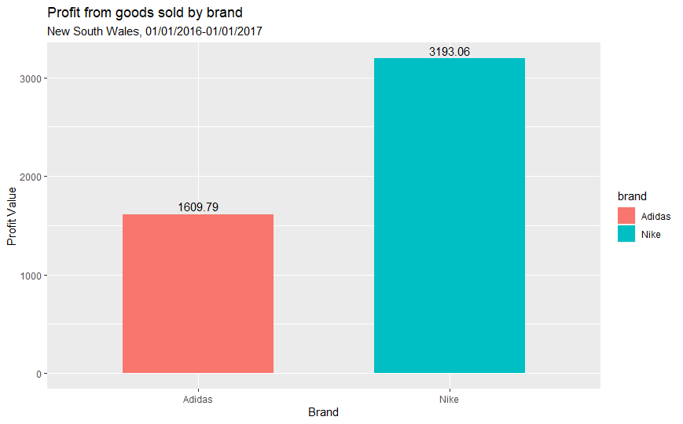

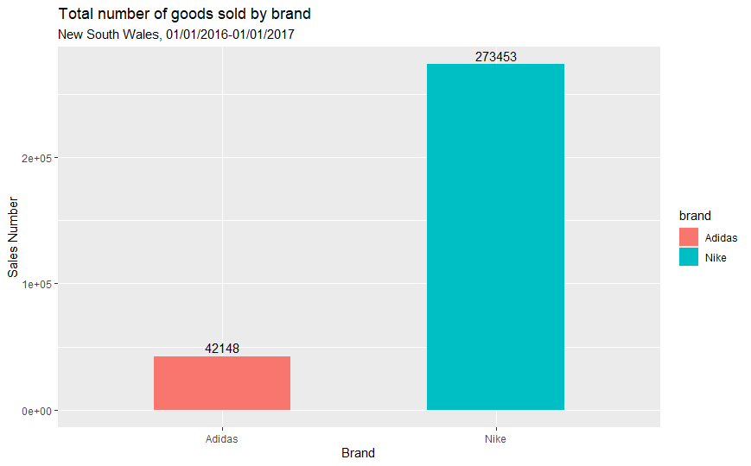
Total Sales and Profit Comparison

Slide 8
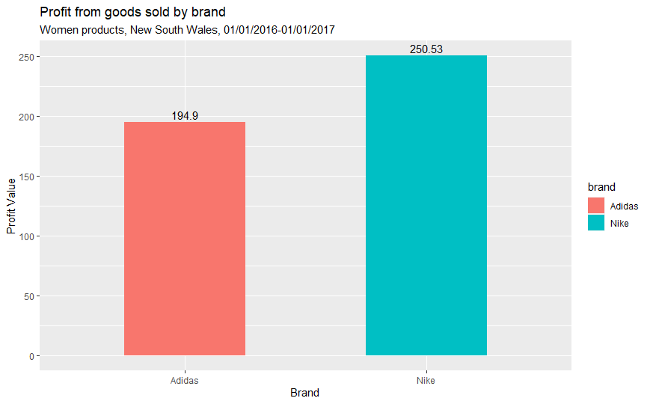
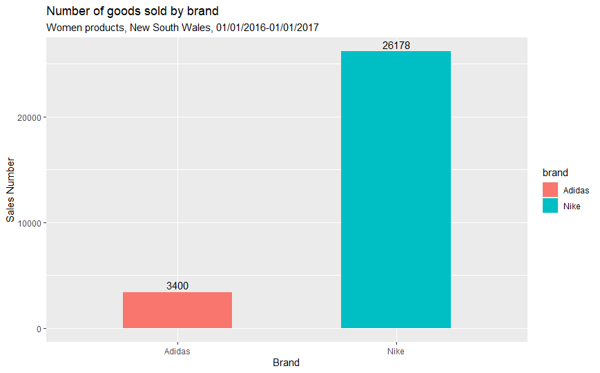
Sales and Profit Comparison -Women Products-

Slide 9
Even though Nike generated a bigger profit for the mentioned time frame in NSW, the sales volume differ enormously between the two companies.
In order to generate only 2 times more profit than Adidas, Nike had to sell virtually 6.5 times more products than its competitor. This fact leads to concerns regarding the profitability of the company.
Two possibilities were considered: 1.Nike presents cost management issues, 2. Nike product prices are considerably lower than Adidas’ items.

Slide 10
Addressing the first concern
Does Nike have cost management issues in the production and sales of finished goods?
- In order to analyze this phenomenon, and with the help of the available data, the Gross Profit Margin was computed ((total revenue – cost of goods sold) / total revenue)

Slide 11
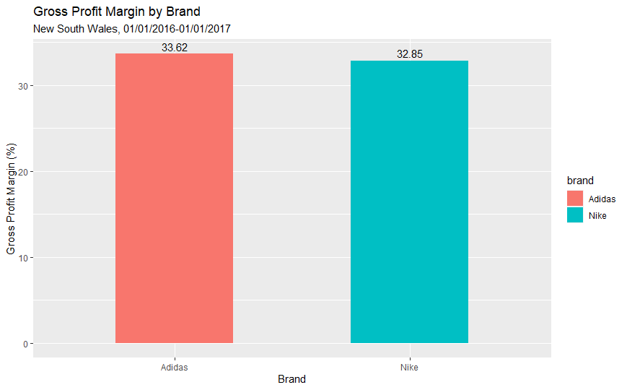
- The bar chart depicts better results in terms of profitability for Adidas
- The relative difference between the two brands is only 0.77%, which doesn’t seem extremely significant at first sight.
- In absolute terms, for every 1 dollar generated by each of the companies, Adidas would retain almost 0.34 dollars, whereas Nike would keep 0.33 dollars.
- By putting in a context, if both companies would have gained 48.000 dollars in profit, Nike would keep 15.840 dollars, and Adidas 16.320 (480 dollars difference).

Slide 12
Addressing the second concern
Does Nike items have considerably lower prices than Adidas’ products?
In order to test this, the measures of central tendency were calculated and observed.

Slide 13
Measures of Central Tendency

Slide 14
Conclusion
Even though Nike generated a bigger profit than Adidas, the profitability of the company is to be questioned.
01
After a thorough analysis, it was observed that Adidas’ profitability was better than Nike’s. Thus, improvement could be made in order to restructure the costs of production.
02
The average difference in the product prices of 1.15 dollars could impact the overall revenue, and thus the profit. A better solution could be to keep an eye opened in thinking of how to increase the prices without affecting the customer portfolio and the prospect market.
03

