Slide 1
Dr Neal Aggarwal FIMIS, FBCS
AI Engineer
Chairman Amateur Radio Emergency Network of the Radio Society of Kenya
RSK - AMRAN
Disclaimer: I have no financial ties to any of the products/organizations/hardware and/or software mentioned in this presentation. I stand to make no money at all from what I am talking about herein. My interest is in promoting radio usage in the region in particular in response to disaster and emergency response.
https://drnealaggarwal.info

Slide 2
Who am I and what are my interests:
AI Engineer
in the Medical/Surgical and Finance/Crypto arenas
Surgeon – computer vision and guided robotics
Open Source proponent
Core Dev - Linux, Ubuntu BIOS/MBR bootloader now EFI/UEFI
CryptoCurrency Hedge Fund Manager
Core Beliefs:
Remove concentration of power in large organisations
Fix disinformation generated by big pharma, big agra & big tech
Distributive systems – bitcoin-core dev
The World Computer – Ethereum core dev
Distributed Communications – LoRa/Meshtastic/Meshcore
Open Source Medicine especially nutritional science
… to ultimately usher in the next step in human evolution >> AGI

Slide 3
Meshcore
Low cost
2300/- on AliExpress (MPESA, door delivery)
Smartphone leveraging
Ease of installation (https://flasher.meshcore.co.uk)
Unlicensed (ISM Band)
Free App (smart phone penetration in KE)
Automatic Mesh (no digipeater)

Slide 4
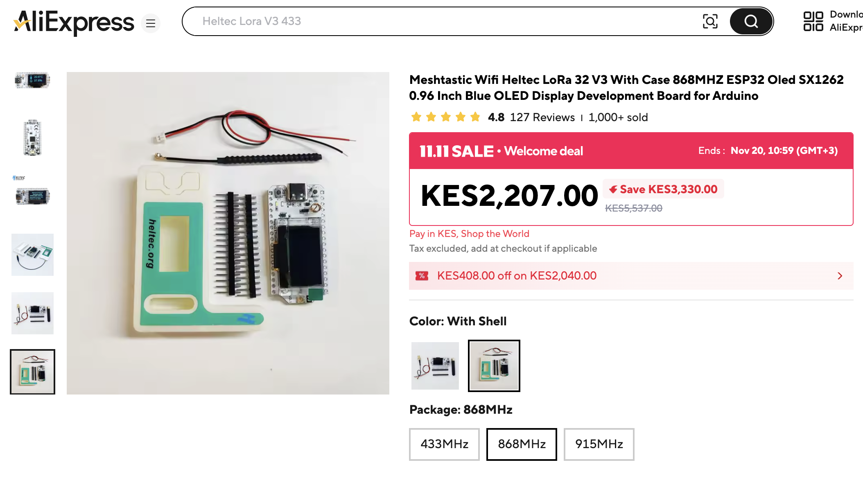

Slide 5
Meshcore
Low cost
2300/- on AliExpress (MPESA, door delivery)
Smartphone leveraging
Ease of installation (https://flasher.meshcore.co.uk)
Unlicensed (ISM Band)
Free App (smart phone penetration in KE)
Automatic Mesh (no digipeater)

Slide 6
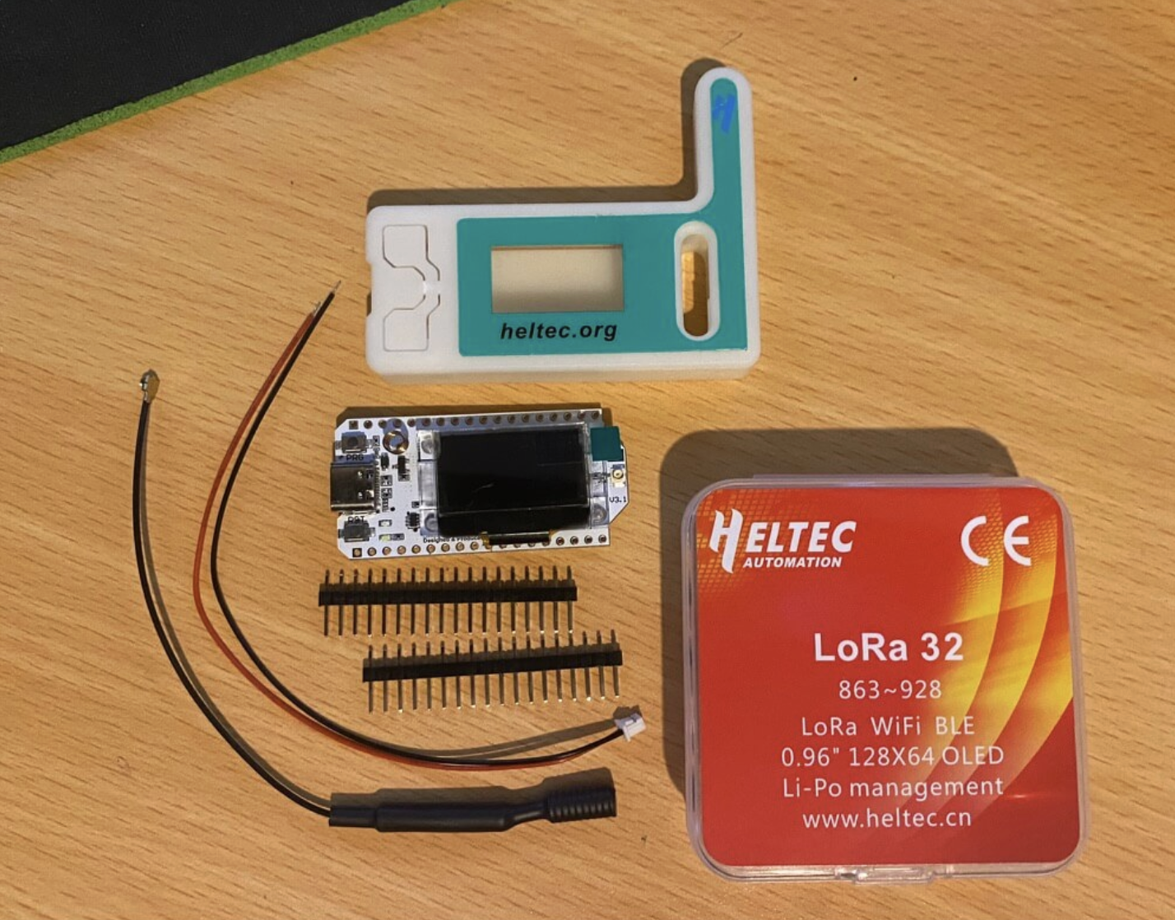

Slide 7

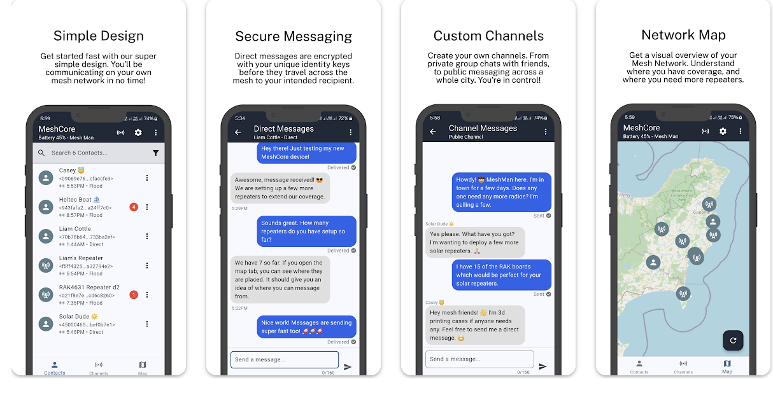
MeshCore

Slide 8
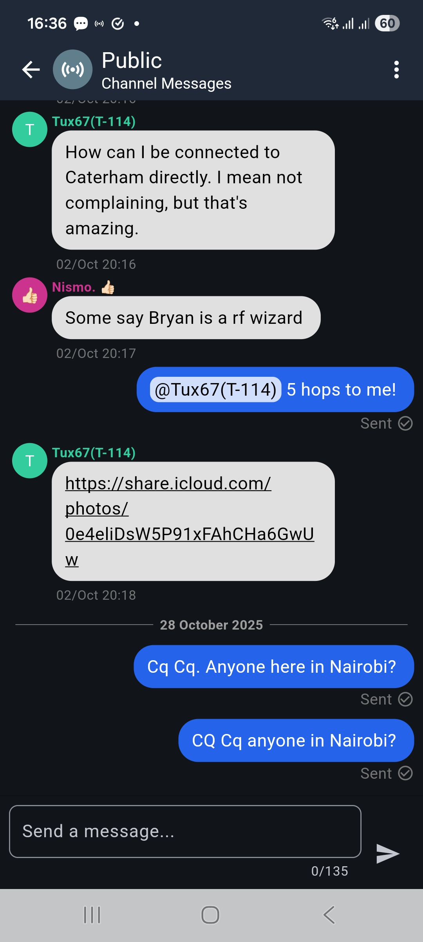
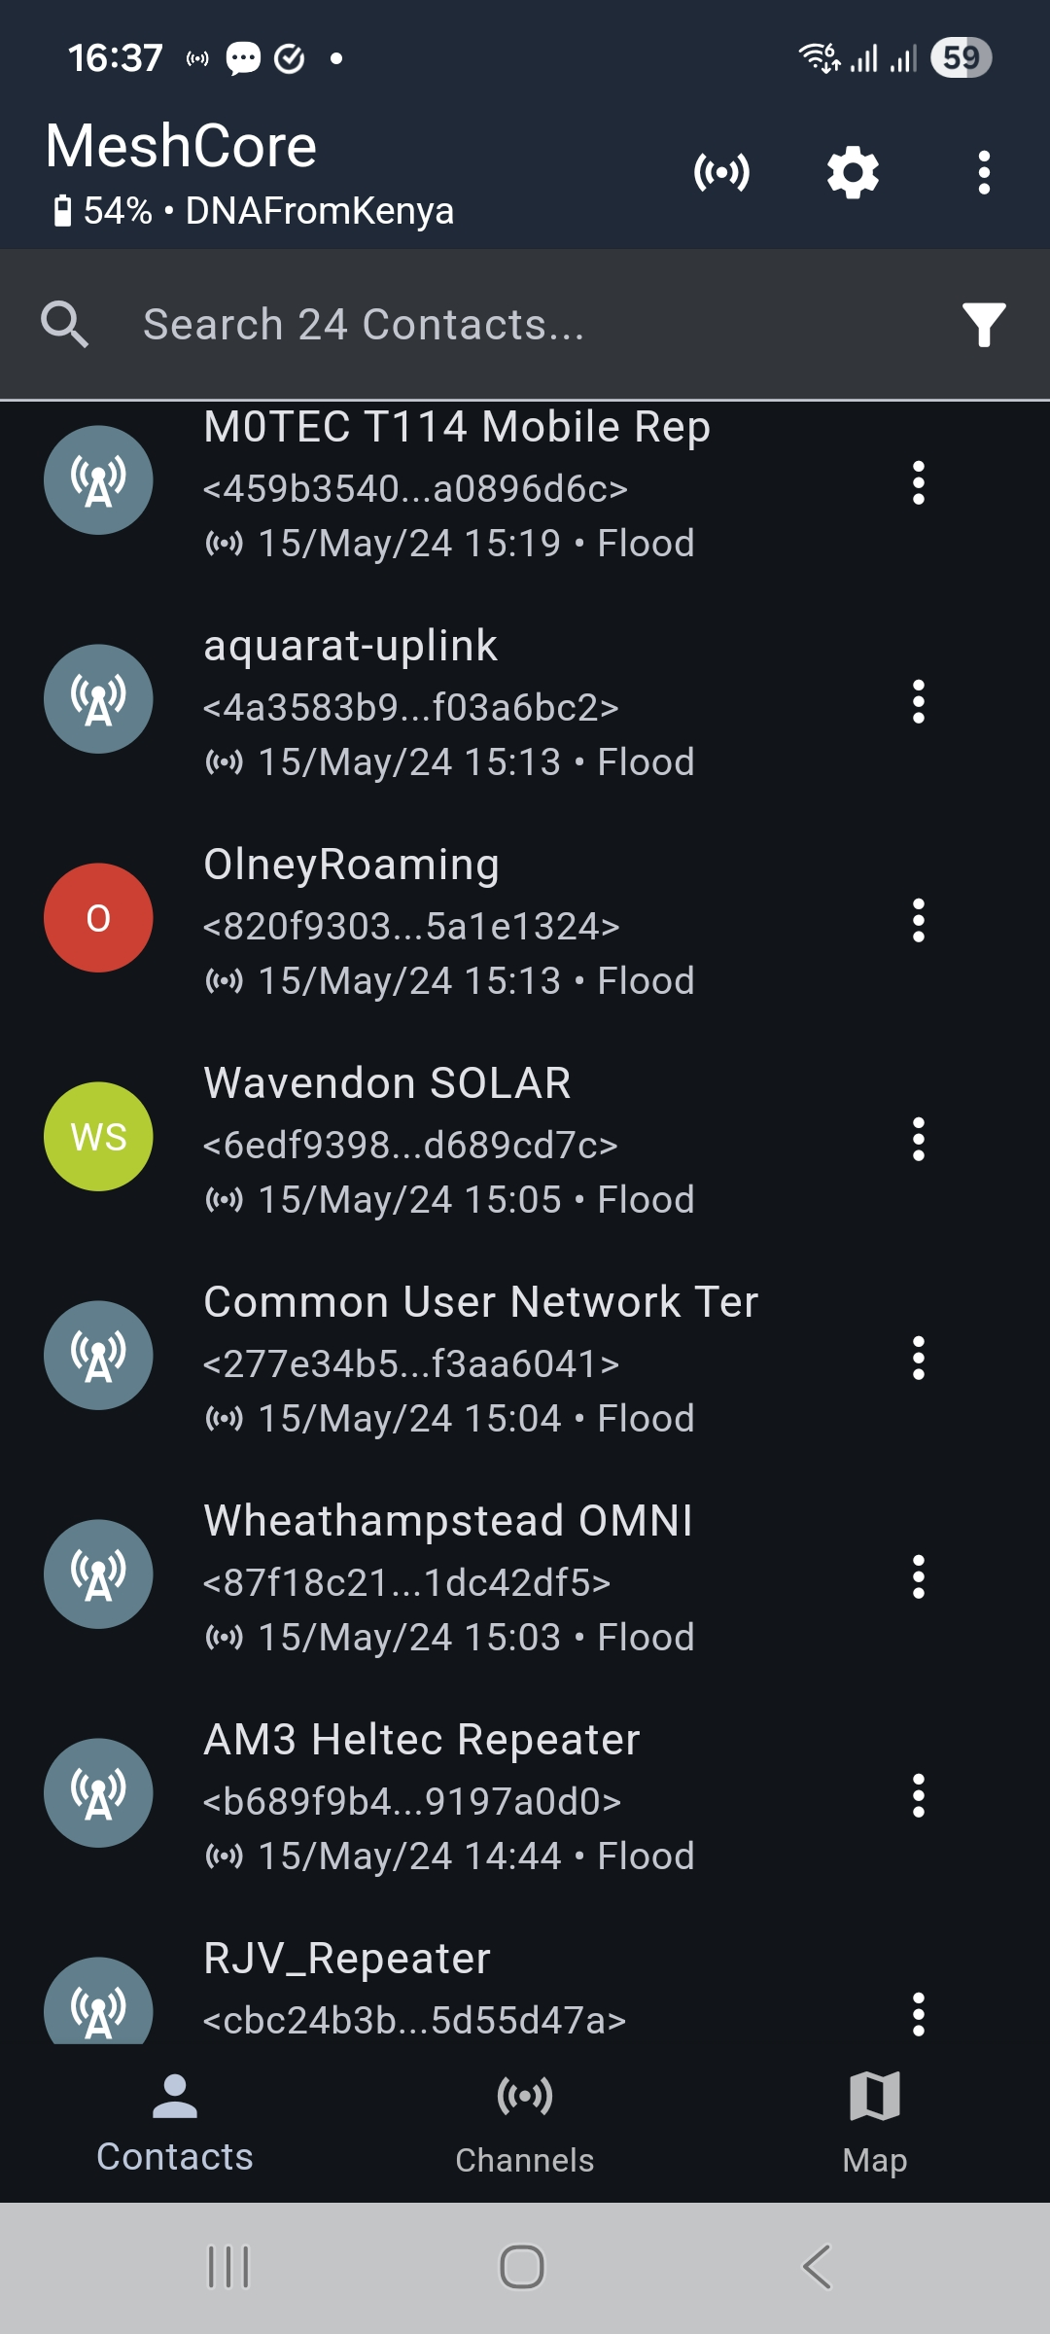

Slide 9
The core mission revolves around adoption
Given the attributes surrounding the hardware and software
affordability,
ease of use,
easy deployment,
Usefulness
we should have few if any barriers to entry . We just have to get the word out there.
The simple and straight forward vision
Individuals need to be sold on the idea so they will
Buy the hardware
Install the app
Flash the software onto the radio
Start messaging
--- and WE need to build out the network of repeaters

Slide 10
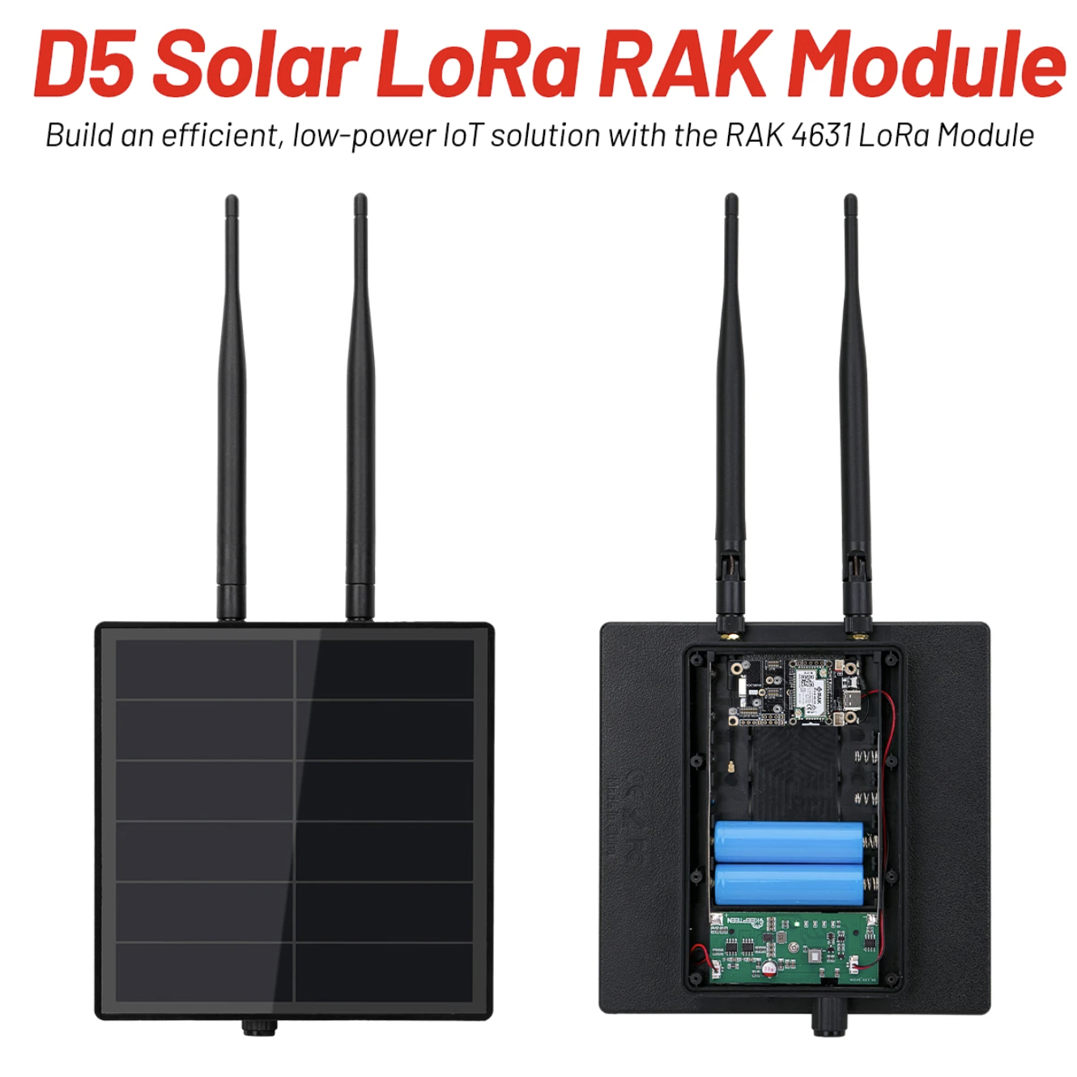

Slide 11


