Slide 1
Chapter 1: The Python Data Model
May, 08, 2020

Slide 2
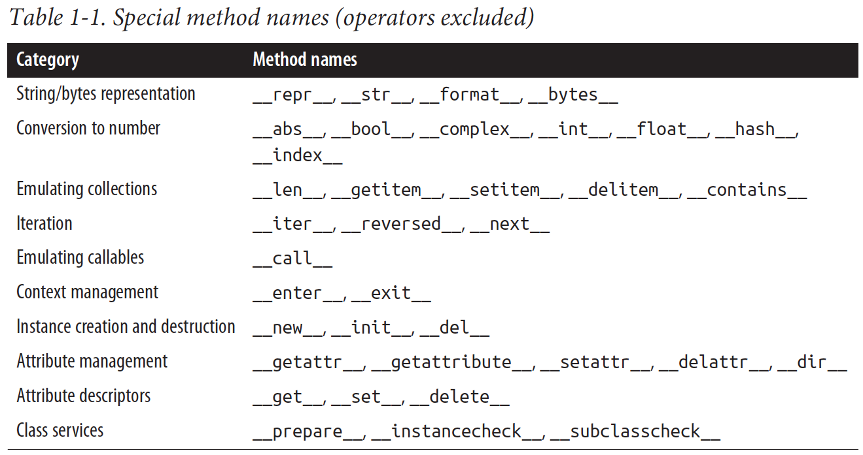
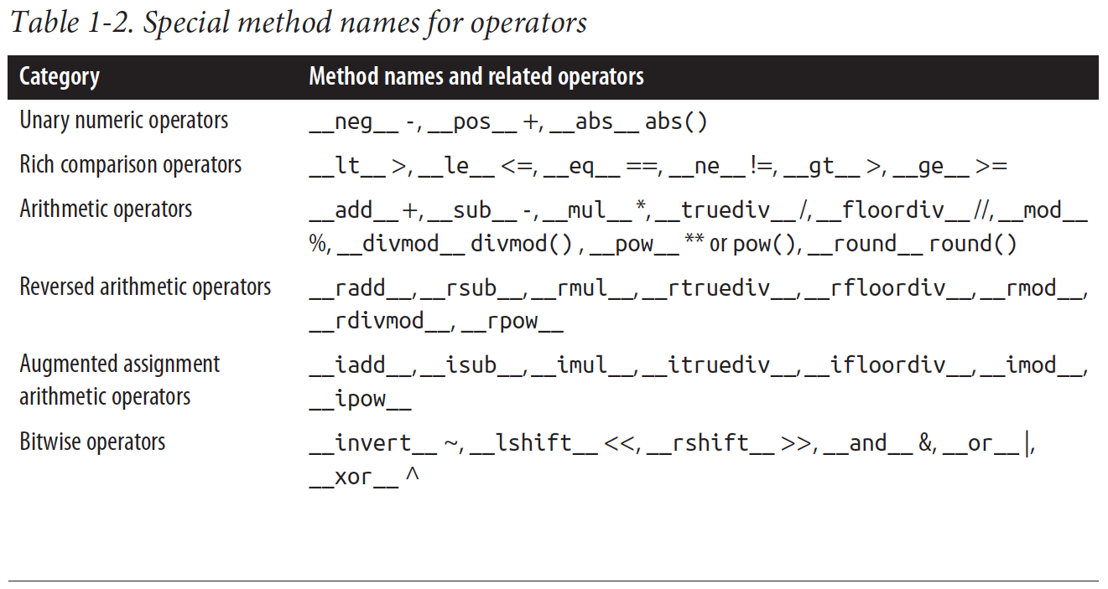
Python Special Methods Overview
Special method: also called “magic method”, “dunder method”: __methodname__
special methods are meant to be called by the Python interpreter, and not by you.
use len(x), not use x.__len__(), python interpreter will call x.__len__() instead
One exception is __init__, invoke initializer of the superclass in your own __init__ implementation
Advantages:
build-in function is much faster than method calls
统一的接口, len(x) rather than x.length(), x.size()
直接使用python 已有的方法，例如random.choice

Slide 3
Example: Sequence Operations
class FrenchDeck:
ranks = [str(n) for n in range(2, 11)] + list('JQKA')
suits = 'spades diamonds clubs hearts'.split()
def __init__(self):
self._cards = [Card(rank, suit) for suit in self.suits
for rank in self.ranks]
def __len__(self):
return len(self._cards)
# __getitem__ delegates to the [] operator of self._cards
def __getitem__(self, position):
return self._cards[position]
# 初始化一个FrenchDeck 对象
>> deck = FrenchDeck()
# 实际调用__len__ 方法, 获取长度
>> print(len(deck))
>> 52
# 实际调用__getitem__ 方法, 获取特定元素
>> print(deck[0])
>> Card(rank='2', suit='spades’)
# Slicing: 获取前两张牌
>> print(deck[:2])
>> [Card(rank='2', suit='spades'), Card(rank='3', suit='spades’)]
# 随机访问一个元素
>> from random import choice
>> print(choice(deck))
>> Card(rank='Q', suit='diamonds')
>> print(choice(deck))
>> Card(rank='4', suit='clubs’)
# 遍历
>> for card in deck:
>> ... print(deck)
>> ... # 输出忽略
By implementing the special methods __len__ and __getitem__, our FrenchDeck behaves like a standard Python sequence, allowing it to benefit from core language features (e.g., iteration and slicing)

Slide 4
Example: Sequence Operations
class FrenchDeck:
ranks = [str(n) for n in range(2, 11)] + list('JQKA')
suits = 'spades diamonds clubs hearts'.split()
def __init__(self):
self._cards = [Card(rank, suit) for suit in self.suits
for rank in self.ranks]
def __len__(self):
return len(self._cards)
# __getitem__ delegates to the [] operator of self._cards
def __getitem__(self, position):
return self._cards[position]
# 倒序遍历
>> for card in reversed(deck):
>> ... print(deck)
>> ... # 输出忽略
# 判断是否包含某个元素
>> Card('Q', 'hearts') in deck
>> True
>> Card('1', 'hearts') in deck
>> False
# 排序
>> suit_values = dict(spades=3, hearts=2, diamonds=1, clubs=0)
>> def spades_high(card):
>> ... rank_value = FrenchDeck.ranks.index(card.rank)
>> ... return rank_value * len(suit_values) + suit_values[card.suit]
>> sorted(deck, key=spades_high)
>> ... # 输出忽略
# Shuffle
>> ...
*如果没有实现__contain__ 方法，in 操作符会顺序遍历
By implementing the special methods __len__ and __getitem__, our FrenchDeck behaves like a standard Python sequence, allowing it to benefit from core language features (e.g., iteration and slicing)

Slide 5
Example: Vector Operation
from math import hypot
class Vector:
def __init__(self, x=0, y=0):
self.x = x
self.y = y
def __repr__(self):
return 'Vector(%r, %r)' % (self.x, self.y)
def __abs__(self):
# math.hypot: Return the Euclidean norm
# sqrt(x*x + y*y)
# It is the length of vector
return hypot(self.x, self.y)
def __bool__(self):
return bool(abs(self))
def __add__(self, other):
x = self.x + other.x
y = self.y + other.y
return Vector(x, y)
def __mul__(self, scalar):
return Vector(self.x * scalar, self.y * scalar)
# 调用__init__ 方法初始化一个Vector 对象
>> v1 = Vector(2,4)
>> v2 = Vector(2,1)
# 调用__repr__ 的到一个字符串描述
>> print(v1)
>> Vector(2, 4)
>> print(v2)
>> Vector(2, 1)
# 调用__bool__ 方法的到一个布尔值
>> if v1:
>> ... print(‘hello v1’)
>> hello v1
# 调用__add__ 方法相加两个Vector 对象
>> v1 + v2
>> Vector(4, 5)
# 调用__mul__ 方法初对两个Vector 对象进行点积
>> v1 * 3
>> Vector(6, 12)

Slide 6
__repr__
__repr__:
__str__:
类似于toString，called by the str()
implicitly used by the print function.
返回面向用户的字符串.
如果__str__ 没有实现，str()会调用__repr__

