Slide 1


Slide 2
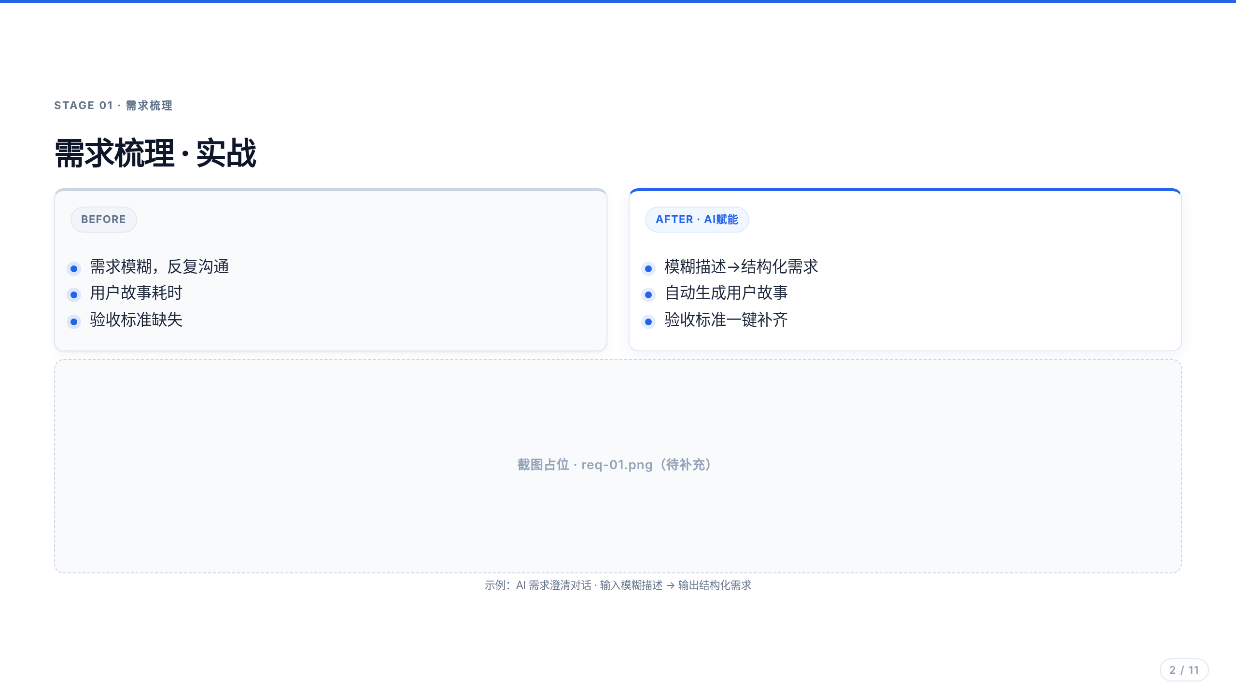
Notes:
TODO: 待补充真实截图 assets/shots/req-01.png

Slide 3
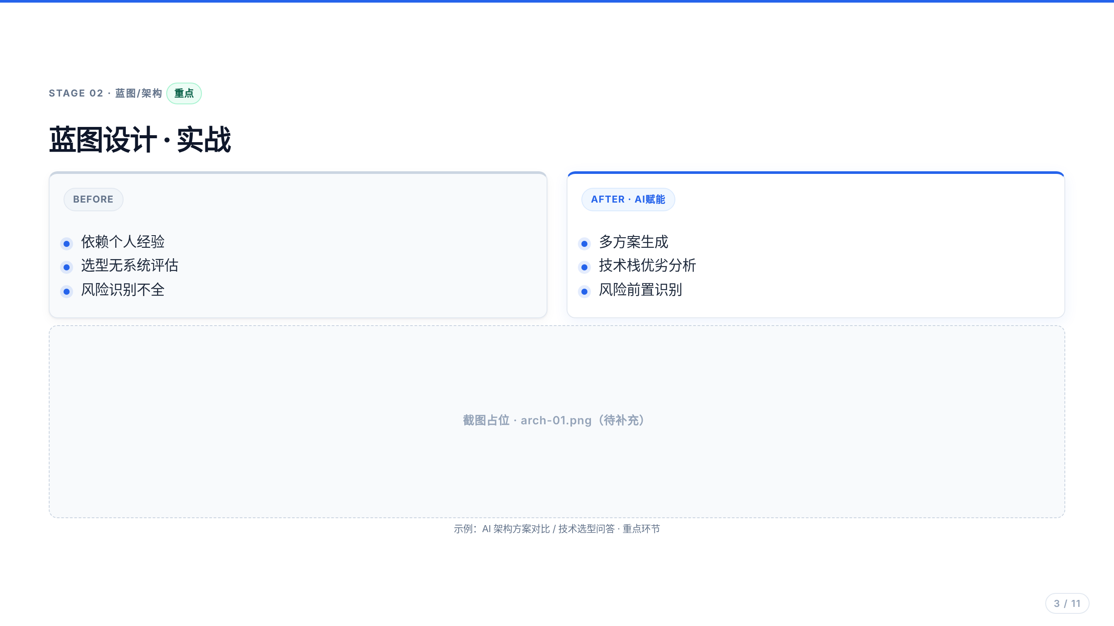
Notes:
TODO: 待补充真实截图 assets/shots/arch-01.png

Slide 4

Notes:
TODO: 待补充真实截图 assets/shots/func-01.png

Slide 5
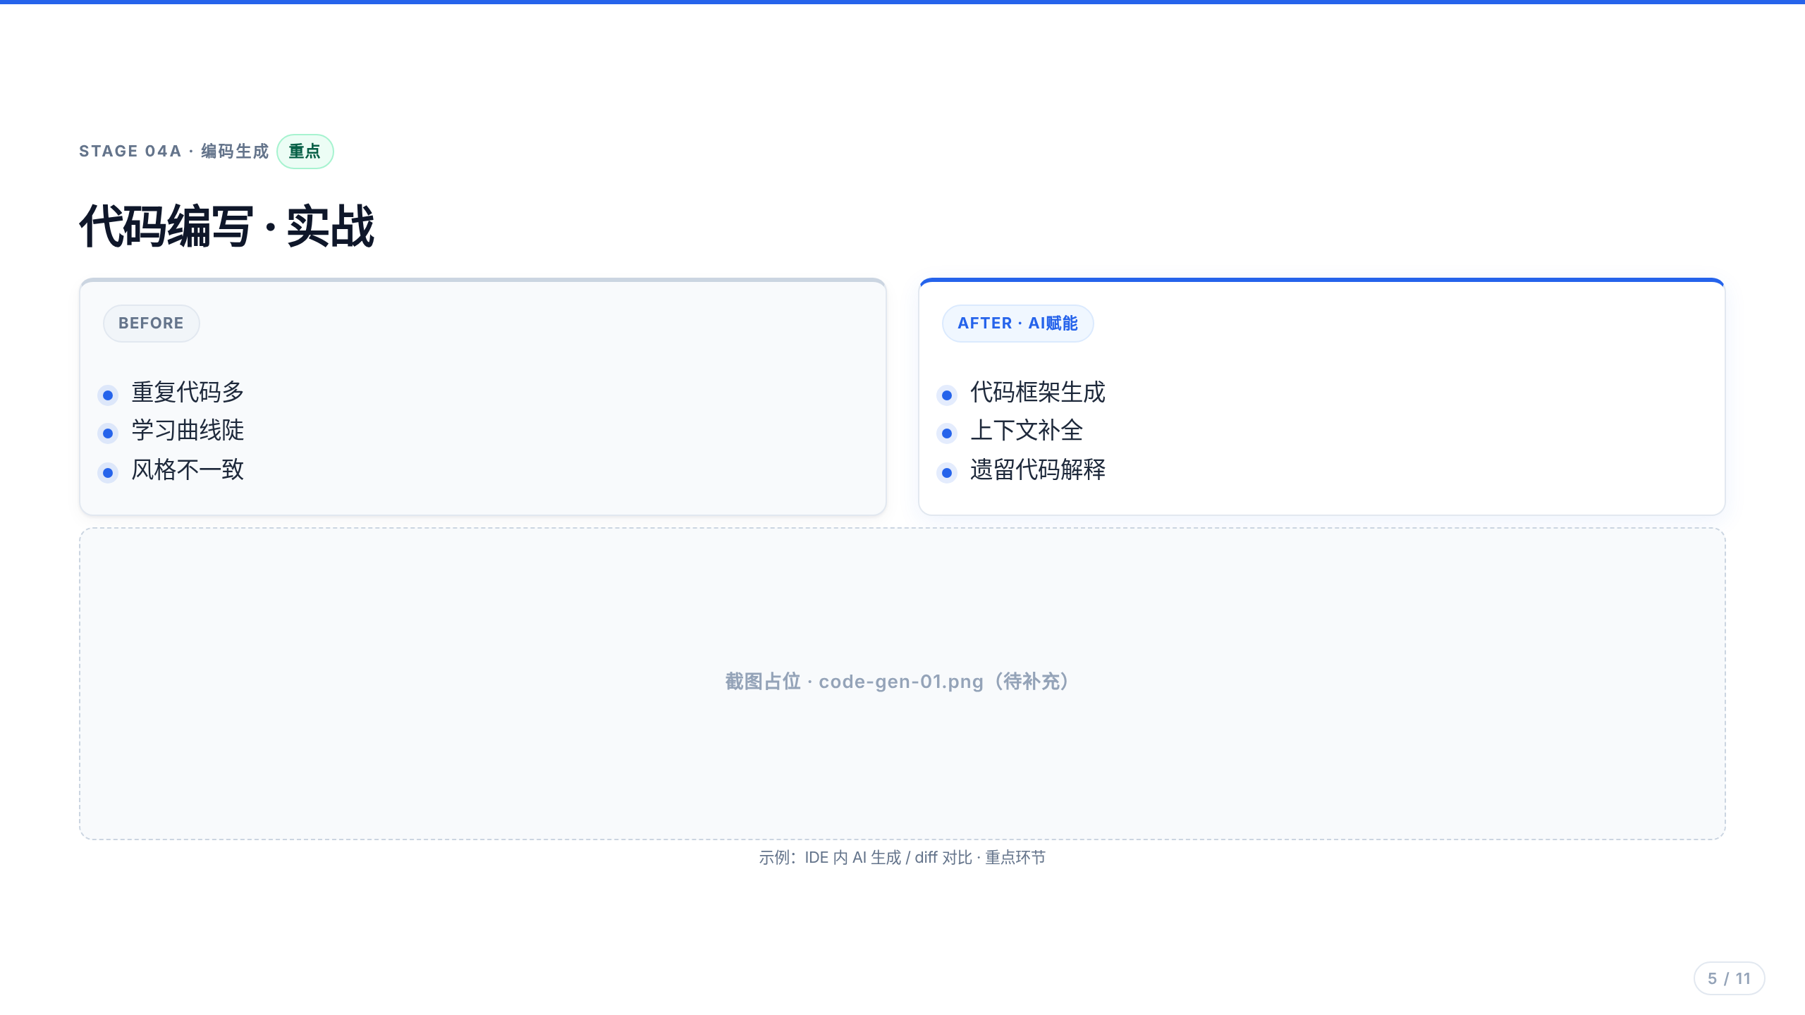
Notes:
TODO: 待补充真实截图 assets/shots/code-gen-01.png

Slide 6

Notes:
TODO: 待补充真实截图 assets/shots/code-review-01.png

Slide 7

Notes:
TODO: 待补充真实截图 assets/shots/test-01.png

Slide 8
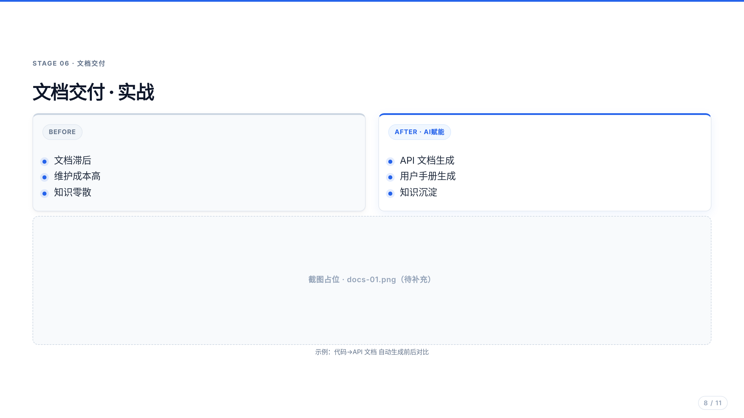
Notes:
TODO: 待补充真实截图 assets/shots/docs-01.png

Slide 9
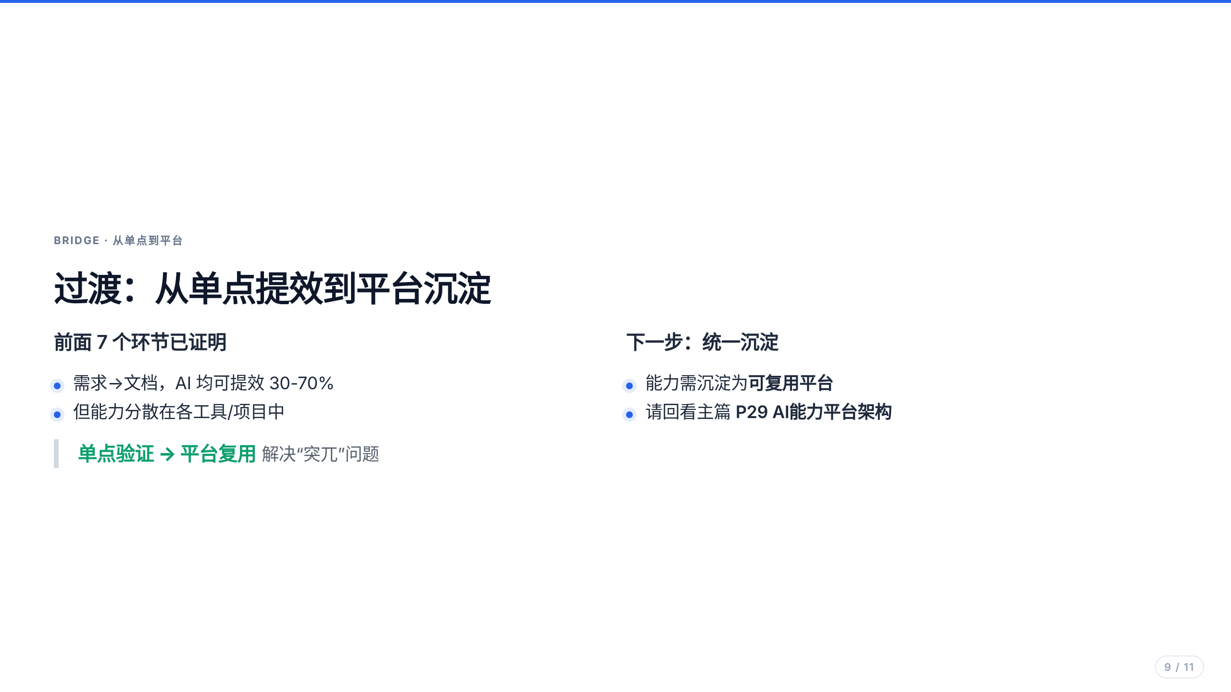

Slide 10
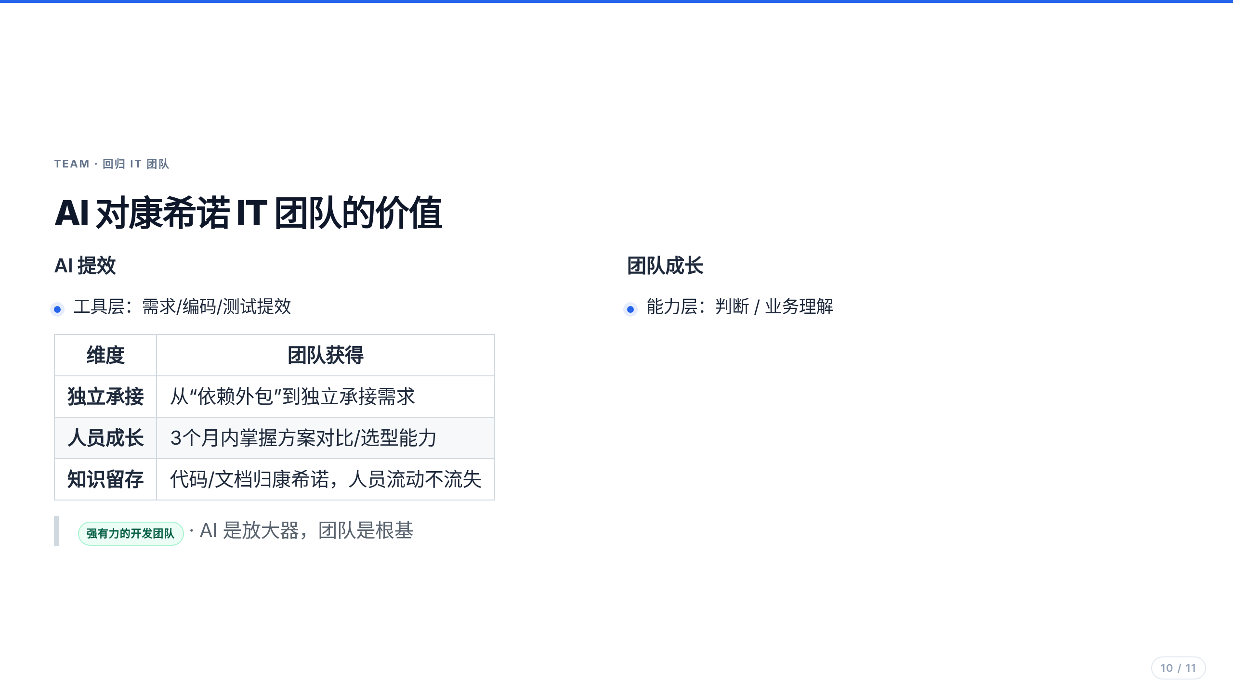

Slide 11


