Slide 1
Turtle Games analysis
David Robertshaw

Slide 2
contents
Background & Context
insights
recommendations
conclusion

Slide 3
Background & context
TURTLE GAMES
OBJECTIVE
A global game manufacturer and retailer
To improve sales performance by utilising customer trends
UNDERSTANDING THE DATA
QUESTIONS TO ANSWER
Analysis of raw data using Python and R to understand data reliability, patterns, relationships and to analyse text data.
Statistical techniques such as linear regression, K-Means clustering, normality testing used to determine results
How do we predict our most loyal customers?
Can we segment our customer base and how?
How can we use social data to understand customers?
What is impacting Sales?
What are the relationships in the sales data and regions?

Slide 4
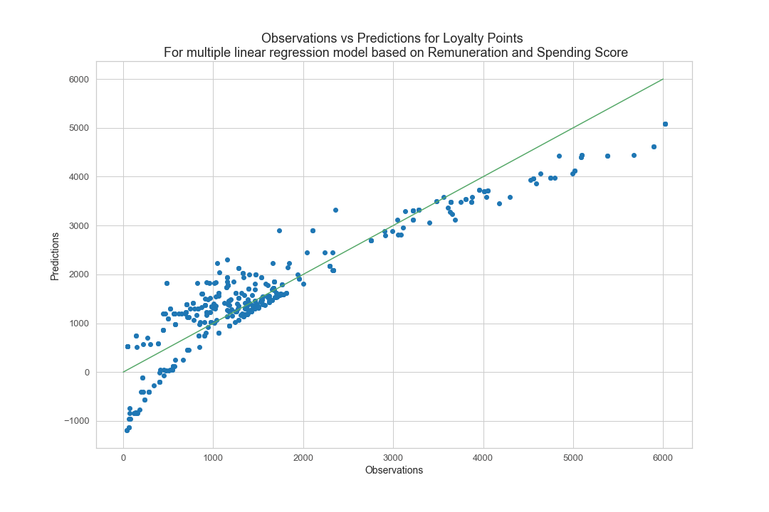
INSIGHTS – Customer loyalty
Using a Multiple Linear Regression Model we can reasonably reliably predict the Loyalty Points a member will accumulate based on their Remuneration and Spending Score.
The accuracy of this is good but not perfect.
Recommendation: this is used to prioritise and target most valuable customers.
Can we improve this with more data?
Can we understand why we the relationship weakens at higher remuneration and spending scores?

Slide 5
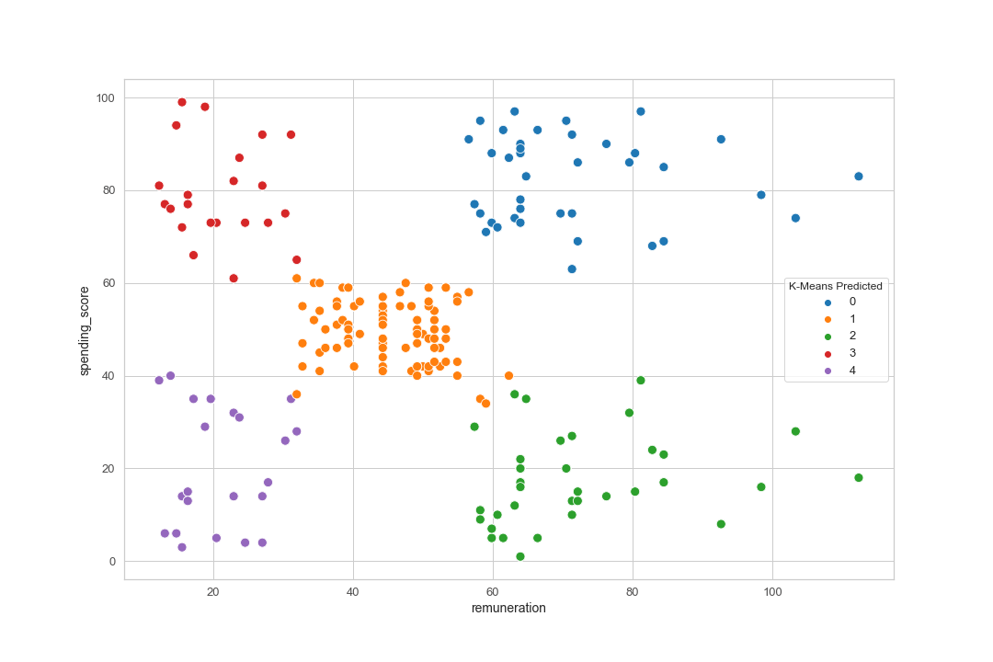
INSIGHTS – segmentation
We have identified 5 clear customer segments based on Remuneration and Spending Score
The accuracy of this is good but not perfect.
Recommendation: segment into the following groups and target marketing activity appropriately.;
0 = mid-spending score, mid-remuneration
1 = low-spending score, low-remuneration
2 = low-spending score, high-remuneration
3 = high-spending score, high-remuneration
4 = high-spending score, low-remuneration
Can we learn more about the segments, such as gender, education, location, customer behaviour (eg click through on promo emails)?

Slide 6
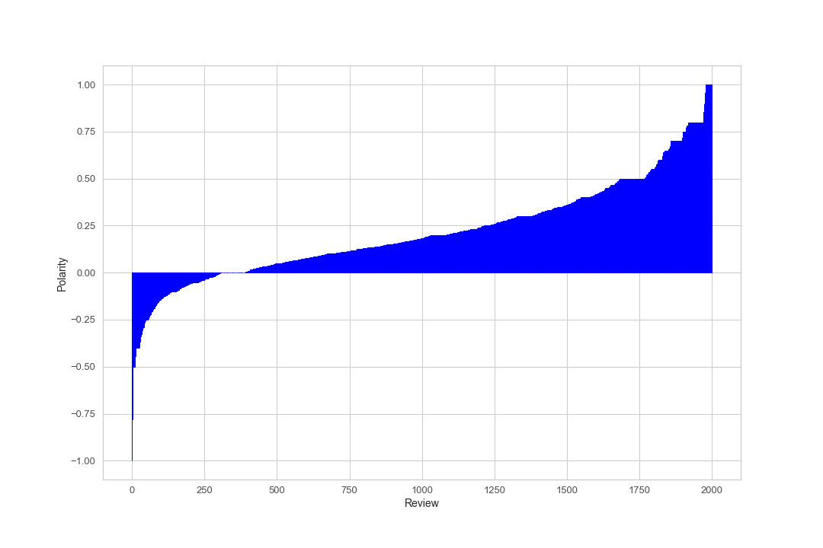
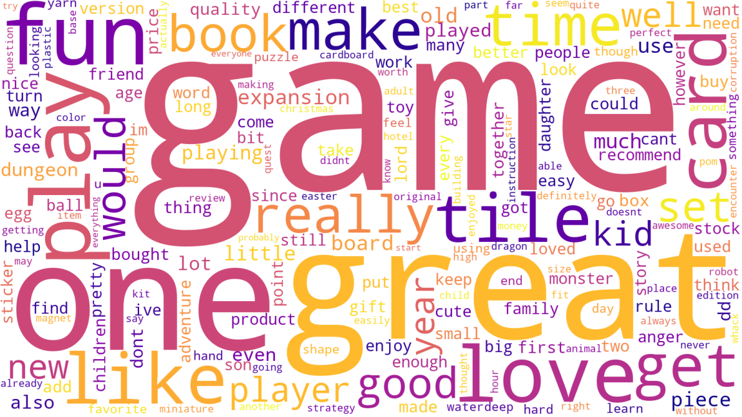
INSIGHTS – SENTIMENT
General Customer Sentiment towards Turtle Games is good.
Recommendation: dig deeper to understand common themes both good and bad. Ensure marketing campaigns leverage this, addressing issues and exploiting opportunities. Employ regular updates to ensure issues are understood in real time and Turtle can react appropriately. Engage with customers more to gather more data (surveys, social posts etc). Create feedback loop for any activity Turtle do.
Validate the sentiment scores – some errors found.
Can we align to product code to understand how customers feel about specific products?

Slide 7
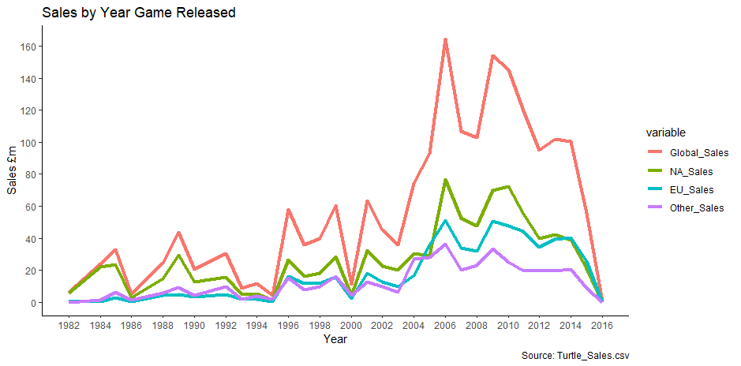
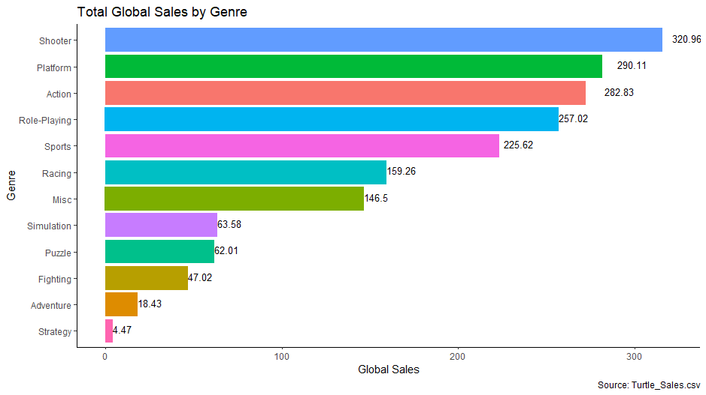
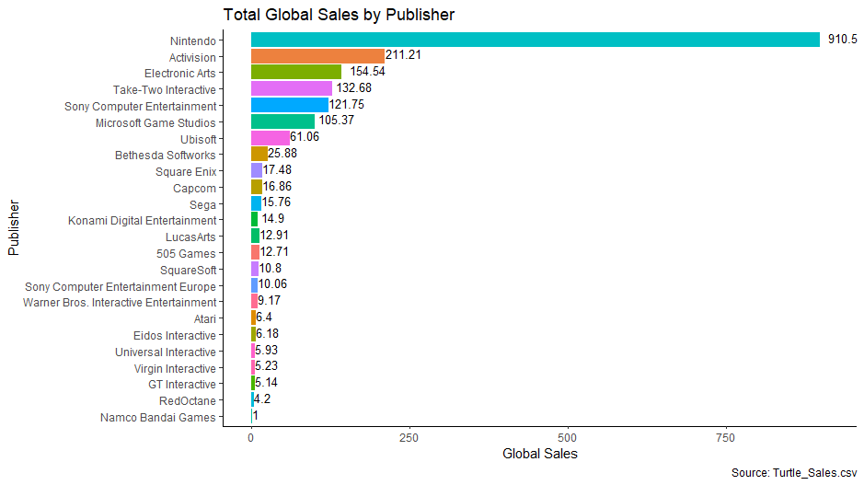
INSIGHTS – SALES
We understand our highest selling product types (genre) and who publishes them. We have an issue with declining sales - for recent releases they have fallen short of previous peaks, and NA region is now smaller than EU
Recommendation: dig deeper to understand why recent releases have underwhelmed. Do we understand the issues driving the decline in NA – more stark than EU, is it competition? Operational? Lack of investment? Change in the marketplace?
Gather more data to add more colour to this analysis, such as location breakdown, numbers of stores, socio-economic factors etc.

Slide 8
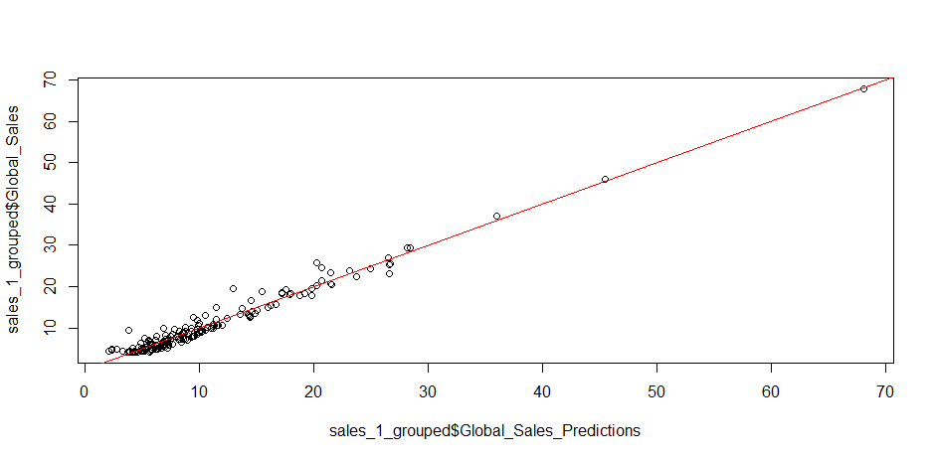
INSIGHTS – SALES PREDICTIONS
There is a close correlation between the NA and EU sales numbers and Global Sales. This information gives us two things – the ability to forecast future Global sales based on EU and NA performance and also an emphasis on the importance of these two regions to the company as a whole and the need to fix the issues highlighted previously, particularly in NA
Can we now look to understand predictors for NA and EU sales? What data do we have such as market sizes, game release plans, platform ownership, competition, marketing investment etc to reliably understand what a realistic revenue is for the next year and how we can start growing our business.

