Slide 1
MSDS 6306 Week 2 – VISUALIZATION | ggplot2, plotly
January 9, 2026
Diane Roberts

Slide 2
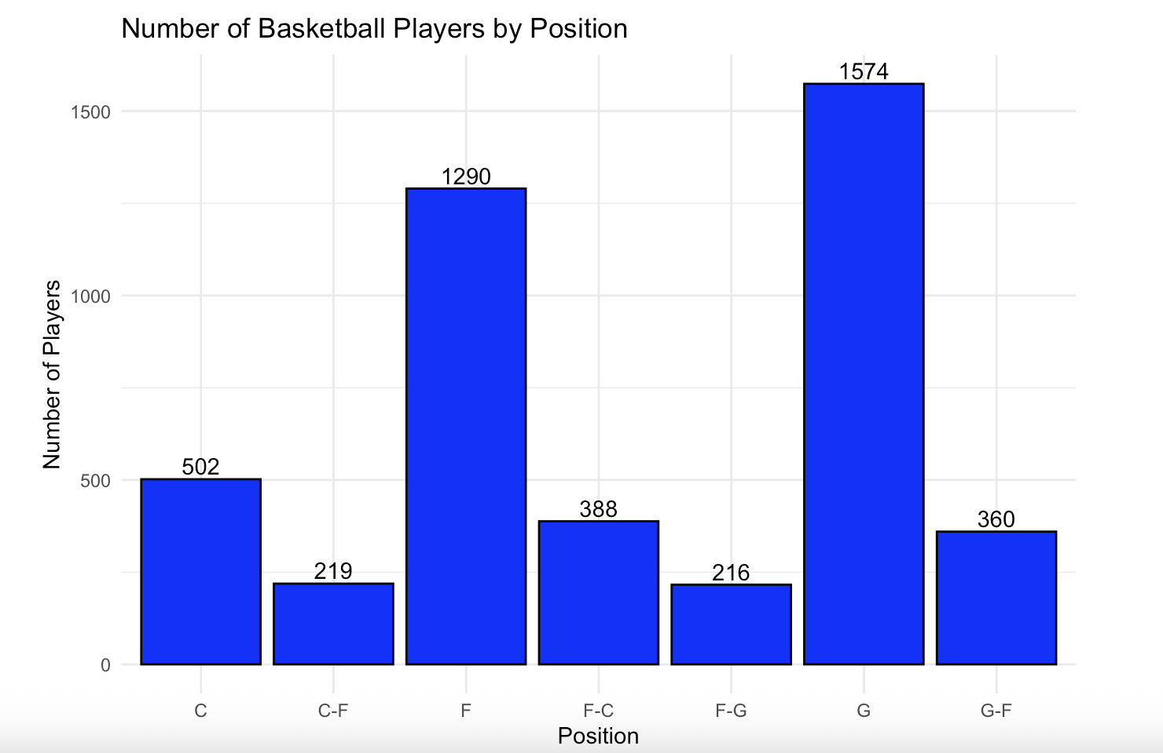
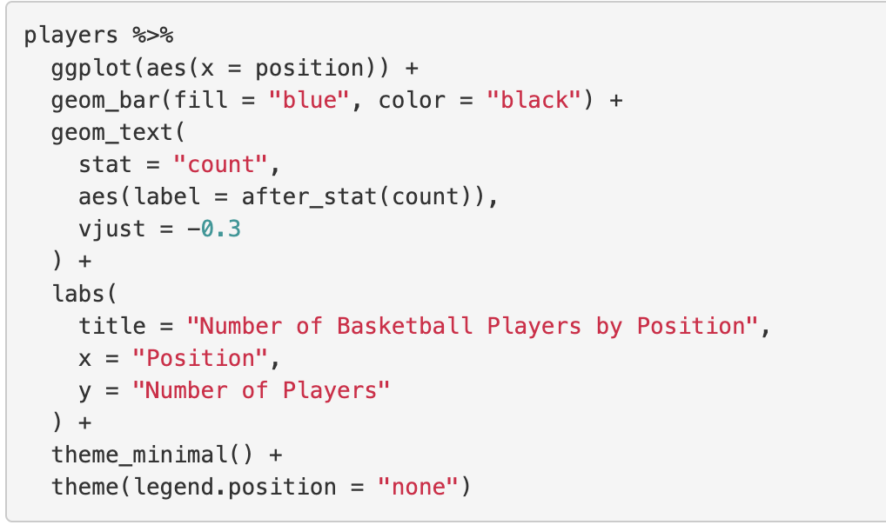
For Live Session
1. Use the PlayerBBall.csv dataset to visually represent (summarize) the number of players in each position.
Data needed to be cleaned as the first few runs captured an extra space, leading the visualization to originally reflect a blank position in the first x on the barplot.

Slide 3
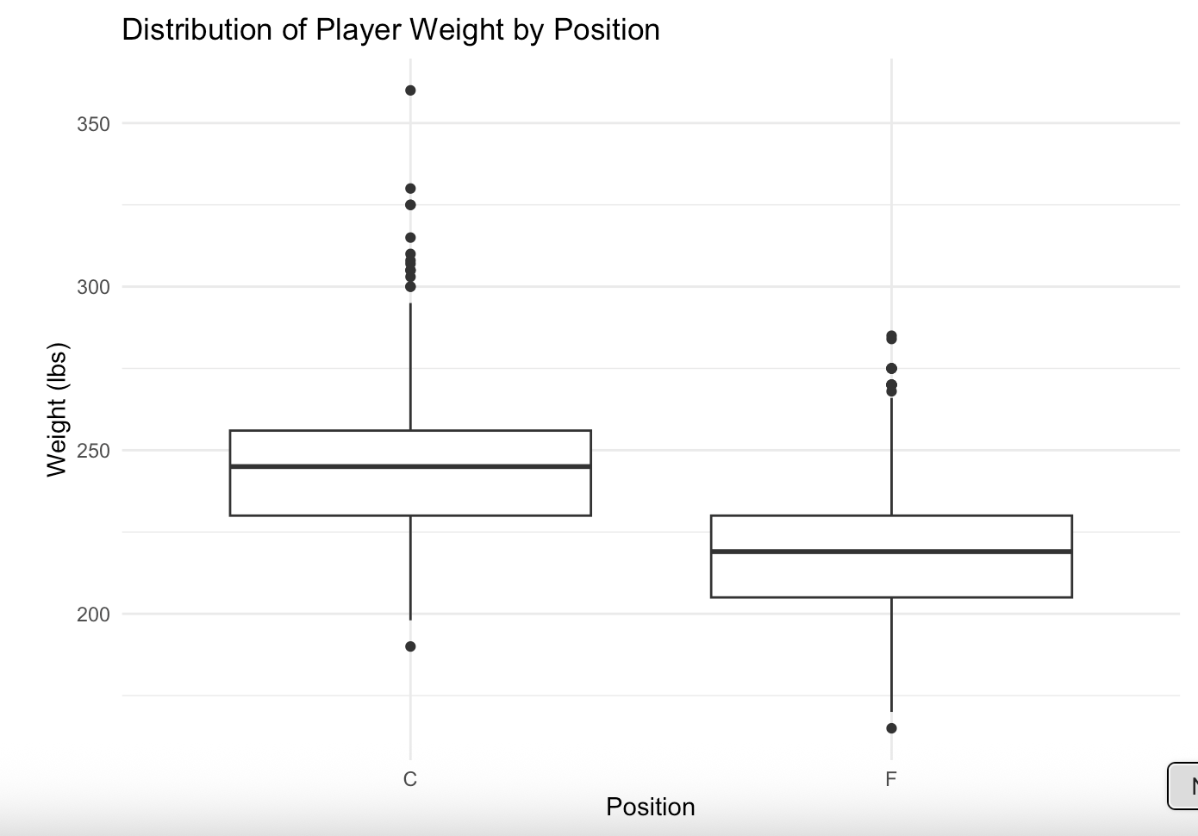
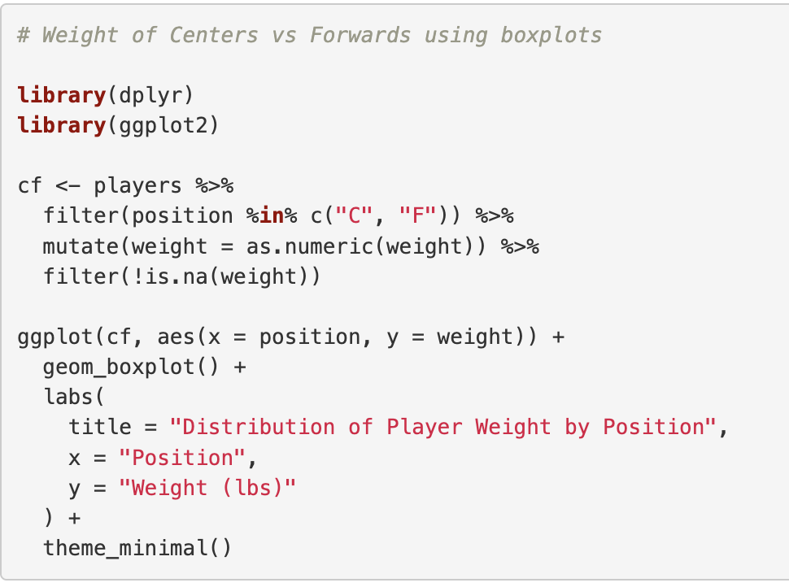
For Live Session
Use the dataset to visually investigate if the distribution of the weight of centers C is greater than the
Distribution of the weight of forwards F.
The first challenge was in truly understanding what the question was asking for and how to best display it. The question is not simply looking for the means (or average weight) but the distribution of data for both positions to determine if there is a consistent difference in the weight of players at a given position. The shape of the data is not the key determinant in this question. Boxplots give a visual that shows the spread of data. Using this visualization, it appears that Centers ( C ) are generally heavier than Forwards (F). The quartiles and median appear at a heavier weight.

Slide 4
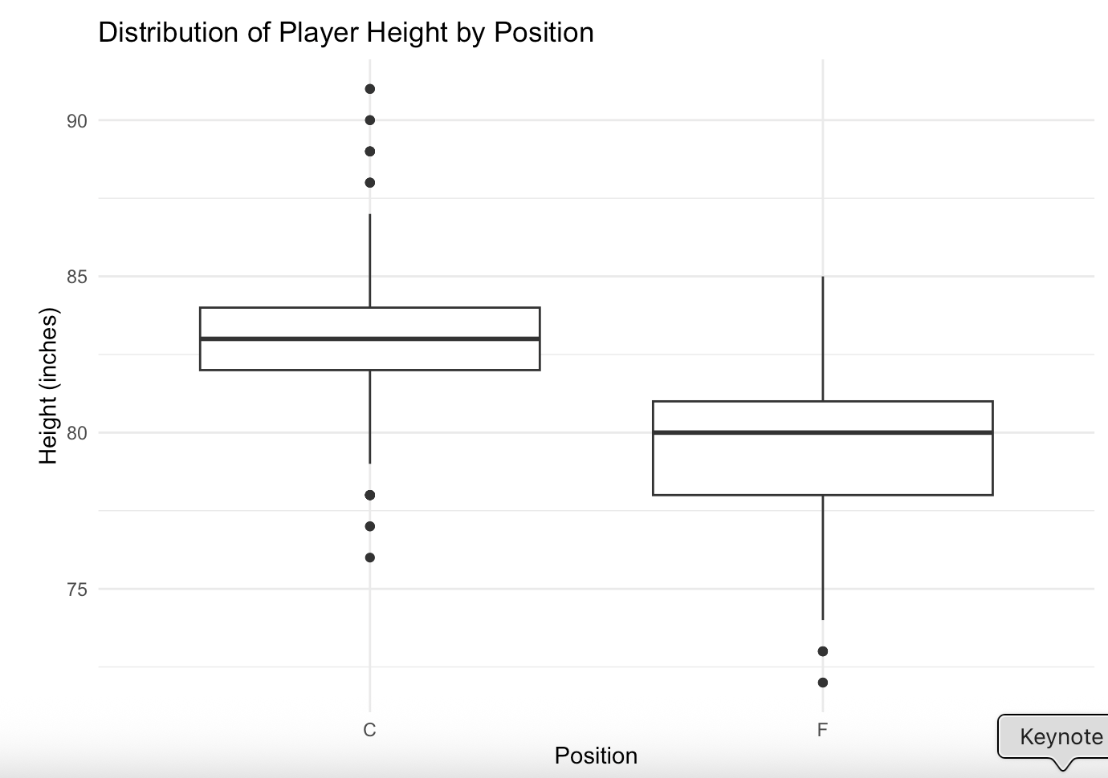
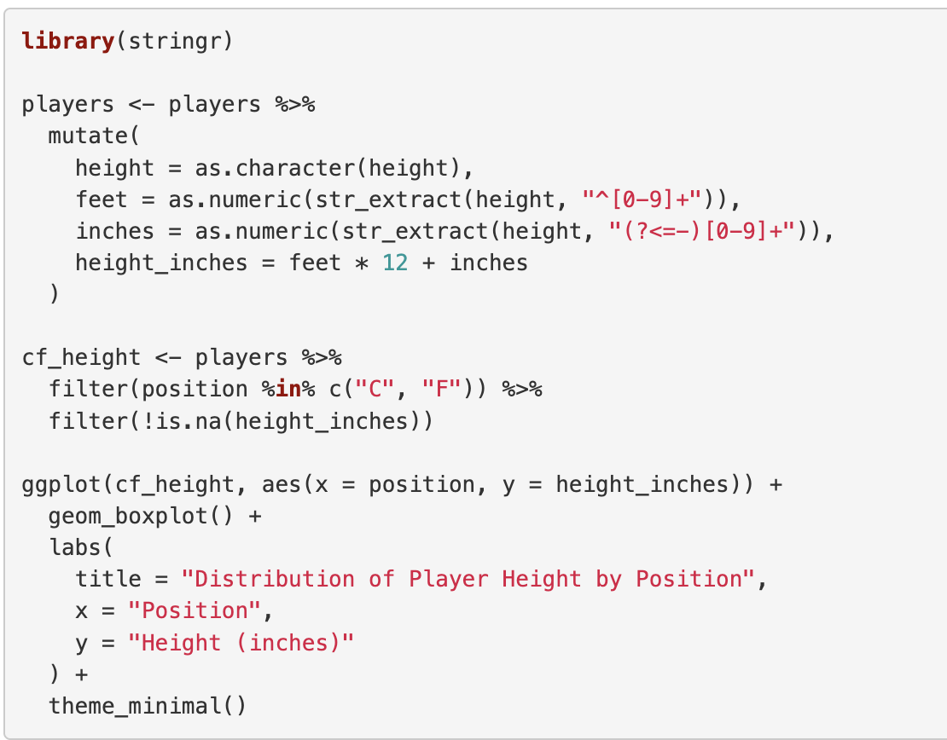
For Live Session
Use the dataset to visually investigate if the distribution of the height of centers C is greater than the
Distribution of the height of forwards F.
The first run of data did not produce visuals, which lead to the discovery that the height information was text. Tidying up this data was required to obtain the height in total inches for plotting. Using the visualization, it appears that the height of Centers ( C ) is greater than the height of Forwards (F). Given the positive relationship between height and body mass in athletes, one might expect taller players to also weigh more; however, this assumption should be evaluated using the data.

Slide 5
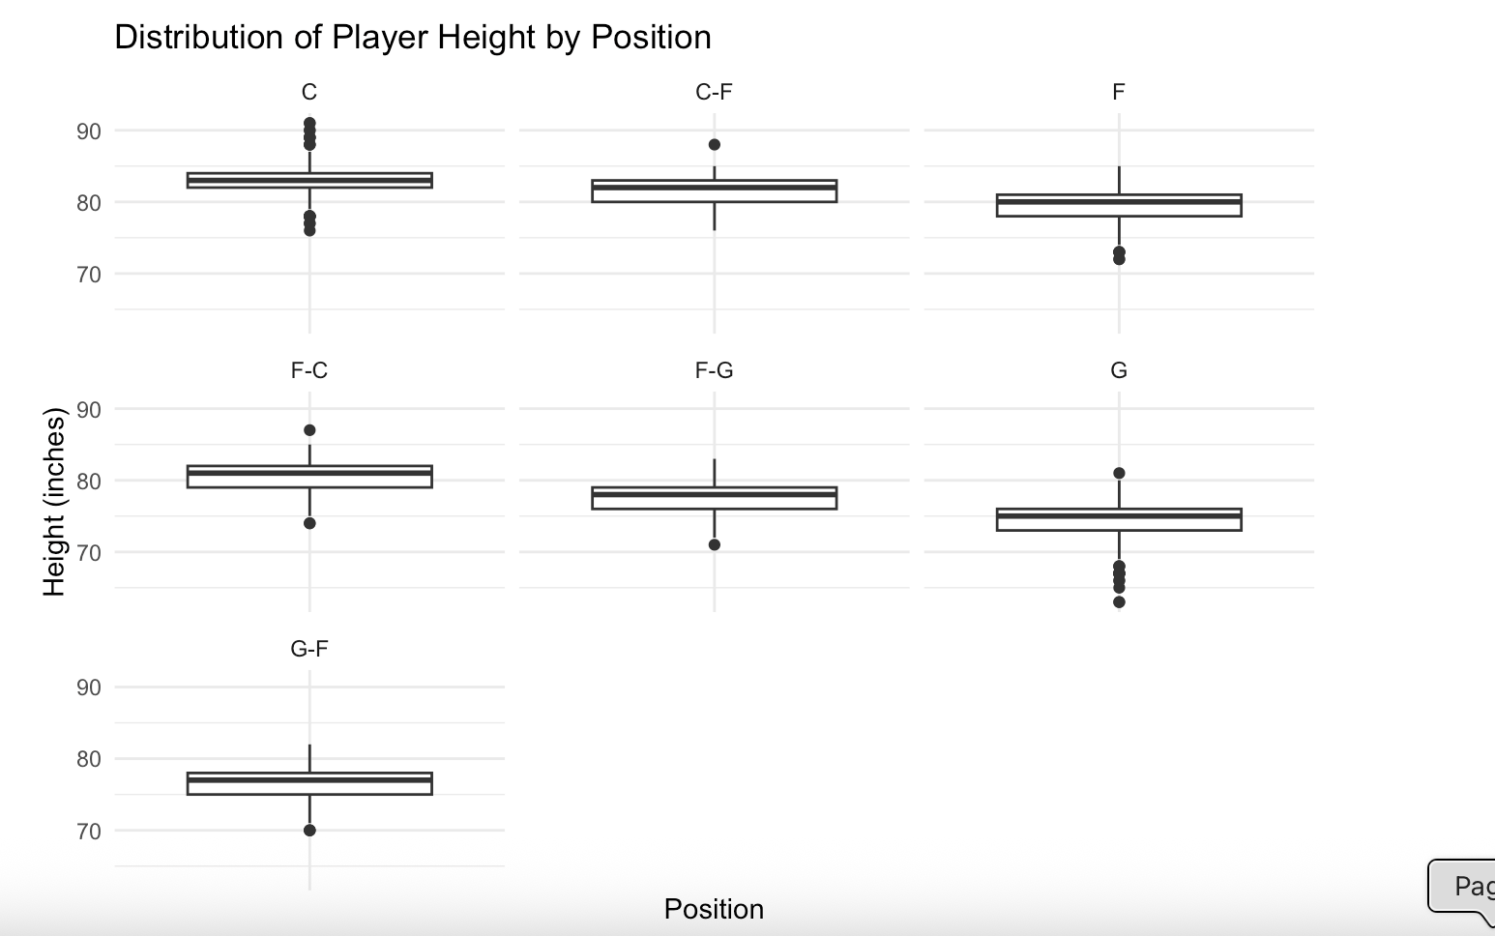
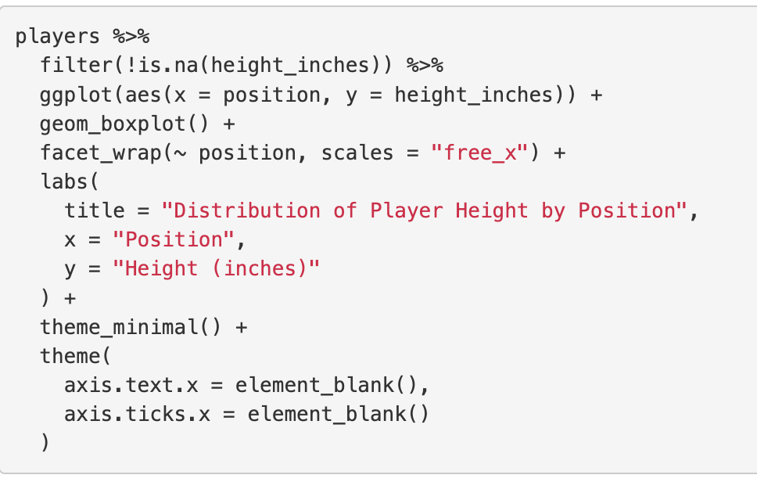
For Live Session
Use the dataset to visually investigate if the distribution of height is different between any of the positions.
Using facet_wrap (one variable) display of boxplots provides a clean way to examine each position with relation to height. Side-by-side boxplots could have also been used. Based on the visualization, positions that include Centers (C, C-F and F-C) appear to have greater height in inches.

Slide 6
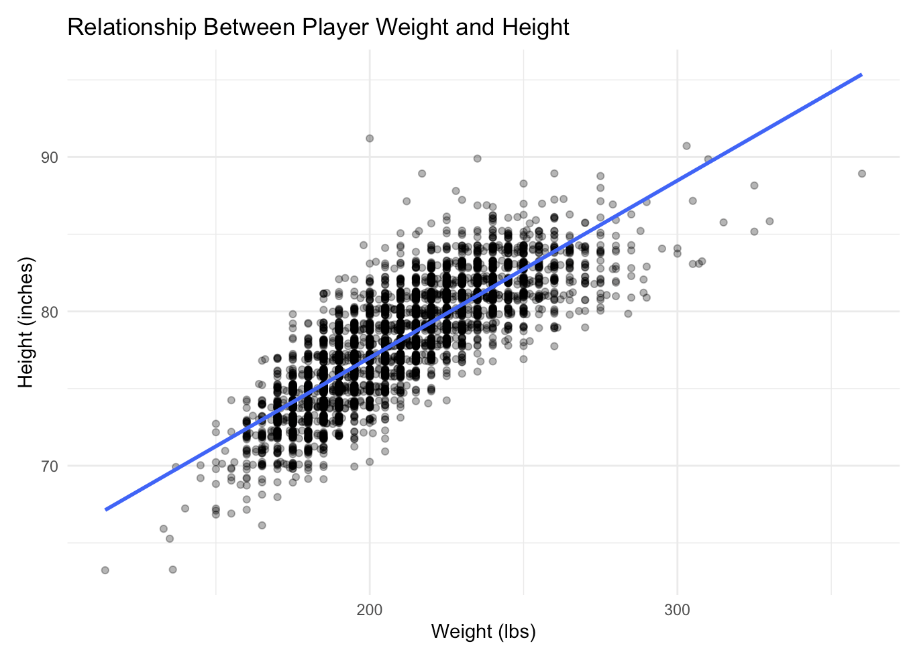
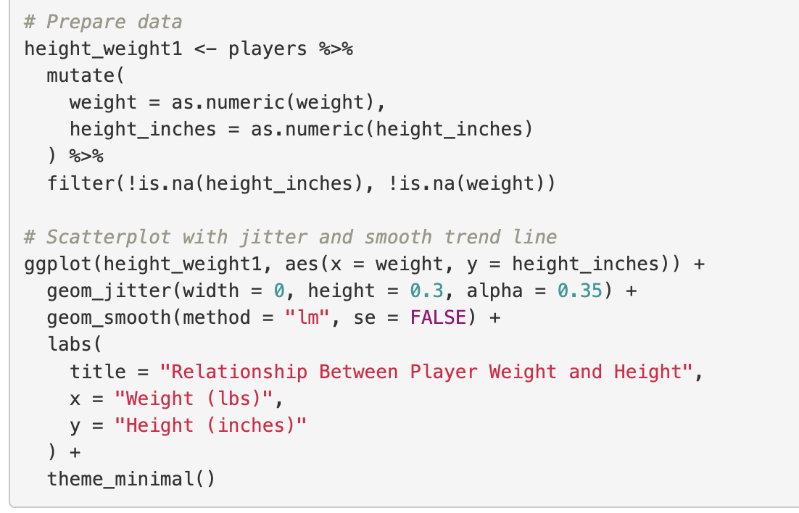
For Live Session
Use the dataset to investigate how the player’s height is related to the player’s weight.
How does height change as the weight changes?
The visualization shows a general relationship between height and weight. It does not show cause and effect or any differences across positions.

Slide 7
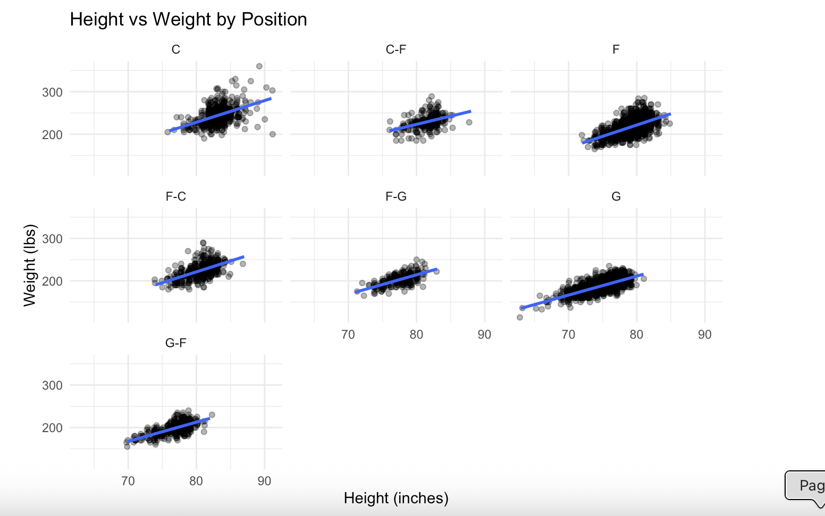
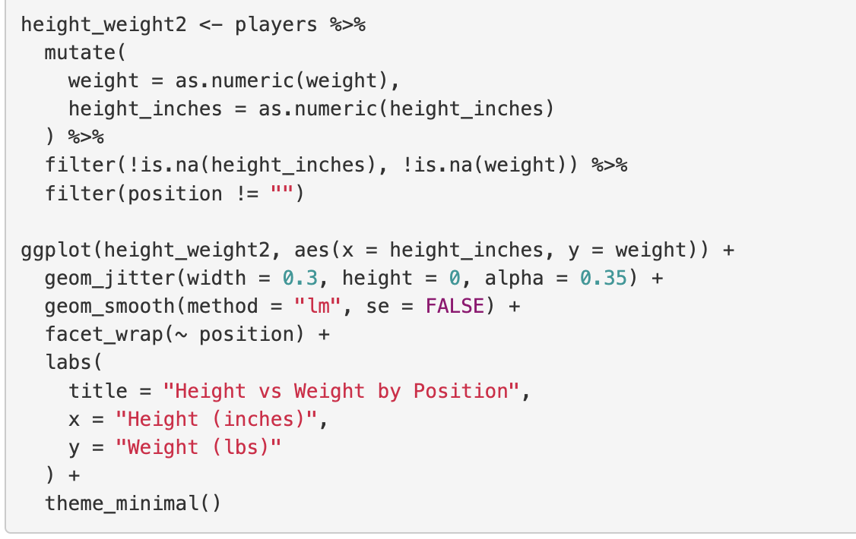
For Live Session
Is there any difference in the relationship between height and weight between positions?
Are height and weight related differently for different positions?
Using jitter with faceted scatterplots and smoothing, allows visualization that shows a general relation between height and weight among positions. However, it also shows that for some positions the relation is not as tight along the smoothing line (points are further spread out) so there is variability across positions. For example, looking at the distribution of Centers versus Forward-Guard shows variability. Additional evaluation of the data would need to be conducted to strengthen statements about the relationship.

Slide 8
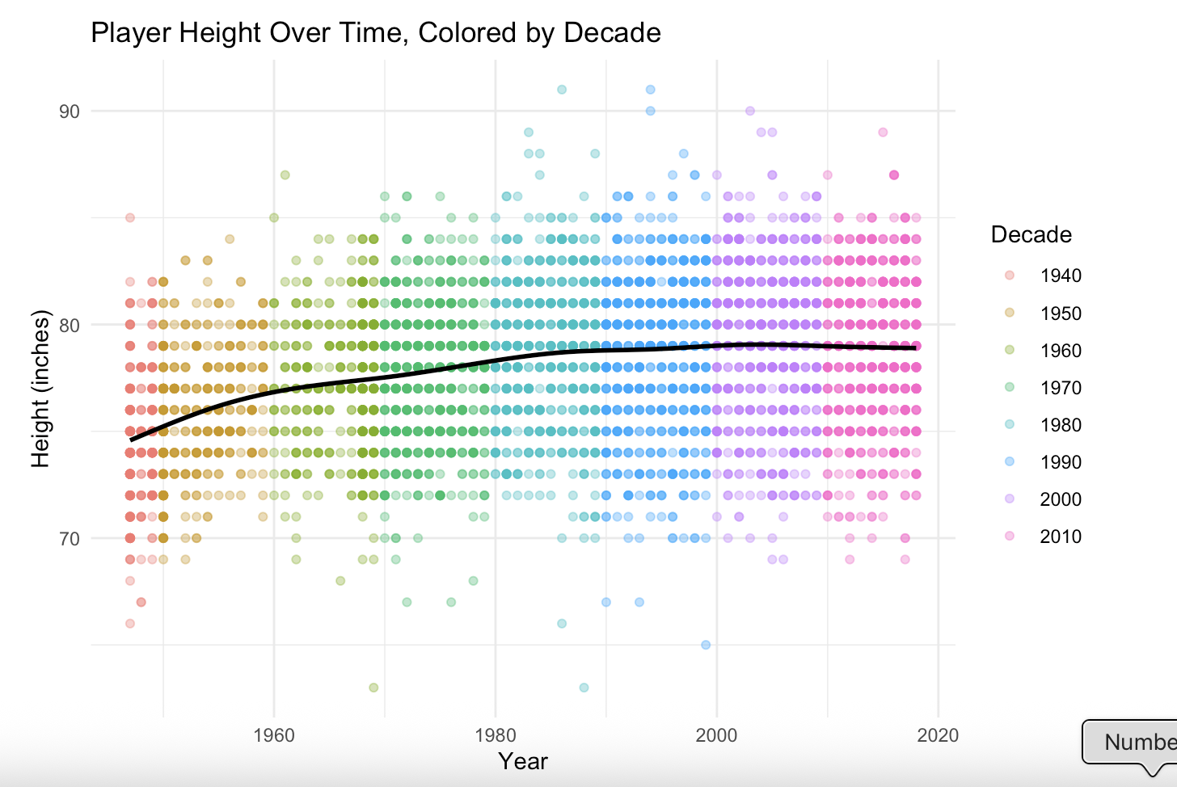
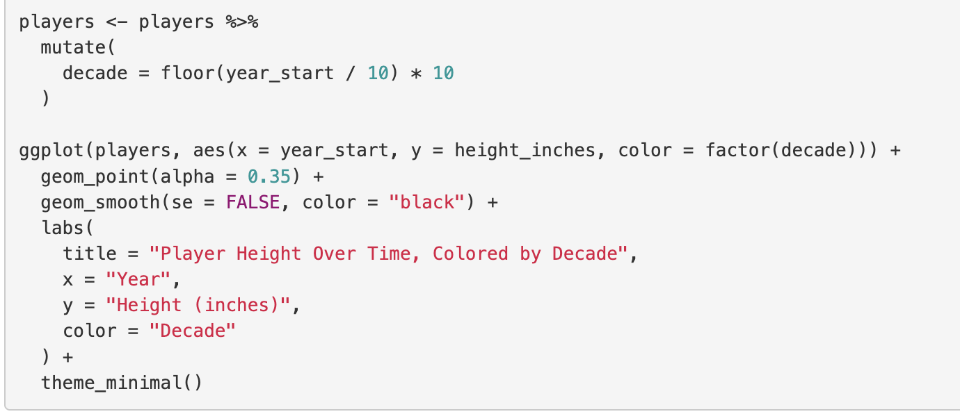
For Live Session
A historian would like to investigate the claim that the heights of players have increased over the years.
Analyze this claim graphically/visually.
Using color to help with readability over the decades and a smoothing line, there is a gradual trend towards player heights having increased over the years. The visualization does not indicate a drastic increase.

Slide 9
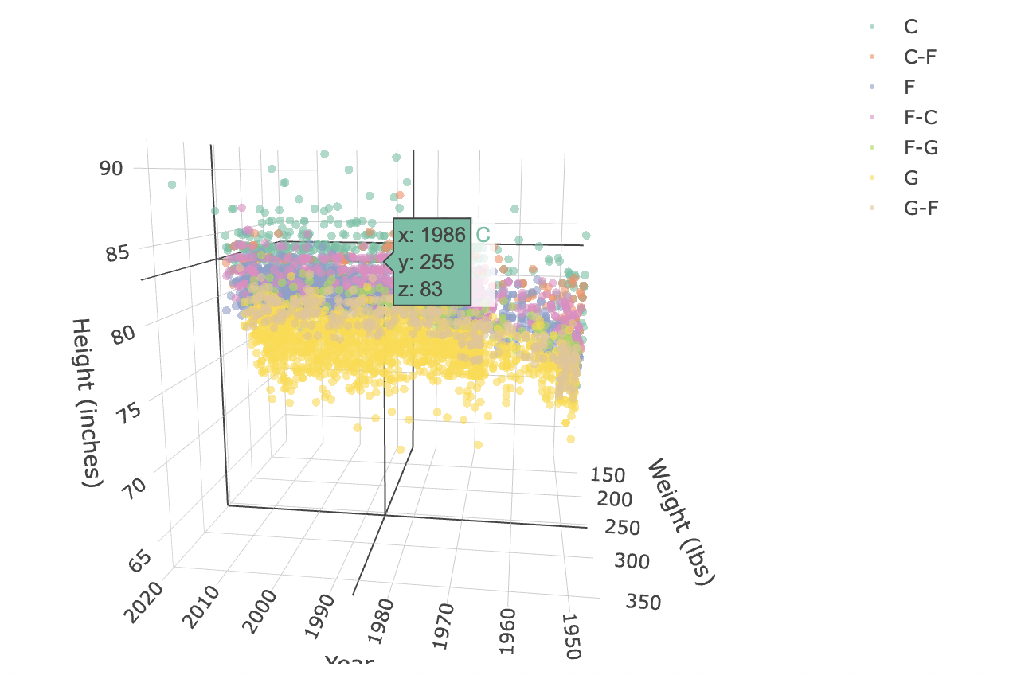
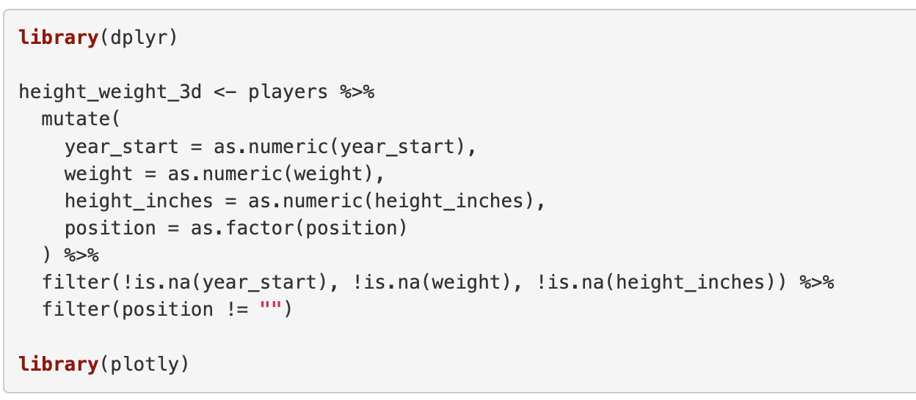
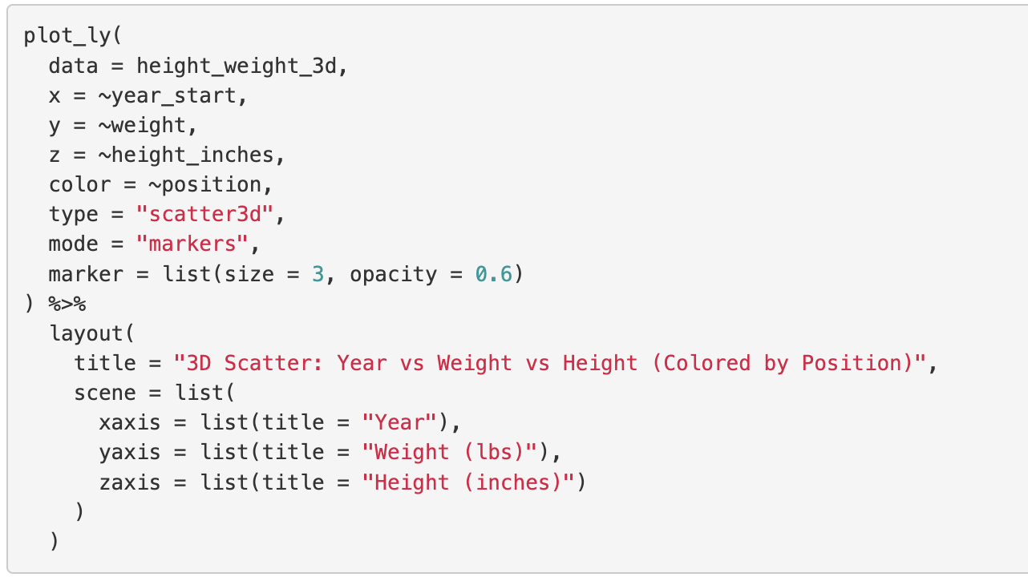
For Live Session
Create a 3D plot of height vs. weight vs. year and color code the points by position.
This is a visually interesting plot but one that is difficult to read due to the large dataset and points where players could have the same point value. Overloading is taking place here in terms of data values and color.

Slide 10
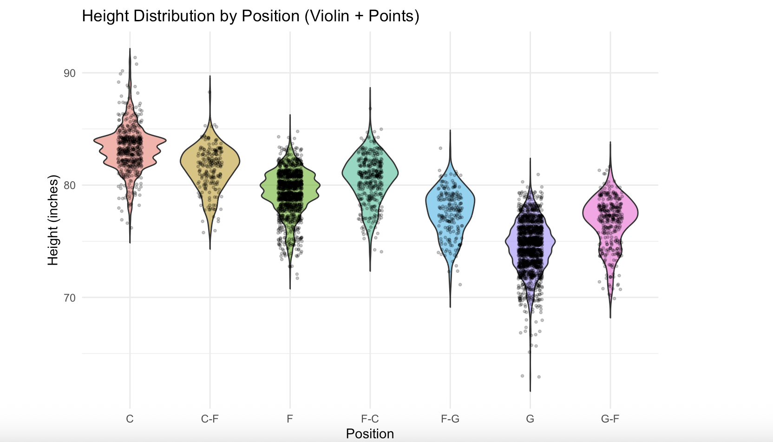
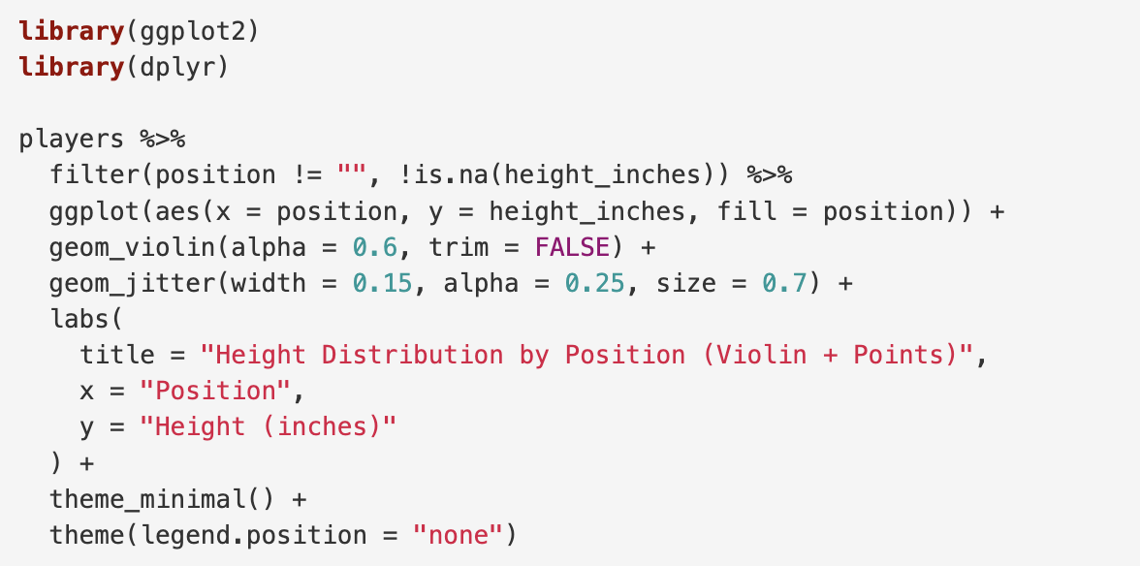
For Live Session
Chose a plot to visualize some aspect of the data and provide at least one insight.
Most of the analysis of weight and height relationship was done using boxplots. I chose a violin plot for this exercise. The violin plot makes it clear that Centers are generally taller, with most players clustered in the low 80-inch range and a noticeable tail extending toward taller heights. Guards, on the other hand, tend to be shorter and much more tightly grouped, showing less variation in height. The hybrid positions fall somewhere in between, with wider and sometimes uneven shapes that suggest a mix of different body types.

Slide 11
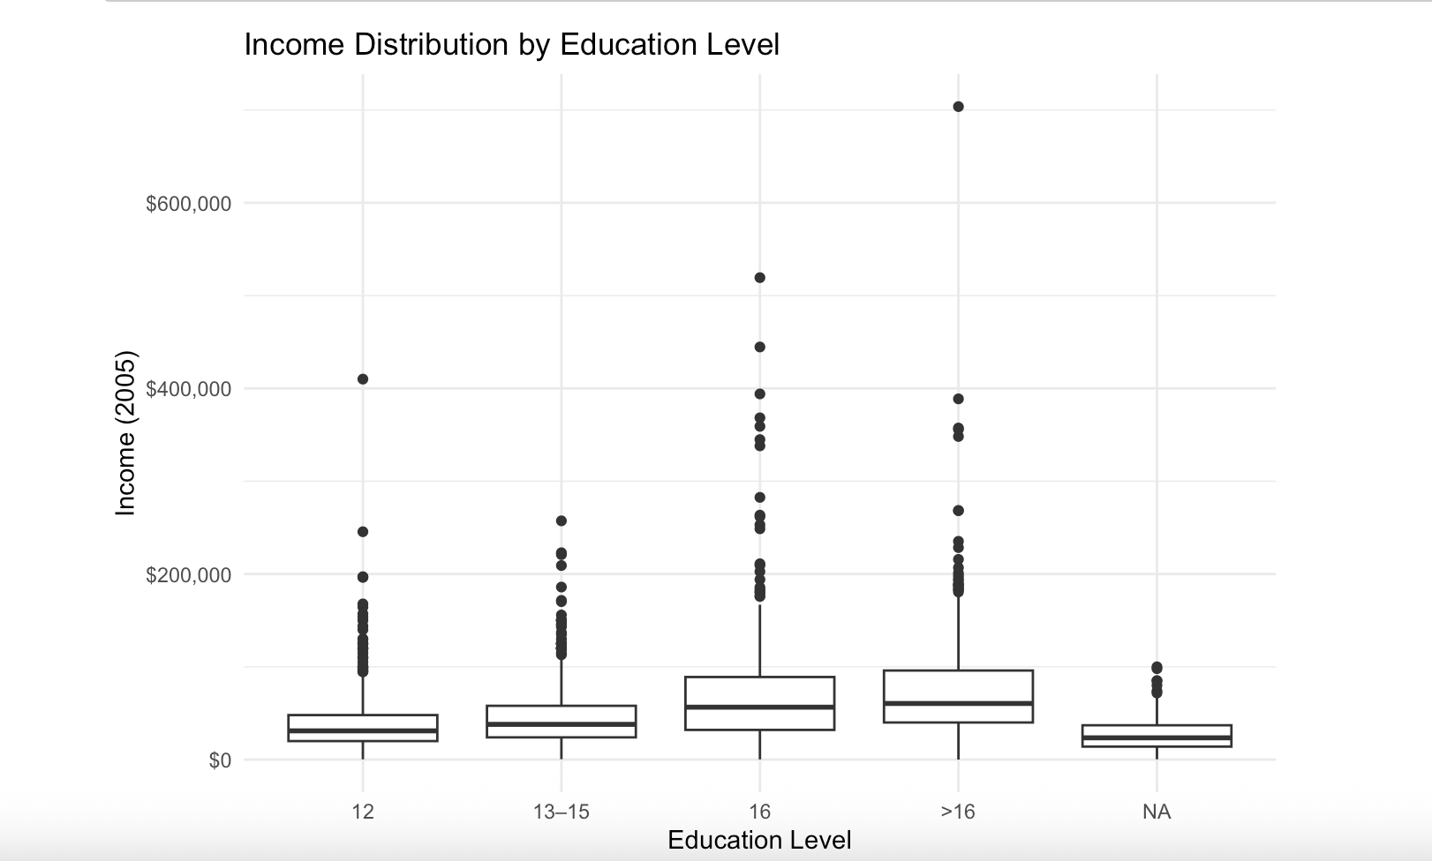
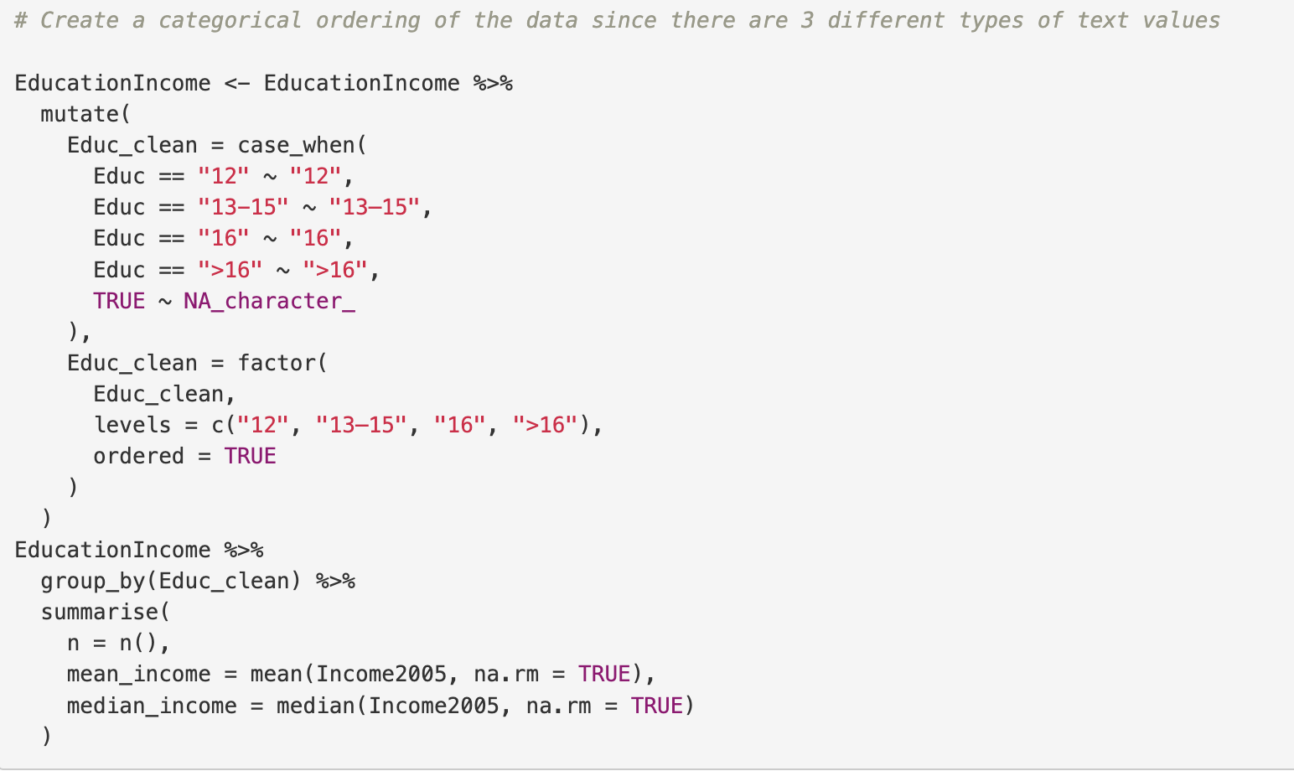
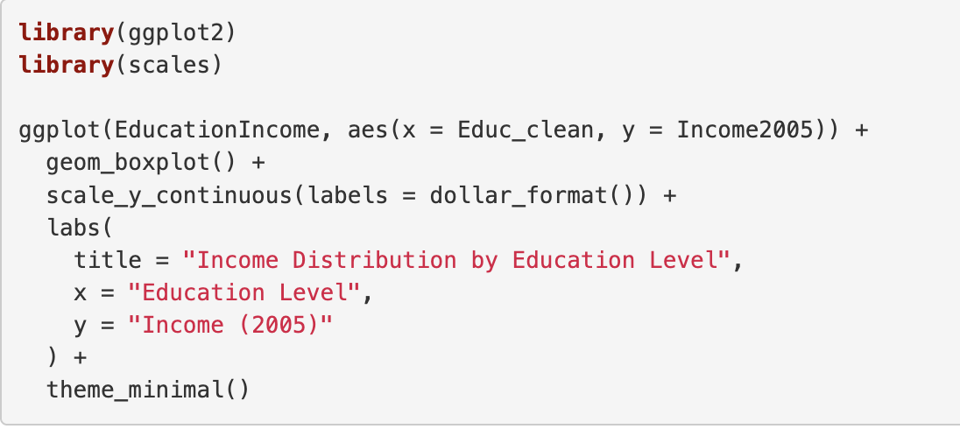
For Live Session
Using the EducationIncome.csv dataset visually test the claim that the distribution of incomes
increase (mean or median) as the education level rises.
Income does rise based on the categories of education. The boxplots show that the median has a gradual increase. The visualization also shows that there is overlap within the categories and because of the categorical nature of the number of years it is difficult to see exactly where the differences lie. Boxplots are used to compare income across education levels that were grouped into categories (12 years, 13–15 years, 16 years, and more than 16 years of education). This makes it easier to see how typical income and variability change as education increases, especially since income is skewed. While boxplots give a clear summary, they don’t show the full shape of the data. Had there been more time a few different visualization techniques would have been used to see if there are better ways to show that income does in fact rise with education.

Slide 12
Key Takeaways
Know the structure of the data. In hindsight, while I was viewing the table players to determine if data was loaded properly, I should have also evaluated how data was imported via R to determine and allowed for cleaner code so that all conversions were done at one time.
Boxplots were better for examining distributions. Scatterplots and smoothing were better for evaluating individual data points and trends. Scatterplots though could get overwhelming for large populations of data. This may be where using the distribution of sample means (CLT) would be of better use.
The visualization identified overlapping which made it challenging to find any cause and effect without running additional tests.

Slide 13
Question(s)
I’m going to make an assumption that using CLT and hypothesis testing would have created a situation where we could get to better cause and effect data. Is that accurate or am I oversimplifying possible options based on what we’ve focused on to date?
Are there standards for visualization across industries? For example, in Fin Tech do executives resonate with the type of plots that the Economist or WSJ demonstrate? What about agriculture?

