Slide 1
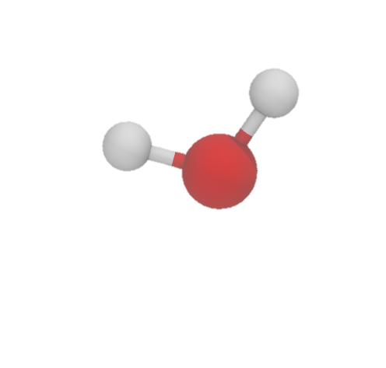

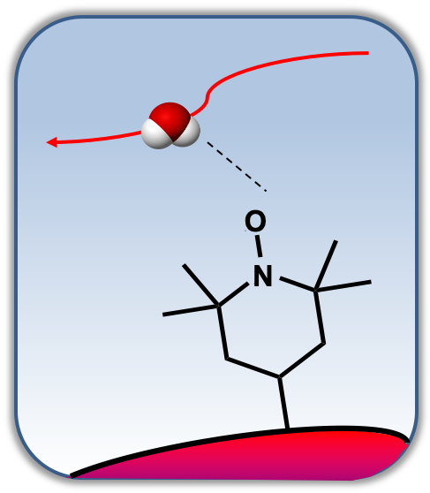






$$\vec{u}\left(t_{0}\right)$$
$$\vec{u}\left(t>t_{0}\right)$$
$$t_{0}$$
$${t>t}_{0}$$
$$r_{cutoff}$$
$$θ_{cutoff}$$

Slide 2






$$\vec{u}\left(t_{0}\right)$$
$$\vec{u}\left(t>t_{0}\right)$$
$$t_{0}$$
$${t>t}_{0}$$
$$r_{cutoff}$$
$$θ_{cutoff}$$
Notes:
Top Left: Orientaional Autocorrelation function (OACF) of bulk water vs. the OACF of water within the second hydration shell of the oxygen radical of a 4-Hydroxy TEMPO molecule.
Top Right: Survival probability of waters within the second hydration shell of the oxygen radical of the 4-Hydroxy TEMPO molecule.
Bottom Left: Hydrogen Bonding survival probability of bulk water vs. the Hydrogen Bonding survival probability of waters within the second hydration shell of the oxygen radical of a 4-Hydroxy TEMPO molecule.
Top Right: Survival probability of waters within the second hydration shell of the oxygen radical of the 4-Hydroxy TEMPO molecule.

