Slide 1
Project Presentation Evacuation and Emergency System
Project team:
Project leaders: Kacper – Pablo
Java programming: Charlotte - Maciek – Alberto - Pablo – Dennis
Project design: Dennis – Kyrylo – Thomas
Data structures: Kacper – Thomas – Dennis
Tester: Maciek – Pablo – Kyrylo
Documentation: Kacper – Alberto - Charlotte

Slide 2
Introduction – The Problem
The main motivation of this project is to help ensure the safety of users.
To create a system with a social benefit, we wish to help people to gain knowledge about escape routes and evacuation plans in case of emergencies.
The idea of everyone having a way to escape from danger by just looking at their phone to show the quickest route.

Slide 3
The Team and Teamwork
At the beginning of the project everyone was involved in each task, we coordinated this using WhatsApp and making the necessary commitments to the repository on GitHub.
By the end of the project we split the team in 2 groups:
- Development : Maciek, Dennis, Pablo and
Kacper.
- Documentation: Charlotte, Kyrylo, Thomas
and Alberto.

Slide 4
The Solution (slide 1)
The application will work out optimal evacuation routes inside buildings according to the user’s position.
Certified registered building owners will be able to submit building plans to the system.
The system will store data to show and calculate the most convenient way of leaving the building at the time of an emergency.

Slide 5
The Solution (slide 2)
To simulate a mobile environment, by creating a similar graphical user interface and model.
Mocking database connection by using text files with all necessary data.
There will be a graphical presentation of the computation (what the end-user will see).
We have decided to track statistics about users who use our application.

Slide 6
Software Engineering Activities
Requirements
We have considered the following main requirements:
User can see their current position on the map provided by the system.
The system has to provide an escape route. In case of situations such as a collapse of part of the building, the system will provide an alternative route.
The system will also provide statistics about users of the application.

Slide 7
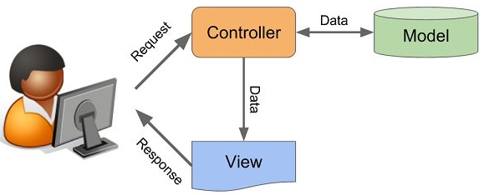
Software Engineering Activities
Architecture
For the architectural style, we have used Model-View-Controller, which is very common in graphical user interfaces and is based on the idea of code reuse. This architecture seeks to facilitate the task of developing applications and their maintenance.

Slide 8
Software Engineering Activities
Models
To capture the static aspect of the system, we have used a Class diagram, the most common structural diagram which basically represents the object-oriented view of a system.
To capture the dynamic aspect of the system, we have used two behavioural diagrams, the Use Case diagram an the Sequence diagram.
The aforementioned diagrams are in the slides that follow.

Slide 9
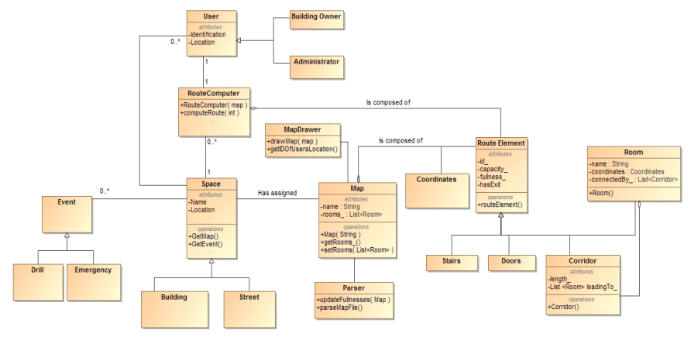
Class Diagram (high abstraction)

Slide 10
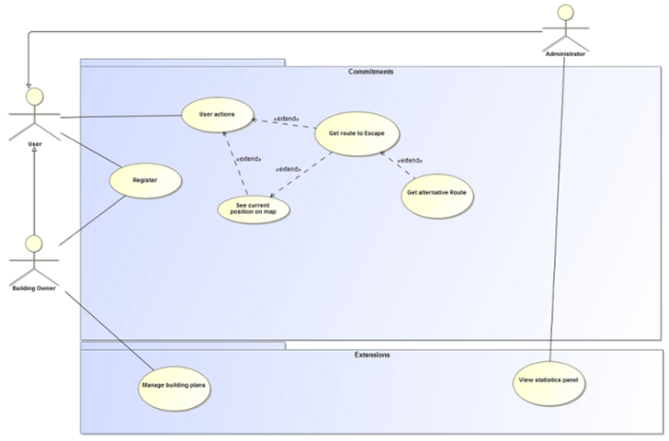
Use Case Diagram (high abstraction)

Slide 11
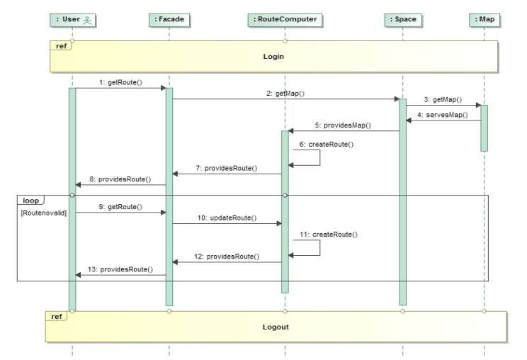
Sequence Diagram (Get route to escape)

Slide 12
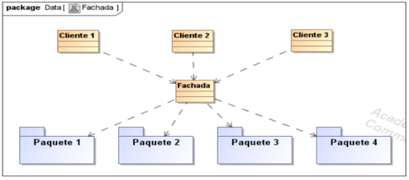
Software Engineering Activities
Principles/Patterns
For the structural pattern we used Facade (Fachada). The reason to use this pattern is because an API is considered a system of high level complexity and the way to use the basic functionality of the system while ignoring its complexity is through the Facade pattern.

Slide 13
Software Engineering Activities
Testing
We used jUnit to test different methods.
- here is where we should add the test case and its result after been run.
In this case, we have created the class EscapeRouteTest to check the class EscapeRoute and find out the behavior depending of several parametres. Quitar esto y poner un test case y su resultado

Slide 14

Development / Deployment
Tools
Development :
Eclipse
Mockito
Java
jUnit
Team Work :
Trello
Google Drive
MagicDraw
Github

Slide 15
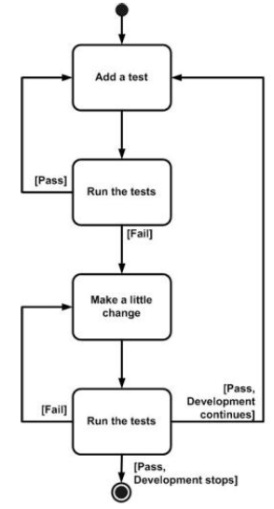
Development / Deployment
Strategies
In order to avoid errors in code and increase productivity, we used Test Driven Development (TDD).
In this case, we have created the class EscapeRouteTest to check the class EscapeRoute and find out the behaviour depending on several parameters.

Slide 16
Development / Deployment
Implementation Model
We have implemented the two chosen commitments
Request for evacuation route
Request for own location
and the GUI.
What we have not implemented :
The extensions (e.g. : owner of building / Administrator actions)
-> Also, we realized it was too complex to achieve in the time we had, so we reduced the commitments to 2

Slide 17
Development / Deployment
Deployment
Using java swing to mock the GUI of a mobile application
Mocked parts of the project (database -> text file (stored on computer))
Actual database will be stored on one machine and its data will be accessible from a server

Slide 18
Code example
Pending to add the code mentioned by Maciek

Slide 19
Code example
Pending to add the code mentioned by Maciek

Slide 20

Results
UML diagrams :
Functional requirements
Use case
Sequence diagrams
Class diagrams
Several tests
Documentation of diagrams
Application result:
GUI Swing
Dijkstra’s Algorithm
Display map JGraphX
Text parser

Slide 21
Conclusion

