Slide 1
Project Presentation Escaper
Project management: Kacper
Development team - Maciej - Pablo - Kacper - Alberto
Project design team: Dennis – Kyrylo – Thomas - Maciej
Testers team: Pablo – Kyrylo - Denis - Charlotte
Documentation: Kacper – Alberto - Charlotte - Thomas - Maciej

Slide 2
Introduction – The Problem
The main motivation of this project is to help ensure the safety of users.
To create a system with a social benefit, we wish to help people to gain knowledge about escape routes and evacuation plans in case of emergencies.
The idea of everyone having a way to escape from danger by just looking at their phone to show the quickest route.

Slide 3
The Team and Teamwork
At the beginning of the project everyone was involved in each task, we coordinated this during meetings and using communication tool WhatsApp and making the necessary commitments to the repository on GitHub.
By the end of the project we split the team in 2 groups:
- Development : Maciek, Dennis, Pablo and
Kacper.
- Documentation: Charlotte, Kyrylo, Thomas
and Alberto.

Slide 4
The Solution (slide 1)
The application is working out optimal evacuation routes inside buildings according to the user’s position.
Certified registered building owners are able to submit building plans to the system.
The system is storing data to show and calculate the most convenient way of leaving the building at the time of an emergency.

Slide 5
The Solution (slide 2)
To simulate a mobile environment, by creating a desktop application with similar graphical user interface and model.
Mocking database connection by using text files with all necessary data.
There is a graphical presentation of the computation (what the end-user will see).

Slide 6
Software Engineering Activities
Requirements
We have considered the following main requirements:
User can see their current position on the map provided by the system.
The system has to provide an escape route. In case of situations such as a collapse of part of the building, the system will provide an alternative route.
The system will also allow to manage users while working as Administrator

Slide 7
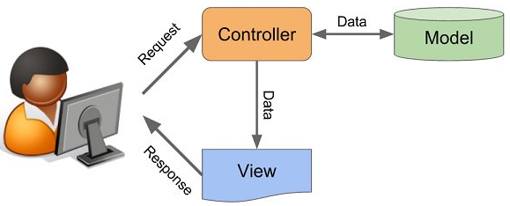
Software Engineering Activities
Architecture
For the architectural style, we have used Model-View-Controller, which is very common in graphical user interfaces and is based on the idea of code reuse. This architecture seeks to facilitate the task of developing applications and their maintenance.

Slide 8
Software Engineering Activities
Models
To capture the static aspect of the system, we have used a Class diagram, the most common structural diagram which basically represents the object-oriented view of a system.
To capture the dynamic aspect of the system, we have used two behavioural diagrams, the Use Case diagram an the Sequence diagram.
The aforementioned diagrams are in the slides that follow.

Slide 9
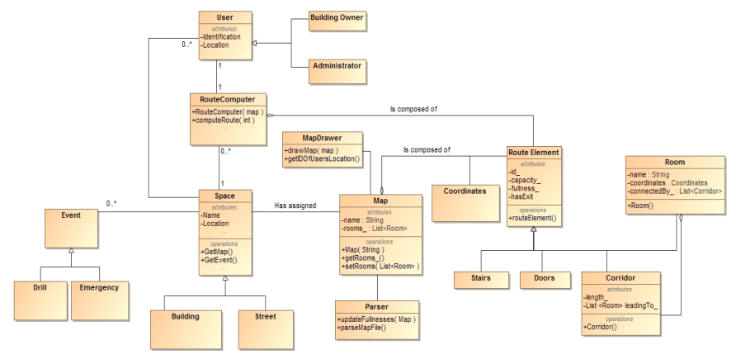
Class Diagram (high abstraction)

Slide 10
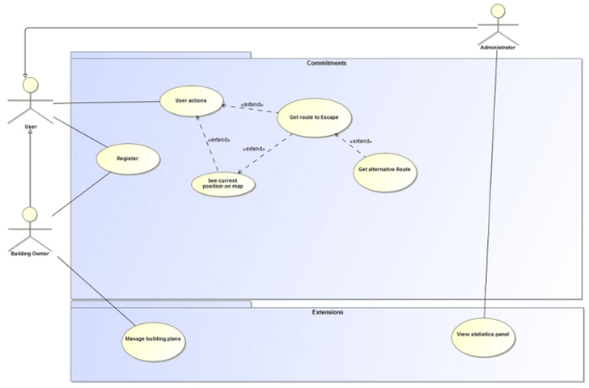
Use Case Diagram (high abstraction)

Slide 11
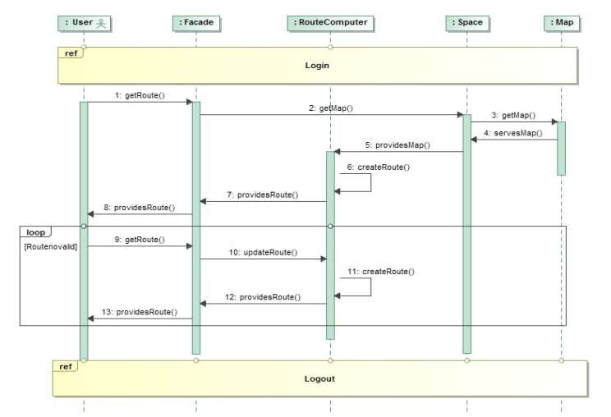
Sequence Diagram (Get route to escape)

Slide 12
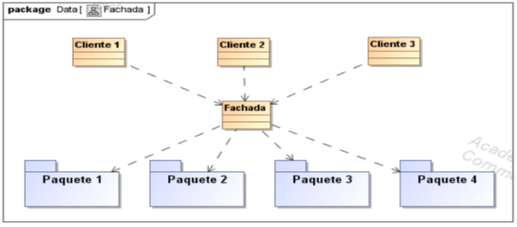
Software Engineering Activities
Principles/Patterns
For the structural pattern we used Facade (Fachada). The reason to use this pattern is because an API is considered a system of high level complexity and the way to use the basic functionality of the system while ignoring its complexity is through the Facade pattern.

Slide 13
Software Engineering Activities
Testing
We used jUnit to test different methods.
- We developed class RouteComputerTest with most important tests for route algorithm
- All the JUnit tests were successfully passed.
- After implementation process we performed live tests on already working application

Slide 14

Development / Deployment
Tools
Development :
Eclipse
Mockito
Java
jUnit
IntelliJ
Team Work :
Trello
Google Drive
MagicDraw
Github
What’s App

Slide 15
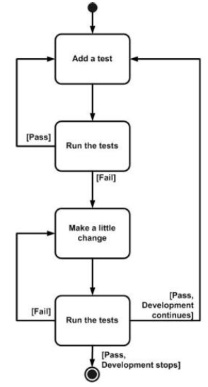
Development / Deployment
Strategies
In order to avoid errors in code and increase productivity, we used Test Driven Development (TDD).
In this case, we have created the class EscapeRouteTest to check the class EscapeRoute and find out the behaviour depending on several parameters.

Slide 16
Development / Deployment
Implementation Model
We have successfully realised below commitments in our application:
Escape route visualisation
Escape route management
Uploading building plans live
Managing users account
Work over application from GUI level

Slide 17
Development / Deployment
Deployment
Using SWING and AWT libraries to create the GUI application
Mocked database of the project (database -> text file (stored on computer))
Actual database will be stored on one machine and its data will be accessible from a server
We deployed project on GitHub repository using IDE connected with GIT client

Slide 18
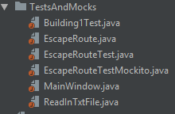
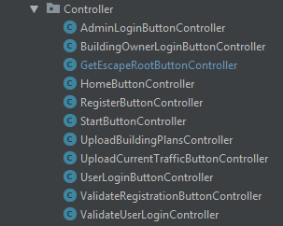
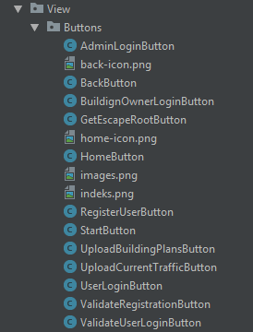
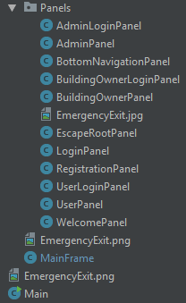
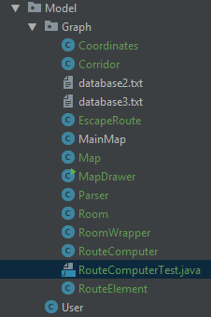
Code Structure
48 classes divided into 7 packages

Slide 19

Results
UML diagrams :
Functional requirements
Use case
Sequence diagrams
Class diagrams
Several tests
Documentation of diagrams
Application result:
GUI
Dijkstra’s Algorithm
Display map JGraphX
Text parser
User management

Slide 20
Problems occured
Different approaches to class diagram idea
Merging models in MagicDraw
Parser part for Map project
Merging GUI with Map
Displaying map in the same window

Slide 21
Conclusion
We realise how important is to follow a well-structured methodology when working on a new project. The main first step is the correct understanding of the new SUD in order to apply the right model to develop the new system.
We all know now what the idea of being part of a team means, including the importance of working in a coordinated way to complete the different tasks assigned successfully and complete the project on time and in form.

