Slide 1
Project presentation Evacuation and Emergency System
Project team:
Project leaders: Kacper – Pablo
Java programming: Charlotte - Maciek – Alberto - Pablo – Dennis
Project design: Dennis – Kyryll – Thomas
Data structures: Kacper – Thomas – Dennis
Tester: Maciek – Pablo – Kyryll
Documentation: Kacper – Alberto - Charlotte

Slide 2
Contents
Introduction – The problem
The team and teamwork
The solution
Sw engineering activities
Requirements
Architecture
Models
Principles/Patterns
Testing
Development/Deployment
Strategies and tools
Implementation model (what is and what is not real)
Deployment
Results
Conclusions

Slide 3
Introduction – The problem
The main motivation of this project is to help ensure the safety of users.
The idea of everyone having a way to escape from danger by just looking at their phone to show the quickest route.
To create a system with a social benefit, we wish to help people to gain knowledge about escape routes and evacuation plans in case of emergencies.

Slide 4
The Team and teamwork
To be developed, how we divided the team, in groups, etc, how we’ve been working coordinate, assig task, possible to add a graph with the split of groups…..

Slide 5
The solution (sheet 1)
The application will work out optimal evacuation routes inside the buildings according to user’s position.
Certified registered building owners will be able to submit building plans to the system.
The system will have data storage to show and calculate the most convenient way of leaving the building at the time of an emergency.

Slide 6
The solution (sheet 2)
To simulate mobile environment, especially by creating similar graphical user interface and model.
Mocking database connection by using text files with all necessary data.
There will be graphical presentation of the computation (what the end-user will see).
We have decided to lead statistics about users who use our application.

Slide 7
Sw engineering activities
Requirements
We have considered the following main requirements:
User can see his current position on map, provided by the system.
The system has to provide an escape route. In case of collapse or any other situation the system will provide an alternative rout.
The system has also to provide statistics about users of the application.

Slide 8
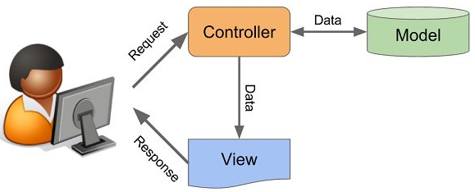
Sw engineering activities
Architecture
As architectual style, we have used Model-View-Controller, very common in graphical user interfaces, and based on the idea of code reuse. This architecture seek to facilitate the task of developing applications and their maintenance.

Slide 9
Sw engineering activities
Models
To capture the static aspect of the system, we have used Class diagram, the most common structural diagram which basically represents the object-oriented view of a system.
To capture the dynamic aspect of the system, we have used two behavioral diagrams, the Use case diagram an the Sequence diagram.
We show the mentioned diagrams in next sheets.

Slide 10
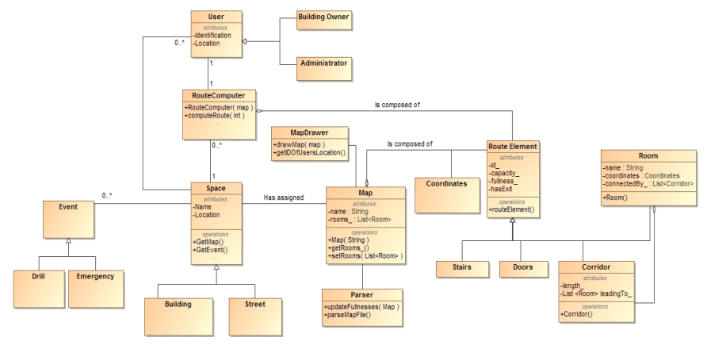
Class diagram (high abstraction)

Slide 11
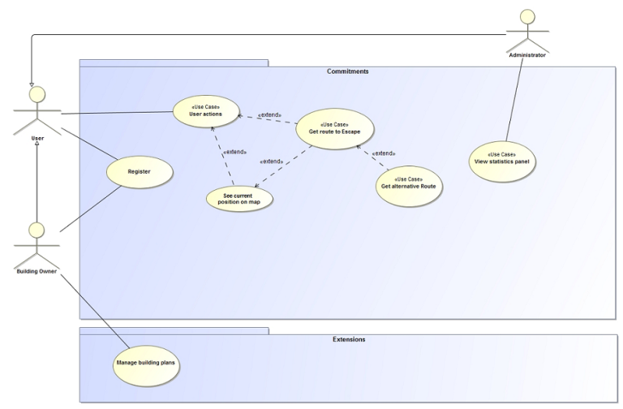
Use case diagram (high abstraction)

Slide 12
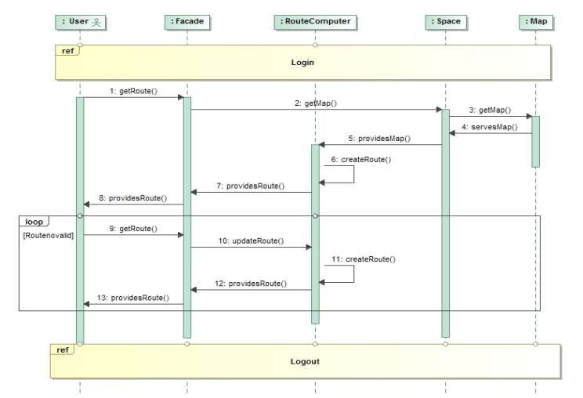
Sequence diagram (Get route to Escape)

Slide 13
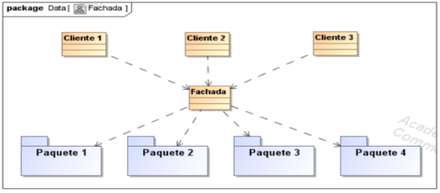
Sw engineering activities
Principles/Patterns
As structural pattern we used Facade (Fachada). The reason to use this pattern is because an API is considered a system with high level of complexity, and the way to use the basic funcionality of the system ignoring its complexity is through the Facade pattern.

Slide 14
Sw engineering activities
Testing
We use jUnit to test different methods. In this case, we have created the class EscapeRouteTest to check the class EscapeRoute and find out the behavior depending of several parametres. As result of testing we have ….(include test cases tested, passed and refined changing the relationed class in order to pass the test successfully)

Slide 15
Sw engineering activities

