Slide 1
Dependencies in C++
Why there is no SerialPort in C++?
oct-2014

Slide 2
I just want a SerialPort
$ pip install pyserial
>>> import serial
>>> ser = serial.Serial(0)
>>> print ser.name
>>> ser.write("hello")
>>> ser.close()

Slide 3
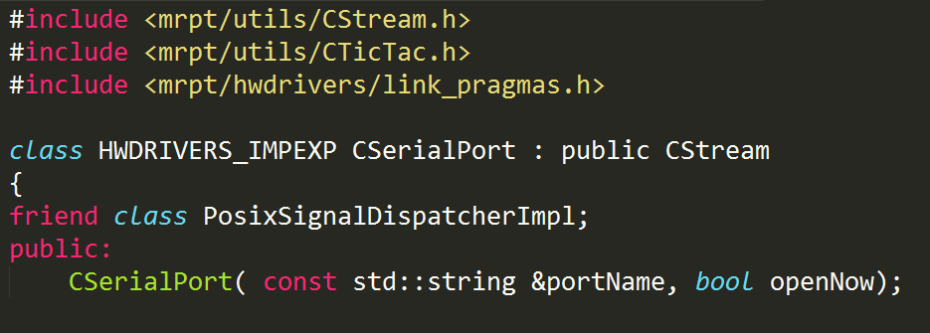
Serial Port in MRPT
>5K files, 70 Mb
First class robotics SW.
CSerializable, CObject…

Slide 4
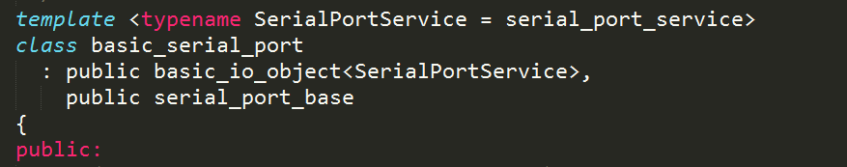
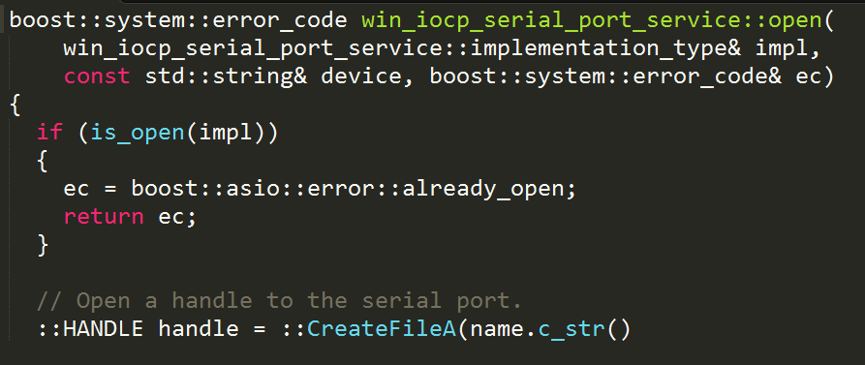
Serial Port in Boost/Asio

Slide 5
CONCLUSION
There is no such “SerialPort” in C/C++

Slide 6
THE PROBLEM: NO DEP MANAGER
Deps manager:
Portable, C/C++, Win, Nix, Mac (& others)
Same workflow in all OS
Per project specification of deps (like maven pom.xml or python requirements.txt)
Different project can depend on different versions of same code, no changes to OS
Simple and fast (instant) to upload/share
Mainly source based, binaries deps only for caching/speed

Slide 7





EXISTING DEP MANAGERS

Slide 8


WHAT IS BIICODE?

Slide 9
Initialization
myproject/deps
$ bii init myproject
$ bii new jdaniel/chat
Put files in folder
jdaniel/chat
Person.h
Client.h
Server.h
Person.cpp
Client.cpp
Server.cpp
ClientApp.cpp
ServerApp.cpp
myproject/blocks

Slide 10
Processing
myproject/deps
$ bii build
CMake: 2 exe, 1 lib
Error, missing include
$ bii deps
…
unresolved:
-libzmq
-protobuf
-sqlite
#include “diego/libzmq/zmq.h”
#include “google/protobuf/…”
jdaniel/chat
Person.h
Client.h
Server.h
Person.cpp
Client.cpp
Server.cpp
ClientApp.cpp
ServerApp.cpp
myproject/blocks

Slide 11
Find & retrieve deps
myproject/deps
$ bii find
or edit “biicode.conf”
$ bii build
$ server
$ client
OK!
diego/ libzmq
google/ protobuf
sqlite/ sqlite
jdaniel/chat
Person.h
Client.h
Server.h
Person.cpp
Client.cpp
Server.cpp
ClientApp.cpp
ServerApp.cpp
myproject/blocks

Slide 12
Publish
myproject/deps
$ bii publish
Uploads sources & graph of jdaniel/chat
No packaging
Available in web
DEV (overwritable)
ALPHA, BETA, STABLE
diego/ libzmq
google/ protobuf
sqlite/ sqlite
jdaniel/chat
Person.h
Client.h
Server.h
Person.cpp
Client.cpp
Server.cpp
ClientApp.cpp
ServerApp.cpp
myproject/blocks

Slide 13
Reuse (same or other computer)
project2/deps
$ bii init project2
$ bii new other/client
Copy ClientApp.cpp
$ bii find
$ bii build
$ client… OK!
NO SERVER
NO SQLITE
NO CONFIG
diego/ libzmq
google/ protobuf
jdaniel/chat
Person.h
Client.h
Client.cpp
Person.cpp
other/client
ClientApp.cpp
project2/blocks

Slide 14
SUMMARY
Pros:
Portable, C/C++, Win, Nix, Mac (& others)
Same workflow in all OS
Per project specification of deps (like maven pom.xml or python requirements.txt)
Different project can depend on different versions of same code, no changes to OS
Simple and fast (instant) to upload/share
Growing community, hundreds of users
SDL, ZMQ, Gtest, Parsers, SFML, Protobufs…
Cons:
Require (minor) modifications to project for new model
Large libraries not handled now (Qt, WxWidgets, Boost), impossible to publish. Might be available via hooks for automated external download & setup
All sources, might be slow for large repos (proof of concept with binaries)
CMake based. Can work in the future with other build systems, as it is independent from it

Slide 15
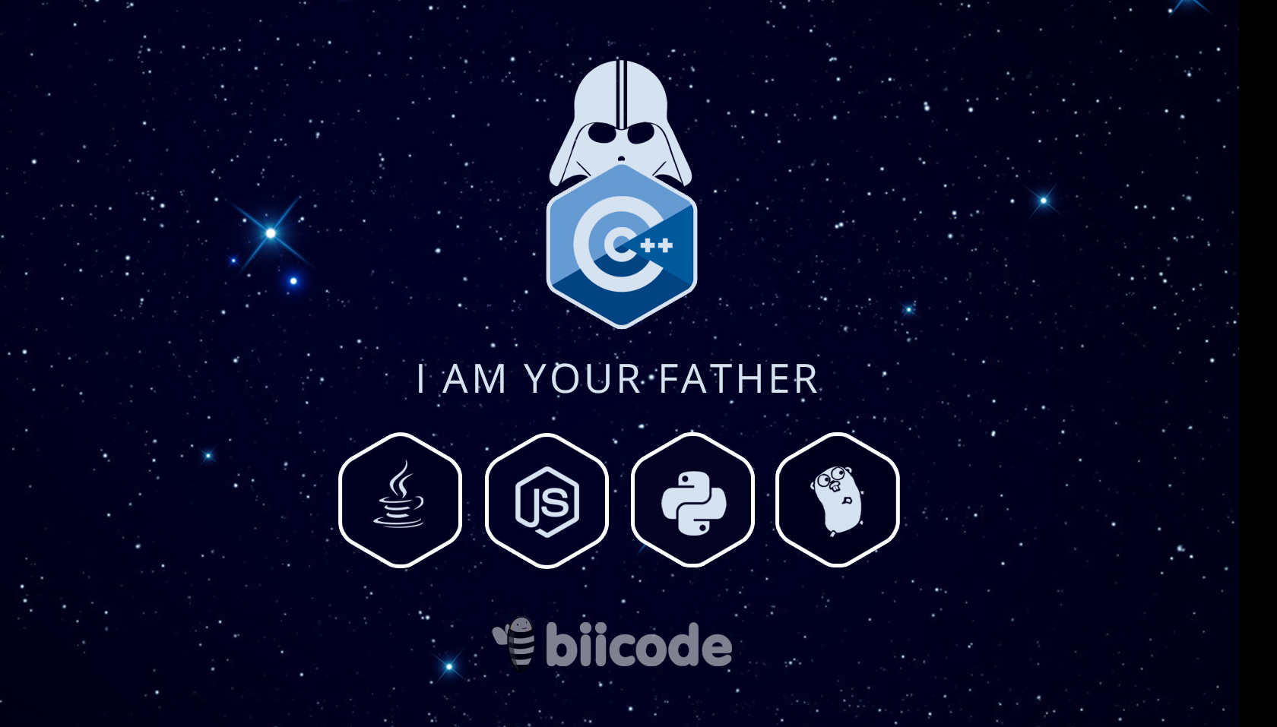
OPEN SOURCE

