Slide 1
Intro to ZMQ and Google Protobuf in C++
@diegorlosada
@t3chfest C3M Feb-2015

Slide 2
Serialization
JSON, XML, CSV…
Parsing efficiency (vs human readable)
Robust to changes
Adding fields
Removing fields? Ignoring fields
SW engineering possible:
Composable, hierarchies…
Necessary for:
Persistence
Transport (network)
RPC/ distributed systems

Slide 3
Protocol Buffers (Protobuf)
Serialization format by Google used by Google for almost all internal RPC protocols and file formats
(currently 48,162 different message types defined in the Google code tree across 12,183 .proto files. They're used both in RPC systems and for persistent storage of data in a variety of storage systems.)
XML vs Protobuf
Speed 20-100x
Size 10x
Not human readable

Slide 4
Protocol Buffers (Protobuf)
Define .proto
Compile with “protoc” (different languages)
Lets do it!
$ bii init myproject
$ cd myproject
$ bii open examples/protobuf
$ bii cpp:build
OR
http://www.biicode.com/examples/protobuf

Slide 5
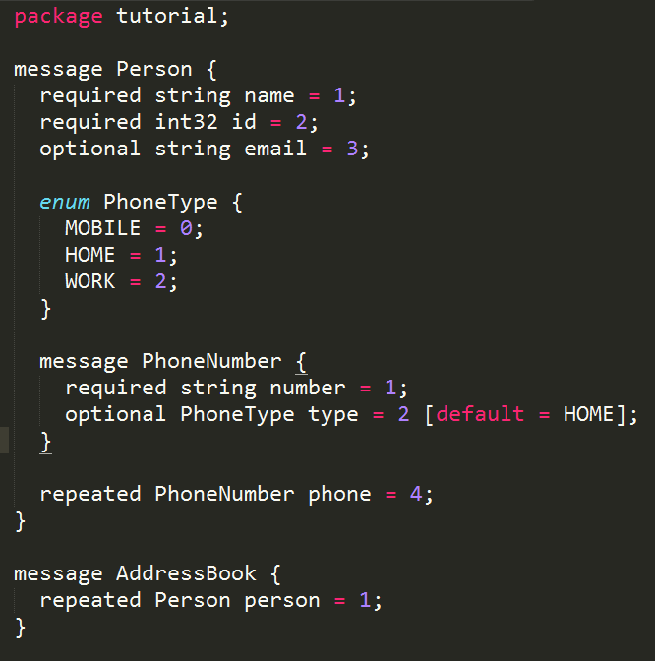
Protocol Buffers IDL
message.proto

Slide 6
Generate code
message.pb.h
message.proto
message.pb.cc
$ protoc message.proto --cpp_out=“.”

Slide 7
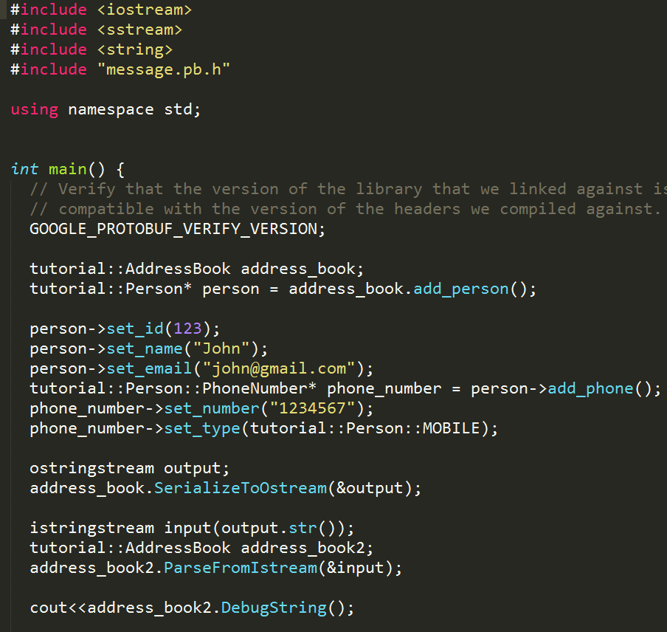
Use

Slide 8
Protocol Buffers IDL
bool SerializeToString(string* output) const;
bool ParseFromString(const string& data);
bool SerializeToOstream(ostream* output) const;
bool ParseFromIstream(istream* input);

Slide 9

ZeroMQ
High level messaging: RabbitMQ
Low level sockets

Slide 10
Raw Sockets
Cliente
TCP/IP
Servidor
socket()
Se crea el socket de conexión y comunicación (es el mismo)
Se crea el socket de conexion
socket()
Se le asigna una direccion y un puerto y se pone a la escucha
bind()
listen()
El socket de conexión se queda bloqueado a la espera “Aceptando una conexión”
accept()
Se conecta a la direccion del servidor
Cuando el cliente se conecta al socket de conexión que esta “Aceptando”, este devuelve un socket de conexión que es con el que se realiza la comunicación
connect()
send()
recv()
Comunicacion
Comunicacion
send()
recv()
shutdown()
close()
Cierre
Cierre
shutdown()
close()

Slide 11
ZeroMQ
No neutral carrier
No protocol

Slide 12
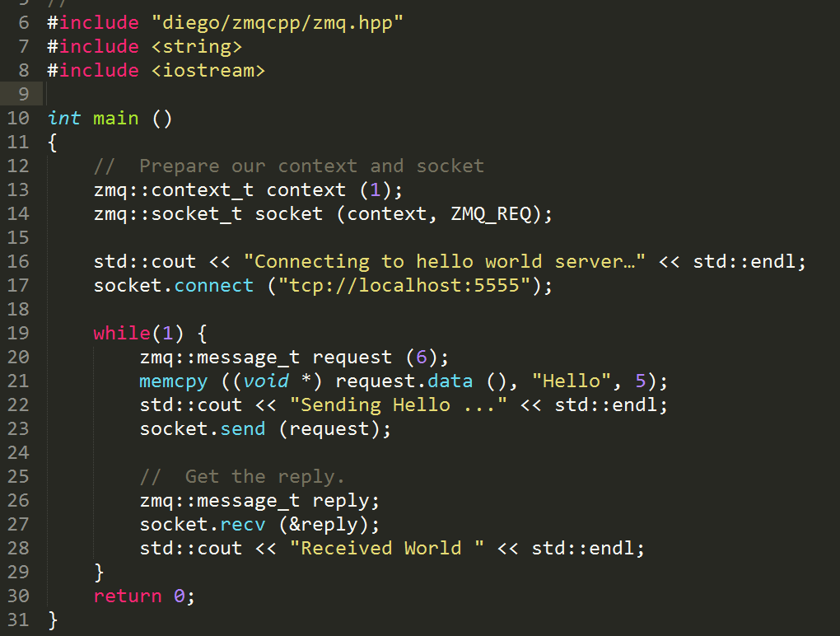
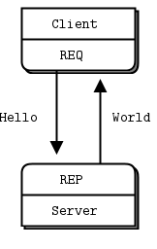
REQ-REP => RPC

Slide 13
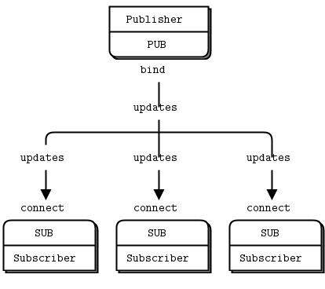
PUB-SUB => Broadcast

Slide 14
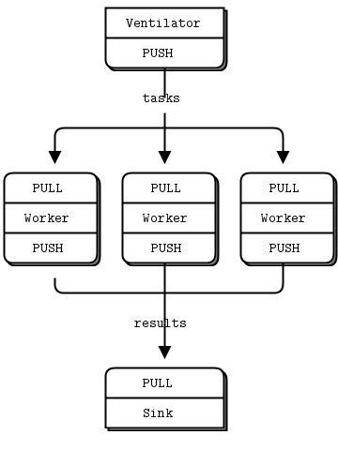
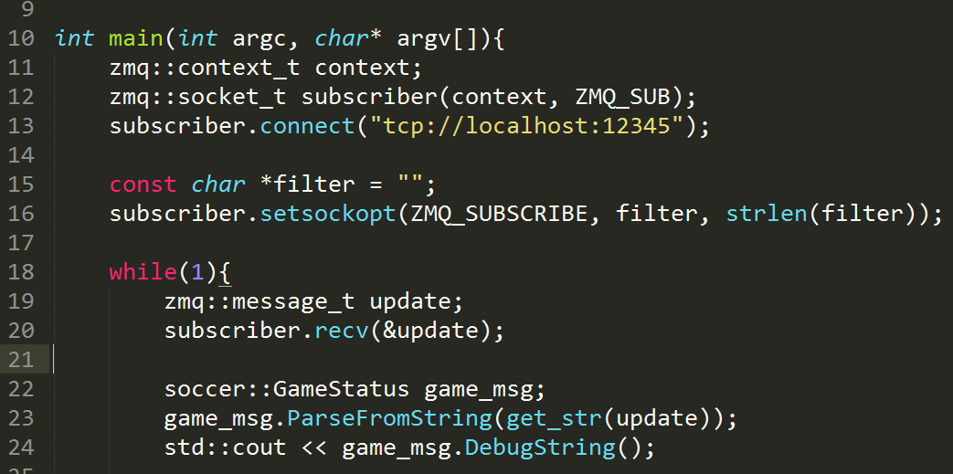
PUSH-PULL => Load Balance, Fair Queueing
Build sha password distributed analyzer

Slide 15
SOCCER TIME
$ bii init myproject
$ cd myproject
$ bii open diego/soccer(enunciado)
$ bii cpp:build
OR
http://www.biicode.com/diego/diego/soccer/enunciado
Github.com/drodri/soccer -> branch enunciado

Slide 16
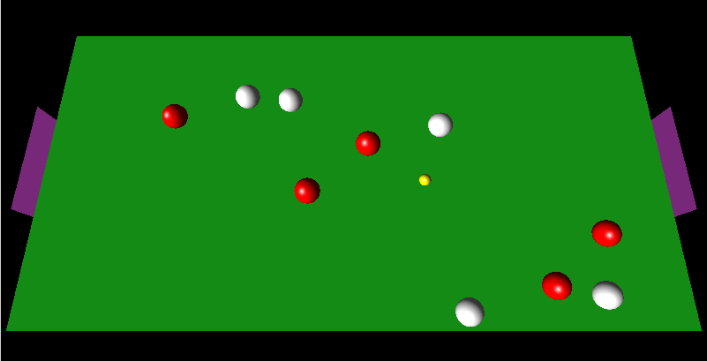
SOCCER TIME

Slide 17
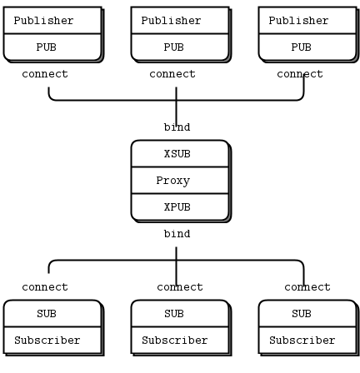
PUB-SUB with proxy

Slide 18
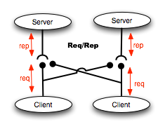
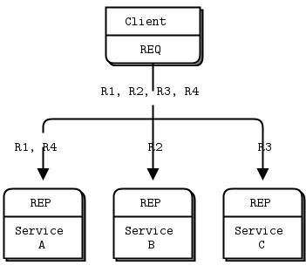
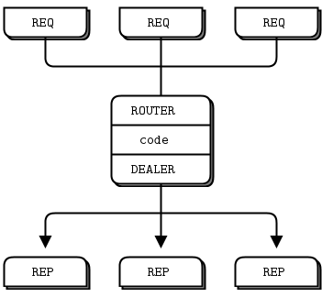
Extend REQ-REP with ROUTER-DEALER

Slide 19
Intro to ZMQ and Google Protobuf in C++
@diegorlosada
@t3chfest C3M Feb-2015

