Slide 1
Blean BioPark Survey – Summary Analysis
April 2025

Slide 2
CONTENTS
Background
Key takeaways
More detail
Appendix

Slide 3
BACKGROUND
Save The Blean is working with partners/funders on Blean BioPark, an alternative for land currently owned by the University of Kent – ‘C12’ in the Draft Local Plan
This survey was designed by the Save The Blean Action Group, supported by Selinger Consultants, to understand what's important to people who live/work in Canterbury and near the Blean

Slide 4



SURVEY KEY TAKEAWAYS
The Blean
Respondents see The Blean as special for its natural beauty wildlife & ancient history
Priorities
Conserving & enhancing this environment is top priority
Celebrating its history, promoting community, learning & wellbeing are important
Possibly also collaborating with partners in the BioPark & preserving some land there for food/agriculture
Top Initiatives
Over 50% chose re-establishing woodlands, re-wilding/re-introducing species, promoting mental health/wellbeing & enhancing historical sites
Nearly 50% also think preserving agricultural land for food production is important
Positives
Preservation of wildlife environment for the future
Accessible nature for the community
Concerns
Cost to set up/maintain
Too many visitors & resultant traffic
Nice to Haves
Nature trails, cycle considerations, toilets & facilities for children

Slide 5
More detail
Answers to survey

Slide 6
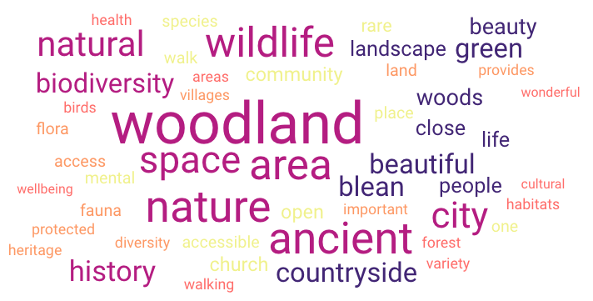
Topic: What do you think makes The Blean special?
Common themes were The Blean’s woodland, wildlife and biodiversity, green countryside, natural beauty and its ancient history
The bigger the word, the more times respondents used it
Notes:
Maybe a dashboard/stats page on demographics
How was the survey constructed? Feels a bit biased towards a positive outcome
How was sample of respondents decided?

Slide 7
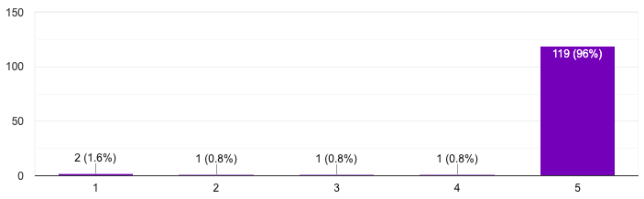
Topic: Conserving & enhancing the natural environment in Blean BioPark
Most believe that conserving & enhancing the natural environment in Blean BioPark is a priority
1 = don’t agree, 5 = strongly agree

Slide 8
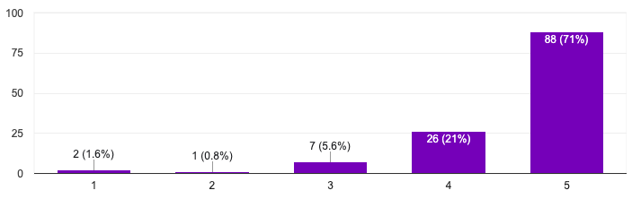
Topic: Celebrating the history & heritage of the area
Most believe that celebrating the history & heritage of the area is either priority or somewhat important
1 = don’t agree, 5 = strongly agree

Slide 9
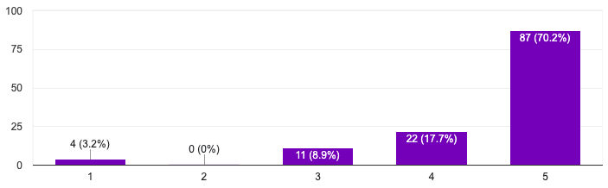
Topic: Encouraging learning & community in Blean BioPark
Most believe that encouraging learning & community in the BioPark is either priority or somewhat important
1 = don’t agree, 5 = strongly agree

Slide 10
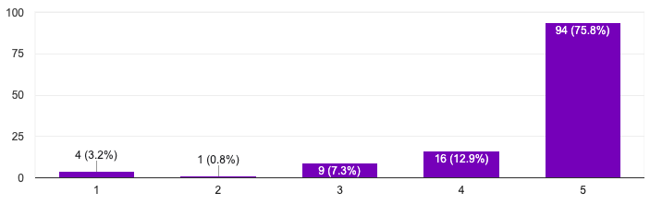
Topic: Promoting wellbeing & good mental health in Blean BioPark
Most believe that promoting wellbeing & good mental health in the BioPark is either priority or somewhat important
1 = don’t agree, 5 = strongly agree

Slide 11
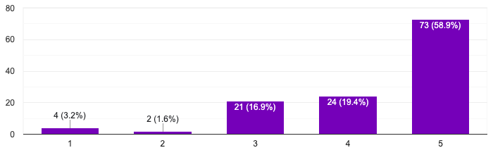
Topic: Collaboration with partners in Blean BioPark
Most believe that collaborating with partners in the BioPark is either priority or somewhat important
1 = don’t agree, 5 = strongly agree

Slide 12
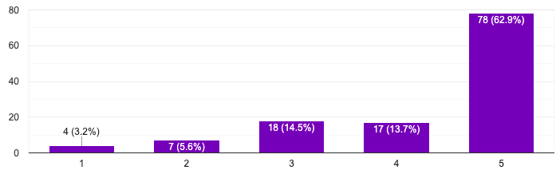
Topic: Preserving some land for agriculture & food production in Blean BioPark
Most believe that preserving some land for agriculture & food production in the BioPark is either priority or somewhat important
1 = don’t agree, 5 = strongly agree

Slide 13
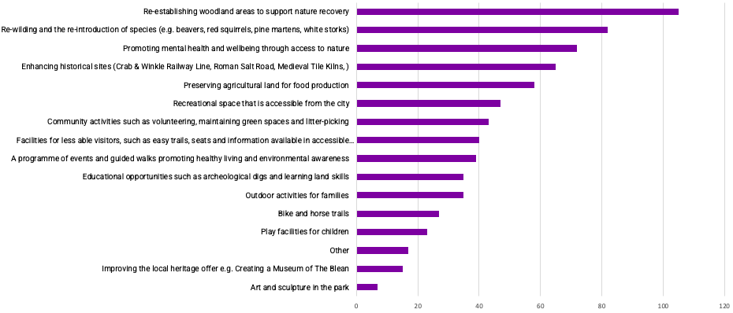
Topic: What Top 5 initiatives are most important to you?
Over half thought re-establishing woodlands, re-wilding/re-introducing species, promoting mental health/wellbeing & enhancing historical sites are most important
Nearly half also thought preserving agricultural land for food production is important
Further detail on Other responses in Appendix

Slide 14
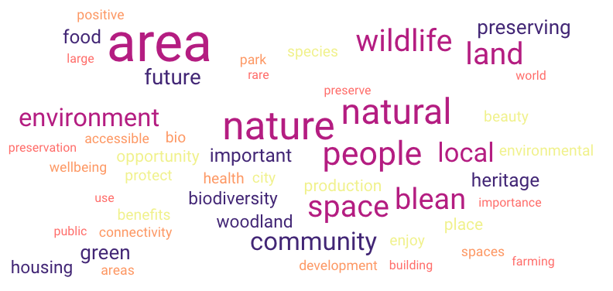
Topic: What positives can you see from Blean BioPark?
Common themes were preservation of wildlife environment for the future & accessible nature for the community
The bigger the word, the more times respondents used it

Slide 15
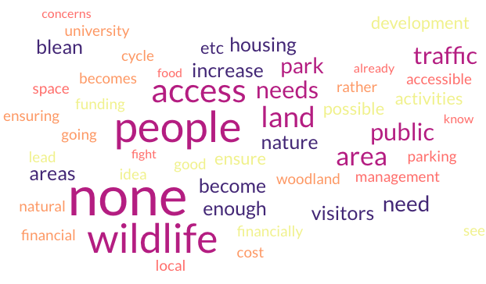
Topic: What issues of concern would you have about Blean BioPark?
Common themes were no concerns, cost to set up/maintain, too many visitors and potentially more traffic to visit
The bigger the word, the more times respondents used it

Slide 16
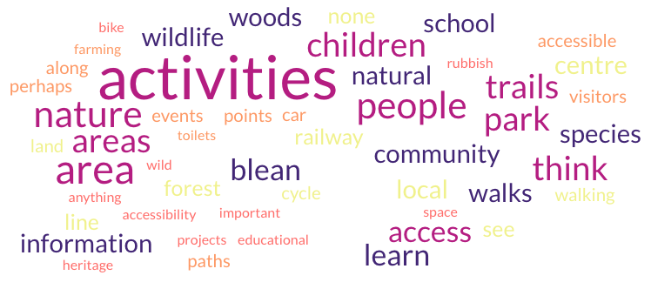
Topic: What other activities or amenities would you like to see included?
Common themes were nature trails, cycle considerations, toilets and facilities for children
The bigger the word, the more times respondents used it

Slide 17


Slide 18
APPENDIX – OTHER INITIATIVES MENTIONED
Recovery & sensitive management of the Sarre Penn stream
Offering activities & events for children
Wetland introduction/creation
Examples of sustainable farming being run by local farmers
Preserving the woodland & biodiversity
No more enroachment of building around the Blean
Supporting the great biodiversity of the area
Reporting to British Trust for Ornithology annual breeding Bird Survey
Regenerative farming!
Management for protection of the vital Sarr Penny
Forest school & similar experiences for children
Promoting artistic and natural/permaculture crafting
Working alongside farms to promote agricultural apprenticeships for young people
Houses
Combining engagement of the above 4 activities holistically
Dog walking
Regenerative & organic farming
Back to Report

Slide 19

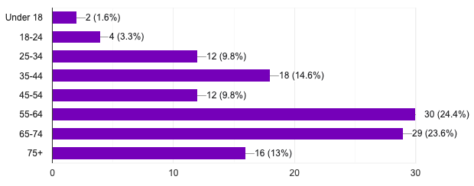
APPENDIX – AGE DEMOGRAPHICS
Summary
All but 1 respondent answered this optional question
Skewed towards an older makeup but some younger representation

Slide 20

APPENDIX – DISABILITY DEMOGRAPHICS
No
Autism and ME
Summary
76% answered this optional question
Various disabilities including arthritis, Parkinson’s, Alzheimer's, inability to walk, irritable bowel syndrome, spinal issues, mental health, ADHD, autism, ME, hearing & anxiety
How many answered in each category is unknown
N/A
Limited mobility
Kent
Mental health
Too damn handsome
Limited mobility due to arthritis
No but our son is
Parkinson's disease
No but I have Type I diabetes
Degenerative spinal issues
No physical disabilities, but ADHD
Early onset Alzheimer’s
Yes
Physically challenged
I have ADHD and Anxiety
Irritable bowel syndrome. Anxiety
Deaf
Yes, I am unable to walk
Yes, hearing impaired

Slide 21

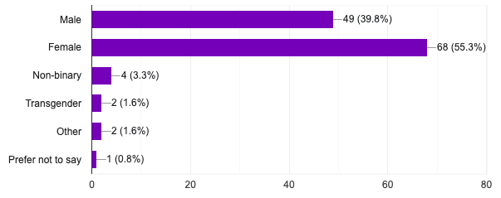
APPENDIX – GENDER DEMOGRAPHICS
Summary
All but 1 respondent answered this optional question
Skewed towards Females but significant Male representation and some representation from non-binary, transgender & other gender types

Slide 22
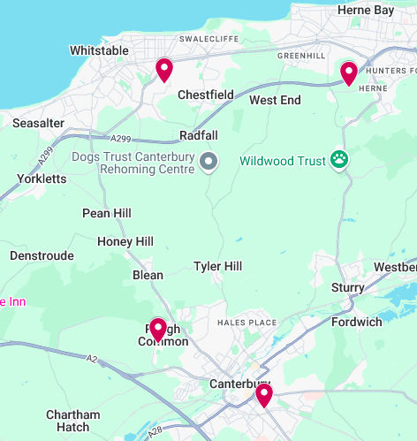

APPENDIX – ADDRESS DEMOGRAPHICS
Summary
All but 1 respondent answered this optional question
76 distinct text responses
How many answered per distinct response is unknown
Mostly CT (some anomalies including Surrey, London)
Where more detail was given:
CT2 was dominant
Followed by CT1
Then further out CT5 (Whitstable), CT6 (Herne Bay) & other CTs

