Slide 1
Trading Game
Organization of Financial Markets
Rodrigo Sánchez
Álvaro Collantes

Slide 2
Contents
Portfolio
1.1. Portfolio distribution
1.2. Portfolio process
Assets & candidates
Selection of assets
3.1. Sharpe & Sortino
3.2. Jensen Alpha
3.3. Selection index
Assigning weights
4.1. Random weights
4.2. Portfolio optimization
Additional notes

Slide 3
1. Portfolio

Slide 4
1.1. Portfolio distribution
1. Portfolio

Slide 5
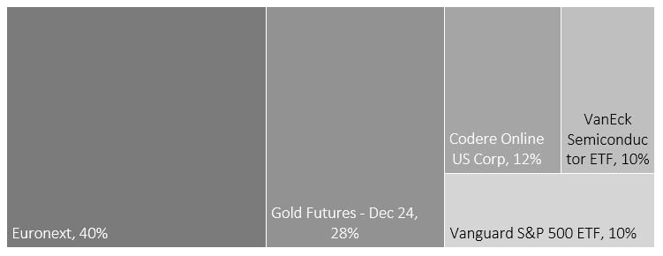
1. Portfolio
1.1. Portfolio distribution
NAME | CODE | USD PRICE | EUR PRICE
Euronext | ENX | 111.73 | 100.80
Gold Futures - Dec 24 | GCZ4 | 2610.70 | 2355.24
Codere Online US Corp | CDRO | 8.00 | 7.22
VanEck Semiconductor ETF | SMH | 236.91 | 213.73
Vanguard S&P 500 ETF | VOO | 516.57 | 466.02
Prices date: 2024/09/13

Slide 6
1.2. Portfolio process
1. Portfolio

Slide 7
1. Portfolio
1.2. Portfolio process
Find candidates for assets
Selection criteria
Assign weights
Stocks
Absolute risk measures
Bonds
ETFs
Futures
Relative risk measures
Diversification
Find optimum weights to optimize portfolio

Slide 8
2. Assets & candidates

Slide 9
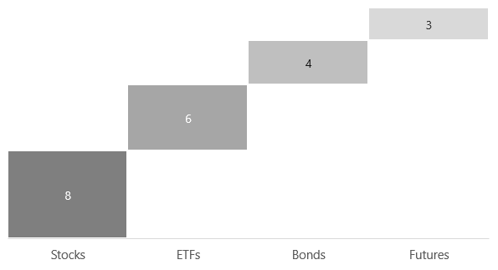
2. Assets & candidates
Initially, we search assets that could be candidates for the portfolio based on their type (stocks, bonds, futures, ETFs) and their performance. As initial source of information: financial news, websites, blogs.
21 initial candidates

Slide 10
3. Selection of assets

Slide 11
3.1. Sharpe & Sortino
3. Selection of assets
Measuring Absolute Risk.

Slide 12



3. Selection of assets
3.1. Sharpe & Sortino
Sharpe ratio
Measure of risk-adjusted return: excess return (return above the risk-free rate) an investor receives for each unit of risk (volatility) taken.
$${Sharpe}_{i}=\frac{r_{i}−r_{f}}{σ_{i}}$$
$r_{i}$: asset return.
$r_{f}$: risk free rate.
$σ_{i}$: asset deviation.
Sortino ratio
Excess return of an asset (or portfolio) over a risk-free rate (or target return) to its downside deviation.
$${Sortino}_{i}=\frac{r_{i}−MAR}{{dσ}_{i}}$$
$MAR$ : minimum acceptable return.
$dσ_{i}$ : downside deviation.

Slide 13
3. Selection of assets
3.1. Sharpe & Sortino
Figure 1. Sharpe & Sortino ratios for candidates (descending order)

Slide 14
3.2. Jensen Alpha
3. Selection of assets
Measuring Relative Risk.

Slide 15

3. Selection of assets
3.2. Jensen Alpha
Measures the excess return of an asset or portfolio over what is predicted by the Capital Asset Pricing Model (CAPM), abnormal returns (skill).
$$α_{i}=r_{i}−[r_{f}+β_{i}×(r_{m}−r_{f})]$$
$β_{i}$ : asset beta (volatility).
$r_{m}$: benchmark return.
Figure 2. Jensen Alpha estimates for candidates (descending in Sharpe ratio)

Slide 16
3.3. Selection index
3. Selection of assets

Slide 17


3. Selection of assets
3.3. Selection index
Normalized Sharpe & Sortino
Adjusting values between 0 and 1.
$${Norm. Sharpe}_{i}=\frac{{Sharpe}_{i}−{Sharpe}_{min}}{{Sharpe}_{max}−{Sharpe}_{min}}$$
$${Norm. Sortino}_{i}=\frac{{Sortino}_{i}−{Sortino}_{min}}{{Sortino}_{max}−{Sortino}_{min}}$$
Selection index
$${Index}_{i}={Norm. Sharpe}_{i}×{Norm. Sortino}_{i}$$

Slide 18
3. Selection of assets
3.3. Selection index

Slide 19
3. Selection of assets
3.3. Selection index
3.2.1. Assets & ratios
Code | Type | Sharpe | Sortino | Jensen Alpha | Norm. Sharpe | Norm. Sortino | Index
CDRO | stock | 3.00 | 6.04 | 1.37 | 0.98 | 1.00 | 0.98
ENX | stock | 3.09 | 5.41 | 0.48 | 1.00 | 0.92 | 0.92
GCZ4 | future | 2.14 | 3.62 | 0.28 | 0.77 | 0.69 | 0.53
VOO | etf | 1.83 | 3.02 | 0.00 | 0.70 | 0.61 | 0.43
SMH | etf | 1.77 | 2.90 | 0.10 | 0.68 | 0.60 | 0.41
3.2.2. Assessing diversification (covariance)
CODE | CDRO | ENX | GCZ4 | VOO | SMH
CDRO | 0.2764 | 0.0105 | 0.0089 | 0.0142 | 0.0260
ENX | 0.0105 | 0.0294 | 0.0022 | 0.0037 | 0.0050
GCZ4 | 0.0089 | 0.0022 | 0.0217 | 0.0029 | 0.0032
VOO | 0.0142 | 0.0037 | 0.0029 | 0.0166 | 0.0346
SMH | 0.0260 | 0.0050 | 0.0032 | 0.0346 | 0.1148
Threshold | 0.01 | 0.05 | 0.10

Slide 20
4. Assigning weights

Slide 21
4.1. Random weights
4. Assigning weights
Monte Carlo and efficient frontier.

Slide 22
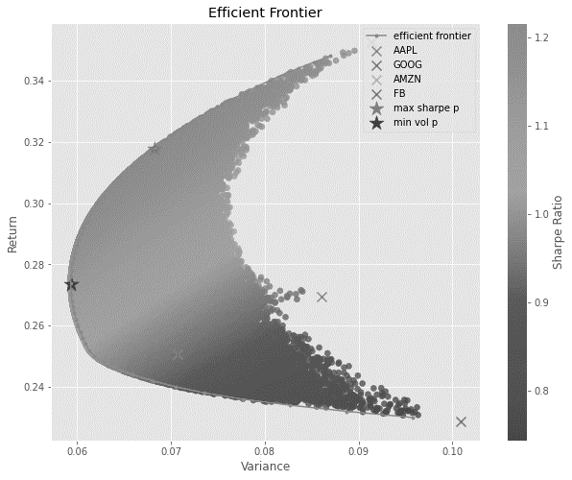
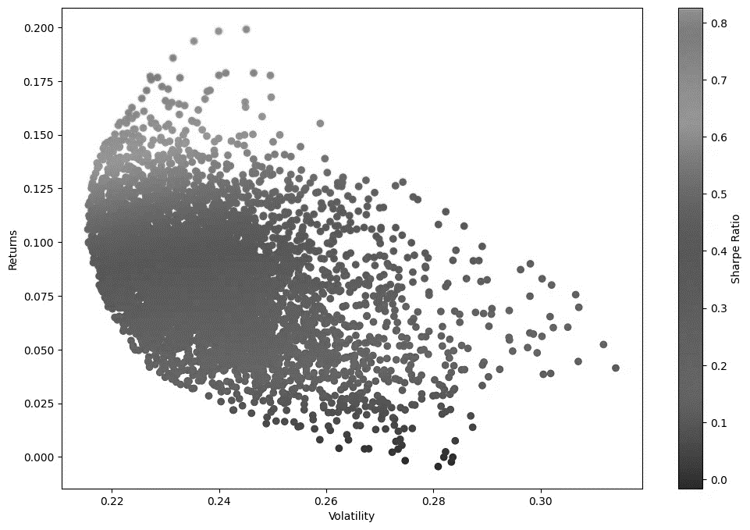
4. Assigning weights
4.1. Random weights
Monte Carlo simulation
Assigning different weights to assets in the portfolio and check their respective Sharp ratio. Check weights which maximize the overall ratio.

Slide 23
4.2. Portfolio optimization
4. Assigning weights

Slide 24
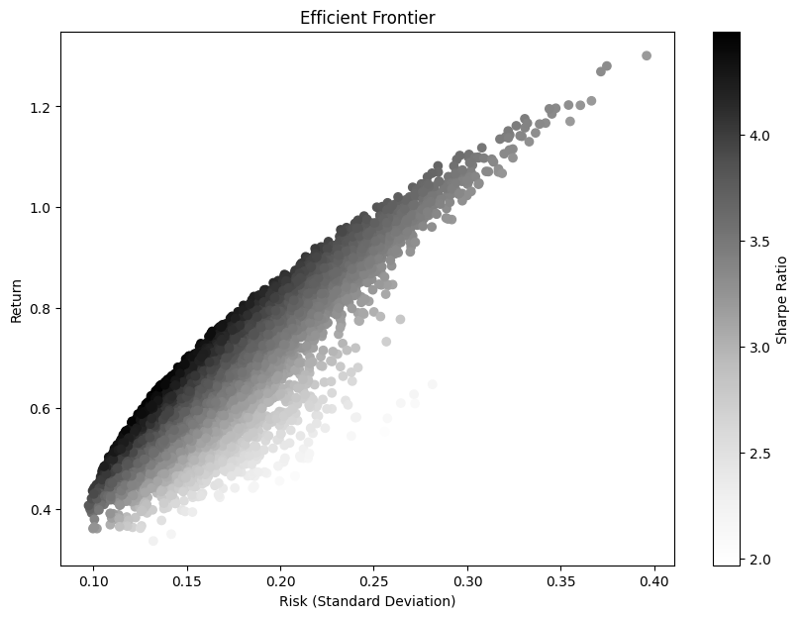
4. Assigning weights
4.2. Portfolio optimization
CODE | NAME | WEIGHT
ENX | Euronext | 0.40
GCZ4 | Gold Futures - Dec 24 | 0.28
CDRO | Codere Online US Corp | 0.12
SMH | VanEck Semiconductor ETF | 0.10
VOO | Vanguard S&P 500 ETF | 0.10

Slide 25
5. Additional notes

Slide 26
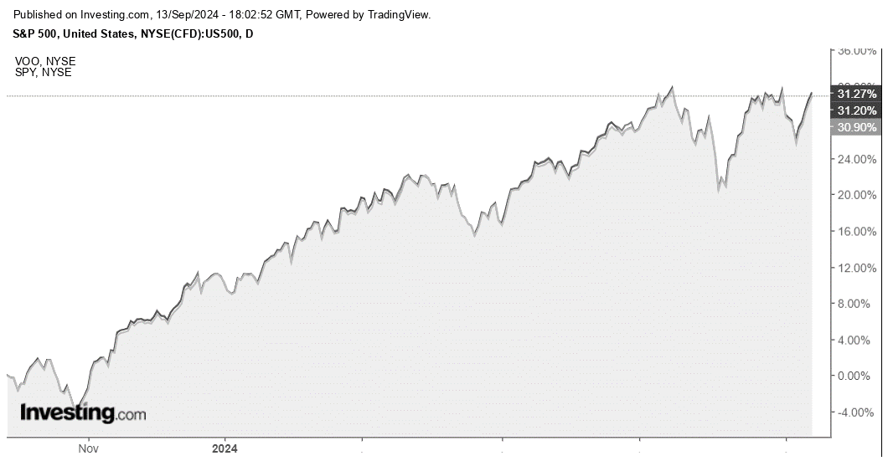
5. Additional notes
5.1. Candidate assets notes and ratios for every asset.
5.2. Covariance matrix for selected assets.
5.3. Methodology and replication.

