Slide 1

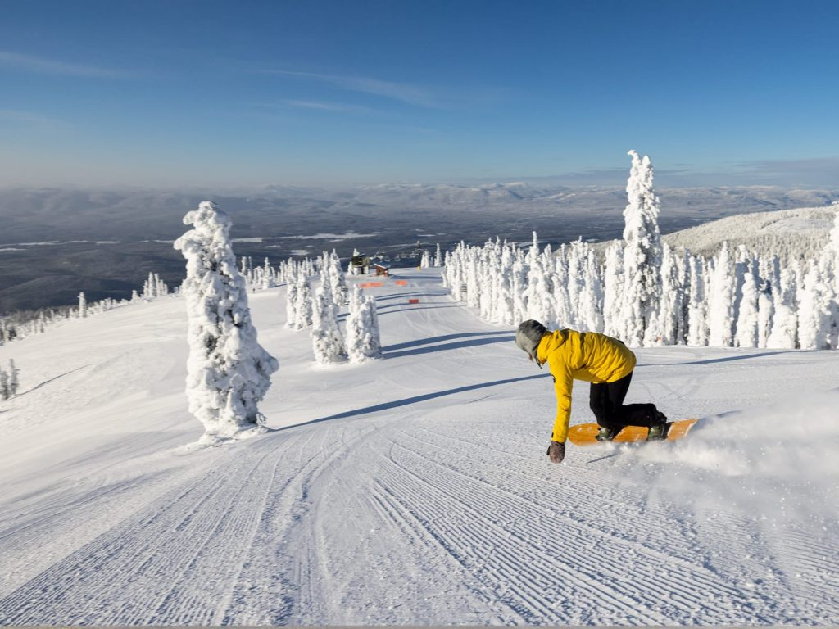
PROPERTY PRICING IN AMES, IOWA
HOUSING PRICE PREDICTION MODEL
DATA SCIENCE TRAINEE
CREATED BY:
ALESSANDRO GATTI

Slide 2
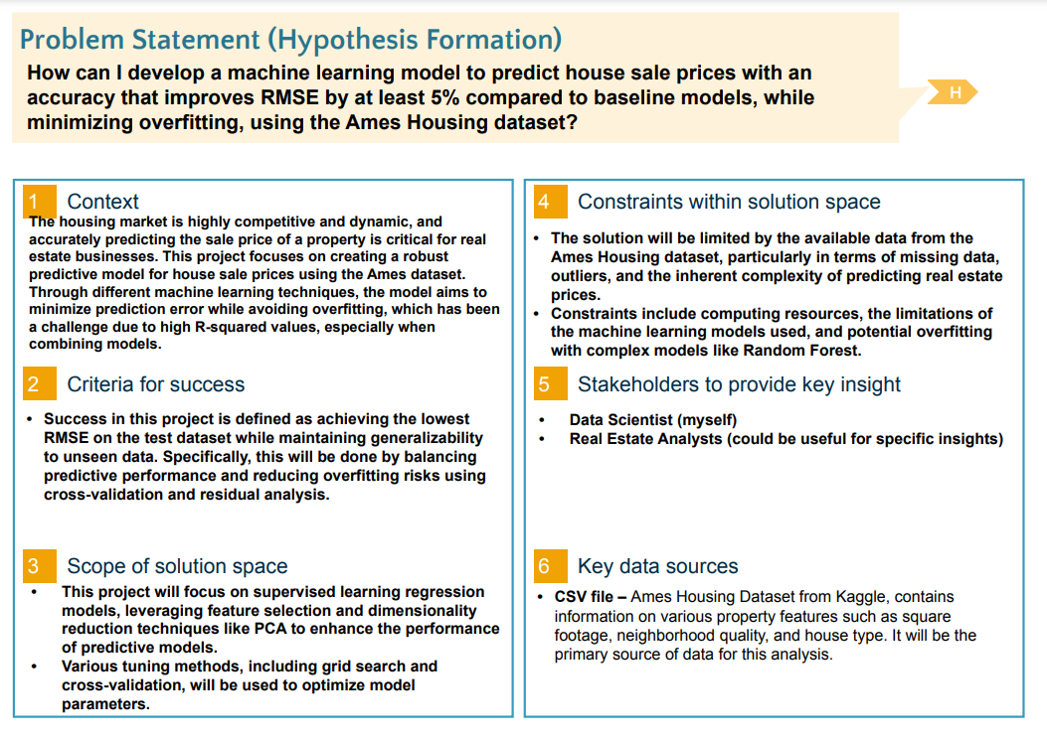

Slide 3
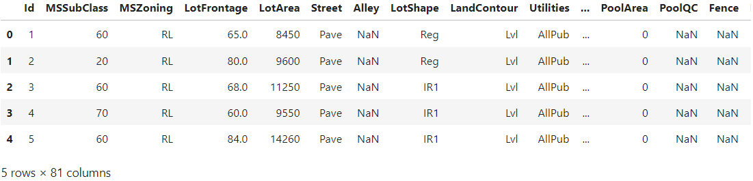
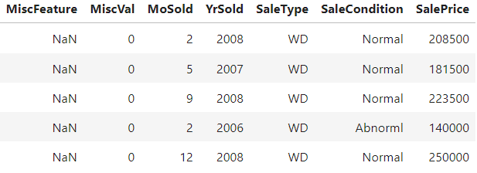
Data Overview - train.csv

Slide 4
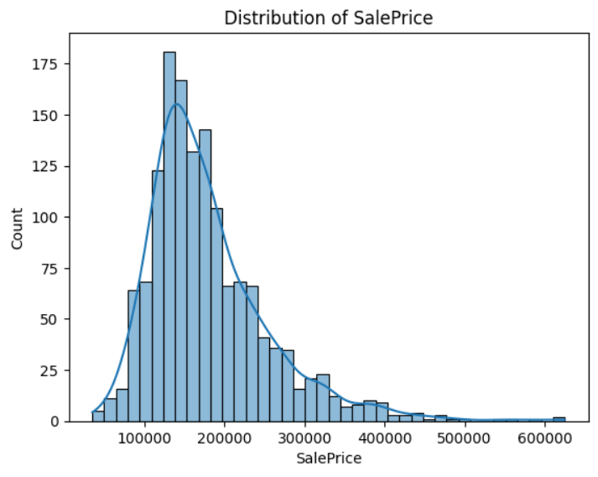

Slide 5
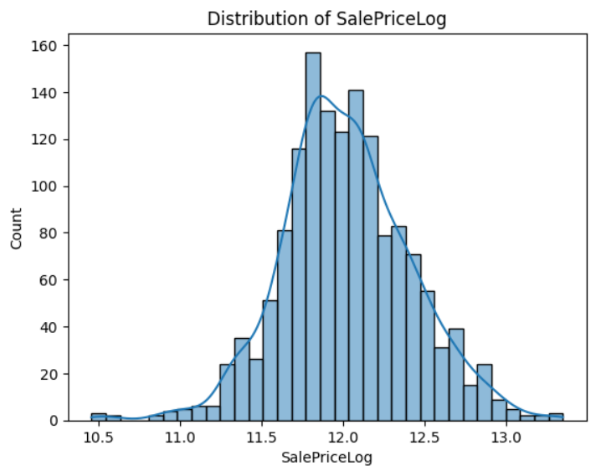

Slide 6
Feature Engineering
#creating new features that represents existing data
train_data['TotalSF'] = train_data['TotalBsmtSF'] + train_data['1stFlrSF'] + train_data['2ndFlrSF']
train_data['TotalFinishedSF'] = train_data['BsmtFinSF1'] + train_data['BsmtFinSF2'] + train_data['1stFlrSF'] + train_data['2ndFlrSF']
train_data['HouseAge'] = train_data['YrSold'] - train_data['YearBuilt']train_data['RemodelAge'] = train_data['YrSold'] - train_data['YearRemodAdd']
train_data['OverallQualCond'] = train_data['OverallQual'] * train_data['OverallCond']
train_data['TotalPorchSF'] = train_data['OpenPorchSF'] + train_data['EnclosedPorch'] + train_data['3SsnPorch'] + train_data['ScreenPorch']
train_data['TotalGarageSize'] = train_data['GarageArea'] + train_data['GarageCars']
train_data['TotalBsmtSF'] = train_data['BsmtFinSF1'] + train_data['BsmtFinSF2'] + train_data['BsmtUnfSF']
train_data['OverallGrade'] = train_data['OverallQual'] * train_data['YearBuilt']
train_data['BathsPerBed'] = (train_data['FullBath'] + 0.5 * train_data['HalfBath']) / train_data['BedroomAbvGr']
train_data['LotFrontageToLotArea'] = train_data['LotFrontage'] / train_data['LotArea']
#neighborhood pricing feature
neighborhood_median_price = train_data.groupby('Neighborhood')['SalePrice'].median()
train_data['NeighborhoodMedianPrice'] = train_data['Neighborhood'].map(neighborhood_median_price)

Slide 7
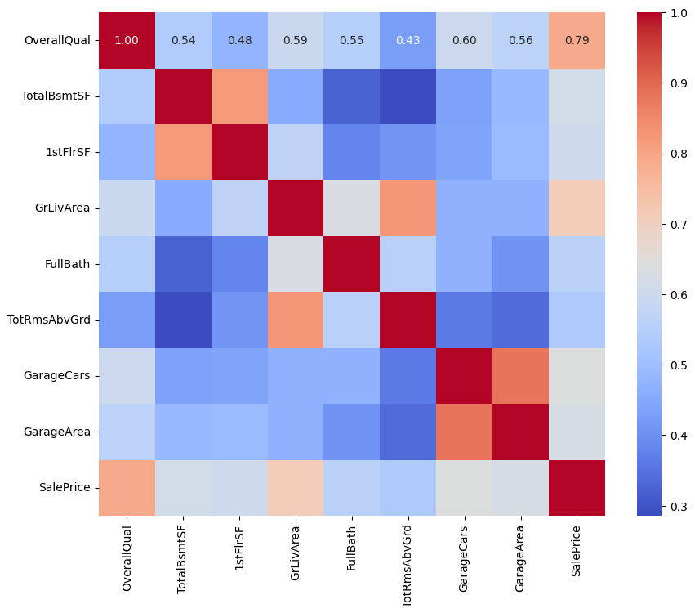
PREPROCESSING
KEY FEATURES
Scaler:
Correlation Threshold:
Variance Threshold:
Blended Model Weights:
StandardScaler()
0.20
0.01
Ridge:57%, RF:43%

Slide 8
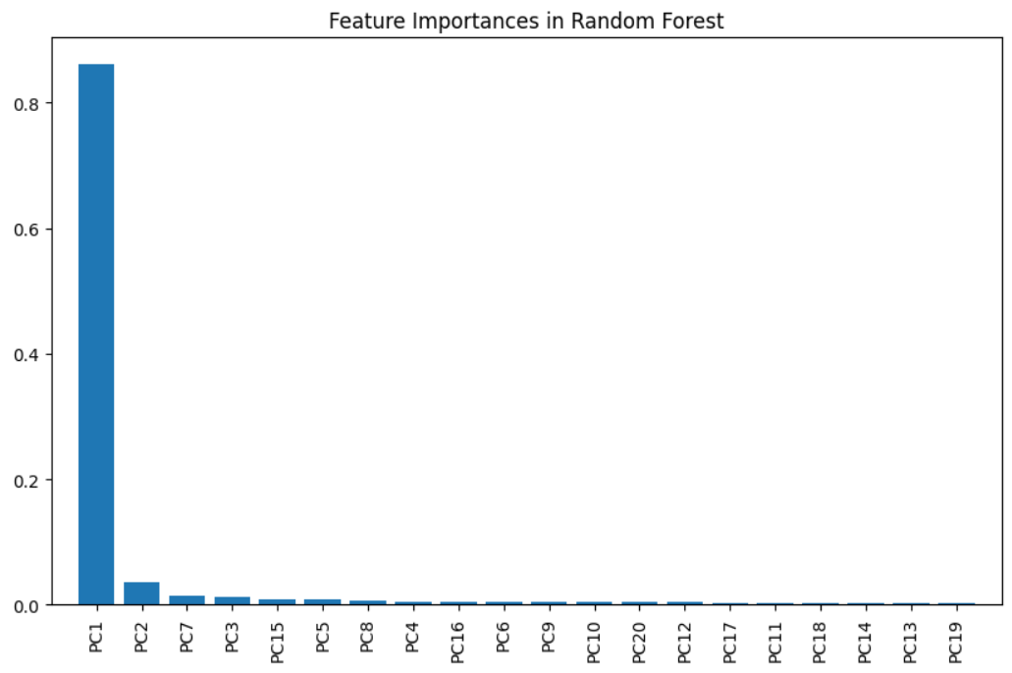
MODEL
EVALUATION
&
DIM. REDUCTION

Slide 9
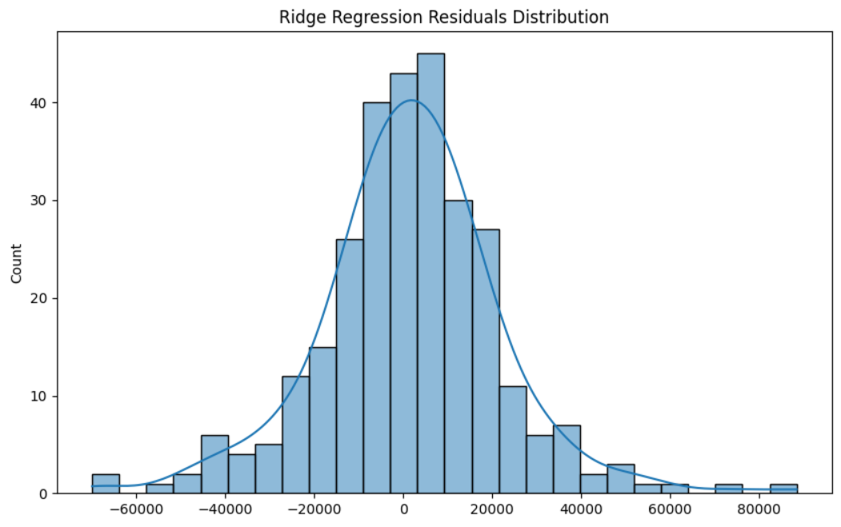

Slide 10
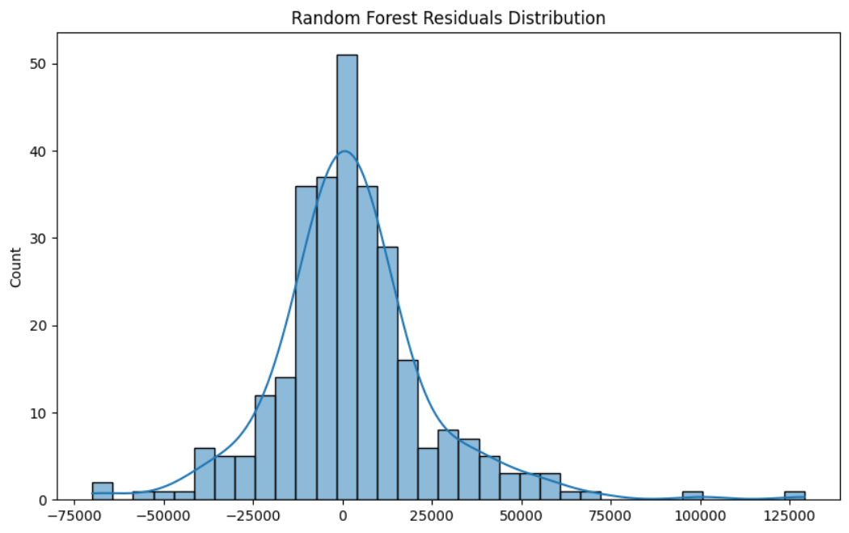

Slide 11
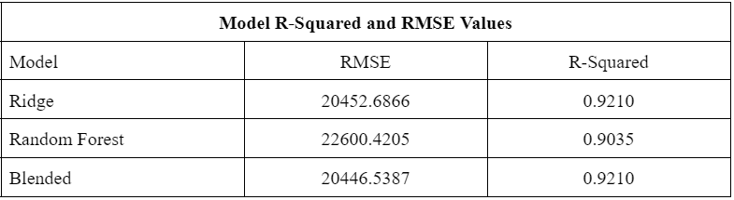

Slide 12
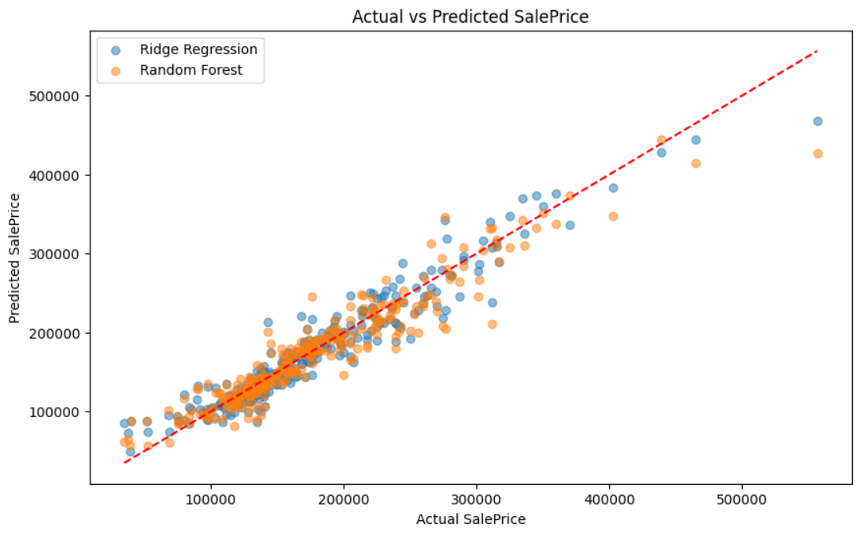

Slide 13
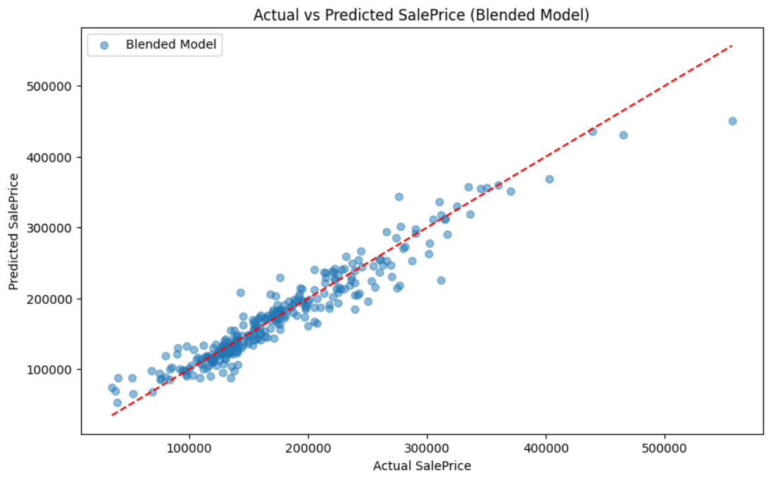

Slide 14
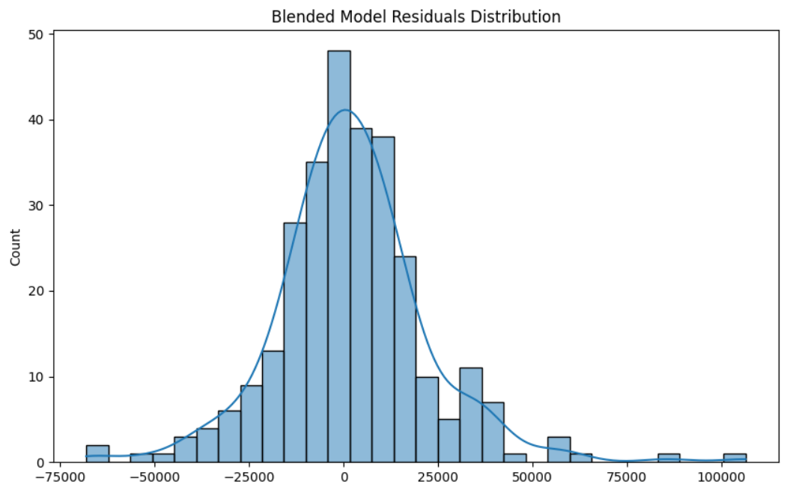

Slide 15



CONCLUSIONS & KEY TAKEAWAYS
Transforming the SalePrice variable and selecting features based on correlation and variance were instrumental in enhancing model performance. The log transformation normalized skewness, improving predictive accuracy, while feature importance analysis highlighted key contributors to sale price prediction, such as overall quality and living area.
The blended model combining Ridge Regression and Random Forest achieved an improved predictive accuracy compared to individual models, with an RMSE of approximately 20,446.5. While this DID NOT meet the full 5% reduction target, it demonstrated the effectiveness of blending models to leverage complementary strengths, particularly balancing bias and variance.
Overfitting remains a consideration, especially in the Random Forest component of the blended model, as indicated by residual distributions and R-squared values. Future iterations could focus on tuning model parameters further or exploring additional regularization techniques to refine generalization and potentially meet the 5% RMSE improvement target.

