Slide 1
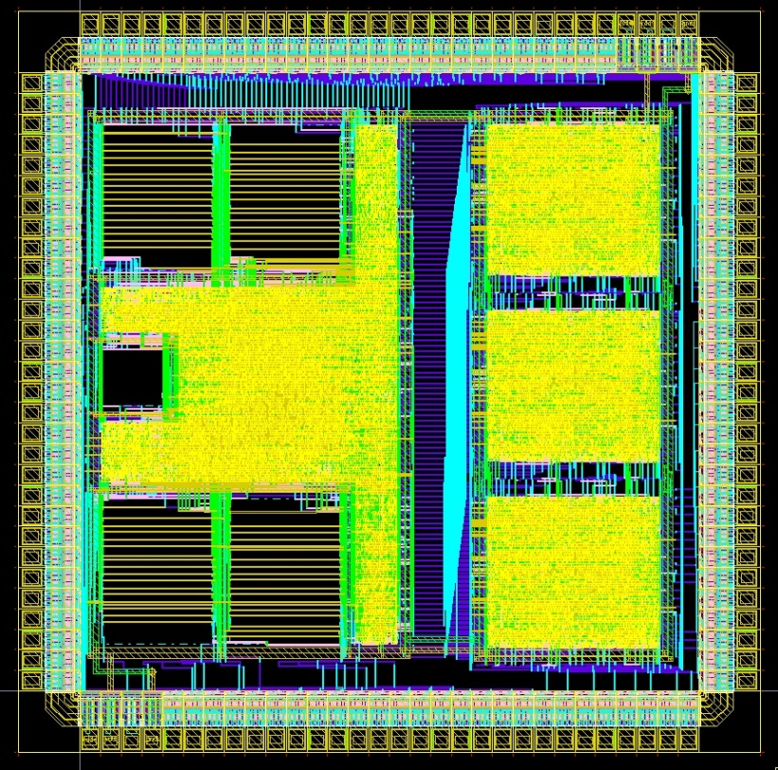
Digital Systems and Microprocessor Design (H7068)
10.2. Interrupts
Daniel Roggen
d.roggen@sussex.ac.uk

Slide 2
Content
Summary: discontinuities in program flow
  Jumps
  Reset
Interrupts: changing the program flow upon hardware event
External interrupts
Internal interrupts

Slide 3
Program flow
PC Adr Inst
-> 00 mov ra,42
02 mov rb,3
04 add ra,rb
06 cmp ra,70
08 ja 0Ch
0A jmp 04
0C ...
0E ...

Slide 4
Program flow
PC Adr Inst
00 mov ra,42
-> 02 mov rb,3
04 add ra,rb
06 cmp ra,70
08 ja 0Ch
0A jmp 04
0C ...
0E ...

Slide 5
Program flow
PC Adr Inst
00 mov ra,42
02 mov rb,3
-> 04 add ra,rb
06 cmp ra,70
08 ja 0Ch
0A jmp 04
0C ...
0E ...

Slide 6
Program flow
PC Adr Inst
00 mov ra,42
02 mov rb,3
04 add ra,rb
-> 06 cmp ra,70
08 ja 0Ch
0A jmp 04
0C ...
0E ...
Under “normal” circumstances PC is incremented to point to the next instruction (after each instruction / clock cycle, depending on the implementation)
In the Educational Processor PC is incremented by 1 in the fetchh and fetchl cycles

Slide 7
Program flow
PC Adr Inst
00 mov ra,42
02 mov rb,3
04 add ra,rb
06 cmp ra,70
-> 08 ja 0Ch
0A jmp 04
0C ...
0E ...
PC is not always incremented to point to the next instruction:
Conditional jumps
Unconditional jumps
Here the conditional jump is not taken

Slide 8
Program flow
PC Adr Inst
00 mov ra,42
02 mov rb,3
04 add ra,rb
06 cmp ra,70
08 ja 0Ch
-> 0A jmp 04
0C ...
0E ...
PC is not always incremented to point to the next instruction:
Conditional jumps
Unconditional jumps
This unconditional jump is taken

Slide 9
Program flow
PC Adr Inst
00 mov ra,42
02 mov rb,3
-> 04 add ra,rb
06 cmp ra,70
08 ja 0Ch
0A jmp 04
0C ...
0E ...
jmp
Habitual program flow continues

Slide 10
Program flow
PC Adr Inst
00 mov ra,42
02 mov rb,3
04 add ra,rb
-> 06 cmp ra,70
08 ja 0Ch
0A jmp 04
0C ...
0E ...

Slide 11
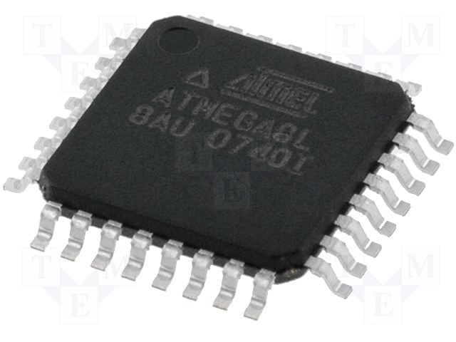
Program flow
PC Adr Inst
00 mov ra,42
02 mov rb,3
04 add ra,rb
06 cmp ra,70
-> 08 ja 0Ch
0A jmp 04
0C ...
0E ...
clk
rst
Reset creates a discontinuity in the program flow: PC set to 0
Really: more than a discontinuity as all registers are cleared – but fundamentally it is a discontinuity

Slide 12
Program flow
PC Adr Inst
00 mov ra,42
02 mov rb,3
04 add ra,rb
06 cmp ra,70
08 ja 0Ch
-> 0A jmp 04
0C ...
0E ...
clk
rst
Let’s reset the processor!

Slide 13
Program flow
PC Adr Inst
-> 00 mov ra,42
02 mov rb,3
04 add ra,rb
06 cmp ra,70
08 ja 0Ch
0A jmp 04
0C ...
0E ...
rst
clk
rst
Processor after reset: PC=0

Slide 14
From reset to interrupts
Reset is a an external signal that changes the flow of execution
Interrupts are another mechanism by which an external signal can change the execution flow
Interrupts exist on all commercial processors and microcontrollers!
Note: there are no interrupts in the educational processor...
clk
rst

Slide 15
Motivation for interrupts
Let’s say a program must wait until a pin goes high on the external interface….
  for example to count how often a pin is toggled
  Or to implement a communication protocol in software (e.g. I2C, SPI, etc)
How to implement this in a program?
Ext interface
clk
rst

Slide 16
Polling
Implementation by polling: continuously reading the pin to detect changes
mov ra,0 // number of toggles
testbit:
in rb // read ext input
and rb,1 // check bit 0
cmp rb,1 // bit 0 set?
jne testbit //
add ra,1 // increment counter
// instead of increment we
// could do more complex stuff
waitclr: // now wait until clear
in rb
and rb,1
cmp rb,0 // bit clear?
jne waitclr // no, loop until clear
jmp testbit // yes, go back to test bit set

Slide 17
Polling
Latency?
  7 instructions to react to rising edge (worst case)
  8 instructions to react to falling edge (worst case)
mov ra,0 // number of toggles
testbit:
in rb // read ext input
and rb,1 // check bit 0
cmp rb,1 // bit 0 set?
jne testbit //
add ra,1 // increment counter
// instead of increment we
// could do more complex stuff
waitclr: // now wait until clear
in rb
and rb,1
cmp rb,0 // bit clear?
jne waitclr // no, loop until clear
jmp testbit // yes, go back to test bit set

Slide 18
Polling
Latency?
  7 instructions to react to rising edge
  8 instructions to react to falling edge
Total: 15*3=45 processor clock cycles to detect one cycle on the external input!
If the external signal toggles with a period smaller than 45 clock cycles then the processor cannot count the number of toggles!
Ext input:
45clk

Slide 19
Polling
Polling is usually a very slow solution (compared to a hardware approach) to the problem of detecting changes on input pins
  1/45th speed of processor in this example! (100MHz->2MHz)
  (although some specific use cases are suitable for polling!)
During polling the processor cannot do anything else!
Not suitable for multitasking

Slide 20
Solution 1: hardware
Hardware counter (outside of processor)
Hardware interface: see previous lectures
  There are hardware interfaces dedicated to "count" events in many microcontrollers!
(however that's not the point of this lecture)

Slide 21
Solution 2: external interrupt
An external interrupt is a condition on a external pin that triggers an interruption of the normal program flow
Several conditions can trigger ints (usually configurable):
  Rising edge
  Falling edge
  Any edge
  Level-triggered
Ext interface
pin that generates an interrupt
clk
rst

Slide 22
External interrupts
FLASH
External condition interrupts program flow
PC set to jump to an interrupt vector
Interrupt vector: piece of code that will handle the interrupt (do something in reaction to it)
There can be multiple interrupts!
  E.g. one per pin
RAM
Int vect 1
Int vect 2

Slide 23
External interrupts
FLASH
The following happens during an interrupt:
The processor keeps a return address:
  Address of PC before the interrupt
PC set to the interrupt vector (i.e. jump to IV)
The processor executes the instructions in the interrupt vector
Interrupt return instruction (RETI)
  Indicates the end of the interrupt routine
  The processor returns to the PC value before the interrupt (return address)
RAM
Int vect 1
Int vect 2

Slide 24
Interrupt vector table
Processor jumps to a fixed location! (interrupt vector)
  Typically at the start or end of memory
Interrupt vector table (IVT): with multiple interrupts, all interrupt vectors follow each other
Each entry is one instruction wide
Reset can sometimes be seen as an entry in the IVT
Adr What
----- ------
00-01 First instruction on reset
02-03 Int0 (First instruction of Int0)
04-05 Int1 (First instruction of Int1)
...
0A-0B First "normal" program instruction

Slide 25
Interrupt vector table
The IVT holds only one instruction per interrupt!
  How to have an interrupt routine of more than one instruction??
A jump (one instruction) is stored in the IVT
This allows to program the location of interrupt routine
  The programmer can decide where to place the interrupt routine!
The program continues until the RETI instruction
Adr What
----- ------
00-01 First instruction on reset
02-03 Int0 (First instruction of Int0)
04-05 Int1 (First instruction of Int1)
...
0A-0B First "normal" program instruction

Slide 26
IVT example
Adr What
----- ------
00-01 jmp 20
02-03 jmp 80
04-05 jmp A0
20-21 First program instruction
.....
78-79 Last possible program instruction
80-81 First instruction for Int0
.....
A0-A1 First instruction for Int1
.....

Slide 27
Using interrupt to count toggles
Assumption: int0 is called on rising edge of a pin
Adr
00 jmp 10h
02 jmp 20h
10 mov ra,0h // number of toggles
12 ... // do
14 ... // something
16 ... // continuously
18 jmp 12h // here
20 add ra,1h // increment counter
22 reti // interrupt return

Slide 28
Using interrupt to count toggles
Latency?
  1 instruction to go to interrupt vector
  1 instruction to return from interrupt vector
Adr
00 jmp 10h
02 jmp 20h
10 mov ra,0h // number of toggles
12 ... // do
14 ... // something
16 ... // continuously
18 jmp 12h // here
20 add ra,1h // increment counter
22 reti // interrupt return

Slide 29
External interrupts
External interrupts are a very fast approach to react to external events!
  2 instruction latency instead of 15 -> 7.5x speedup!
Interrupts permit the processor to execute a main task and occasionally process "urgent" events
Processors have an "interrupt pin" that can be used by peripherals (I/O interfaces) to trigger interrupts
  Often used in microcontrollers
  E.g. Interrupt once byte is sent over I2C
Commonly used for:
  communication
  storage devices
  user interaction
  sensor sampling
Foundation of multitasking

Slide 30
Possible Implementation
comp_ip: entity work.dffre generic map(N=>N) port map(clk=>clk,rst=>rst,en=>'1',d=>ipnext,q=>ip);
ipnext <= ip+1 when fetch='1' else
ip when jump='0' else
jumpip;
Educational processor has no interrupts!
  ip incremented in the fetchh and fetchl cycles
  In exec cycle ip is unchanged if there is no jump,
  or ip is set to the jump address if there is jump
    unconditional jump
    conditional jump with a valid jump condition

Slide 31
Possible Implementation
comp_ip: entity work.dffre generic map(N=>N) port map(clk=>clk,rst=>rst,en=>'1',d=>ipnext,q=>ip);
ipnext <= ip+1 when fetch='1' else
ip when jump='0' and int ='0' else
iv when int='1' else
jumpip;
Adding an interrupt:
  Implemented in the same way as a jump
  int indicates an interrupt: e.g. can be level of a signal of the external input interface
  iv is the address of the interrupt vector (e.g. "02" in the previous example)

Slide 32
Possible Implementation
Additionally (not shown here):
  Keep the return address (PC before modification stored in a register or memory
  Implement the RETI instruction (e.g. using a spare opcode)

Slide 33
Internal interrupts
External interrupts react to external events (on pins)
Internal interrupts react to processor events
Common processor events:
  Division by zero / invalid math operation
  Invalid opcode
  Data alignment check
  etc
For example, "invalid opcode" could be used to emulate new opcodes on an older processor!

Slide 34
Summary
Interrupts change the control flow until a RETI instruction
Multiple interrupts can placed in programmer-defined memory location using the interrupt vector table
External interrupts allow very fast reaction to external events while allowing multitasking!
External interrupts include pin change interrupts and peripheral interrupts
Processors have internal interrupts to indicate issues

