Slide 1
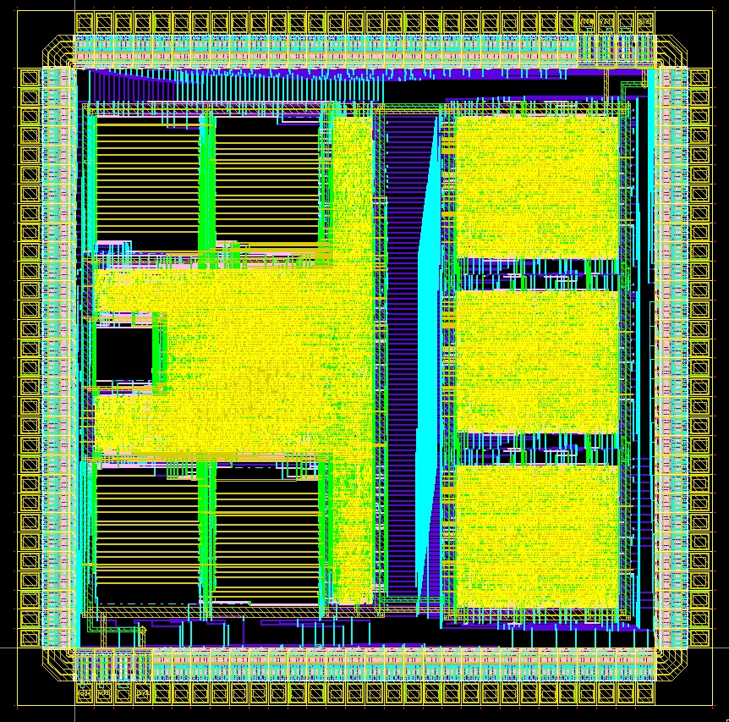
Digital Systems and Microprocessor Design (H7068)
10. Exercises / Laboratory
Daniel Roggen
d.roggen@sussex.ac.uk

Slide 2
Objective / success criteria
Prerequisite: lab of week 8
The objective of this laboratory is to:
  Understand the memory addressing mode of the educational processor
Success criteria:
  You are able to understand and predict the action of the move memory instructions

Slide 3

Tutorial I
You are going to try simple programs using the mov r,[src] instruction to understand its behavior
Both immediate and register sources will be tested
Instructions | instruction(15..8) |  |  |  |  |  |  |  | Instruction(7..0)
Move | Opcode |  |  |  | dd#m | sd#m | dreg |  | src
mov r, r | 0 | 0 | 0 | 0 | 0 | 0 | r | r | - | - | - | - | - | - | r | r
mov r, i | 0 | 0 | 0 | 1 | 0 | 0 | r | r | i | i | i | i | i | i | i | i
mov r, [r] | 0 | 0 | 0 | 0 | 0 | 1 | r | r | - | - | - | - | - | - | r | r
mov r, [i] | 0 | 0 | 0 | 1 | 0 | 1 | r | r | i | i | i | i | i | i | i | i
mov [r], r | 0 | 0 | 0 | 0 | 1 | 0 | r | r | - | - | - | - | - | - | r | r
mov [r], i | 0 | 0 | 0 | 1 | 1 | 0 | r | r | i | i | i | i | i | i | i | i

Slide 4
Tutorial I
Consider the following program:
00 mov ra,[1d] 141D
02 mov rb,[1e] 151E
04 mov rc,1f 121F
06 mov rd,[rc] 0702
In addition, fill in the memory with the following values at these locations:
Addr Data
1D 33
1E 44
1F 55

Slide 5
Tutorial I
Answer the following questions running the instructions in your head and verifying on the board:
What is the resulting content of registers RA, RB, RC, RD?
Explain in your words what the mov dst,[src] instruction does
How is the behaviour different than this program:
00 mov ra,1d 101D
02 mov rb,1e 111E
04 mov rc,1f 121F
06 mov rd,rc 0302

Slide 6
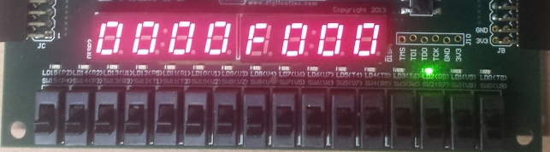
Tutorial I
Remember the 3 clock cycles per instruction: fetch high, fetch low, and execute. The board shows the address placed on the memory bus during each cycle (mem addr)
Explain what is placed on mem_addr at each clock cycle and why?
How is what is on mem_addr different during the execute cycle when the instruction is a move memory (e.g. at address 0, 2 and 6 of the first program) v.s. when the instruction is not a mov memory (at address 4 of the first program)
2: RA
1: RA
2: RB
1: mem addr
2: RC
1: instr
2: RD
1: instr

Slide 7
Tutorial II
You are going to try simple programs using the mov [r],src instruction to understand its behavior
Both immediate and register sources will be tested
Instructions | instruction(15..8) |  |  |  |  |  |  |  | Instruction(7..0)
Move | Opcode |  |  |  | dd#m | sd#m | dreg |  | src
mov r, r | 0 | 0 | 0 | 0 | 0 | 0 | r | r | - | - | - | - | - | - | r | r
mov r, i | 0 | 0 | 0 | 1 | 0 | 0 | r | r | i | i | i | i | i | i | i | i
mov r, [r] | 0 | 0 | 0 | 0 | 0 | 1 | r | r | - | - | - | - | - | - | r | r
mov r, [i] | 0 | 0 | 0 | 1 | 0 | 1 | r | r | i | i | i | i | i | i | i | i
mov [r], r | 0 | 0 | 0 | 0 | 1 | 0 | r | r | - | - | - | - | - | - | r | r
mov [r], i | 0 | 0 | 0 | 1 | 1 | 0 | r | r | i | i | i | i | i | i | i | i

Slide 8
Tutorial II
Consider the following program:
00 mov ra,1e 101E
02 mov rb,99 1199
04 mov [ra],rb 0801
06 add ra,01 3001
08 mov [ra],88 1888
In addition, fill in the memory with the following values at these locations:
Addr Data
1E 44
1F 55

Slide 9
Tutorial II
Answer the following questions running the instructions in your head and verifying on the board:
What is the content of memory locations 1E and 1F after executing the program?
Explain in your words what the mov dst,[src] instruction does
How is the behaviour different than this program:
00 mov ra,1e 101E
02 mov rb,99 1199
04 mov ra,rb 0001
06 add ra,01 3001
08 mov ra,88 1088

Slide 10
Tutorial II
In tutorial I and II we used some memory locations to store data. Discuss what makes the difference (if any) between a memory location corresponding to an instruction or to data.
How does the processor know if a memory location is instruction or data?
Explain why are there no mov instructions to do at the same time a read from memory and a write to memory (e.g. mov [a],[1Eh])?
Discuss what modifications to the processor would be required to have such a mov instruction reading and writing to memory at the same time

Slide 11
Tutorial III
Consider the following program
00 mov ra,07 1007
02 mov rb,00 1100
04 mov [ra],rb 0801
06 out 00 D000
08 add rb,1 3101
0A jmp 04 B004

Slide 12
Tutorial III
What do you expect the out instruction to do on the LEDs?
Execute the program for ~50 clock cycles: what happens on the LEDs?
Can you explain the result?

Slide 13
Tutorial III
Go into the memory edit mode, and check the content of memory locations 4-8; does it correspond to the program you entered?
With this knowledge, to what kind of program are you dealing with?
What could be the uses for such kind of programs?

Slide 14
Coursework assignment
Take time to advance the coursework assignment!
If you want to create a custom program discuss with me if the complexity is adequate to get a full mark.

