Slide 1
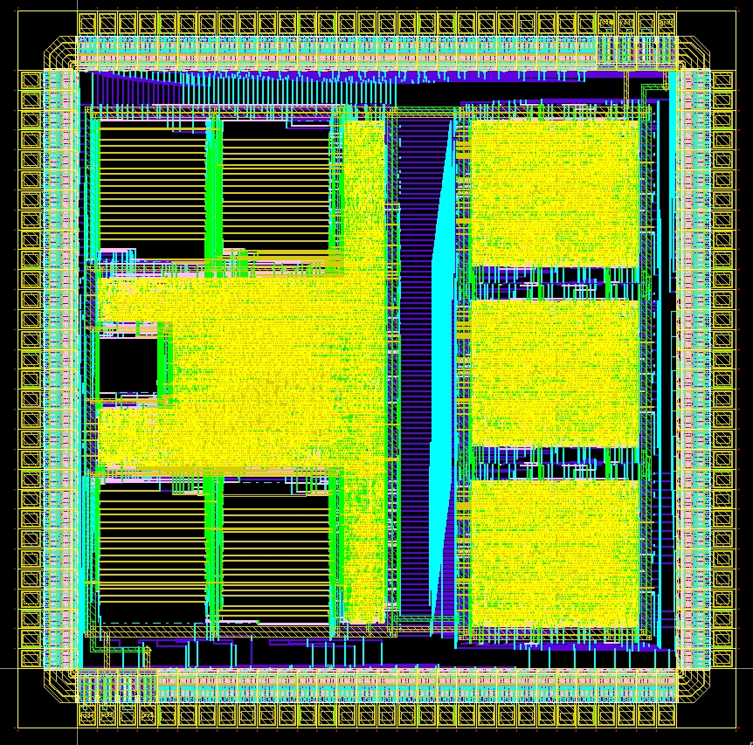
Digital Systems and Microprocessor Design (H7068)
8. Exercises / Laboratory
Daniel Roggen
d.roggen@sussex.ac.uk

Slide 2
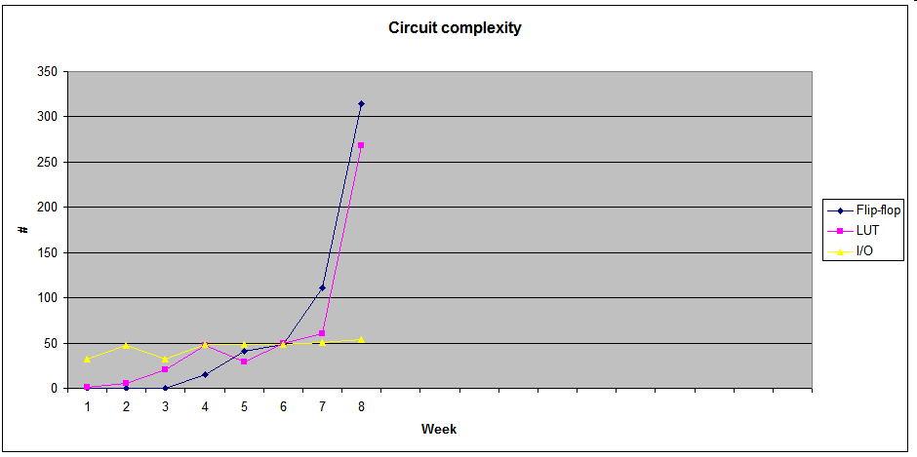
Circuit complexity
CPU

Slide 3
Objective / success criteria
Prerequisite: none for this week
The objective of this laboratory is to:
  Become familiar with the use of the UoS educational processor on the FPGA board
  Create your first assembler program
  Find the assembler code for a memory dump
Success criteria:
  You have been able to create and modify your own program
  You have been able to understand the operation of a program provided as a memory dump

Slide 4
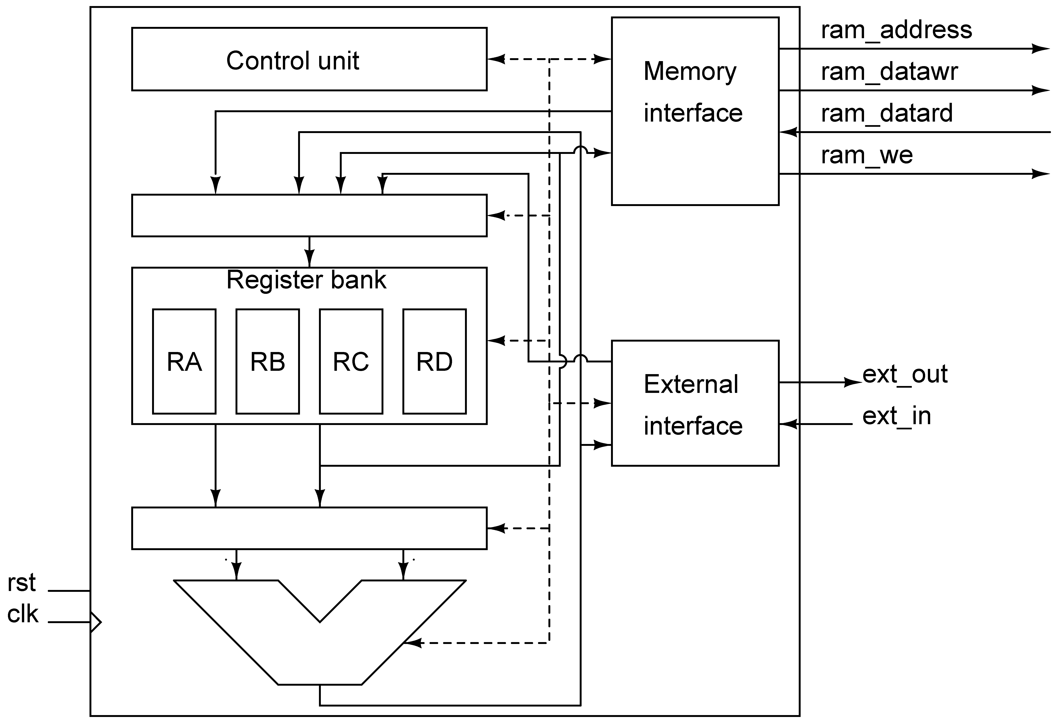
UoS Educational Processor on FPGA
Memory
Mux
LEDs
Push button
Switches
Memory
editor
sw(15)
The processor is synthesized on the FPGA with entity port map.
A 32 bytes memory is synthesized alongsize the processor for program and data. It has 32 entries (5 bit address) of 8 bits
Push buttons allow to generate single clocks to test the processor
LED and switches connected to external interface

Slide 5
System modes
In order to view the memory where program or data is stored the system implements two system modes
Processor mode: the board enables the processor
  The processor is connected to the RAM
  The central push button is the clock
  Switches and LEDs are connected to the external interface
  The display shows the status of the CPU
Memory edit mode: the board allows to view/edit the the memory. The processor is paused.
  The memory editor is connected to the RAM
  Push buttons allow to change address and store data
  Switches allow to enter data
Switch sw(15) allows to change modes.
  sw(15)=0: processor mode
  sw(15)=1: memory edit mode

Slide 6
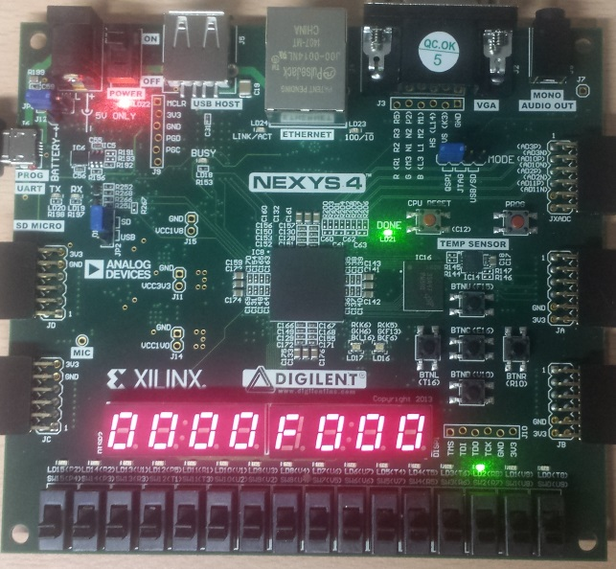
Memory edit mode
Enter with sw(15) high
Use up/dn buttons to choose address
Right button stores sw(7..0) at the current address
Left btn jumps to address sw(12..8)
addr shows the current address
mem_out shows the memory content
sw is the current state of sw(7..0)
goto
address
increment
address
store
store
decrement
address
addr
sw
mem_out
mem edit
high

Slide 7
CPU mode
1: RA
0: RA
1: RB
0: mem addr
1: RC
0: instr
1: RD
0: instr
mem edit
low
ext_out
seq
z
o
c
s
ext_in
CPU display
0 or 1
Auto/manual clock

Slide 8
CPU mode
Two "debug" display modes with sw(14)
Display 0:
  Shows content of register RA
  Current address on memory bus
    Value of IP/PC in the fetchh and fetchl states.
    Address of memory where data must be read/written or zero in exec state
Display 1:
  Shows content of registers RA, RB, RC, RD
LEDs display internal CPU states
  seq: 2 bits indicating the fetchh (00), fetchl (01) and exec (10) states
  z,o,c,s: Zero, Overflow, Carry, Sign bits, used in compare and jump instructions

Slide 9
CPU mode
Manual/automatic clock with sw(13)
Manual clock: center button
Automatic clock: about 2Hz clock
manualclk

Slide 10
Tutorial
Create a new project with the template from lab8 on study direct
Program the FPGA: this gives you the CPU and memory editor described previously

Slide 11
Tutorial
Consider the following program that adds two numbers:
mov ra,23h
add ra,15h
We want to implement it in the processor.
Step 1: find the instruction encoding (in hex)
mov ra,23h -> 1023
add ra,15 h -> 3015

Slide 12
Tutorial
Step 2: memory mapping
  The program starts at memory address 0 (reset) and each instruction is 16 bit. Thus we can define the memory content:
  Address 0: 10
  Address 1: 23
  Address 2: 30
  Address 3: 15

Slide 13
Tutorial
Step 3: edit the memory
  Push sw(15) high: the display blinks to indicate memory edit mode
  Make sure you are at address 0 (see display), if not use the up/down buttons to go to address zero.
  Enter the first value to store (10) on sw(7..0). You can use the display to check to configure the switches correctly
  Press the right button to store.
  Verify that the memory contains the desired value (rightmost two 7-segments)
  Repeat the process for memory location 1, 2, 3
Step 4: exit the memory edit mode with sw(15)=0

Slide 14
Tutorial
Step 5: reset the processor
  Press and hold the cpu_reset button on the board and press the manual clock (synchronous reset)
Step 6: check starting conditions:
  All registers are zero (display mode 2), the PC and the instruction register are zero (display mode 1)
  All internal states are zero: LEDs for seq and flags are off
  The processor is reset.
  The processor is in the state fetchh: on the next clock cycle it will fetch the 8 MSBs of the instruction from address 0

Slide 15
Tutorial
Step 7: clock the processor once!
  The processor will read the data at the PC location (PC=0, data=10) and put it into the 8 MSBs of the instruction register.
  PC is incremented by one (PC=1 now)
  Processor goes to fetchl state
Step 8: clock the processor another time!
  The processor reads the data at the PC location (PC=1, data=23) and puts in into the 8 LSBs of the instruction register
  PC is incremented by one (PC=2 now)
  Processor goes to exec state
Step 9: clock the processor once more!
  The processor executes the instruction (1023h which means "mov ra,23h"
  The register RA now contains 23!
  PC is not incremented
  Processor goes to fetchh state

Slide 16
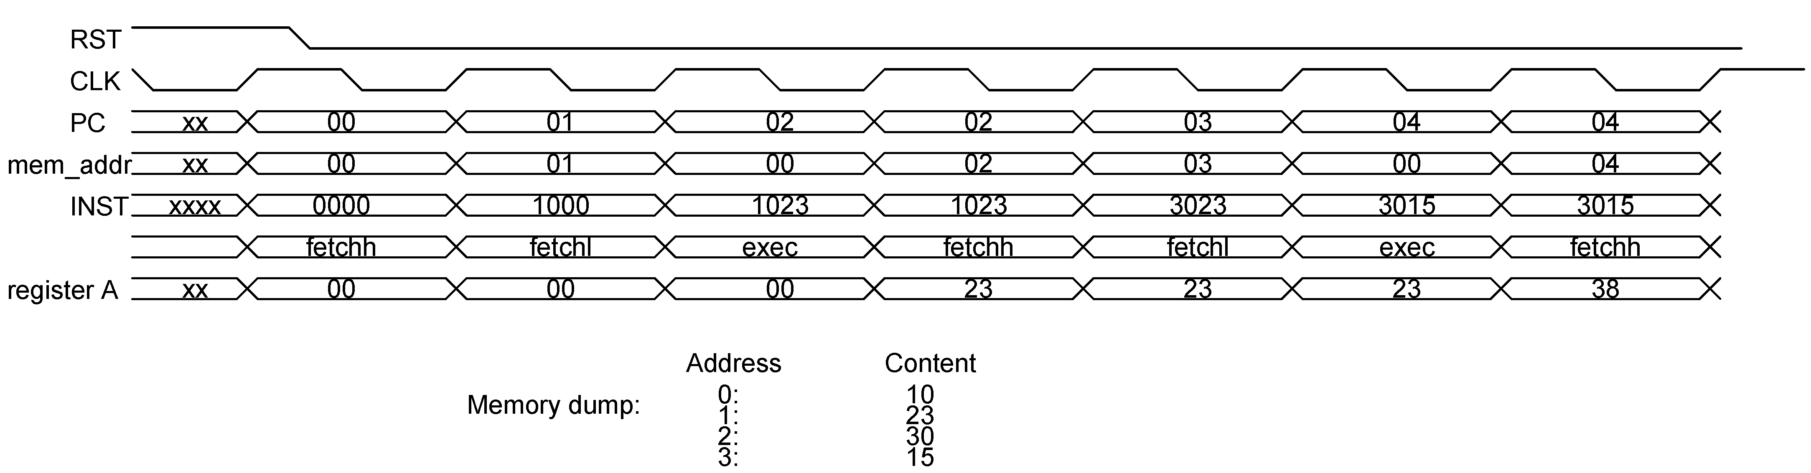
Tutorial
This is what happens!
Note the 3 clock cycles per instruction
For space reason, the board in DisplayMode 1 shows the address on the memory bus (mem_addr) and not PC!
  In fetchh/fetchl mem_addr is the same as PC: the processor puts PC on the address lines to read the data from memory
  In exec state mem_addr depends on the instruction: it is zero unless the instruction is a move with a memory operand, in which case the address of the memory location is on mem_addr

Slide 17
Tutorial
Step 9: continue clocking the processor
  What is the value of RA eventually?
  What happens to PC as you continue clocking?
  Which instructions does the processor read (in hexadecimal)?
  What does this instruction mean?
  Does PC wrap around? If yes, when, and why?

Slide 18
Tutorial II
Consider the following extension to the previous program, where we use register B as well
mov ra,23h
add ra,15h
mov rb,30h
add rb,rb
sub rb,ra
Step 1: find the instruction encoding (in hex)
mov ra,23h -> 1023
add ra,15h -> 3015
mov rb,30h -> 1130
add rb,rb -> 2101
sub rb,ra -> 2500

Slide 19
Tutorial II
Step 2: edit the memory
Step 3: execute
  Use display mode 2 to see the registers ra,rb,rc,rd
  Does the program do what you expected?
  The syntax of the sub instruction is sometimes confusing!
  The result should be 28h in RB....

Slide 20
Tutorial III
Connected to LEDs
Controlled by the “out” instruction
Connected to switches
Can be read by the “in” instruction

Slide 21
Tutorial III
Let’s write a specific pattern of bits to the LEDs using the out instruction. Program:
out 55h
out aah
out f0h
out 0fh
jmp 00
Step 1: find the instruction encoding (in hex)
00 out 55h d055
02 out aah d0aa
04 out f0h d0f0
06 out 0fh d00f
08 jmp 00 b000

Slide 22
Tutorial III
Step 2: edit the memory
Step 3: execute
  See the status of the LED 7..0
  Do the LED light up according to what you would expect?
  Try the automatic clock (switch 23)
  What happens when the program reaches address 08?

Slide 23
Exercise I
Consider the program below. Explain line by line the operation performed by the instruction and the resulting register values, for all registers that are used.
xor ra,ra
add ra,10h
mov rb,11h
sub ra,rb
add ra,ra
ror ra
You can program the processor with this program to see what it does!

Slide 24
Exercise II
This exercise will prepare you for one of the task in the coursework (but it is not identical to the coursework!)
Using the instruction summary sheet (available on StudyDirect under 'UoS processor doc') convert the following instructions given in hex into the human-readable assembler equivalent:
Adr Data
----------
00 10 04
02 42 01
04 54 00
06 B1 10
08 22 00
0A C0 02
0C 34 01
0E B0 04
10 B0 10
12 63 00
14 3D 25
16 A0 03
Attempt to understand the function of the program.
You can program the processor with this program to see what it does!

Slide 25
Exercise I
Suggestion: work on problem (b) of the coursework assignment

Slide 26
Exercise II
Suggestion: work on problem (c) of the coursework assignment
Read next slide as entering long programs can be done by editing the VHDL code!

Slide 27
Alternative way to enter programs
The VHDL file ram.vhd contains the default startup state of the memory
By modifying ram.vhd a program can be placed in memory when the FPGA is programmed
Edit ram.vhd is useful for large programs and/or to keep past programs
Editing memory directly on the board is useful for quick modifications

