Slide 1
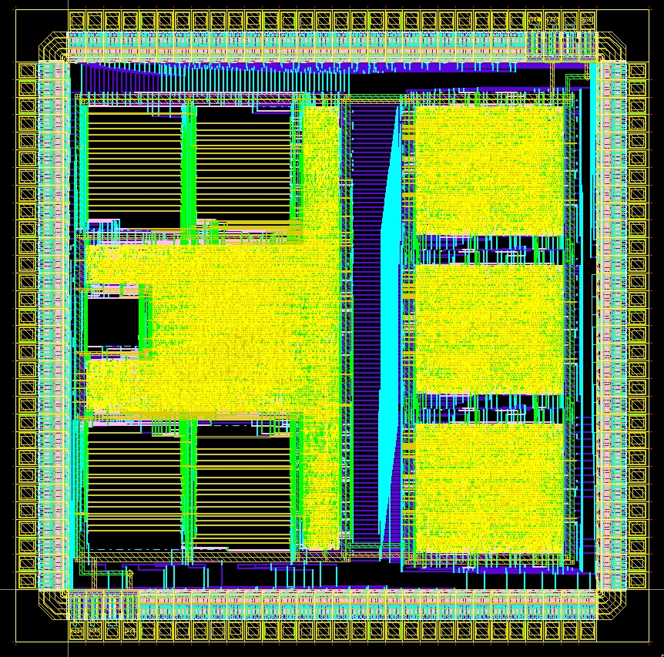
Digital Systems and Microprocessor Design (H7068)
9. Exercises / Laboratory
Daniel Roggen
Richmond 3A13
d.roggen@sussex.ac.uk
2014

Slide 2
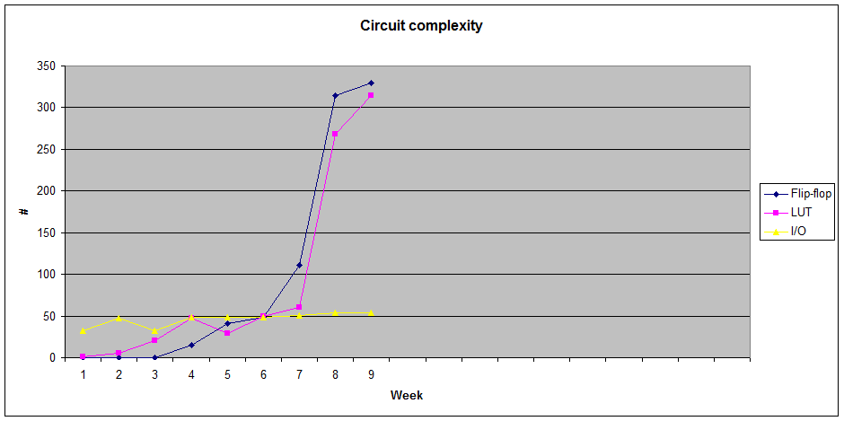
Circuit complexity
CPU with custom instructions

Slide 3
Objective / success criteria
Prerequisite: lab of week 8, knowledge of digital electronics
The objective of this laboratory is to:
  Understand how the ALU of the educational processor is implemented
  Understand how to add instructions to the educational processor (specifically the ALU)
Success criteria:
  You have implemented the two custom instructions in the tutorial of this lab
  You have implemented the random number generator for the coursework assignment

Slide 4
Custom instructions
The easiest place to add custom instructions is in the ALU
  The CPU has been designed to have an extensible ALU
  The instruction decoding to feed the ALU with data and store the result is already in place!
Modifying or creating instructions unrelated to the ALU may involve significant changes to the control unit and other parts of the processor
  For instance creating an instruction that takes 3 parameters instead of 2 would require to change the register bank
  Creating an instruction that moves from memory to memory would require more than 3 clock cycles per instruction...

Slide 5

Custom ALU instruction
ALU instructions are have opcodes: 001, 010, 011
The ALU data path is activated for these opcodes
The general format of the ALU instruction is:
The specific ALU operation is defined by the opcode and the ALUop bits in the instruction: instruction(12..10)
Instruction(12) is called R'/I, but it can have a different meaning.
  Single operand ALU instructions use R'/I as part of ALUop
instruction(15..8) |  |  |  |  |  |  |  | Instruction(7..0)
opcode |  |  |  | ALU op |  | dreg |  | src
0 | X | X | X | X | X | r | r | i/- | i/- | i/- | i/- | i/- | i/- | i/r | i/r

Slide 6
Default ALU data path
instruction(15..8) |  |  |  |  |  |  |  | Instruction(7..0)
opcode |  |  |  | ALU op |  | dreg |  | src
0 | X | X | X | X | X | r | r | i/- | i/- | i/- | i/- | i/- | i/- | i/r | i/r
For ALU instructions, the control unit does the following:
  Input A of the ALU receives the data from register dreg
  Input B of the ALU receives either the immediate src or the value of the register src, depending on instruction(12)
  The output of the ALU is stored in register dreg
  The ALU receives instruction(14..10) to indicate the operation to perform.
Providing data to the ALU and storing the result is done automatically by the control unit
We simply need to add new function to the ALU - the rest is taken care of!

Slide 7
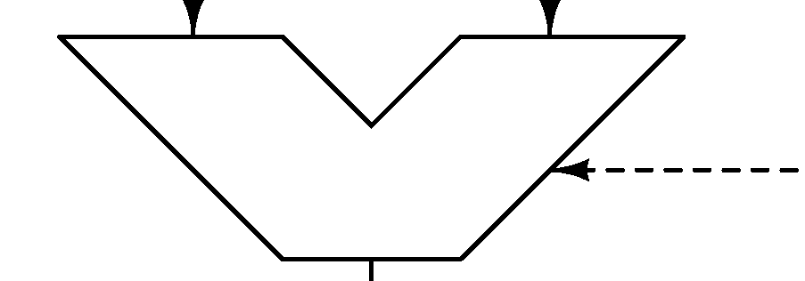
Default ALU data path
The only part of the processor we look at is the ALU in cpualu.vhd
It looks like this:
from dst register
from src register or immediate
A
B
instruction(14..10)
to dst register

Slide 8
Tutorial I
The instruction table shows that the processor has only 3 2-input logic functions: AND, OR, XOR
The objective is to add a new logic instruction: NAND
The ALU is defined in cpualu.vhd

Slide 9
Tutorial I
Step 1: define which instruction code corresponds to the new function
  The opcode has to be 001, 010, 011 (ALU operation)
  Check the instruction table to find which opcode has "space" to contain a new instruction
  Opcode 001 is full: all combinations instruction(12..10) are used
  Opcode 010 is not full: only 4 combinations of instruction(12..10) are used for the xor and cmp. This could be used.
  Opcode 011 is not full: only 5 combinations of instruction(12..10) are used. This could be used.
  To keep some logic in the instruction set we decide to use opcode 010, as the existing instructions with opcode 010 are two-operand instructions (xor and cmp)
  However nothing prevents us from using opcode 011!

Slide 10
Tutorial I
Step 2: Decide which ALUop to use for the selected opcode
  ALUop 00 is xor
  ALUop 01 is cmp
  Choose a value of ALUop for this instruction. Let's say 10!
  We can update our instruction table:
Custom instruction | opcode |  |  |  | ALU op |  | dreg |  | immedite / reg
nand r, r | 0 | 1 | 0 | 0 | 1 | 0 | r | r | - | - | - | - | - | - | r | r
nand r, i | 0 | 1 | 0 | 1 | 1 | 0 | r | r | i | i | i | i | i | i | i | i

Slide 11
Tutorial I
Step 3: Prepare to modify cpualu.vhd
  The ALU is realized by a multiplexer selecting one function:
r <= a+b when op(4 downto 3)="01" and op(1 downto 0)="00" else
sub(7 downto 0) when op(4 downto 3)="01" and op(1 downto 0)="01" else
a and b when op(4 downto 3)="01" and op(1 downto 0)="10" else
a or b when op(4 downto 3)="01" and op(1 downto 0)="11" else
a xor b when op(4 downto 3)="10" and op(1 downto 0)="00" else
not a when op(4 downto 0)="11000" else
'0'&a(7 downto 1) when op(4 downto 0)="11001" else
a(0)&a(7 downto 1) when op(4 downto 0)="11010" else
a(7)&a(7 downto 1) when op(4 downto 0)="11011" else
a(6 downto 0)&a(7) when op(4 downto 0)="11100" else
"00000000";
  We must add an input to this multiplexer to get the NAND of inputs a and b when the opcode is 010 and ALUop is 10
  The current ALU uses op(4..0) to select the operation.
  Where does op come from? Read cpu.vhd to find out!
  op is actually instruction(14..10)

Slide 12
Tutorial I
Step 4: Modify cpualu.vhd
  We want to execute the NAND when instruction(15..10) is "010010"..... (is this correct??!)
  So op(4..0)="10010" for a NAND
  Thus modify the ALU as follows:
r <= a+b when op(4 downto 3)="01" and op(1 downto 0)="00" else
sub(7 downto 0) when op(4 downto 3)="01" and op(1 downto 0)="01" else
a and b when op(4 downto 3)="01" and op(1 downto 0)="10" else
a or b when op(4 downto 3)="01" and op(1 downto 0)="11" else
a xor b when op(4 downto 3)="10" and op(1 downto 0)="00" else
a nand b when op(4 downto 0)="10010" else
not a when op(4 downto 0)="11000" else
'0'&a(7 downto 1) when op(4 downto 0)="11001" else
a(0)&a(7 downto 1) when op(4 downto 0)="11010" else
a(7)&a(7 downto 1) when op(4 downto 0)="11011" else
a(6 downto 0)&a(7) when op(4 downto 0)="11100" else
"00000000";

Slide 13
Tutorial I
Step 5: create a test program
  We want to test the register mode and the immediate mode!
  We use the instruction table to find the encoding
-- register mode
mov ra,a5h 10a5
mov rb,aah 11aa
nand ra,rb 4801
-- expected result: 5F
mov rc,83h 1283
nand rc,84h 5a84
-- expected result: 7F
Custom ALU instruction | opcode |  |  |  | ALU op |  | dreg |  | immedite / reg
nand r, r | 0 | 1 | 0 | 0 | 1 | 0 | r | r | - | - | - | - | - | - | r | r
nand r, i | 0 | 1 | 0 | 1 | 1 | 0 | r | r | i | i | i | i | i | i | i | i

Slide 14
Tutorial I
Step 6: test the program
  Edit the memory to fill it with the instructions:
Address Data
00 10
01 A5
02 11
03 AA
04 48
05 01
06 12
07 83
08 5A
09 84

Slide 15
Tutorial I
Step 7: fix bugs
  The program works with register source, but not with immediate source!
  The error is in this line in the multiplexer in cpualu.vhd:
  a nand b when op(4 downto 0)="10010" else
  Can you fix this?

Slide 16
Tutorial II
The previous instruction was combinational. We will now see how to make an ALU instruction whose internal function is clock dependent
Let's say we want an instruction "tick" that returns the number of clock cycles since the processor was turned on.
We will implement this with a circuit counting up at each clock cycle, with a synchronous reset
The counter output will be connected to one input of the ALU multiplexer and the "tick" instruction will select that input

Slide 17
Tutorial II
Step 1: define which instruction code corresponds to the new function
  As before the opcode has to be 001, 010, 011 (ALU operation), and there is space in the opcodes 010 and 011
  To keep some logic in the instruction set we use opcode 011 this time: all instructions with this opcode have a single operand, as does "tick"
Step 2: Decide which ALUop to use for the selected opcode
  ALUop 000 is not, 001 is shr, 010 is ror, 011 is asr, 100 is rol.
  Let's choose the next free ALUop: 101
  We can update our instruction table:
Instructions | instruction(15..8) |  |  |  |  |  |  |  | Instruction(7..0)
Custom ALU instructions | opcode |  |  | ALU op |  |  | dreg
tick | 0 | 1 | 1 | 1 | 0 | 1 | r | r | - | - | - | - | - | - | - | -

Slide 18
Tutorial II
Step 3: Create the tick counter: a counter with reset
  We could create a dedicated VHDL component (in a separate file), but we are lazy here and put everything in cpualu.vhd
  Add a signal in cpualu.vhd: tick as an 8-bit std_logic_vector
  Add the following counter code somewhere in the architecture:
    We use a handy VHDL operation for the addition!
    This is a D flip-flop with synchronous reset and an increment
process(clk)
begin
if rising_edge(clk) then
if rst='1' then
tick<="00000000";
else
tick<=tick+1;
end if;
end if;
end process;

Slide 19
Tutorial II
Step 4: Modify the multiplexer
  Select "tick", the output of the counter, when instruction(14..10) is "11101"
r <= a+b when op(4 downto 3)="01" and op(1 downto 0)="00" else
sub(7 downto 0) when op(4 downto 3)="01" and op(1 downto 0)="01" else
a and b when op(4 downto 3)="01" and op(1 downto 0)="10" else
a or b when op(4 downto 3)="01" and op(1 downto 0)="11" else
a xor b when op(4 downto 3)="10" and op(1 downto 0)="00" else
not a when op(4 downto 0)="11000" else
'0'&a(7 downto 1) when op(4 downto 0)="11001" else
a(0)&a(7 downto 1) when op(4 downto 0)="11010" else
a(7)&a(7 downto 1) when op(4 downto 0)="11011" else
a(6 downto 0)&a(7) when op(4 downto 0)="11100" else
tick when op(4 downto 0)="11101" else
"00000000";

Slide 20
Tutorial II
Step 5: Create a test program.
  We will create a loop with register RB that goes from 0 to 4
  We will put the number of clock cycles to complete the look in d (we can verify later that this is correct!)
  Then the program continuously loads c with the tick
0 mov rb,00 1100
2 add rb,1 3101
4 cmp rb,4 5504
6 jb 2 BB02
8 tick rd 7700
A tick rc 7600
C jmp A B00A

Slide 21
Tutorial II
Step 6: Fill in the memory, reset the CPU and test the program
  What do you obtain in register C eventually?
  Is this what you expect from the program? Verify this by counting the number of instructions executed in the program! Hint: the program loops 4 times the instructions between address 2 and 6....
  You may find that your count is off by one cycle... can you explain this?

Slide 22
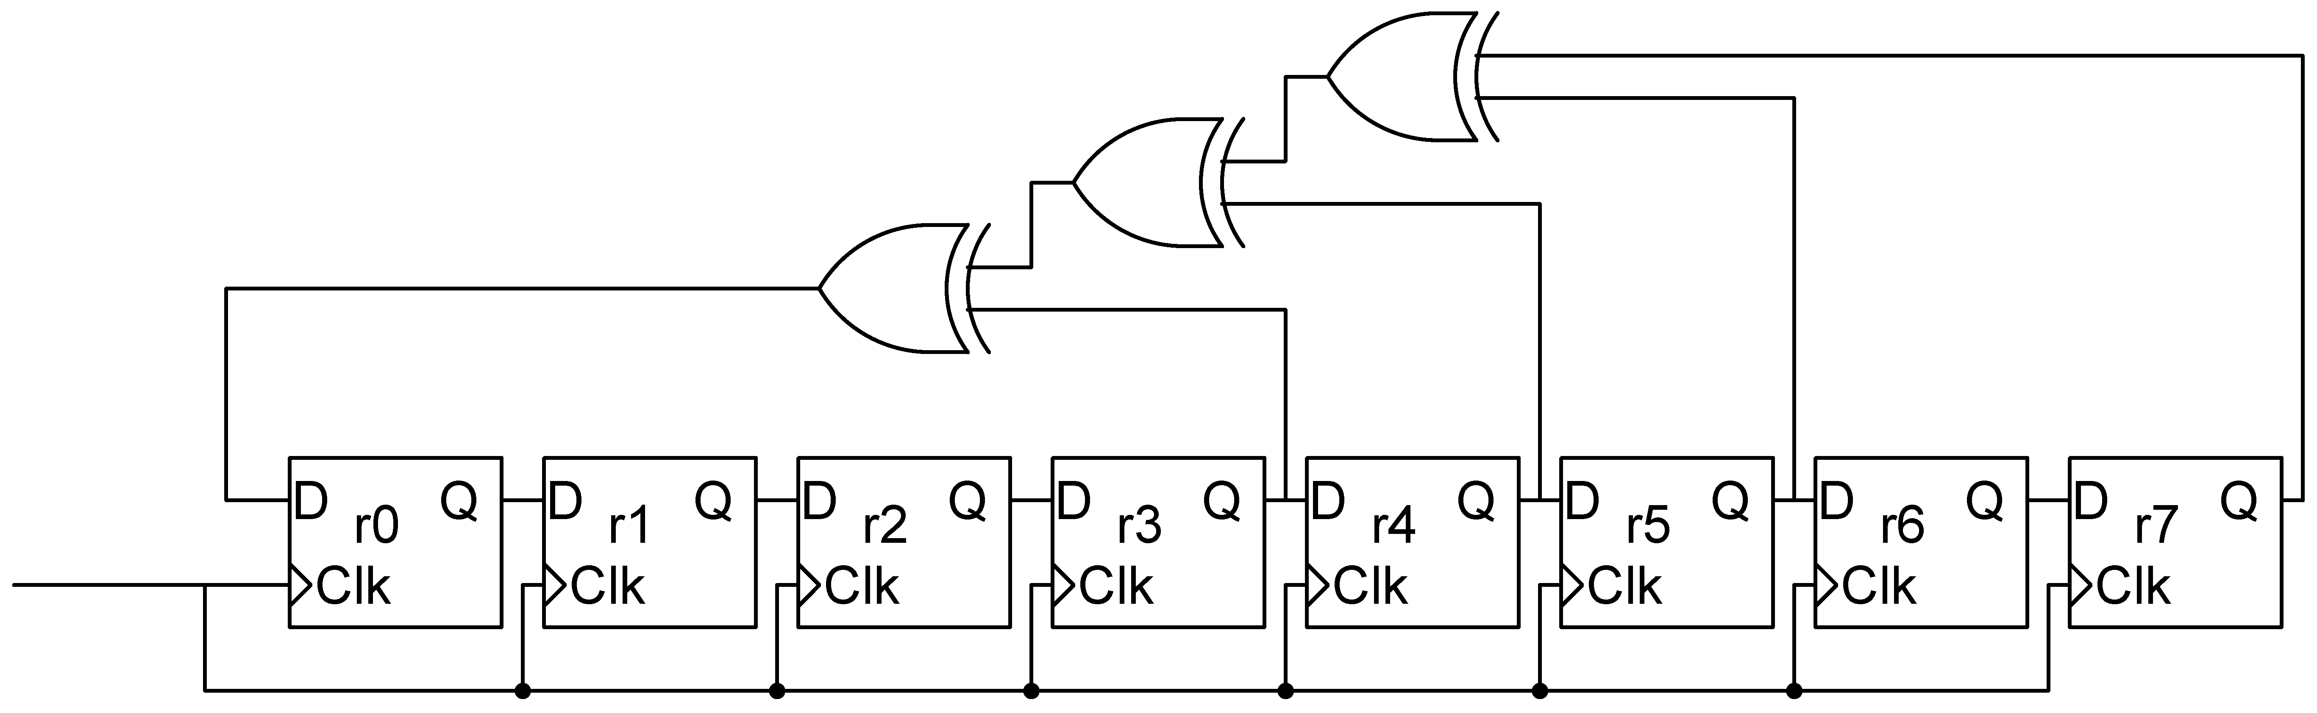
Problem 1: Random Number Generator
(coursework assignment)
Creating a pseudo-random number can be realized with a linear feedback shift register:
The 8-bit number represented by bits r7..r0 is pseudo-random
In reality the sequence is periodical
If the taps of the XOR are well chosen (as in this circuit) the periodicity can be of maximal length (here 255 clocks)
Note that this circuit must be initialized properly: upon reset, at least one bit must be one. Let's say r7=1 on reset

Slide 23
Problem 1: Random Number Generator
(coursework assignment)
The objective is to add an instruction to the ALU that returns a random number using the LFSR circuit and demonstrate that it works with a test program
You are free to select any unused instruction encoding
Check the coursework assignment for details on what you must include in the report.
Hint: you can create a standalone VHDL module to test the LFSR independently of the processor, and then instantiate the circuit in the ALU

