Slide 1
Age & Growth Analyses with R
Derek H. Ogle, Northland College
Taylor R. Stewart, USGS-GLSC, Lake Erie Bio. Station

Slide 2

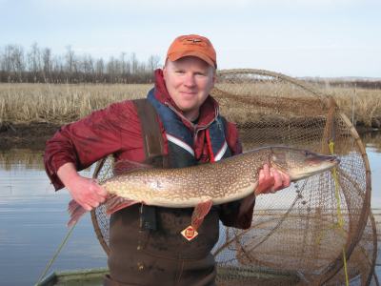
Derek
Professor of Mathematical Sciences and Natural Resources at Northland College
Ph.D. in Fisheries from University of Minnesota

Slide 3
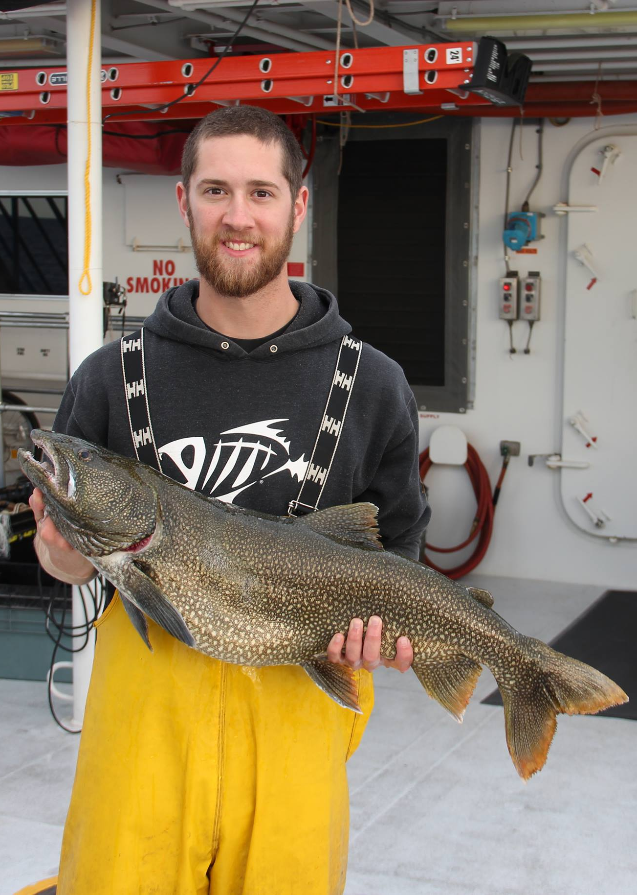
Taylor
Teaching Assistant
Fisheries Research Technician with USGS-Great Lakes Science Center, Lake Erie Biological Station
Graduate of Northland College

Slide 4
Workshop Outcomes
Compute metrics and construct graphics to compare two sets of age estimates.
Compute precision metrics (APE, ACV).
Compute tests of symmetry for assessing bias.
Construct various forms of age-bias plots.

Slide 5
Workshop Outcomes
Compute metrics and construct graphics to compare two sets of age estimates.
Construct and apply an age-length key (ALK).
Construct raw and smoothed ALKs.
Estimate ages for measured-only fish with the Isermann-Knight (2005) method.

Slide 6
Workshop Outcomes
Compute metrics and construct graphics to compare two sets of age estimates.
Construct and apply an age-length key (ALK).
Fit von Bertalanffy growth functions (VBGF) to length-age data.
Understand concepts of fitting non-linear models.
Understand different parameterizations of the VBGF.
Extract parameter estimates and appropriate measures of variability.

Slide 7
Workshop Outcomes
Compute metrics and construct graphics to compare two sets of age estimates.
Construct and apply an age-length key (ALK).
Fit von Bertalanffy growth functions (VBGF) to length-age data.
Statistically compare VBGF parameters between two or more groups of fish.

Slide 8
Fisheries Analyses in R
Introduction to Fisheries Analyses with R
Due out before end of the year.
fishR
Website ... fishR.wordpress.com.
Blog … fishr.wordpress.com/news/.
Twitter … @fishR_ogle.

Slide 9
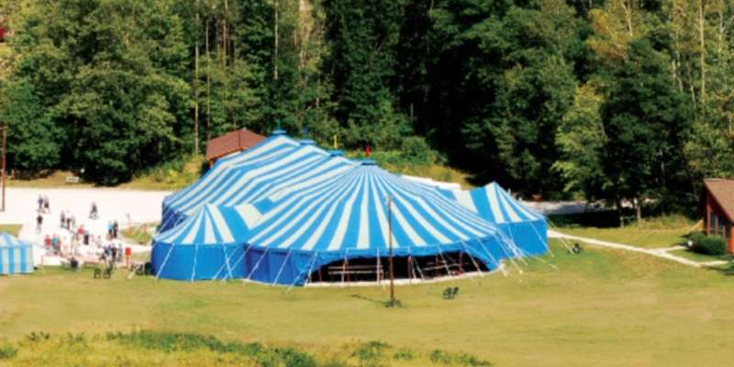
This Better Go Well!!
Big Top Chautauqua

Slide 10

This Better Go Well!!

