Slide 1
Age Comparison Methods
Accuracy, Bias, Precision

Slide 2
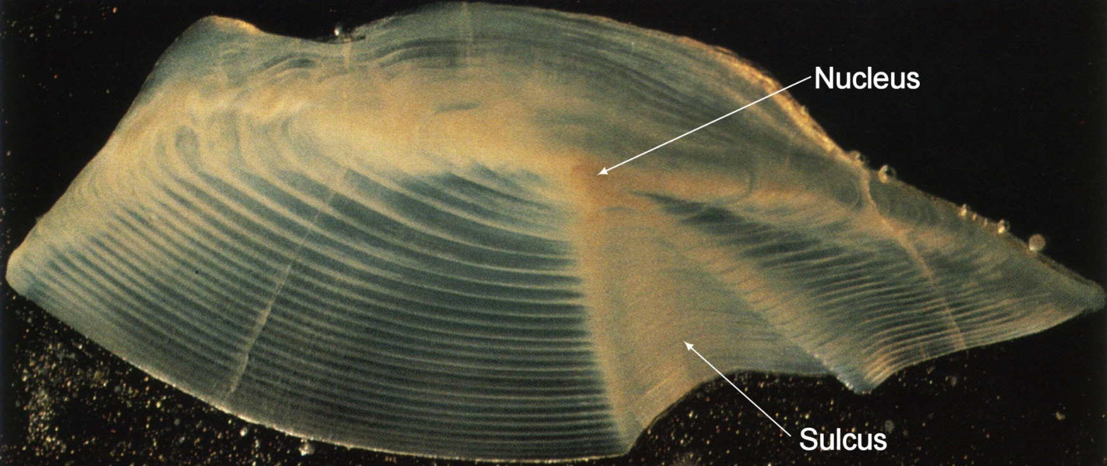
Definitions
Estimated age
Age determined from observation of structures
True age
Actual age of the fish

Slide 3
Types of Data
At least two sets of paired ages
Estimated and true ages
From two structures (scales, otoliths, fin rays, …)
From two readers
From same reader at two times

Slide 4
Definitions
Accuracy
Estimated age equals (known) true age
Related to age validation
“Does age from scales equal true age?”
Bias
Difference between two (or more) estimates
“Do ages from scales and otoliths agree?”
“Do ages from two readers agree?”
Precision
Reproducibility of age estimates (whether true or not)
Measures variability in age estimates
“How often do ages from two readers agree?”
“How variable are ages assigned from two readers?”

Slide 5
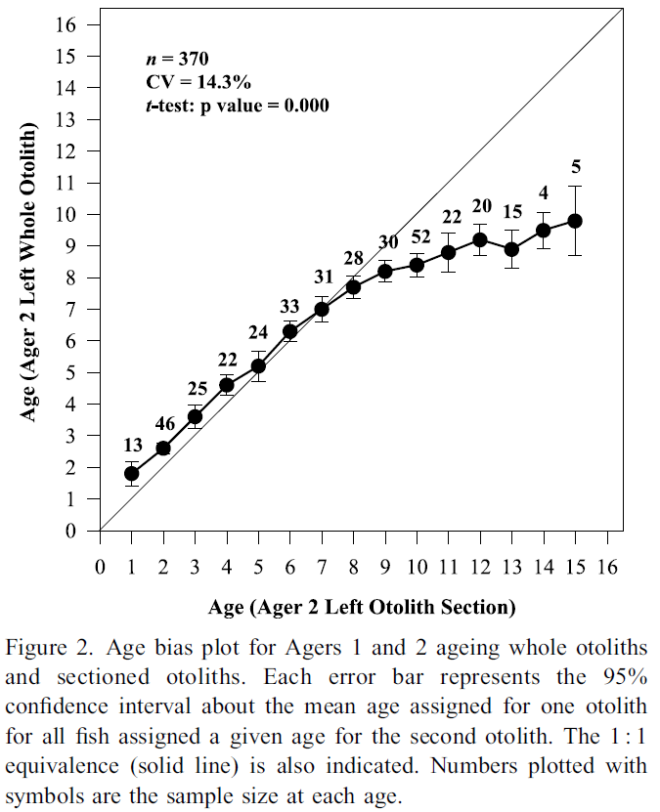
Precision
Bias
Notes:
From Dwyer, KS, SJ Walsh, and SE Campana. 2003. Age determination, validation and growth of Grand Bank yellowtail founder (Limanda ferruginea). ICES Journal of Marine Science 60:1123-1138.

Slide 6
Identifying Bias
Tabular Displays
Age-Agreement Table
Graphical Displays
Age-Bias Plot (Campana et al. 1995)
Modified Age-Bias Plot (Muir et al. 2008)
Statistical Tests
t-tests
Tests of Symmetry

Slide 7
Bias – Age-Agreement Table
 |  | Otolith Age
 |  | 0 | 1 | 2 | 3 | 4 | 5 | 6 | 7 | 8 | 9 | 10
Scale Age | 0 | 2 | 1 | - | - | - | - | - | - | - | - | -
 | 1 | - | 14 | - | - | - | - | - | - | - | - | -
 | 2 | - | 3 | 16 | 2 | - | - | - | - | - | - | -
 | 3 | - | - | 4 | 11 | 5 | 2 | 1 | - | - | - | -
 | 4 | - | - | - | - | 12 | 4 | 3 | 1 | 1 | - | -
 | 5 | - | - | - | - | 1 | 4 | 2 | 5 | 4 | - | -
 | 6 | - | - | - | - | - | - | 2 | 1 | - | 1 | 2
 | 7 | - | - | - | - | - | - | - | - | - | - | -
 | 8 | - | - | - | - | - | - | - | - | - | - | -
 | 9 | - | - | - | - | - | - | - | - | - | - | -
 | 10 | - | - | - | - | - | - | - | - | - | - | -

Slide 8
Bias – Age-Agreement Table
Scale Age | 10 | - | - | - | - | - | - | - | - | - | - | -
 | 9 | - | - | - | - | - | - | - | - | - | - | -
 | 8 | - | - | - | - | - | - | - | - | - | - | -
 | 7 | - | - | - | - | - | - | - | - | - | - | -
 | 6 | - | - | - | - | - | - | 2 | 1 | - | 1 | 2
 | 5 | - | - | - | - | 1 | 4 | 2 | 5 | 4 | - | -
 | 4 | - | - | - | - | 12 | 4 | 3 | 1 | 1 | - | -
 | 3 | - | - | 4 | 11 | 5 | 2 | 1 | - | - | - | -
 | 2 | - | 3 | 16 | 2 | - | - | - | - | - | - | -
 | 1 | - | 14 | - | - | - | - | - | - | - | - | -
 | 0 | 2 | 1 | - | - | - | - | - | - | - | - | -
 |  | 0 | 1 | 2 | 3 | 4 | 5 | 6 | 7 | 8 | 9 | 10
 |  | Otolith Age

Slide 9
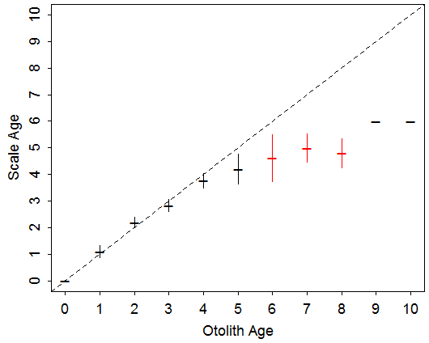
Bias – Age-Bias Plot

Slide 10
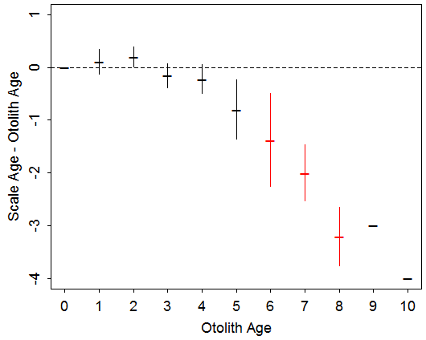
Bias – Modified Age-Bias Plot

Slide 11
Bias – t-Tests
Otolith Age | n | min | max | mean | SE | t | adj.p
0 | 2 | 0 | 0 | 0.00 | -- | -- | --
1 | 18 | 0 | 2 | 1.11 | 0.111 | 1.000 | 0.3313
2 | 20 | 2 | 3 | 2.20 | 0.092 | 2.179 | 0.1684
3 | 13 | 2 | 3 | 2.85 | 0.104 | -1.477 | 0.3308
4 | 18 | 3 | 5 | 3.78 | 0.129 | -1.719 | 0.3111
5 | 10 | 3 | 5 | 4.20 | 0.249 | -3.207 | 0.0535
6 | 8 | 3 | 6 | 4.63 | 0.375 | -3.667 | 0.0480
7 | 7 | 4 | 6 | 5.00 | 0.218 | -9.165 | 0.0007
8 | 5 | 4 | 5 | 4.80 | 0.200 | -16.000 | 0.0007
9 | 1 | 6 | 6 | 6.00 | -- | -- | --
10 | 2 | 6 | 6 | 6.00 | -- | -- | --
Useful for testing where ages diverge
Notes:
Identify one set of ages as the “standard”
Compute the mean of the other set of ages at each age of the “standard”
Test if this mean age differs from the “standard”
Multiple 1-sample t-tests
Must be corrected for error rate inflation

Slide 12
Bias – Tests of Symmetry
If a systematic bias in ages exists then age-agreement table is assymmetric
Chi-square-type test
H₀: “Symmetric” (i.e., no systematic bias)
H_{A}: “Assymetric” (i.e., systematic bias)

Slide 13
Bias – Tests of Symmetry
Systematic Bias?
Assymmetric → Small p-value
 |  | Otolith Age
 |  | 0 | 1 | 2 | 3 | 4 | 5 | 6 | 7 | 8 | 9 | 10
Scale Age | 0 | 2 | 1 | - | - | - | - | - | - | - | - | -
 | 1 | - | 14 | - | - | - | - | - | - | - | - | -
 | 2 | - | 3 | 16 | 2 | - | - | - | - | - | - | -
 | 3 | - | - | 4 | 11 | 5 | 2 | 1 | - | - | - | -
 | 4 | - | - | - | - | 12 | 4 | 3 | 1 | 1 | - | -
 | 5 | - | - | - | - | 1 | 4 | 2 | 5 | 4 | - | -
 | 6 | - | - | - | - | - | - | 2 | 1 | - | 1 | 2
 | 7 | - | - | - | - | - | - | - | - | - | - | -
 | 8 | - | - | - | - | - | - | - | - | - | - | -
 | 9 | - | - | - | - | - | - | - | - | - | - | -
 | 10 | - | - | - | - | - | - | - | - | - | - | -

Slide 14
Bias – Tests of Symmetry
Systematic Bias?
Symmetric → Large p-value
 |  | Otolith Age
 |  | 0 | 1 | 2 | 3 | 4 | 5 | 6 | 7 | 8 | 9 | 10
Scale Age | 0 | 2 | 1 | - | - | - | - | - | - | - | - | -
 | 1 | 1 | 14 | 2 | - | - | - | - | - | - | - | -
 | 2 | - | 2 | 16 | 2 | - | - | - | - | - | - | -
 | 3 | - | - | 3 | 11 | 4 | - | - | - | - | - | -
 | 4 | - | - | - | 3 | 12 | 2 | - | - | - | - | -
 | 5 | - | - | - | - | 3 | 4 | 2 | - | - | - | -
 | 6 | - | - | - | - | - | 3 | 2 | 1 | - | - | -
 | 7 | - | - | - | - | - | - | 1 | 1 | 1 | - | -
 | 8 | - | - | - | - | - | - | - | 1 | 1 | 1 | -
 | 9 | - | - | - | - | - | - | - | - | 1 | 2 | -
 | 10 | - | - | - | - | - | - | - | - | - | 1 | -

Slide 15
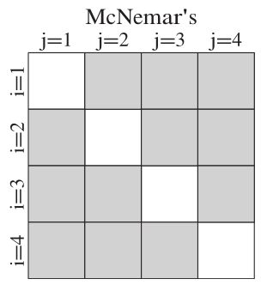
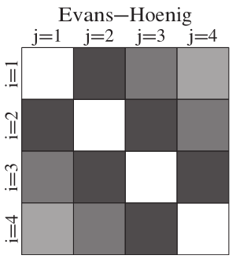
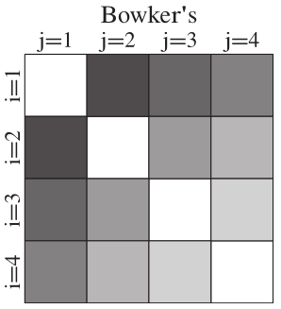
Bias – Tests of Symmetry
Three Types
Compares different off-diagonal cells
Useful for an overall summary

Slide 16
Examine Handout
Pages 1-3

Slide 17
Measuring Precision
Percent Agreement
% where two ages agree perfectly
Percent Agreement with Offset
% where two ages agree within some amount
Abs Age Diff | 0
Percent | 58.7
1 | 2 | 3 | 4
22.1 | 9.6 | 6.7 | 2.9
Easily understood
Poor metric … interpretation depends on range of observed ages

Slide 18
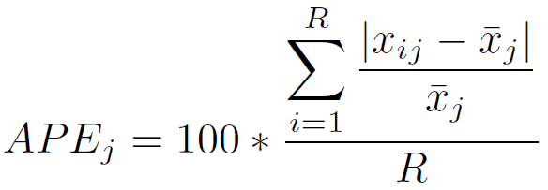
Measuring Precision
Average Percentage Error (APE)
Compute APE for each fish
Average the APEs for a summary metric
fish | oto | scale | diff | avg | APE
69 | 4 | 4 | 0 | 4.0 | 0.0
71 | 4 | 5 | -1 | 4.5 | 11.1
72 | 5 | 3 | 2 | 4.0 | 25.0
74 | 5 | 4 | 1 | 4.5 | 11.1

Slide 19
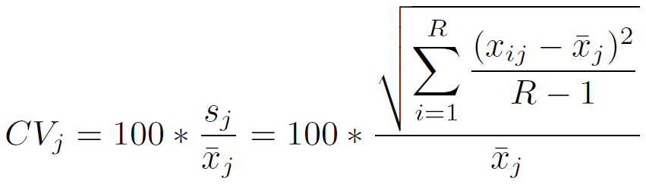
Measuring Precision
Average Coefficient of Variation (ACV)
Compute CV for each fish
Average the CVs for a summary metric
fish | oto | scale | diff | avg
69 | 4 | 4 | 0 | 4.0
71 | 4 | 5 | -1 | 4.5
72 | 5 | 3 | 2 | 4.0
74 | 5 | 4 | 1 | 4.5
sd | CV
0.00 | 0.0
0.71 | 15.7
1.41 | 35.4
0.71 | 15.7

Slide 20
Measuring Precision
APE and ACV
ACV generally preferred … known statistic
ACV generally 40% greater than APE
Campana (2001) … if ACV<5% then precise
Based on empirical median ACV of 7.6%

Slide 21
Examine Handout
Page 4
In Portland 2015
Richard S. McBride Poster – “Testing Tests of Symmetry to Evaluate Paired Age Agreement”
Thursday – “Use of Scales, Otoliths and Fin Rays to Determine Age, Growth, and Life History Characteristics of Fishes”

Slide 22
Age Comparisons Exercises
Complete 4.1 (a)-(c).
(Time Permitting) Complete 4.1 (d)-(h).

