Slide 1
Individual Growth (Size-at-Age Modeling)
Von Bertalanffy Models

Slide 2
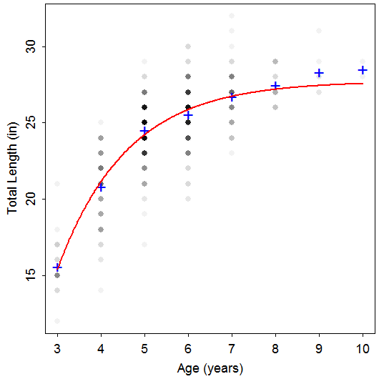
Length-At-Age Data
TL Age Species
24 6 Rainbow
26 8 Rainbow
23 5 Rainbow
25 5 Rainbow
24 4 Rainbow
24 5 Rainbow
23 4 Rainbow
25 5 Rainbow
20 4 Rainbow
23 4 Rainbow
26 6 Rainbow
29 10 Rainbow
20 4 Rainbow
29 8 Rainbow
24 6 Rainbow
26 6 Rainbow
23 5 Rainbow
24 4 Rainbow
22 4 Rainbow
25 7 Rainbow
Notes:
data(TroutBR)
rbt <- TroutBR[TroutBR$Species=="Rainbow",]
attach(rbt)
plot(jitter(TL,1)~jitter(Age,0.5),xlab="Age [jittered]",ylab="Total Length (in) [jittered]")

Slide 3
Length-At-Age Models
Purposes
Summarize growth with a few parameters.
Compare growth parameters among populations.
Used in key fisheries models, such as Beverton-Holt yield models.
Main models
Von Bertalanffy
Gompertz
Schnute

Slide 4
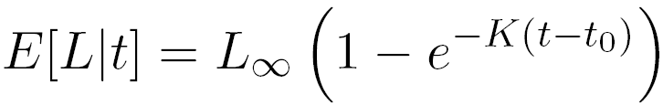
Von Bertalanffy – Typical
L∞ = asymptotic mean length
K = Brody “growth” coefficient
controls “curvature” of the model
e^{-K} is constant change in growth increment
t_{o} = time when mean length is 0 (artifact)

Slide 5
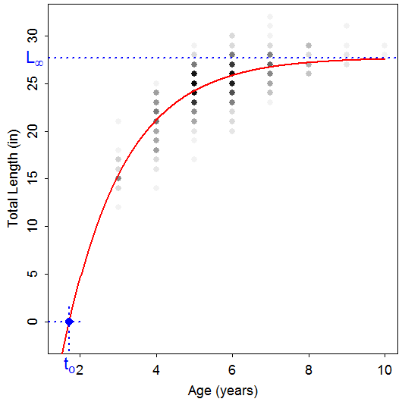
Von Bertalanffy – Typical

Slide 6
Von Bertalanffy – Typical
Common Problems
Misinterpreted meanings
Difficulty modeling L∞
Few old fish
Difficulty modeling K
Few young fish
Model won’t converge, Poor parameter estimates
Much variability in length at each age
Highly correlated parameters
“Scale” of L∞ much different than K or t_{o}
Type of error structure (additive or multiplicative)

Slide 7
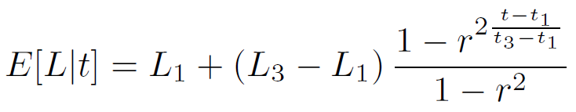
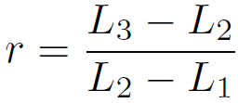
Von Bertalanffy – Francis
A reparameterization
where
Parameters
L₁ = mean length at chosen “young” age (t₁)
L₃= mean length at chosen “old” age (t₃)
L₂ = mean length at “intermediate” age (t₂)

Slide 8
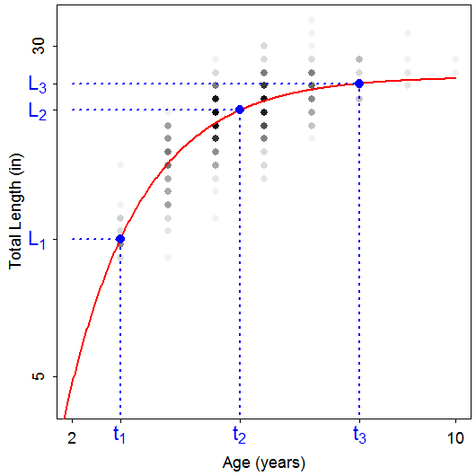
Von Bertalanffy – Francis

Slide 9
Von Bertalanffy – Francis
A reparameterization
Goals
Better model fitting
Reduce correlation among parameters & scale difference
Easier interpretation

Slide 10
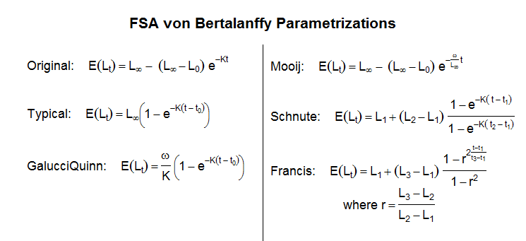
Von Bertalanffy – Other Versions

