Slide 1
Analyzing Age Data with R
Dr. Derek H. Ogle, Northland College
Minnesota AFS CE
St. Paul, MN
4-5 December 2013

Slide 2

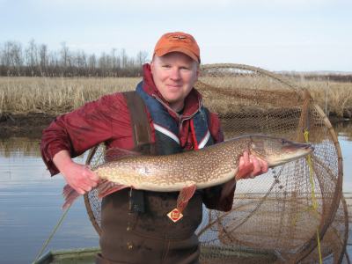
Who Am I?
Derek
Professor of Mathematical Sciences and Natural Resources at Northland College
M.Sc. and Ph.D. in Fisheries with minor in Statistics from the U.

Slide 3
R: Workflow Environment
Script Editor
Input/Save R commands.
Built-in, RStudio, Tinn-R, Notepad, word processor, et al.
Packages
Add-on functionality.
R Core
The analytical engine.
Produce results & graphs.
Report
Output results.
Word processor, HTML, PDF, et al.
Data
An external text (.txt), CSV, Excel, Access, or other database file.
Reproducibility
LaTeX, Markdown
knitr, Sweave

Slide 4
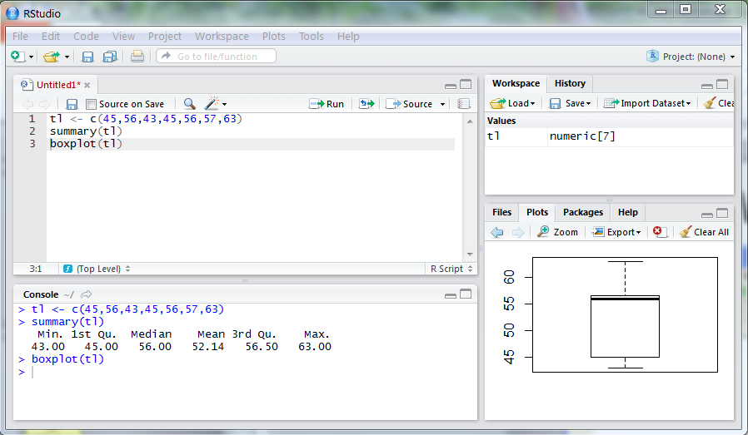
R: Workflow Environment
Script Editor
Input R commands.
Edit R commands.
R Console
Produce results & graphs.
Plot Pane
See graphs.

Slide 5
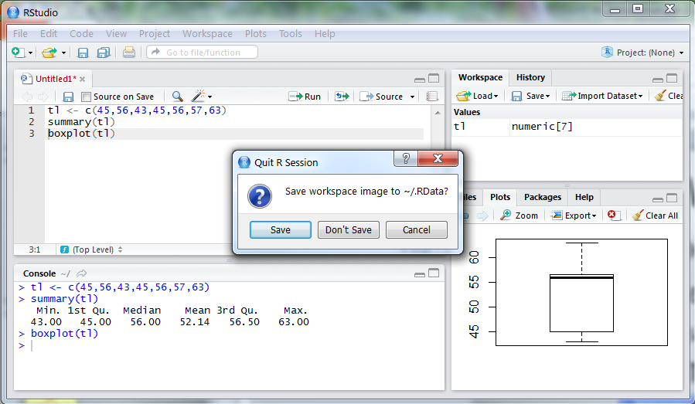
R: Workflow Environment
DO save “good” commands in a text editor.
Like saving a script that allows repeating
Do NOT save workspace image when exiting.

Slide 6
Fisheries Analyses in R
fishR Website
http://fishR.wordpress.com/.
Several example fisheries analyses.
Links to packages devoted to fisheries analyses.

