Slide 1
Back-Calculation Methods
Estimating Previous Lengths

Slide 2
Back-Calculation Methods
At least 22 methods (Viglioga & Meeken 2009)
Four main methods
Dahl-Lea
Fraser-Lee
Scale Proportional Hypothesis
Body Proportional Hypothesis

Slide 3
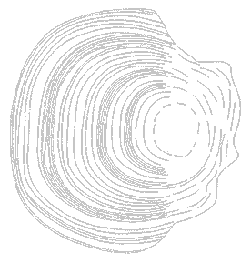
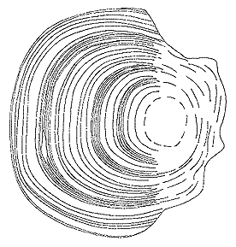

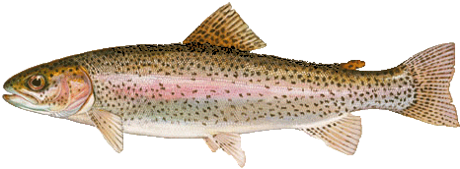
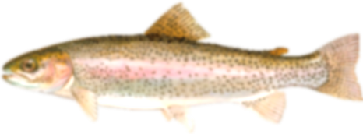
Back-Calculation Principle
S₁
L₁
=
S_{c}
L_{c}

Slide 4
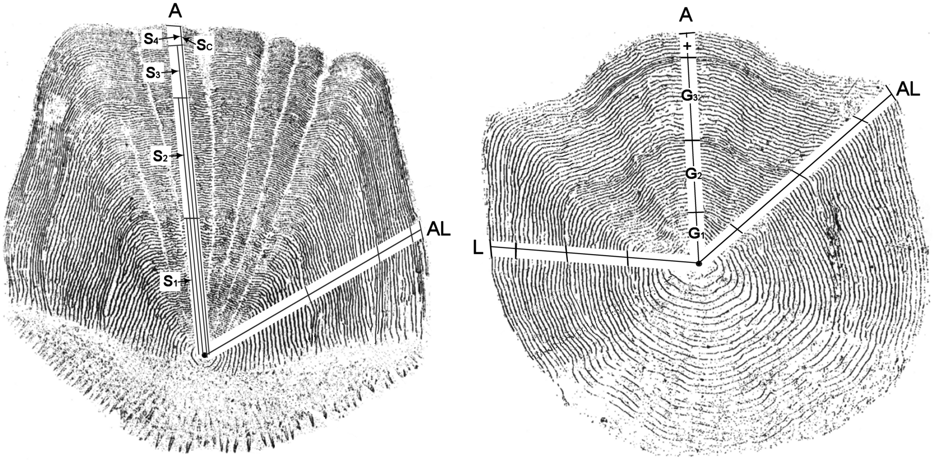
Measurement Types

Slide 5
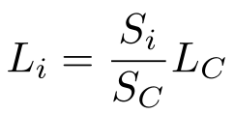
Dahl-Lea (Direct Proportion) Method
Derived from “scale grows in direct proportion to fish length”

Slide 6
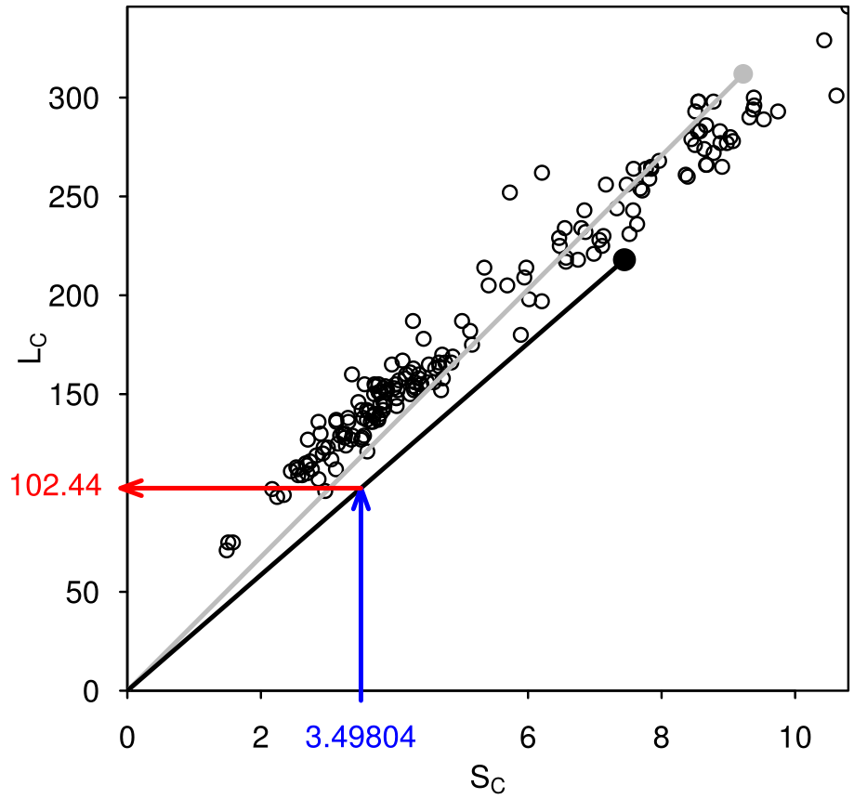
Dahl-Lea (Direct Proportion) Method
Back-calculated length for a fish comes from a line between (S_{c},L_{c}) and the origin.

Slide 7
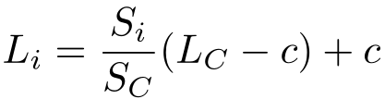
Fraser-Lee Method
Derived from “scale grows in direct proportion to the fish length after an initial adjustment for L when S=0”
Adjustment (c) comes from …
Known L when scales form
Intercept of L on S regression

Slide 8
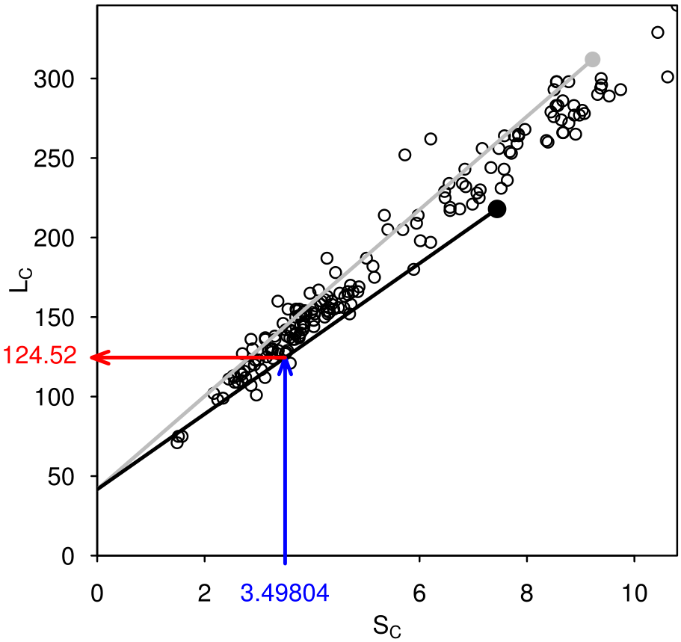
Fraser-Lee Method
Back-calculated length for a fish comes from a line between (S_{c},L_{c}) and (0,c).

Slide 9
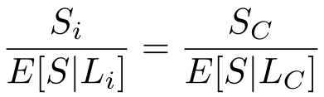
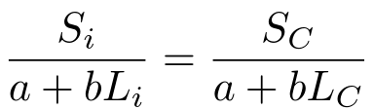
Scale Proportional Hypothesis Meth
Derived from “If S_{c} is 10% larger than average for a fish of L_{c}, then S_{i} was 10% larger than average for a fish of L_{i}”
Expectations come from regression of S on L

Slide 10
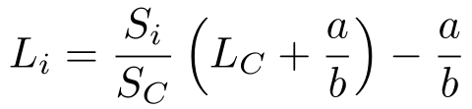

Scale Proportional Hypothesis Meth
Rearrange to get
Same as Fraser-Lee if c= $−\frac{a}{b}$
Same as Dahl-Lea if a=0

Slide 11

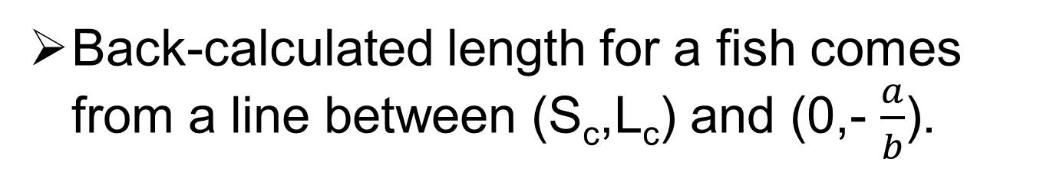
Scale Proportional Hypothesis Meth
Back-calculated length for a fish comes from a line between (S_{c},L_{c}) and (0,- $\frac{a}{b}$).

Slide 12
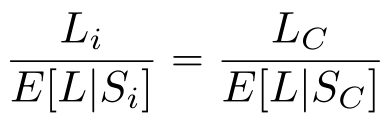
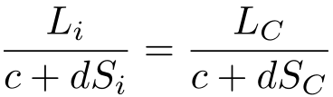
Body Proportional Hypothesis Meth
Derived from “If L_{c} is 10% larger than average for a fish with S_{c}, then L_{i} was 10% larger than average for a fish of S_{i}”
Expectations come from regression of L on S

Slide 13
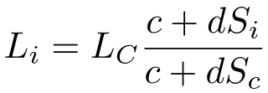
Body Proportional Hypothesis Meth
Rearrange to get
Same as Dahl-Lea if c=0

Slide 14
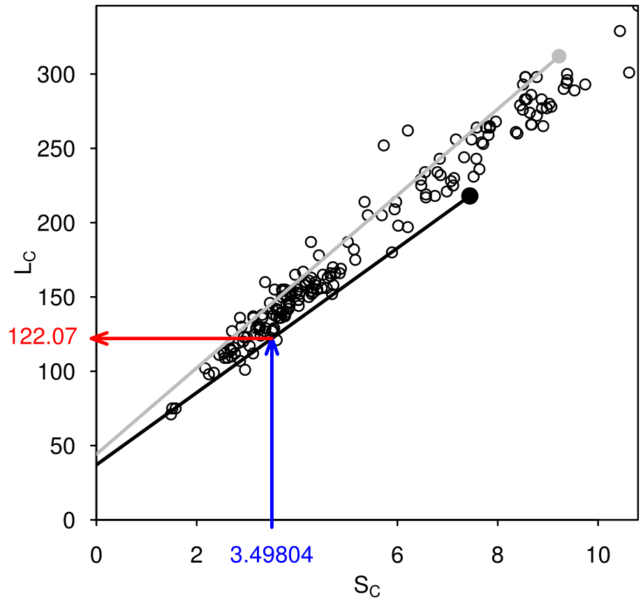
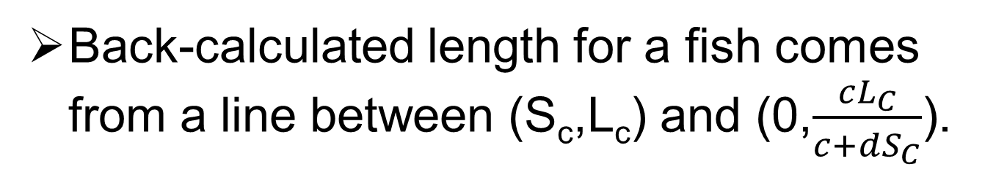
Body Proportional Hypothesis Meth
Back-calculated length for a fish comes from a line between (S_{c},L_{c}) and (0,$\frac{cL_{C}}{c+dS_{C}}$).

Slide 15
Data Types
One-fish-per-line
All information for a fish in one row
Used to develop scale-length relationships
fish | yearcap | agecap | lencap | anu1 | anu2 | anu3 | anu4 | anu5 | anu6 | radcap
47 | 2006 | 2 | 146 | 1.094 | 2.029 | 2.148 | NA | NA | NA | 2.148
17 | 2006 | 3 | 234 | 1.010 | 2.513 | 3.775 | 4.444 | NA | NA | 4.444
8 | 2006 | 5 | 216 | 1.417 | 2.903 | 3.906 | 4.332 | 4.747 | 4.919 | 4.919

Slide 16
Data Types
fish | yearcap | agecap | lencap | anu1 | anu2 | anu3 | anu4 | anu5 | anu6 | radcap
47 | 2006 | 2 | 146 | 1.094 | 2.029 | 2.148 | NA | NA | NA | 2.148
17 | 2006 | 3 | 234 | 1.010 | 2.513 | 3.775 | 4.444 | NA | NA | 4.444
8 | 2006 | 5 | 216 | 1.417 | 2.903 | 3.906 | 4.332 | 4.747 | 4.919 | 4.919
One-measurement-per-line
All information for a growth measure in one row
Used to back-calculate previous length-at-age
fish | yearcap | agecap | lencap | anu1 | anu2 | anu3 | anu4 | anu5 | anu6 | radcap
47 | 2006 | 2 | 146 | 1.094 | 2.029 | 2.148 | NA | NA | NA | 2.148
17 | 2006 | 3 | 234 | 1.010 | 2.513 | 3.775 | 4.444 | NA | NA | 4.444
8 | 2006 | 5 | 216 | 1.417 | 2.903 | 3.906 | 4.332 | 4.747 | 4.919 | 4.919
fish | yearcap | agecap | lencap | radcap | age | anu
47 | 2006 | 2 | 146 | 2.148 | 1 | 1.094
47 | 2006 | 2 | 146 | 2.148 | 2 | 2.029
17 | 2006 | 3 | 234 | 4.444 | 1 | 1.010
17 | 2006 | 3 | 234 | 4.444 | 2 | 2.513
17 | 2006 | 3 | 234 | 4.444 | 3 | 3.775
8 | 2006 | 5 | 216 | 4.919 | 1 | 1.417
8 | 2006 | 5 | 216 | 4.919 | 2 | 2.903
8 | 2006 | 5 | 216 | 4.919 | 3 | 3.906

